Slide 1
Editorial Advisory Group 20210901
Angiography Arteriography Venography
Monica Harry

Slide 2
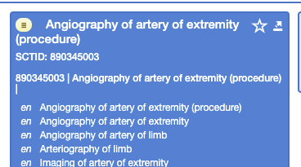
Problem statement: Inconsistent use of terms
Angiography procedures sometimes have synonym arteriography and/or arteriogram...

Slide 3
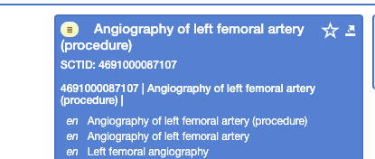
Sometimes not...

Slide 4
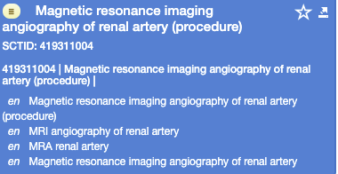
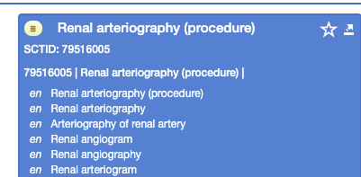
Angiography vs arteriography

Slide 5
Angiography vs arteriography
Common clinical speech uses these two terms interchangeably as found at these various references:
https://www.hopkinsmedicine.org/health/treatment-tests-and-therapies/cerebral-arteriogram - synonymous
https://stanfordhealthcare.org/medical-tests/a/angiogram-arteriogram.html - synonymous
https://www.johnmuirhealth.com/services/cardiovascular-services/intervention/angiography-angiogram-arteriogram.html - synonymous
https://www.healthline.com/health/arteriogram - synonymous
https://www.medicinenet.com/difference_between_angiogram_and_angioplasty/article.htm
patient - https://medlineplus.gov/ency/article/003327.htm
Multimedia Encyclopedia https://www.stlukes-stl.com/health-content/health-ency-multimedia/1/003327.htm

Slide 6
Proposed solution
When an artery is named in the FSN, use:
FSN: Arteriography
PT: Angiography
When imaging procedure is unspecified as to (artery or vein) blood vessel of body site/region, use:
FSN: Angiography
PT: angiography

Slide 7
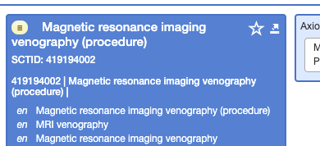
Venography
https://www.chicagotribune.com/news/ct-xpm-1986-01-23-8601060680-story.html
Because there are two major kinds of blood vessels, angiograms can be of two types--either an arteriogram, when the study is done on arteries, or a venogram, when the study is done on veins. However, everyday usage, angiograms and arteriograms are often used synonymously, whereas ''venogram'' is used more precisely.
Recommend: do not change description patterns for Venography concepts.

