Slide 1


APRIL 2024
SNOMED INTERNATIONAL BUSINESS MEETINGS
Addressing the ‘or’ in dose forms
Nicki Ingram and Julie James
Leading healthcare terminology,
worldwide
Wednesday APRIL 17, 2024
LONDON, UNITED KINGDOM

Slide 2

The issue
Logical model mismatch
Dose forms containing ‘or’ in their descriptions have been modelled in SNOMED CT based on their defining relationships as meaning ‘and’ (i.e. conjunction).
Example:
420636007 |Conventional release ear or eye drops (dose form)|

Slide 3

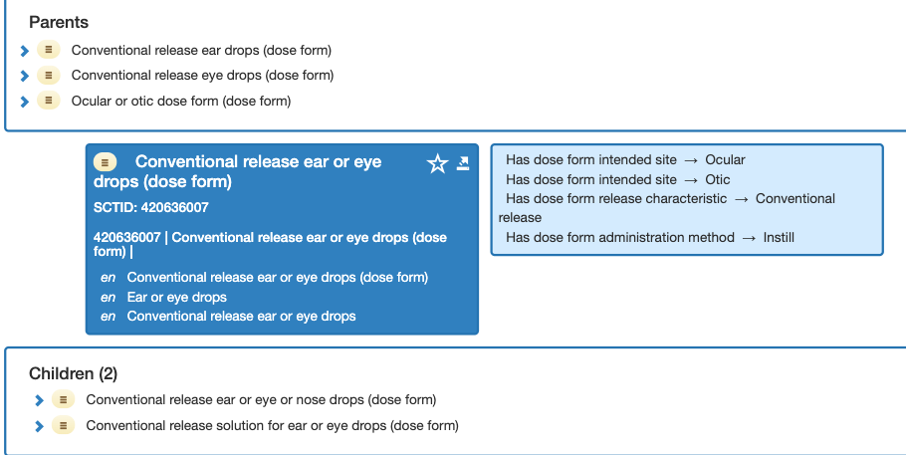
420636007 |Conventional release ear or eye drops (dose form)|
Modelled as ‘and’
Photo by Humphrey Muleba: https://www.pexels.com/photo/photo-of-black-vehicle-at-the-road-1647120/

Slide 4
420636007 |Conventional release ear or eye drops (dose form)|
EDQM: Concept Code 50018000
Term; Ear/eye drops, solution
Definition: Liquid sterile preparation consisting of a solution intended for use as “ear drops” or “eye drops”
….But the solution is manufactured and passes quality checks and sterility tests as a dose form for both ear and eye
State of matter: Liquid
Basic dose form: Solution
Administration method: Instillation
Intended site: Auricular
Ocular
Release characteristics: Conventional
Transformation: No transformation
Photo by Humphrey Muleba: https://www.pexels.com/photo/photo-of-black-vehicle-at-the-road-1647120/

Slide 5

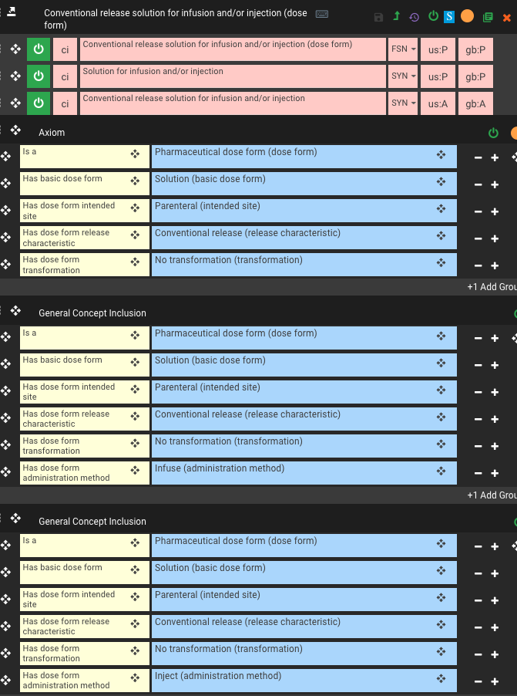
1208958005 |Conventional release solution for infusion and/or injection (dose form)|
‘and/or’
= GCI
‘or’ =
Disjunction
Cannot model
‘or’ currently
Use case:
To have a “parent concept” to support grouping of products that differ only by method of administration
Photo by Harry Shum: https://www.pexels.com/photo/the-big-ben-in-london-13433495/

Slide 6
‘or’ Intended Site Dose Form Concepts
420636007 |Conventional release ear or eye drops (dose form)|
421427005 |Conventional release ear or eye ointment (dose form)|
385163003 |Conventional release ear or eye or nose drops (dose form)|
765163001 |Conventional release solution for ear or eye drops (dose form)|
1229930004 |Conventional release solution for ear or nose drops (dose form)|
385164009 |Conventional release ear or eye or nose ointment (dose form)|
1209093009 |Conventional release suspension for ear or nose drops (dose form)|
765164007 |Conventional release solution for ear or eye or nose drops (dose form)|
1209095002 |Conventional release solution for intravesical or urethral irrigation (dose form)|
896760006 |Powder for conventional release oral or rectal suspension (dose form)|
1209112001 |Granules for conventional release oral or rectal suspension (dose form)|
1237290008 |Concentrate for conventional release oral or rectal solution (dose form)|
1209096001 |Conventional release oral or rectal solution (dose form)|

Slide 7
Resolution
Pharmaceutical Dose Forms with Two or More Intended Sites
Pharmaceutical Dose Forms with more than one intended site will use “and” in their descriptions and include all intended sites in the model. By representing combinations of intended sites as a conjunction ('and' in the description) this will facilitate searching by end users. The concepts are logically modelled as conjunction.
13 existing dose forms with "or" will be updated to "and" in their descriptions, this will be included in the Editorial Guide.
9 clinical drugs using these dose forms will correspondingly have their descriptions updated to 'and'.
Note - pharmaceutical dose forms with two or more administration methods (the injection/infusion use case):
As this is a less common requirement any requests for this type of dose form will be reviewed on a case-by-case basis.
Add Editorial Guidance for two or more administration methods: do not add a method attribute if one method would not be suitable for both sites (e.g. we could not put swallow and insert for an oral and rectal site dose form). For some sites the method is the same (instil for drops, rinse wash for irrigations).

Slide 8
Final issue for discussion
?Inactivate?
Discussion item:
Some “old concepts” were authored a long time ago and before there was a dose form concept model, are “unusual” parent concepts which we do not have for other site combinations.
Examples:
765166009 |Ocular or otic dose form (dose form)|
765167000 |Nasal or ocular or otic dose form (dose form)|

Slide 9


Thank You

