Slide 1
Hypersensitivity, autoimmunity and allergy - update
Bruce Goldberg, MD, PhD

Slide 2
Background
From Tuesday Authors call October 13, 20209
769247005 |Abnormal immune process (qualifier value)| and 472963003 |Hypersensitivity process (qualifier value)| are often found together describing the Pathological process for many concepts. Is there a standard for which attribute-value pair is included in a role group? I've attached the stated view of 402312004 |Acute guttate psoriasis (disorder)| as an example.
Mentioned in Editorial Guide under Disorders of Immune Function section:
https://confluence.ihtsdotools.org/display/WIPEG/Specific+Disorder+Modeling#SpecificDisorderModeling-Hypersensitivity

Slide 3
Background
Quality Improvement QI-687 Inactivate 427439005 |Immune hypersensitivity disorder by mechanism (disorder)
Description
  Currently there is an extra relationship of "Pathological process = Hypersensitivity process" added to all the Grave disease concepts (and MG concepts) because an ancestor 427439005 |Immune hypersensitivity disorder by mechanism (disorder)| has this relationship. Is having that relationship outside of a group appropriate? Could the modeling be improved?

Slide 4
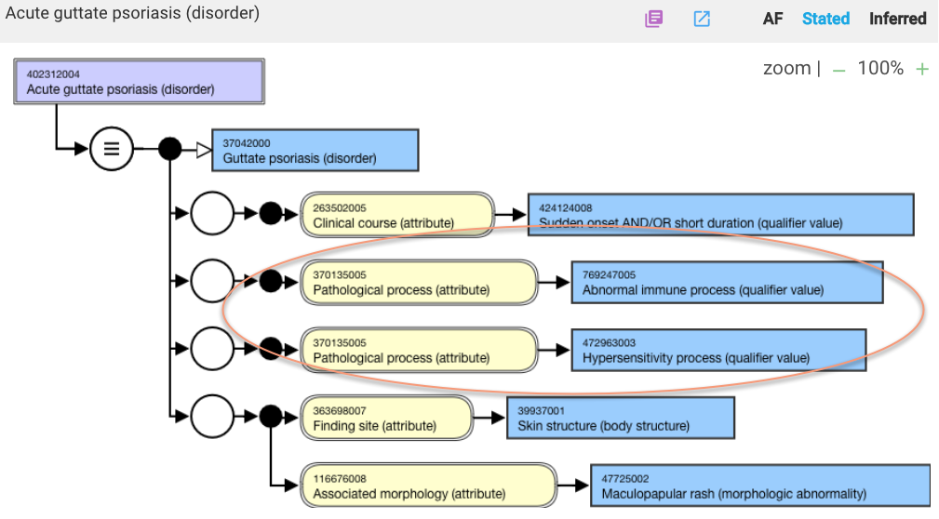
Example

Slide 5
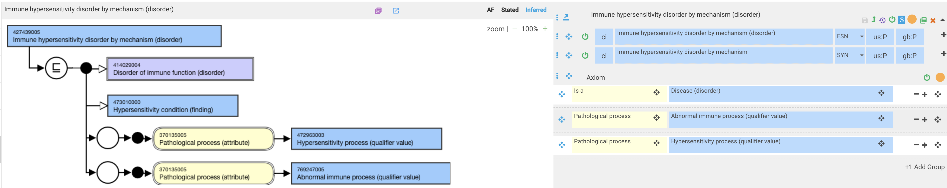
Concepts inherit pathological processes of both Abnormal immune process (qualifier value) and Hypersensitivity process from 427439005 |Immune hypersensitivity disorder by mechanism (disorder)|

Slide 6
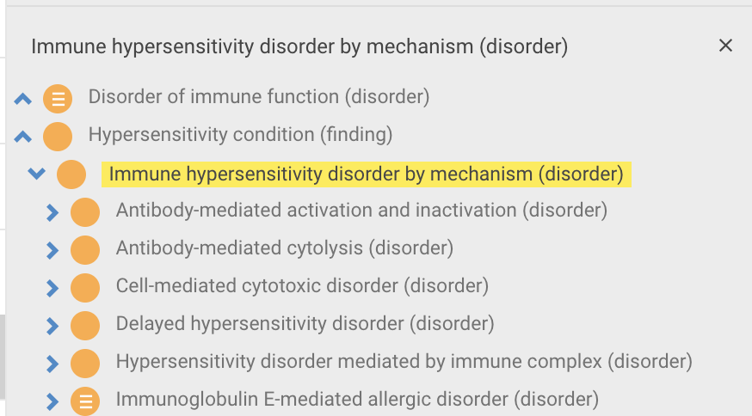
Is the primitive grouper 427439005 |Immune hypersensitivity disorder by mechanism (disorder)|clinically useful ?
427439005 |Immune hypersensitivity disorder by mechanism (disorder)| based on its children represents the Gell and Coombs classification of hypersensitivity diseases which is still widely used

Slide 7
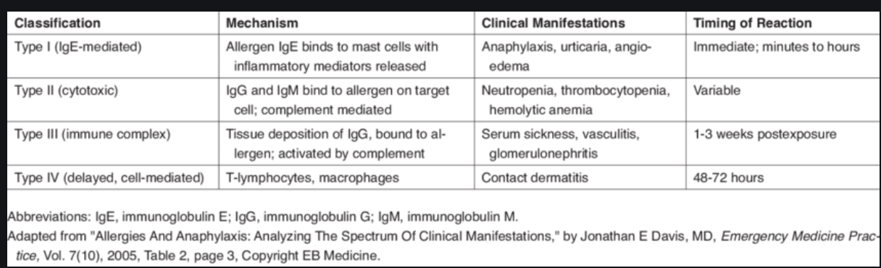
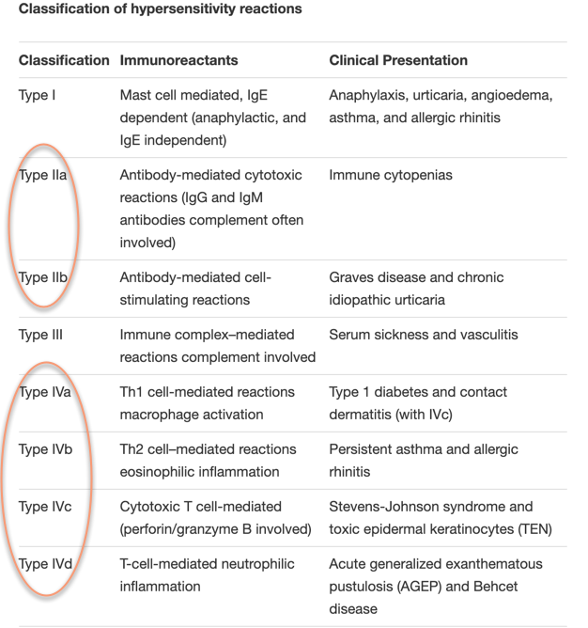
Gell And Coombs Classification Of Hypersensitivity Reactions
Original classification
Revised classification

Slide 8
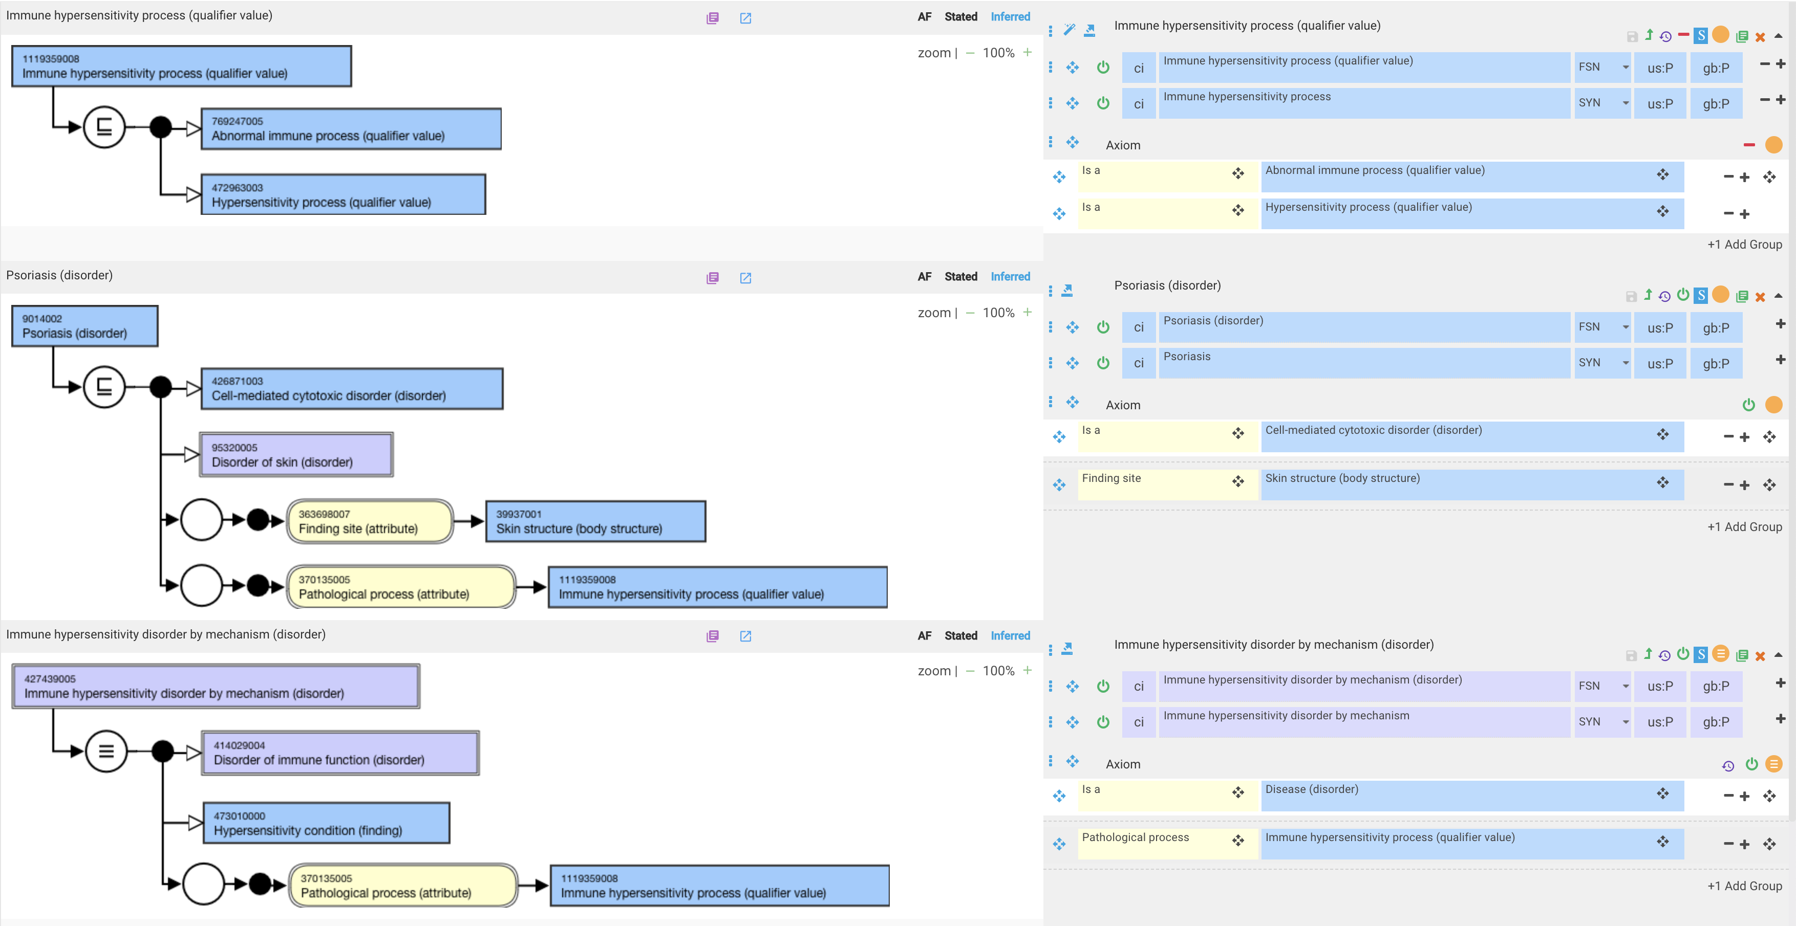
Proposed initial solution
Can be renamed to just Immune hypersensitivity disorder (disorder)

Slide 9
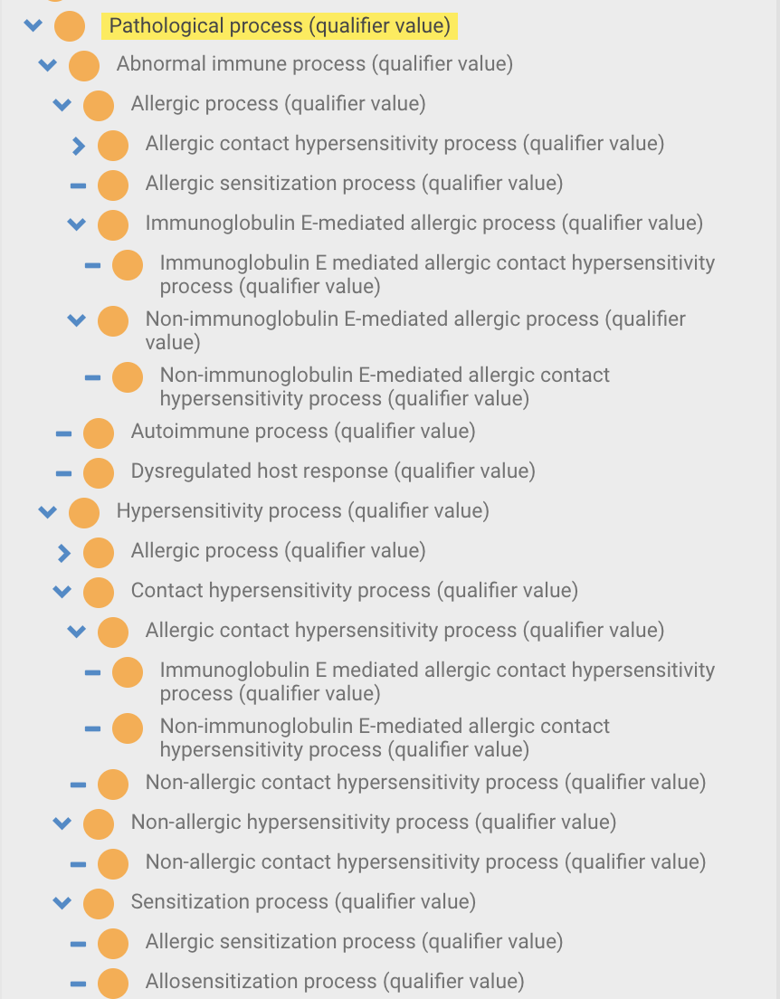
Current organization of Abnormal immune process and Hypersensitivity process qualifier value hierarchies
Most of these are kludges created to make the models for hypersensitivity and disorders of immune function work

Slide 10
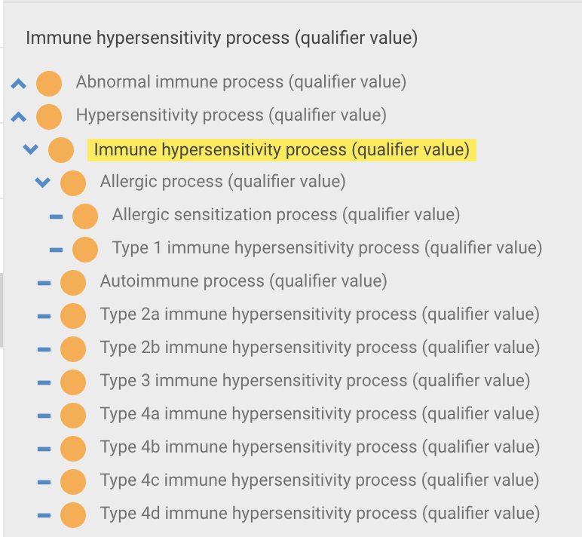
Proposed Immune hypersensitivity process qualifier value hierarchy

Slide 11
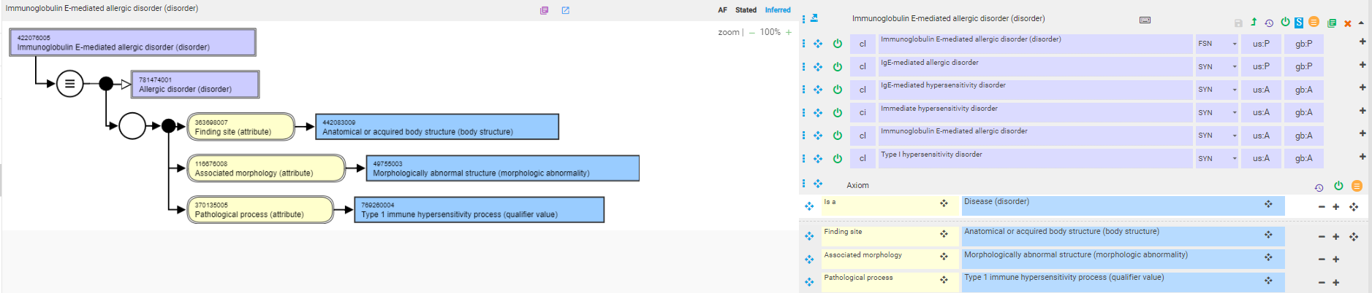
422076005 |Immunoglobulin E-mediated allergic disorder (disorder)|

Slide 12
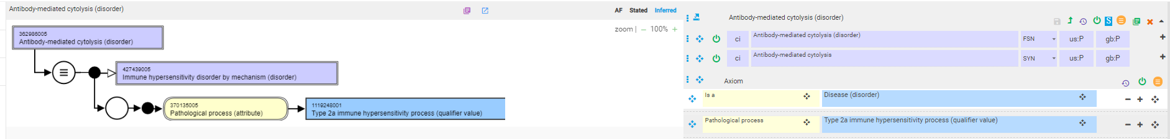
362986005 |Antibody-mediated cytolysis (disorder)|

Slide 13
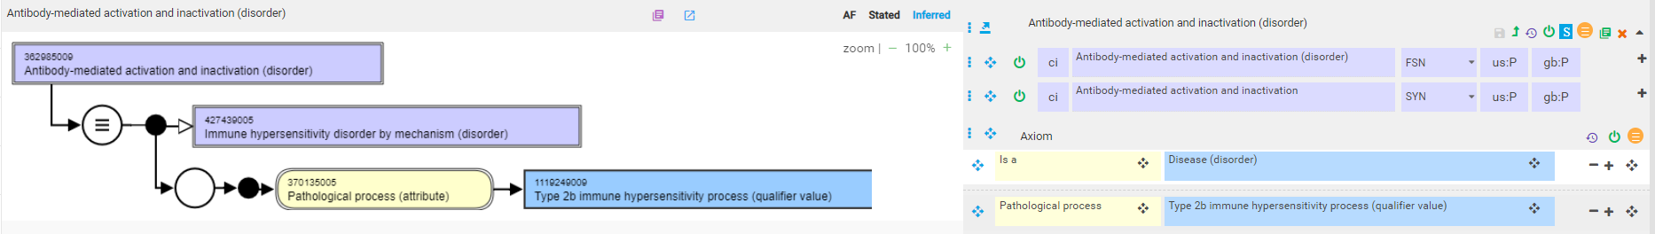
362985009 |Antibody-mediated activation and inactivation (disorder)|

Slide 14
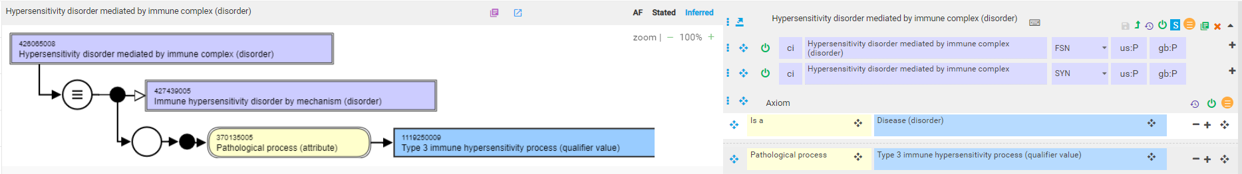
426065008 |Hypersensitivity disorder mediated by immune complex (disorder)|

Slide 15
Autoimmune disorders

Slide 16
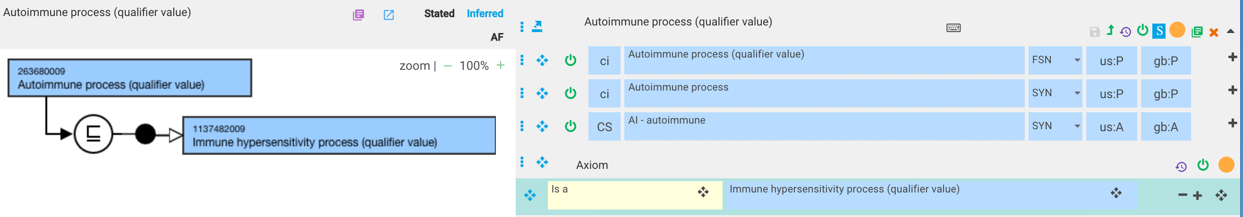
Autoimmune process
An autoimmune process is a immune hypersensitivity to a swlf antigen

Slide 17
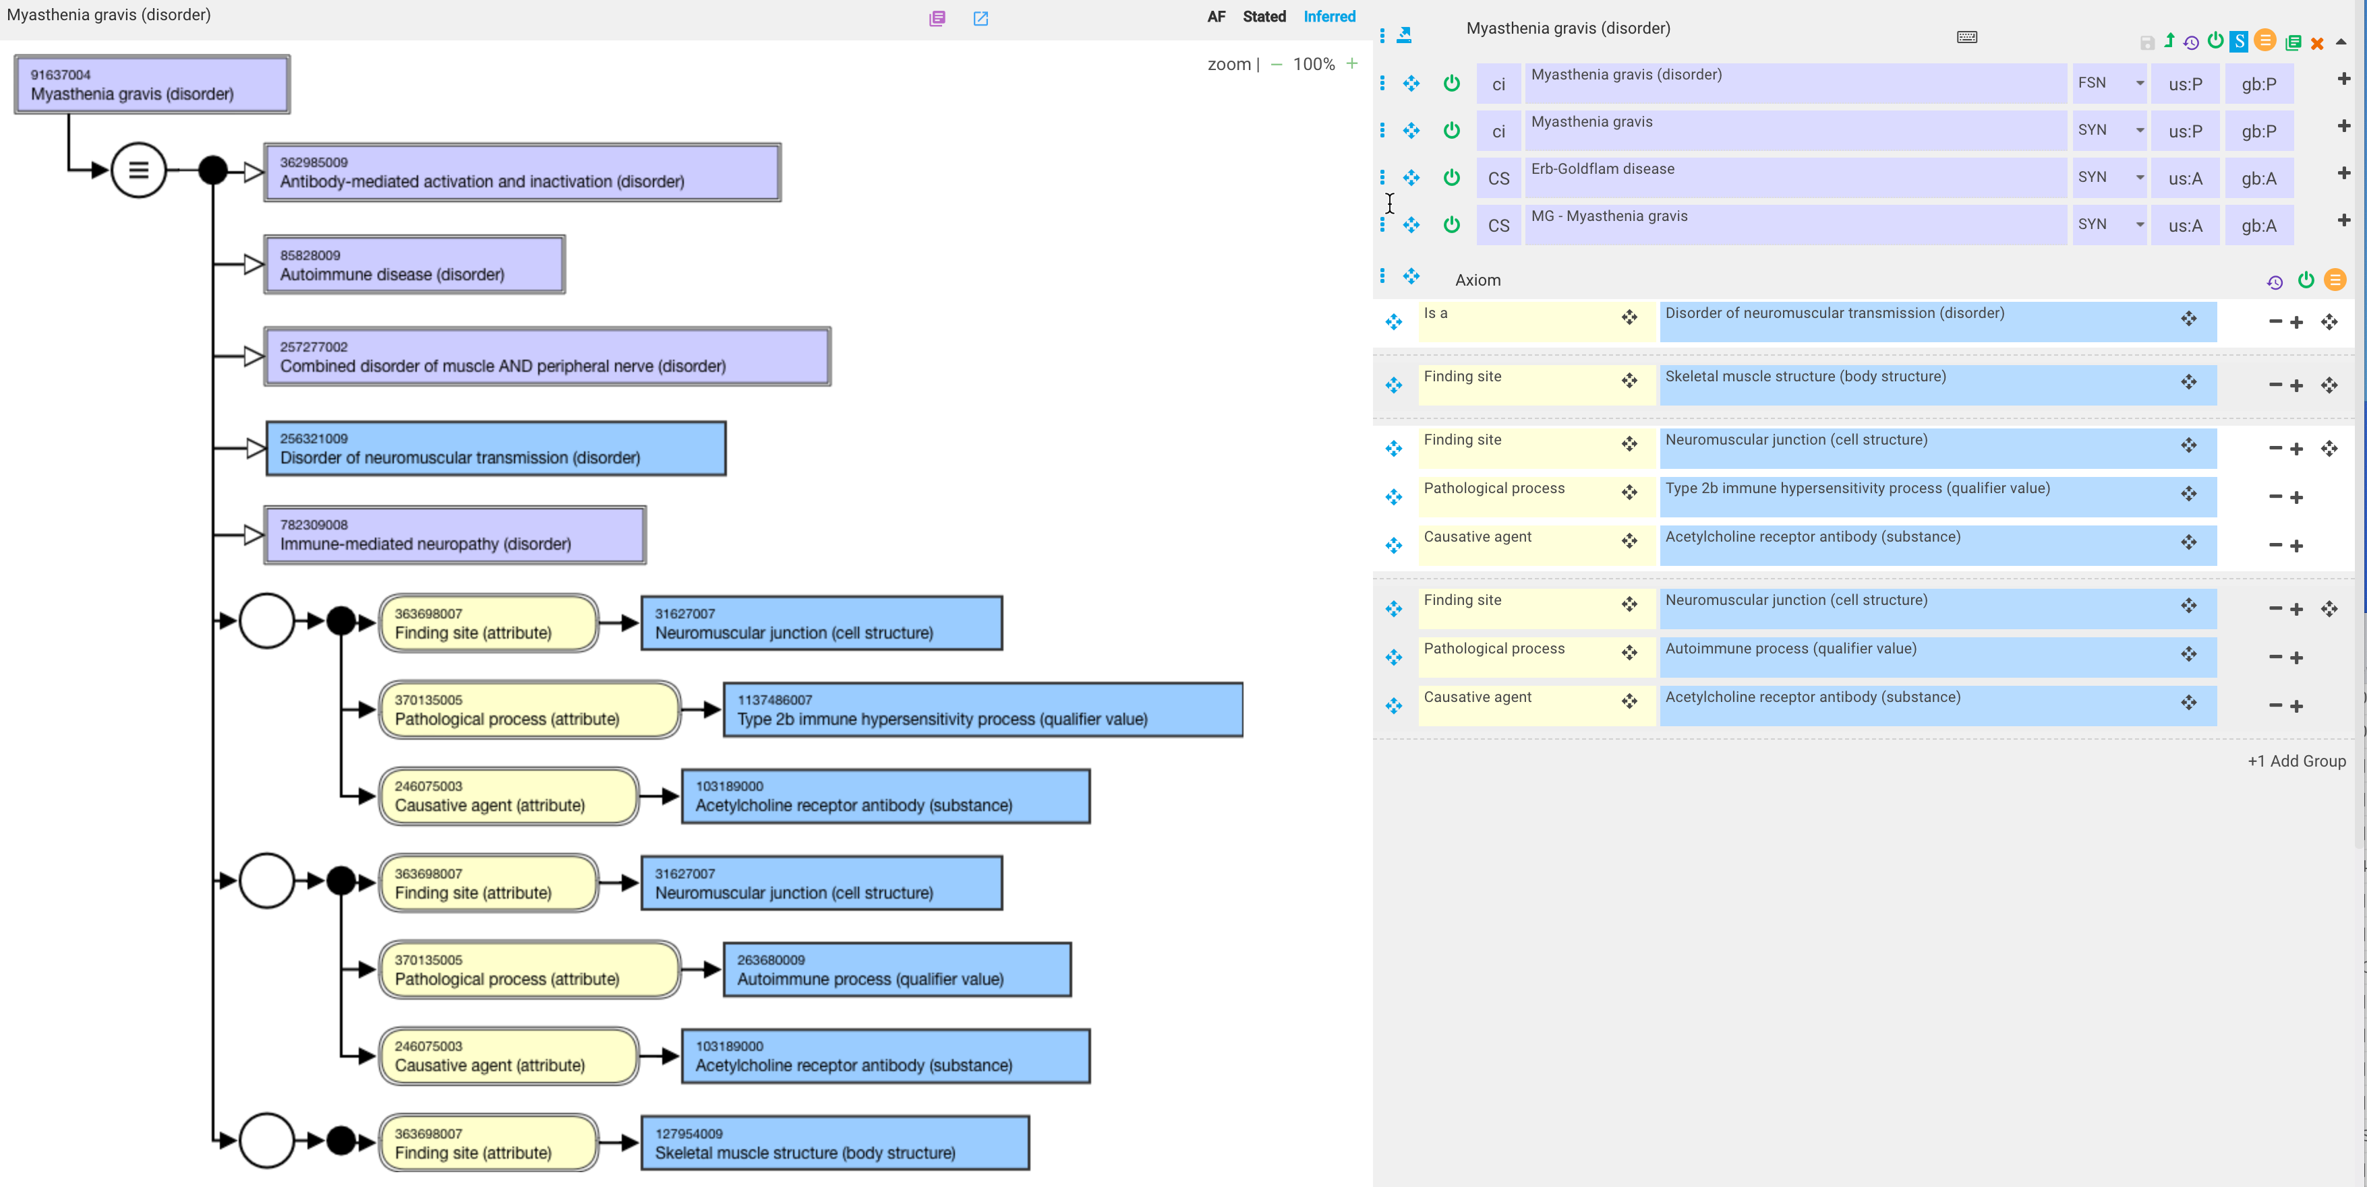
Myasthenia gravis

Slide 18
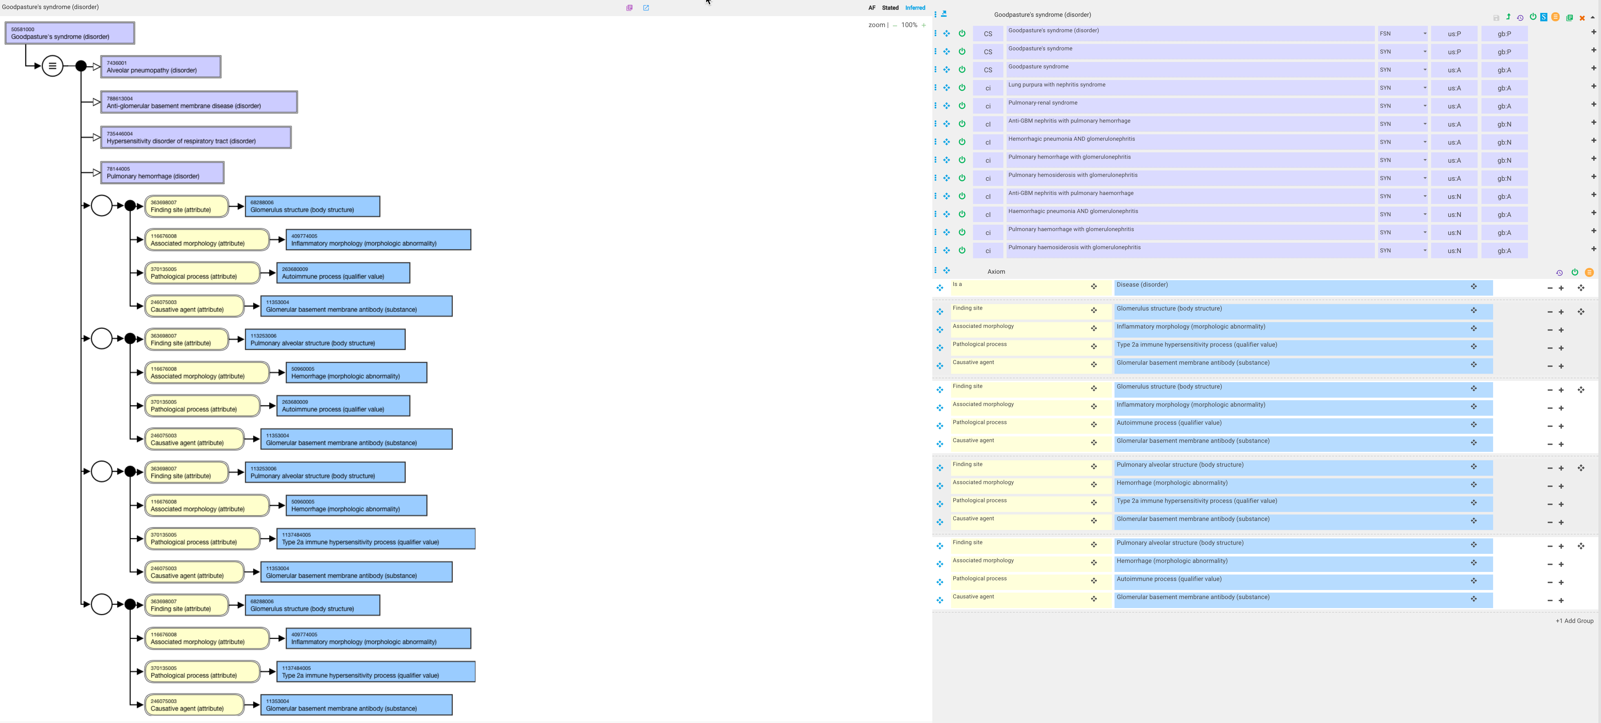
Goodpasture’s syndrome

Slide 19
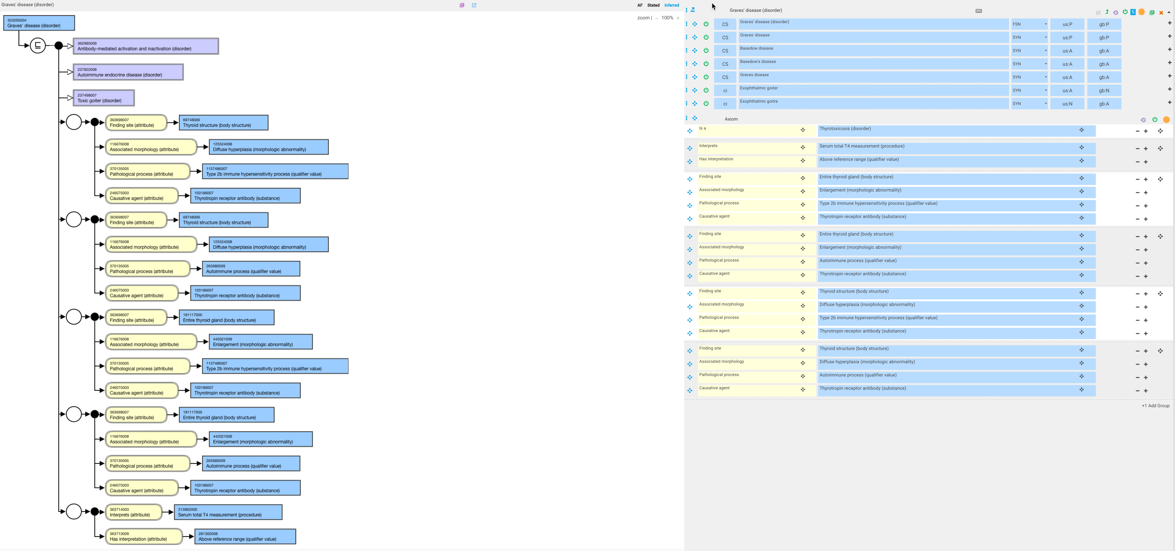
Graves’ disease

Slide 20
Allergic disorders

Slide 21
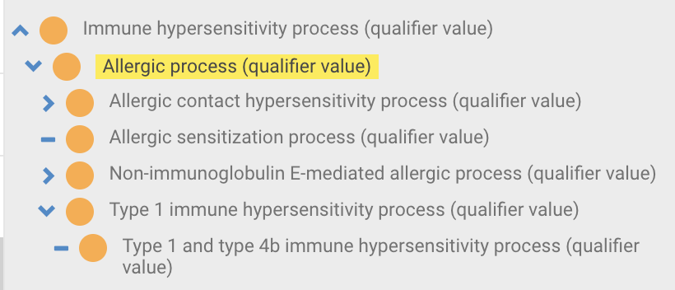
Allergic process

Slide 22
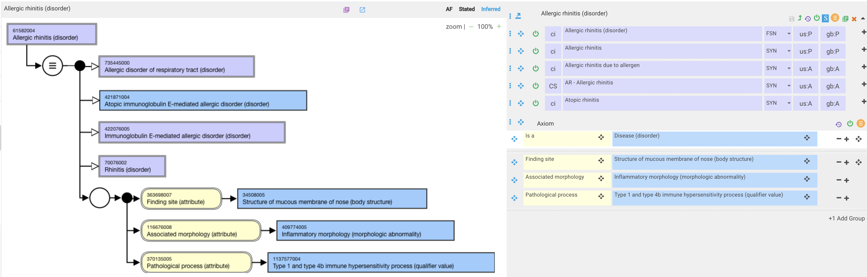
Allergic rhinitis

Slide 23
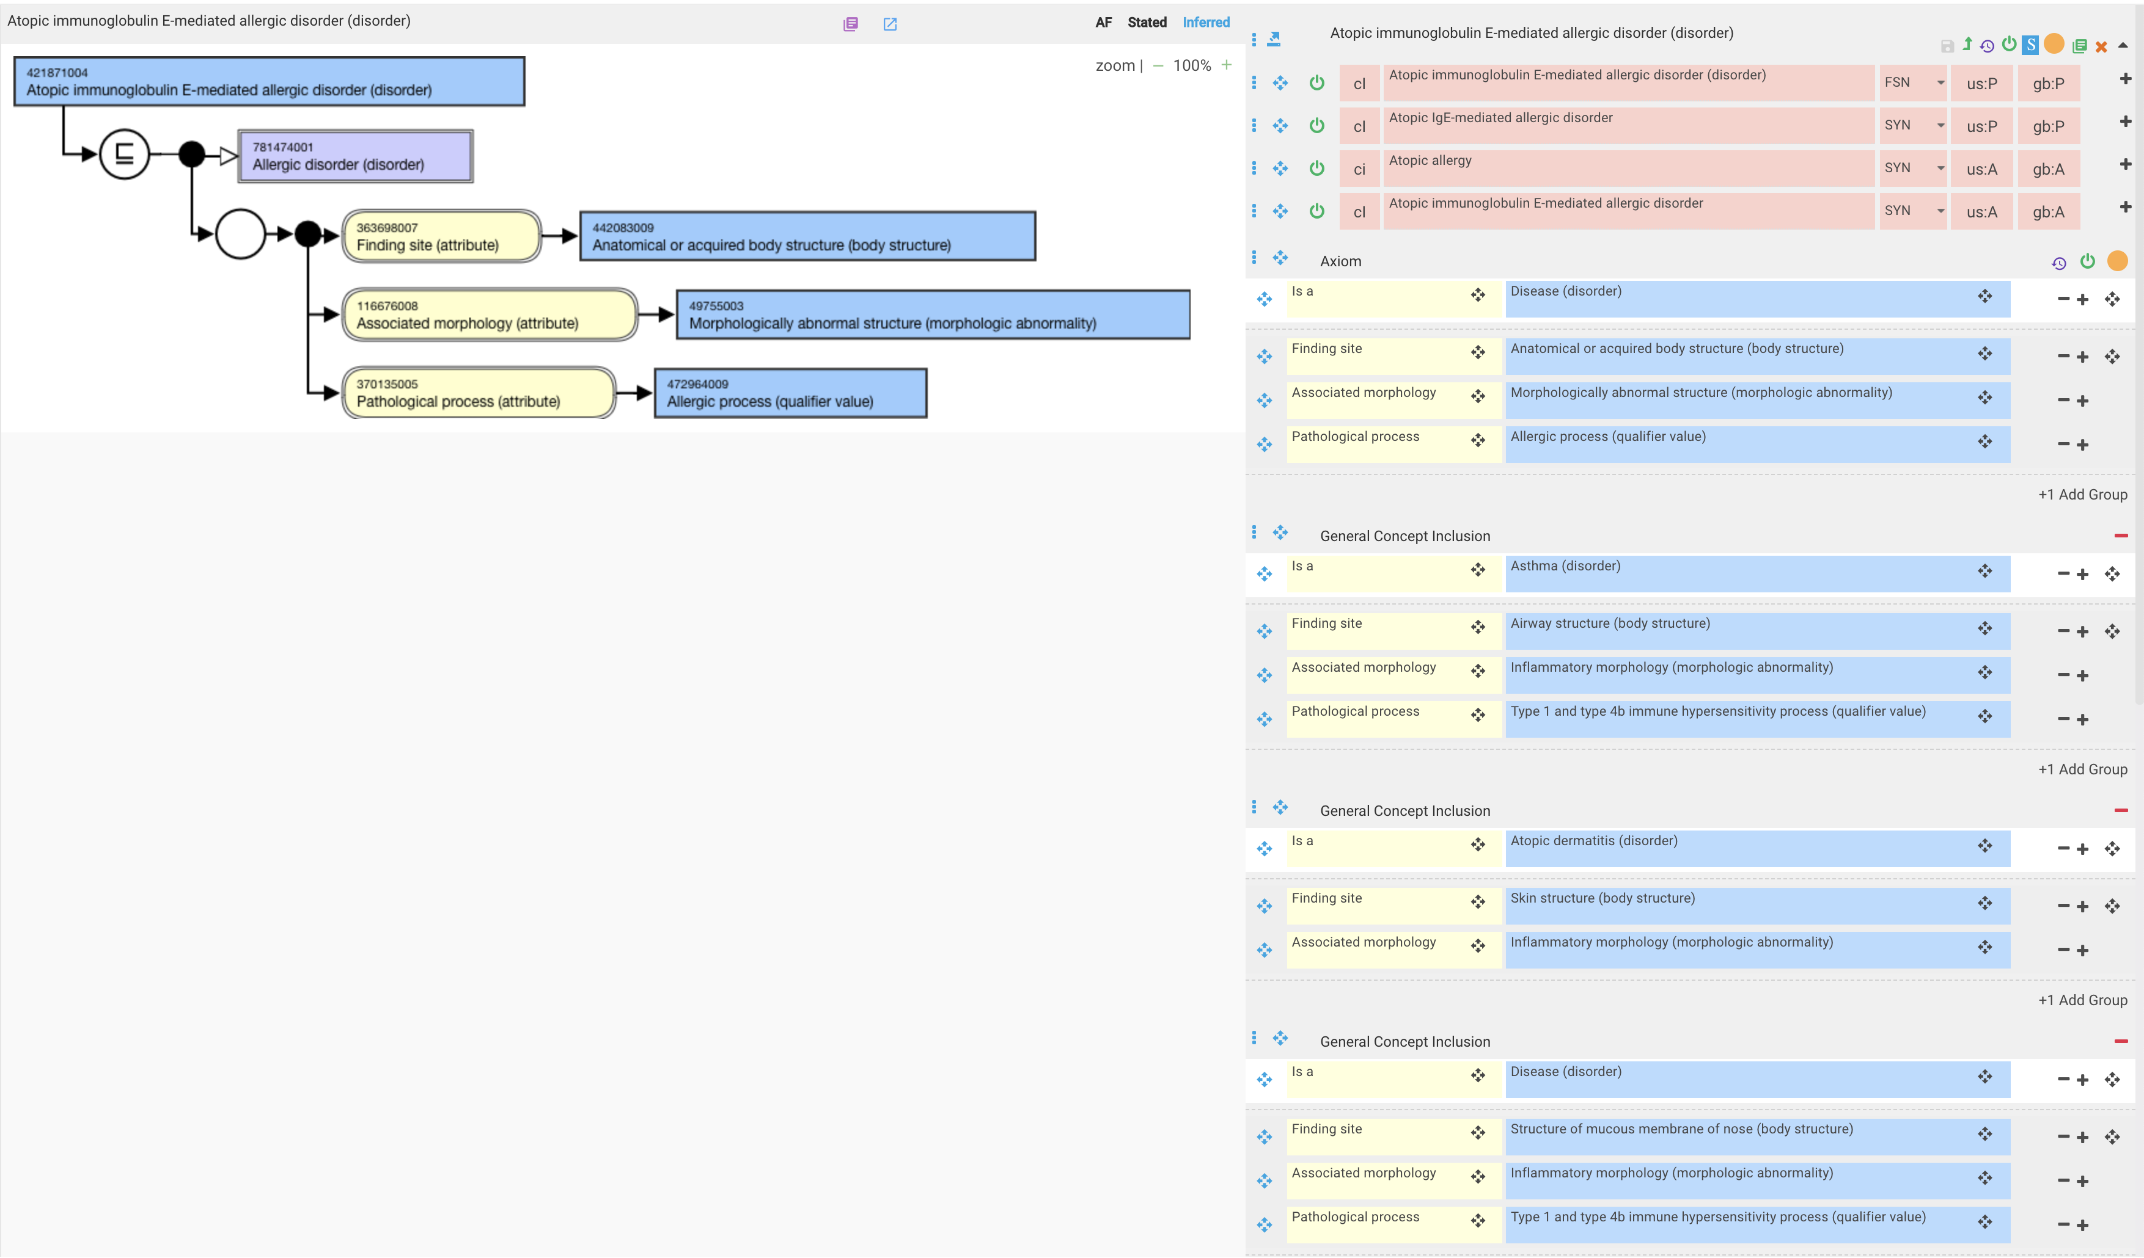
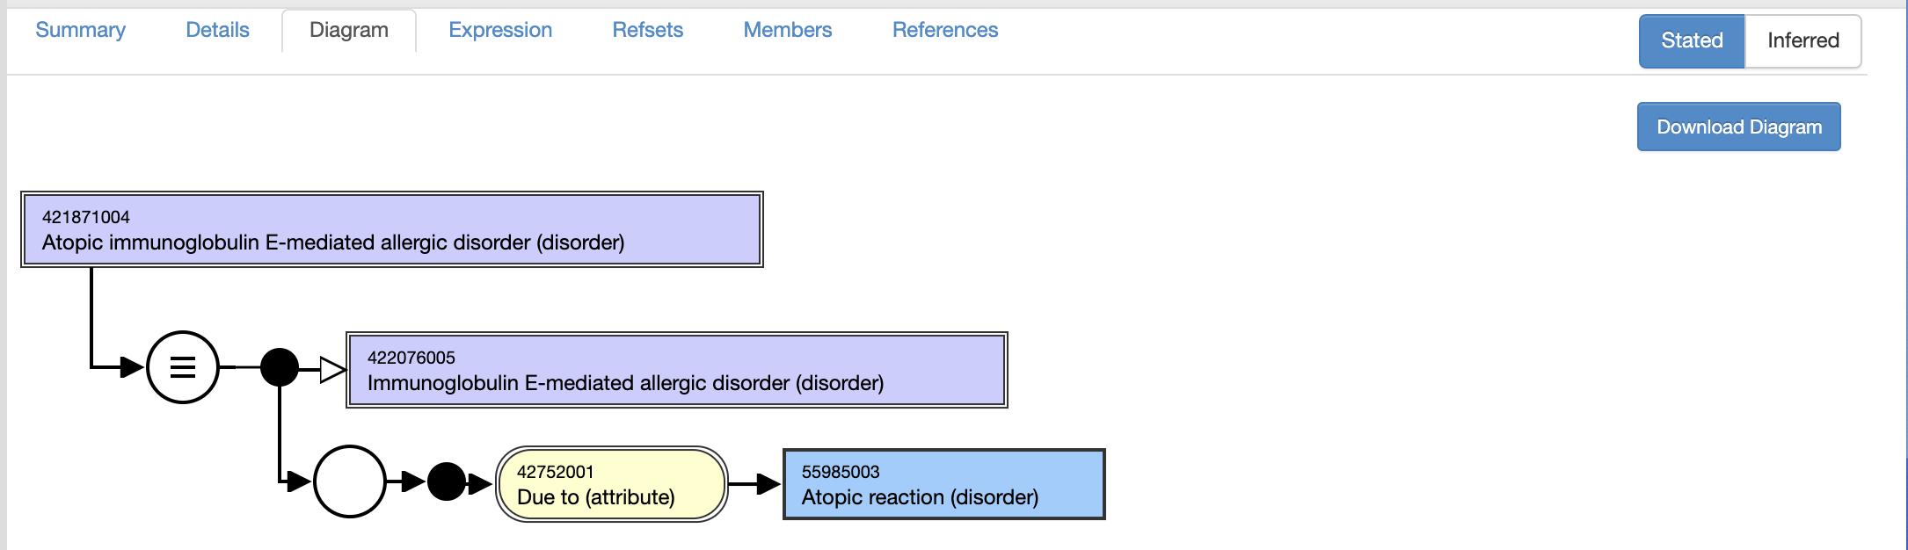
Atopic disease – GCI model

Slide 24
Contact hypersensitivity

Slide 25
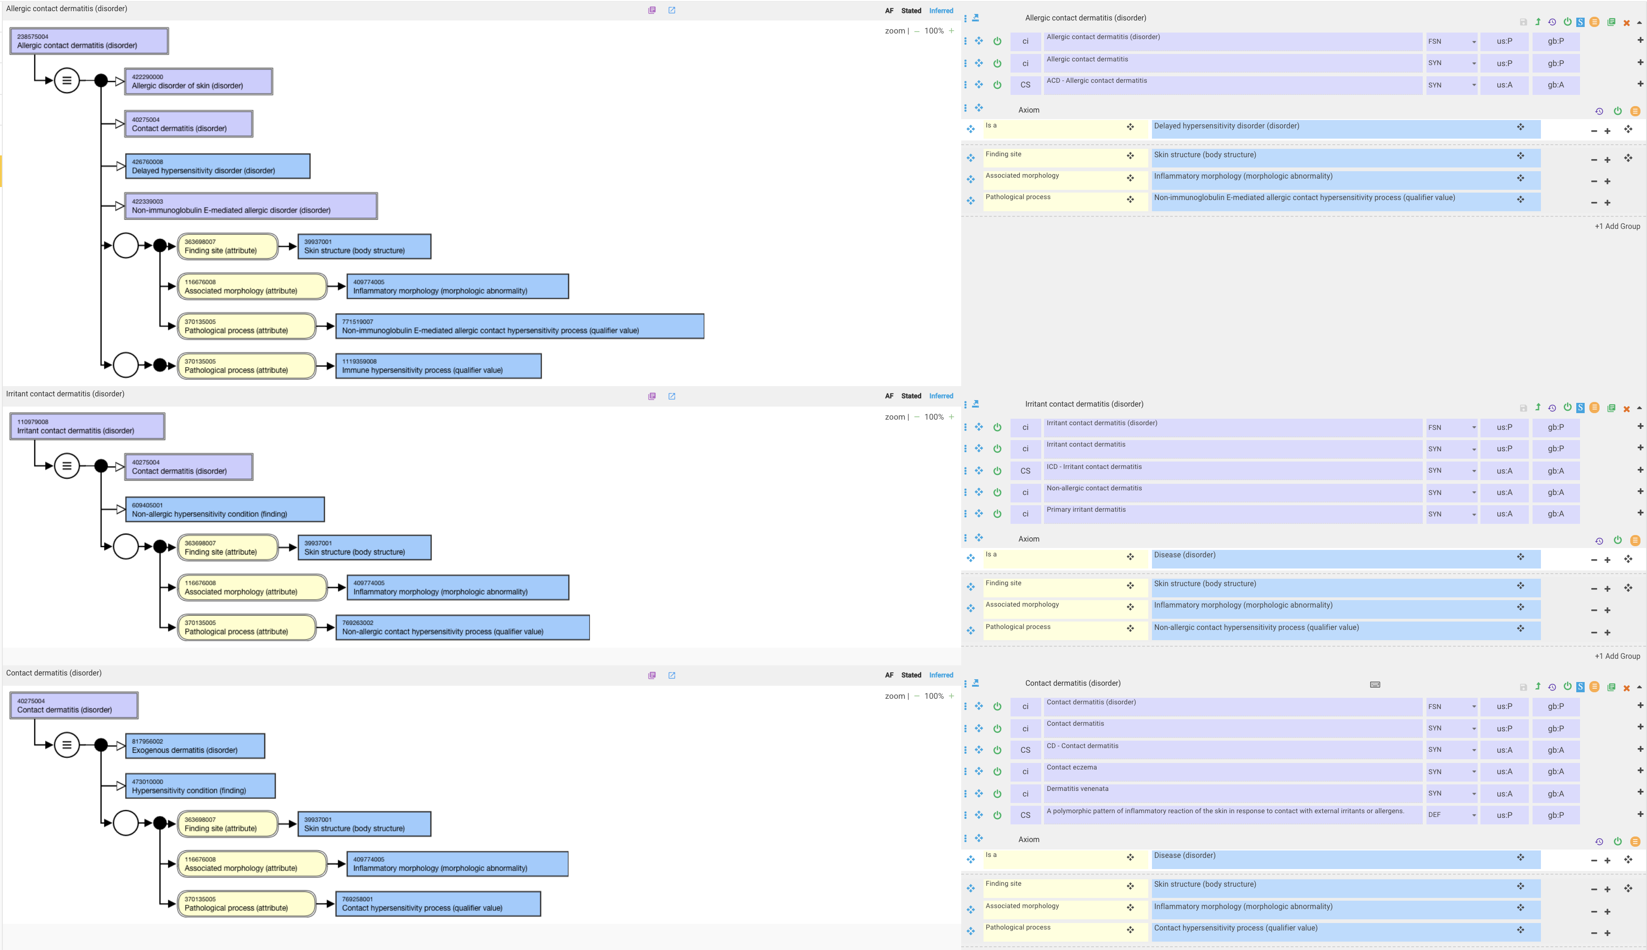
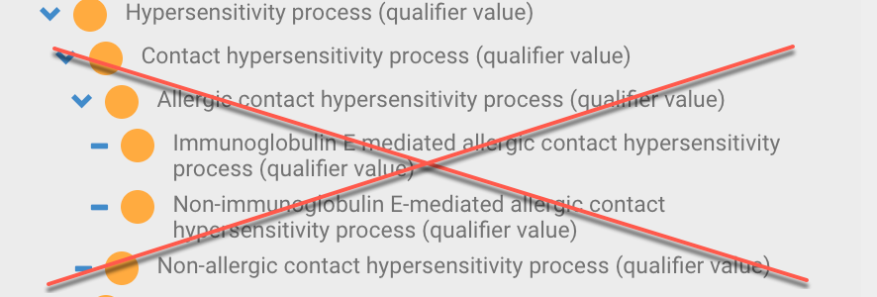
Contact dermatitis – current models

Slide 26
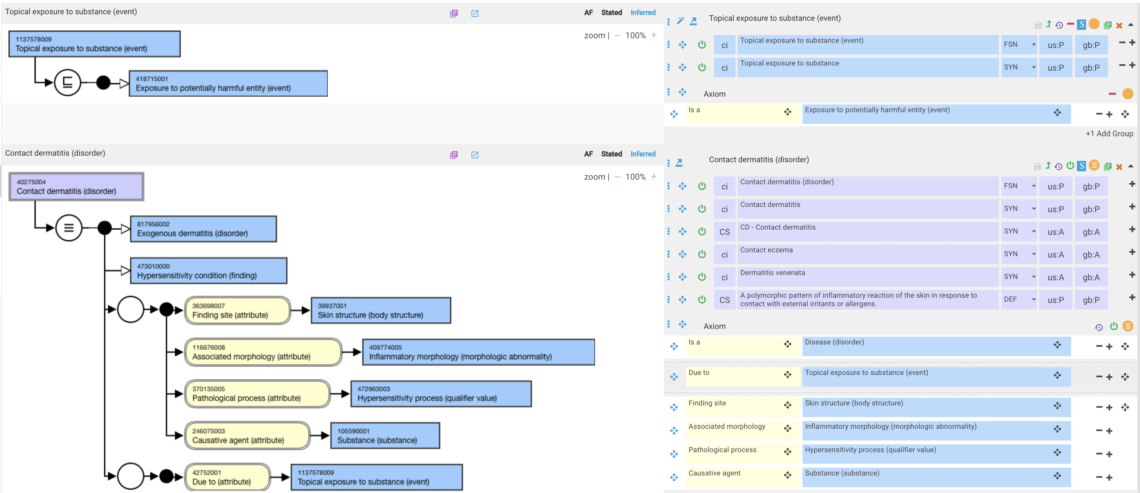
Contact dermatitis – prposed revision

Slide 27
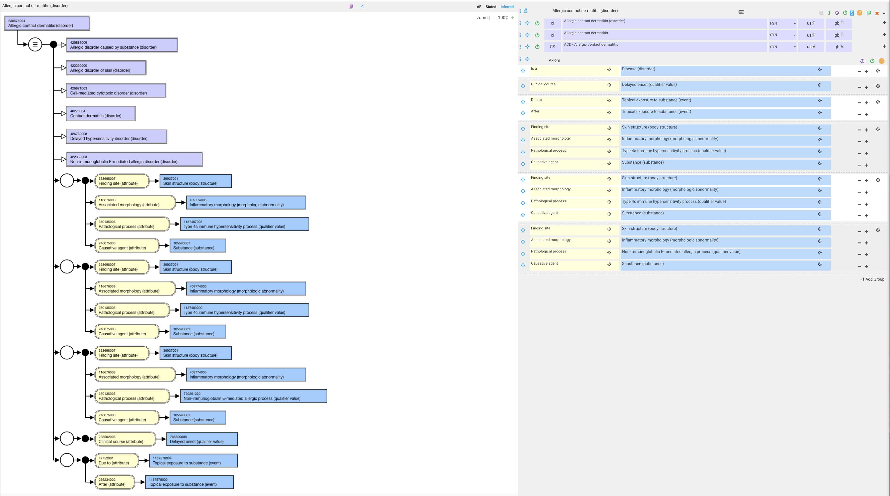
Allergic contact dermatitis – proposed model

Slide 28
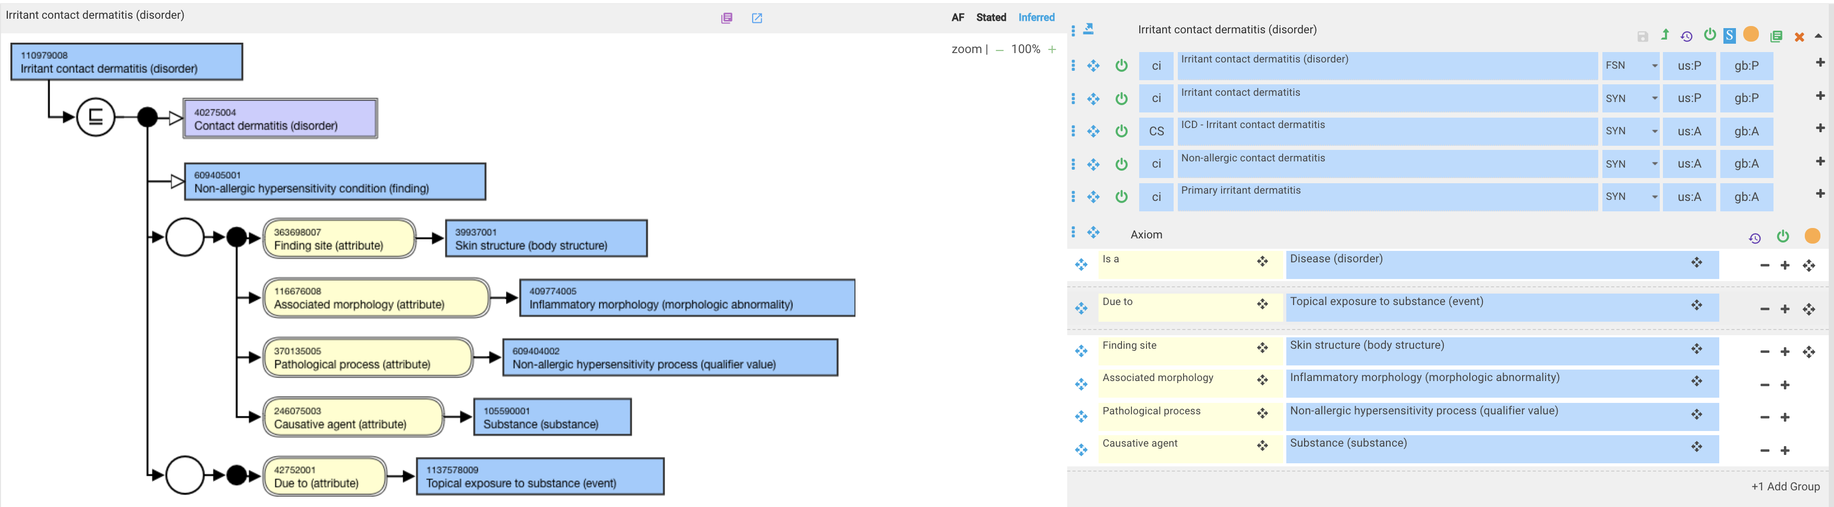
Irritant contact dermatitis

Slide 29
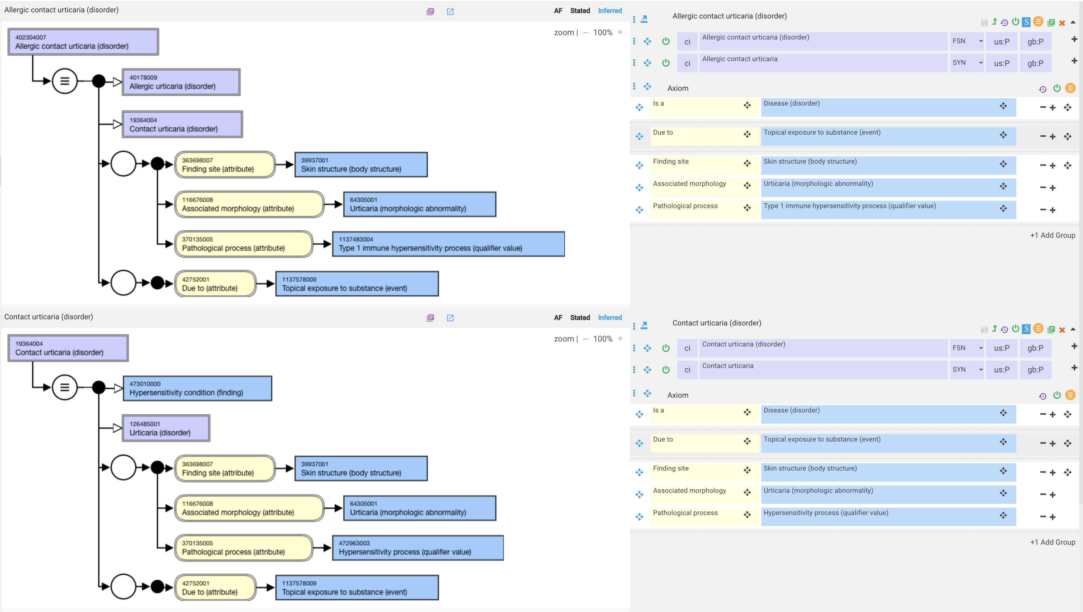
Contact urticaria

Slide 30
Proposed models for immune hypersensitivity disorders (see AUTHORTEST-250 Hypersensitivity, autoimmunity and allergy) at https://authoring.ihtsdotools.org/#/tasks/task/AUTHORTEST/AUTHORTEST-250/edit
Advantages
  Creates real immune hypersensitivity pathological processes replacing “pseudo” processes
  Enables the ability to fully define immune hypersensitivity disorders eliminating proximal primitives
  Creates a more robust model for contact hypersensitivity
Disadvantages
  Creates lots of change
  Allergic and autoimmune disorders will require multiple role groups
  Detailed domain knowledge required to determine appropriate pathologic mechanisms which for some diseases may be multiple

Slide 31
Alternate model

Slide 32
Alternate model - summary
Create Immune hypersensitivity process (qualifier value) as a parent of 263680009 |Autoimmune process (qualifier value)|and 472964009 |Allergic process (qualifier value)|)
Remodel 427439005 |Immune hypersensitivity disorder by mechanism (disorder)|as FD and renamed as Immune hypersensitivity disorder (disorder) using pathological process=Immune hypersensitivity process (qualifier value)
Keep current descendants of 427439005 |Immune hypersensitivity disorder by mechanism (disorder)| (except 422076005 |Immunoglobulin E-mediated allergic disorder (disorder)|) primitive

Slide 33
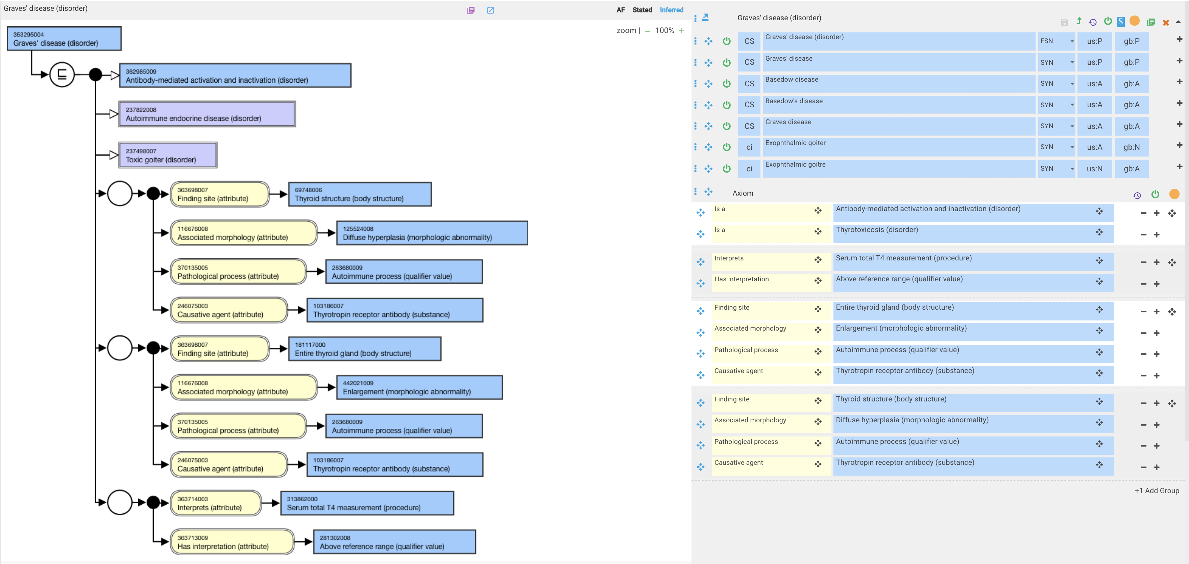
Graves’ disease

Slide 34
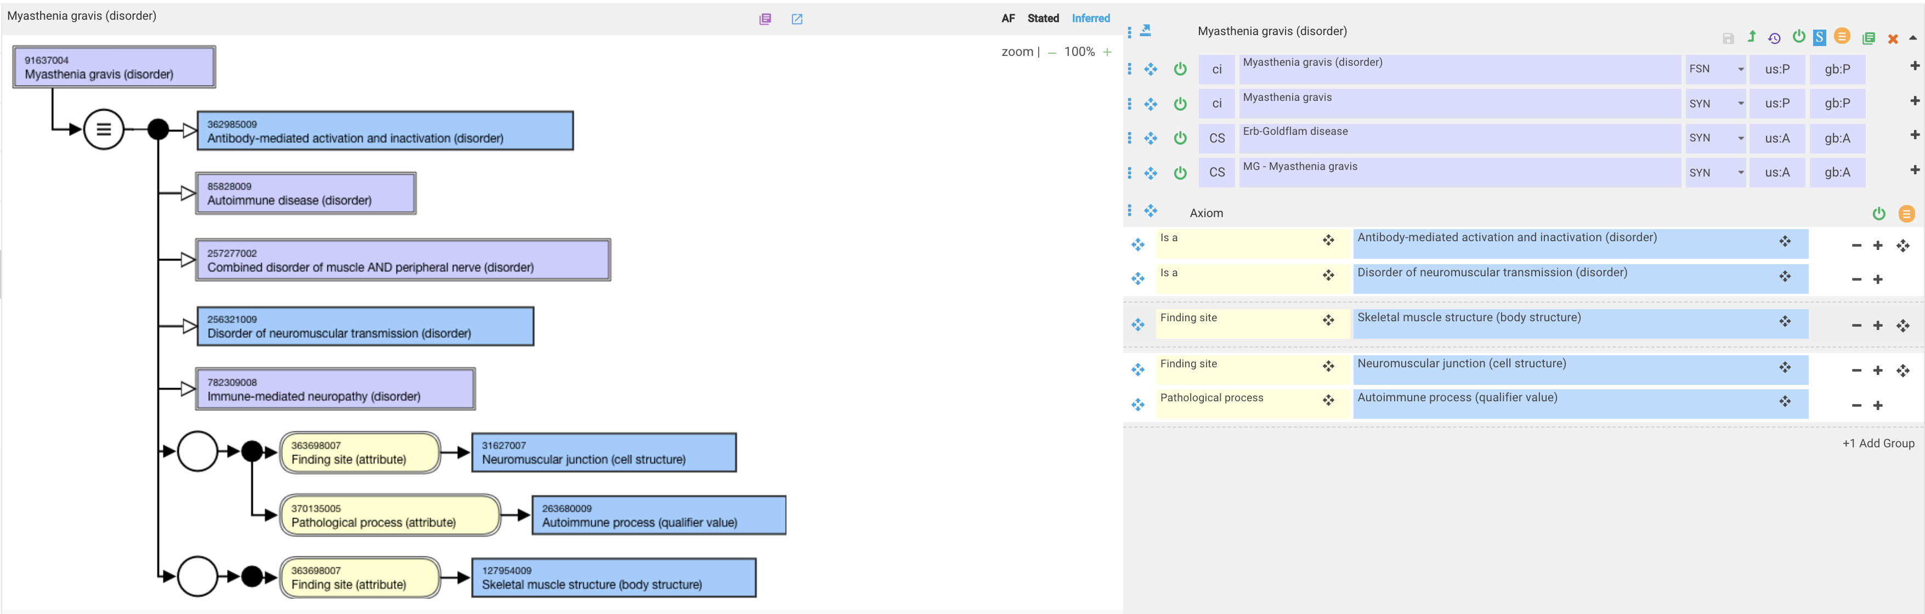
Myasthenia gravis

Slide 35
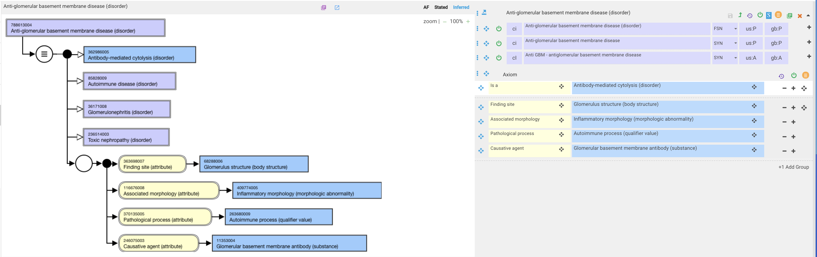
Anti-glomerular basement membrane disease

Slide 36
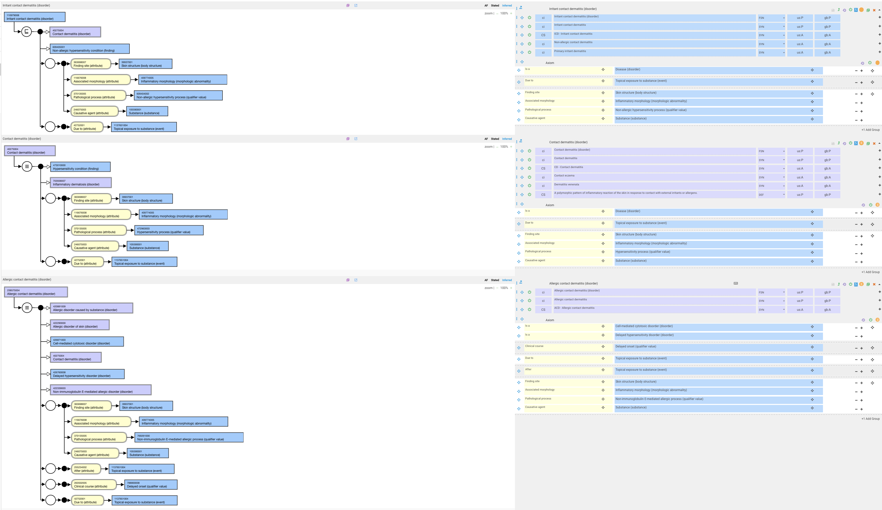
Contact dermatitis

Slide 37
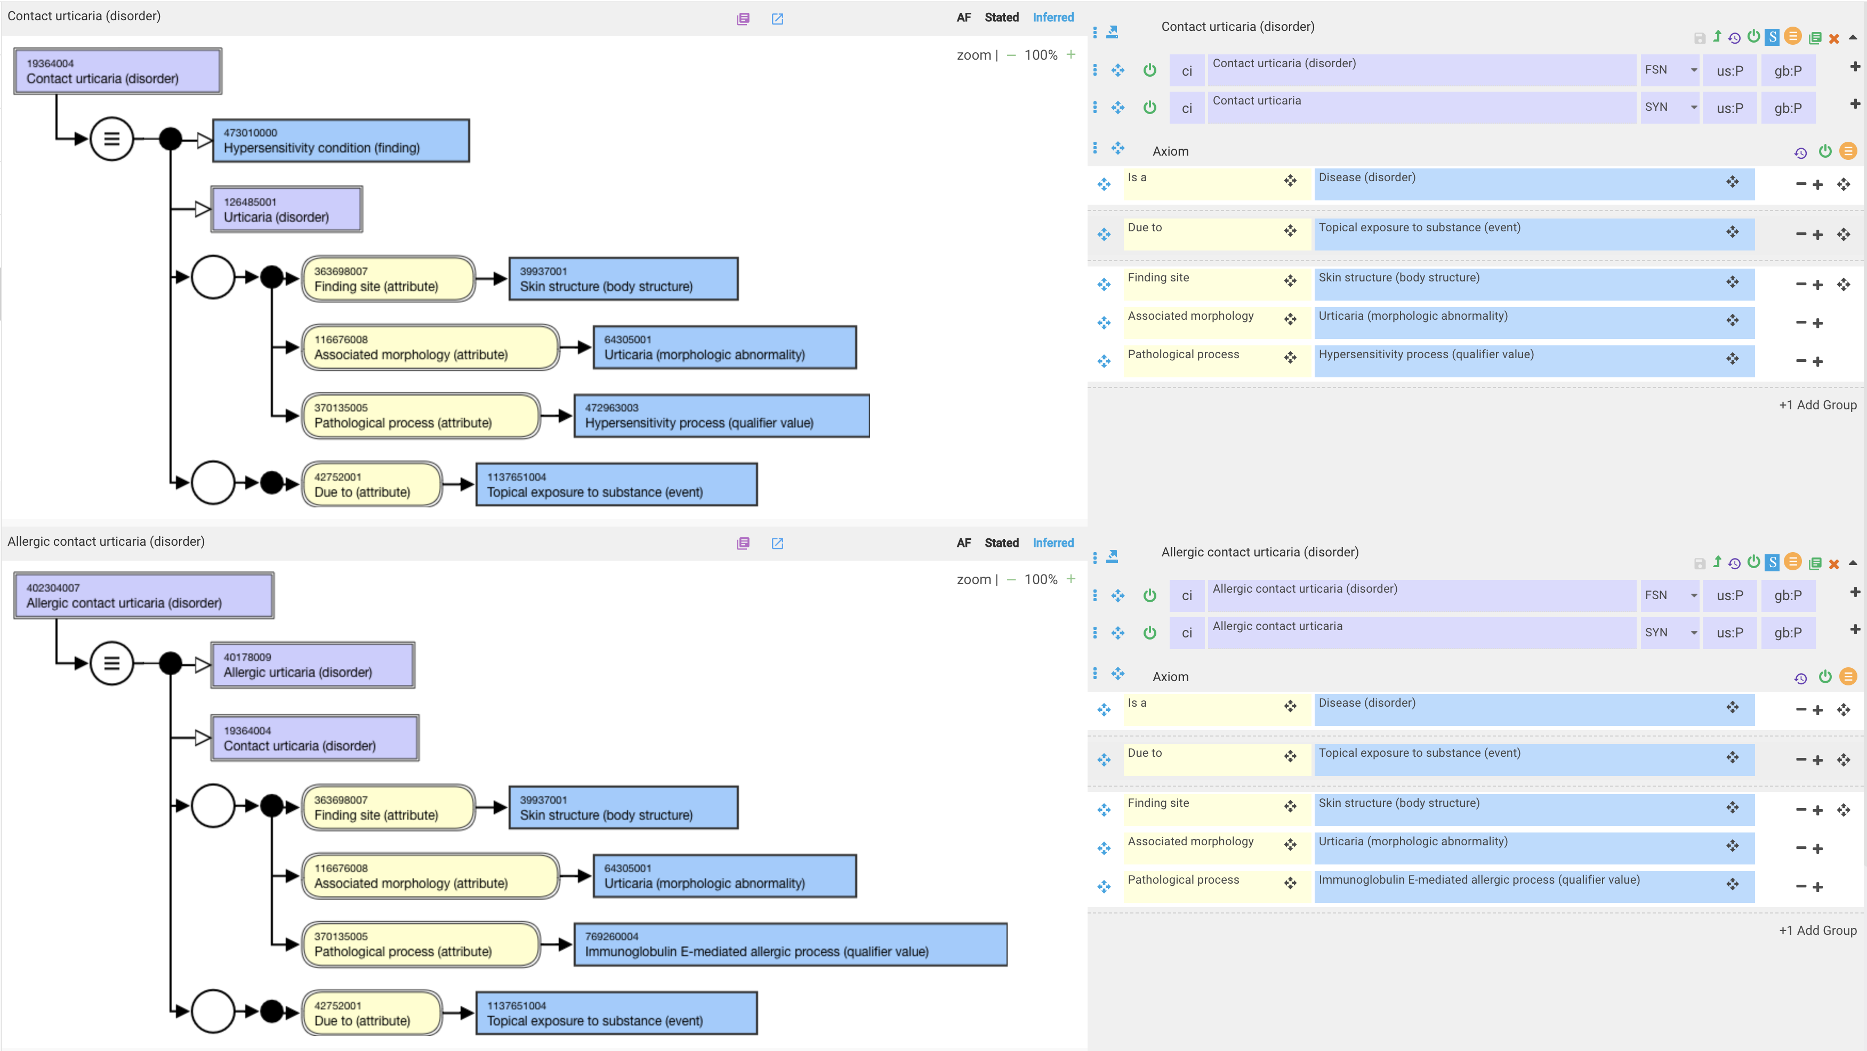
Contact urticaria

Slide 38
Proposed models for immune hypersensitivity disorders (see AUTHORTEST-253 Immune hypersensitivity
- alternate model 2 at: https://authoring.ihtsdotools.org/#/tasks/task/AUTHORTEST/AUTHORTEST-253/edit
Advantages
  Corrects issue with multiple pathological processes being inherited by autoimmune disorders
  Minimizes change
  Creates a more robust model for contact hypersensitivity eliminating several pathological processes related to contact hypersensitivity
Disadvantages
  Retains Gell and Coombs subtypes as proximal primitives

