Slide 1
Allergy CRG meeting
1/26/2024

Slide 2
SNOMED and LOINC - representing allergy testing in SNOMED
The existing content in SNOMED CT representing laboratory procedures and observables will not be inactivated.
In addition, for this specific area of content, some members are still requesting content of this type to be added to SNOMED CT.
Furthermore, RII deemed this type of content useful as order-only groupers for LOINC terms.
Concepts of type evaluation procedures (including laboratory procedures--hence the "Allergen specific antibody measurement" and subtypes), are considered for moving to the Observable entity hierarchy as part of the E2O project.
Removal of the preferred term for these concepts, as the PT for these concepts is incorrectly stated as "RAST".
  Jim and Monica agreed to an update as requested for these concepts.
  "RAST" will be removed as a synonym (PT or not).
    For search purposes, we could consider the addition of a definition (or annotation--when the functionality is available) to the grouper concepts to indicate the fact that RAST is an outdated/often not-applicable, though still highly used term to refer to these tests.

Slide 3
Drug hypersensitivity update
The scope as suggested on slide 15 of my presentation seems to be manageable to both Monica and Jim.
  Is the scope limited to the changes on this slide?
  In other words, after implementing the proposed groupers, is there a need to review and reassign subtypes of the concepts in scope (e.g. subtypes of 62014003 |Adverse reaction caused by drug (disorder)|)? The concern is that the knock-on impact of this change could be more far-reaching and could expand the scope significantly.
Does “Allergy to drug" really fit under the top level "Adverse drug condition". What is the justification for having a high level grouper to include both process and propensity?

Slide 4
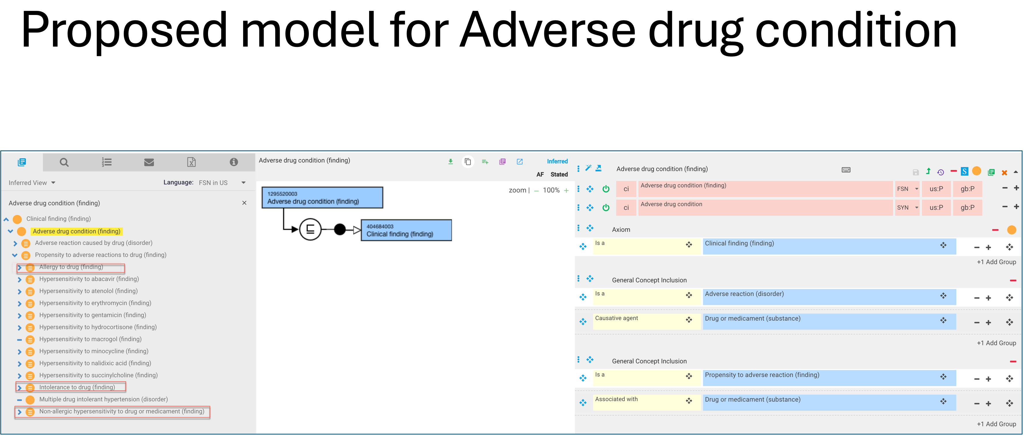
Drug hypersensitivity update
The scope as suggested on slide 15 of my presentation seems to be manageable to both Monica and Jim.

Slide 5
Does “Allergy to drug" really fit under the top level "Adverse drug condition". What is the justification for having a high level grouper to include both process and propensity?
We have used the word “reaction” to specifically refer to the process for the Hypersensitivity/Allergy hierarchies in order to distinguish reactions (processes) from dispositions
If we model adverse drug reactions as processes i.e. disorders it would exclude a large number of concepts that are currently modeled as dispositions from being considered adverse drug reactions
  416098002 |Allergy to drug (finding)| descendants 1042
  416093006 |Allergic reaction caused by drug (disorder)| descendants 12
The above would apply to other “adverse drug reactions” such as intolerance and non-allergic hypersensitivity which are currently modeled as findings
Proposal – As dispositions and processes have different meanings and there is a clinical need to distinguish between them for drug allergy at least, would it be appropriate to create new reaction concepts from existing finding concepts and thus not need to capture the dispositions under Adverse drug reaction?
There is a proposal to be taken to EAG that any disorder with a CAUSED BY relationship to a medicinal product or substance should be a subtype of Adverse reaction.
  OK for disorders not dispositions (findings)

Slide 6
Allergen mixes
Represent multiple allergens bound to a single solid phase. A positive results indicates IgE antibody against one or more of the allergens but does not identify which ones. Usually reported as pos/neg.
Fourteen in SNOMED CT. All but one have radioallergosorbent test in FSN
>300 in LOINC with method of multidisk
Question as to whether these should be defined with a component representing a substance vs. a product.
  “We cannot add a substance concept to define this concept as our Ed Guide section on "Out of scope substances" includes “Concepts that represent a combination of two or more separate substances.”
    Note even apparently single allergens represent a mix of several allergenic proteins
  The component being evaluated is specific IgE not the individual allergens however it may represent multiple specific IgEs for any/all of the allergens. Either way I don’t feel these should be modelled with a component of a product.
My recommendations (completed):
  All of the mixes except the following below should be retired as they are ambiguous because they do not mention what allergens are being tested for (note fx1 and fx22 below). Note however that these may be proprietary to Thermo Fisher
    416801001 Mixed nut (fx1) radioallergosorbent test (procedure)
      Fx1 The test includes a mixture of Peanut, Hazelnut, Brazil nut, Almond, and Coconut allergens.
    417483000 Mixed nut (fx22) radioallergosorbent test (procedure)
      Fx22 The test includes a mixture of Pecan nut, Cashew nut, Pistachio, Walnut
    414370009 Guinea pig epithelium+rabbit epithelium+hamster epithelium+rat epithelium+rat serum proteins+rat urine proteins+mouse epithelium+mouse serum proteins+mouse urine proteins specific immunoglobulin E antibody measurement (procedure)
    The above should be named as 414370009 (ex70) with the individual allergens spelled out. The universal allergen code should also be included
408232008 Animal dander mix radioallergosorbent test (procedure)
408233003 Cereals food mix radioallergosorbent test (procedure)
391494002 Fish mix radioallergosorbent test (procedure)
391547007 Food mix radioallergosorbent test (procedure)
391478009 General foods mix radioallergosorbent test (procedure)
408214008 Mixed fruit radioallergosorbent test (procedure)
391337008 Mixed molds radioallergosorbent test (procedure)
416801001 Mixed nut (fx1) radioallergosorbent test (procedure)
417483000 Mixed nut (fx22) radioallergosorbent test (procedure)
391338003 Mouse mix radioallergosorbent test (procedure)
313674003 Nut mix radioallergosorbent test (procedure)
408234009 Pediatric food panel mix radioallergosorbent test (procedure)
397587005 Radioallergosorbent test (procedure)
391536000 Seafood mix radioallergosorbent test (procedure)
414370009 Guinea pig epithelium+rabbit epithelium+hamster epithelium+rat epithelium+rat serum proteins+rat urine proteins+mouse epithelium+mouse serum proteins+mouse urine proteins specific immunoglobulin E antibody measurement (procedure)

Slide 7
Representation of whether the patient has an allergy as an observable entity
Suggestion to use 406212004 |Immune hypersensitivity response status (observable entity)|
The definition of Allergy from the WAO/EAAACI on which the Allergy content in SNOMED is “Allergy is a hypersensitivity reaction initiated by specific immunologic mechanisms” which would make it synonymous with immune hypersensitivity.
609407009 |Immune hypersensitivity reaction by mechanism (disorder)| subsumes subtypes that represent the immune mechanisms described by Gell and Coombs some of which do not relate to what we commonly think of as allergy (e.g. 83699005 |Hypersensitivity reaction mediated by immune complex (disorder)|).
Initially defining Allergy as simply immune hypersensitivity lead to some autoimmune disorders classifying under allergy.
427439005 |Immune hypersensitivity disorder by mechanism (disorder)|, subsumes concepts that are mostly allergy disorders, but doe contain some non-allergy content such as 362985009 |Antibody-mediated activation and inactivation (disorder)|.
406212004 |Immune hypersensitivity response status (observable entity)| subsumes only 2 children, 405012001 |Systemic allergic response status (observable entity)| and 405011008 |Localized allergic response status (observable entity)|.
It sounds like what is required is something more general than either of the 2 subtypes of Immune hypersensitivity response status (observable entity). Thus if one concludes that Immune hypersensitivity is a supertype of allergy and other adverse conditions due to other immune mechanisms as described by Gell and Coombs, it would seem reasonable to create a new grouper of Allergy status (observable entity).

Slide 8
Request from Belgium for new substance: Fragrance mix II (substance)
Including Fragrance mix I and II in SNOMED is appropriate as they seem to have a universal definition in terms of constituent allergens however adding such diagnostic products as substances is problematic.
This is a diagnostic patch test product used to diagnose ACD.
It is a panel of 6 individual tests.
We cannot add a substance concept to define Fragrance mix II as the Ed Guide section on "Out of scope substances" includes “Concepts that represent a combination of two or more separate substances.”
There is already a 411126008 |Patch test product (product)| hierarchy consisting of 166 descendants, one of which is 411216009 |Fragrance series (product)| containing 11 descendants including one mix (411279007 |Musk mix (product)|).
There is also a parallel 288841007 |Patch test substance (substance)| hierarchy with 391 descendants used to define the products.
The product hierarchy should be used for the patch test series.

Slide 9
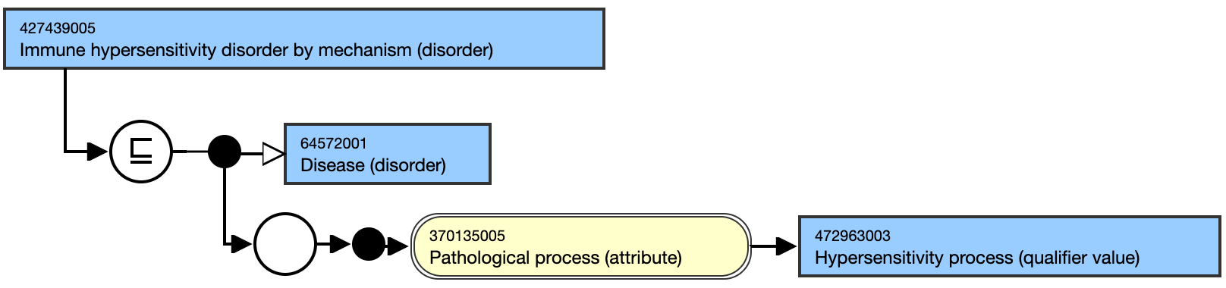
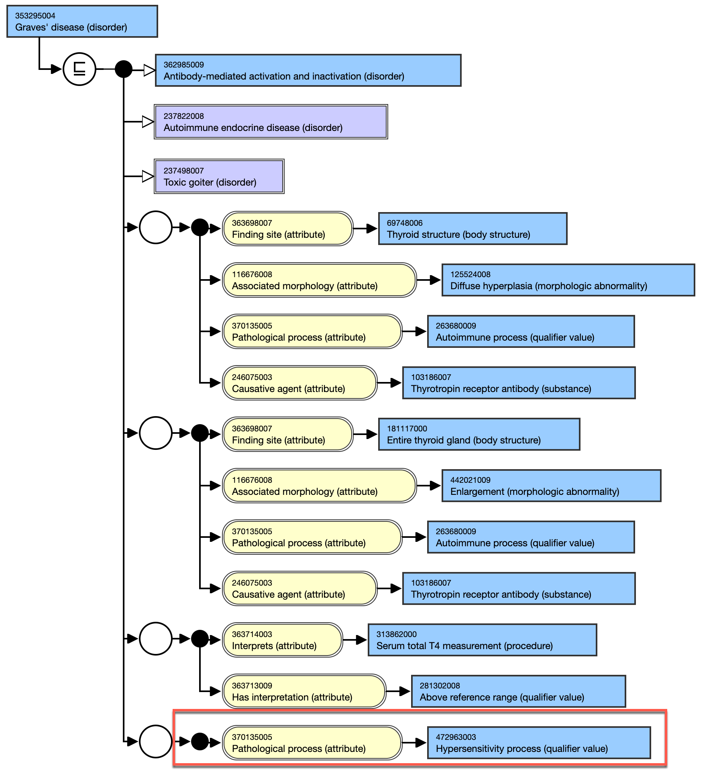
Improving Immune hypersensitivity disorder content in SNOMED CT
Issues Identified:
  427439005 |Immune hypersensitivity disorder by mechanism (disorder)|is an intermediate primitive
  There is an extra relationship of "Pathological process = Hypersensitivity process" added to some of the descendants because the ancestor 427439005 |Immune hypersensitivity disorder by mechanism (disorder)| has this relationship. Having that relationship (usually appearing outside of a group) doesn’t seem appropriate: E.g. 353295004 |Graves' disease (disorder)|

Slide 10
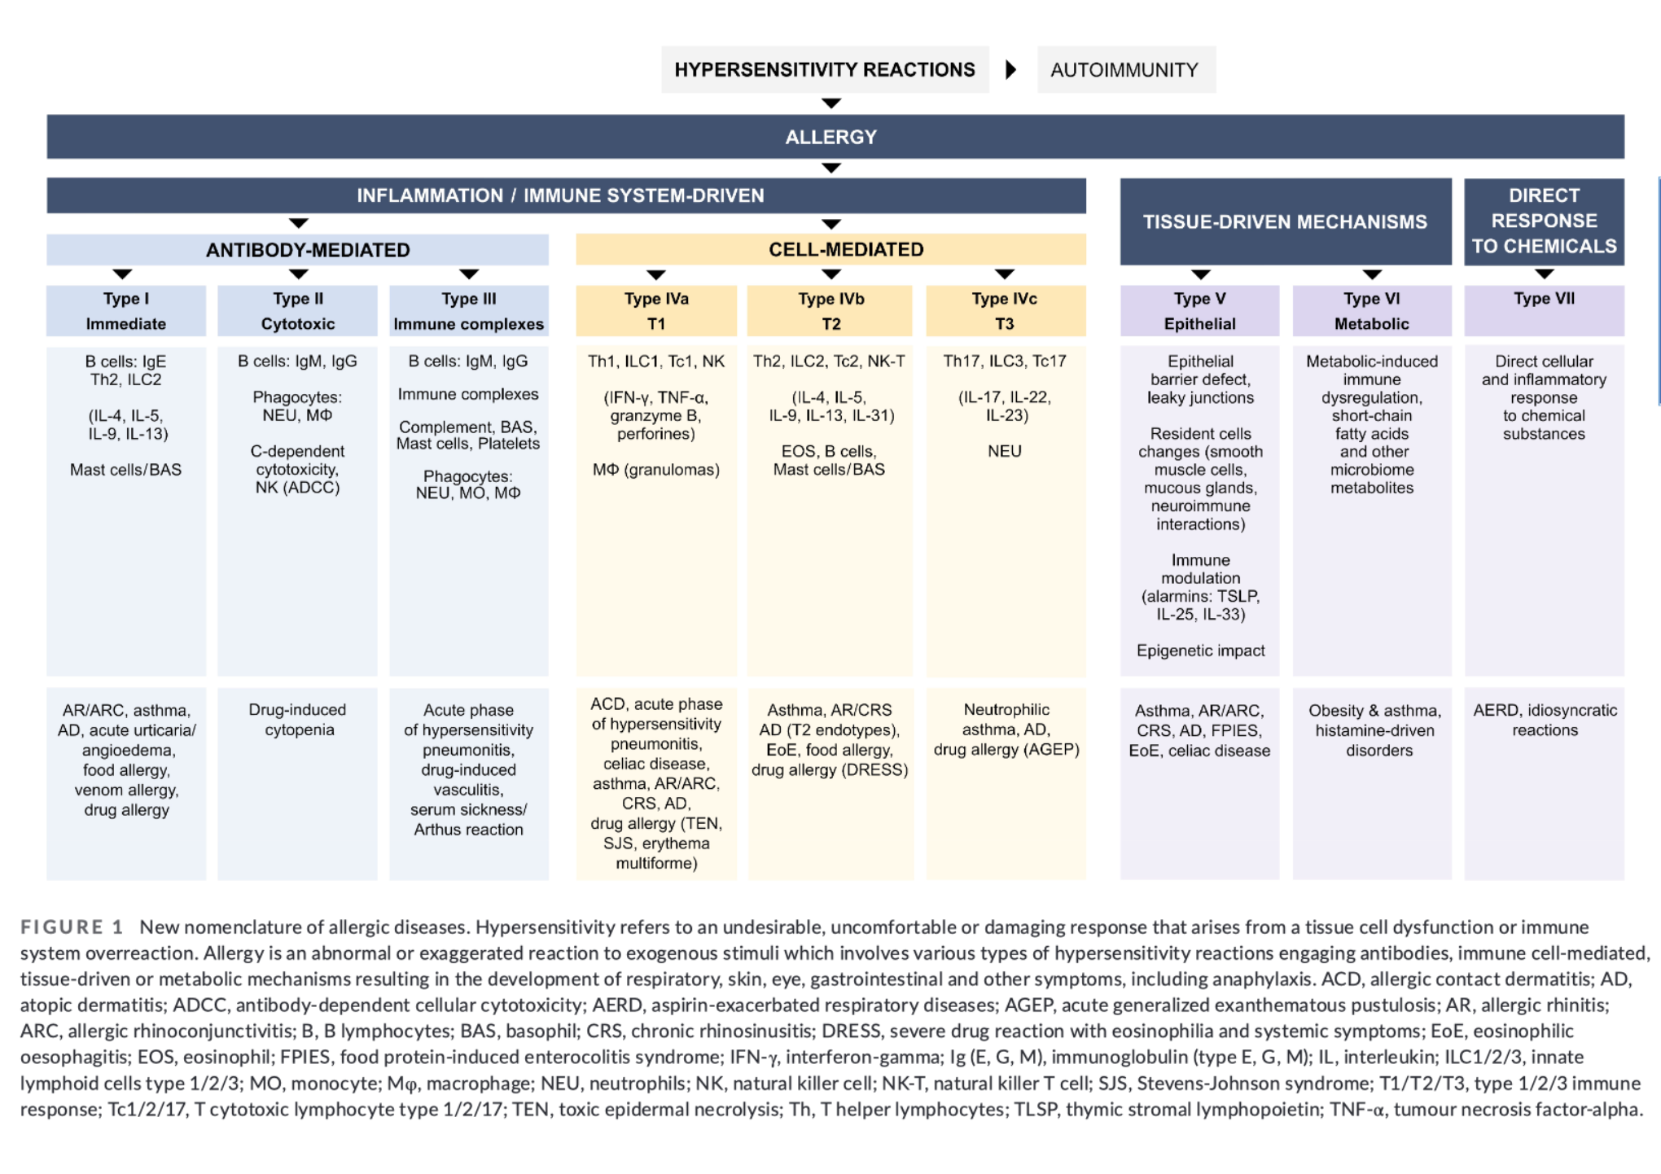
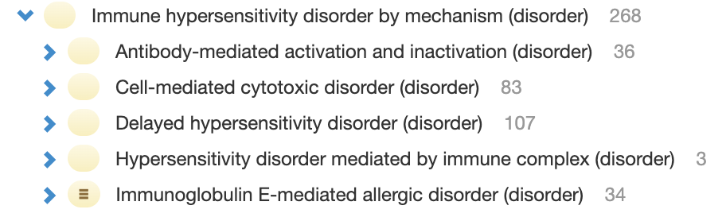
Immune hypersensitivity disorder by mechanism (Gell and Coombs classification)
Current SNOMED CT content
New nomenclature

Slide 11
Proposed solutions
file:///Users/brucegoldberg/Library/CloudStorage/OneDrive-Personal/Powerpoint/Hypersensitivity, autoimmunity and allergy - update.pptx

