Slide 1

Status Update
Nutrition and Dietetics SNOMED CRG
Constantina (Tina) Papoutsakis, PhD, RD
Chair, Clinical Reference Group, Nutrition and Dietetics terminology, SNOMED CT International
https://confluence.ihtsdotools.org/display/NDCRG/Nutrition+and+Dietetics+Clinical+Reference+Group

Slide 2
Disclosures
Constantina (Tina) Papoutsakis, PhD, RD
Senior Director, Nutrition and Dietetics Data Science Center
Research, International, and Scientific Affairs (RISA)
Academy of Nutrition and Dietetics
Chair, Clinical Reference Group, Nutrition and Dietetics terminology
SNOMED CT International
    (Systematized Medical Nomenclature for Medicine–Clinical Terminology (SNOMED CT) is a clinical terminology system that provides a standardized and scientifically validated way of representing clinical information captured by clinicians)
Member, Coding4Food Advisory Committee
https://www.msfnca.org/coding4food
    The Coding4Food (C4F) project is a community-informed initiative aiming to create new Healthcare Common Procedural Coding System (HCPCS) codes to define a spectrum of Food is Medicine interventions as healthcare services, allowing for their full integration into healthcare system infrastructure

Slide 3

SNOMED Nutrition and Dietetics CRG
OBJECTIVE 1: reorganization of feeding/dietary regime hierarchy
Review from a practice perspective
Assess organization of content
Take into account use in HL7 standards
OBJECTIVE 2: release and disseminate first NCPT refset
Released April 2024 along with press release
Contains nutrition problems (diagnoses), 166 concepts
OBJECTIVE 3: NCPT implementation guide
Practical resource for clinicians and technical implementers
Initiated work with SNOMED staff
Presented to CRG members and recruiting volunteers

Slide 4
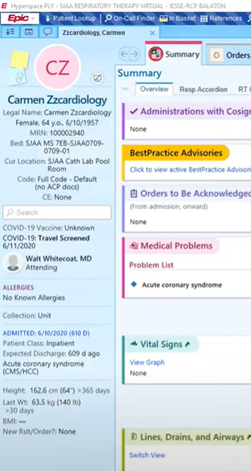
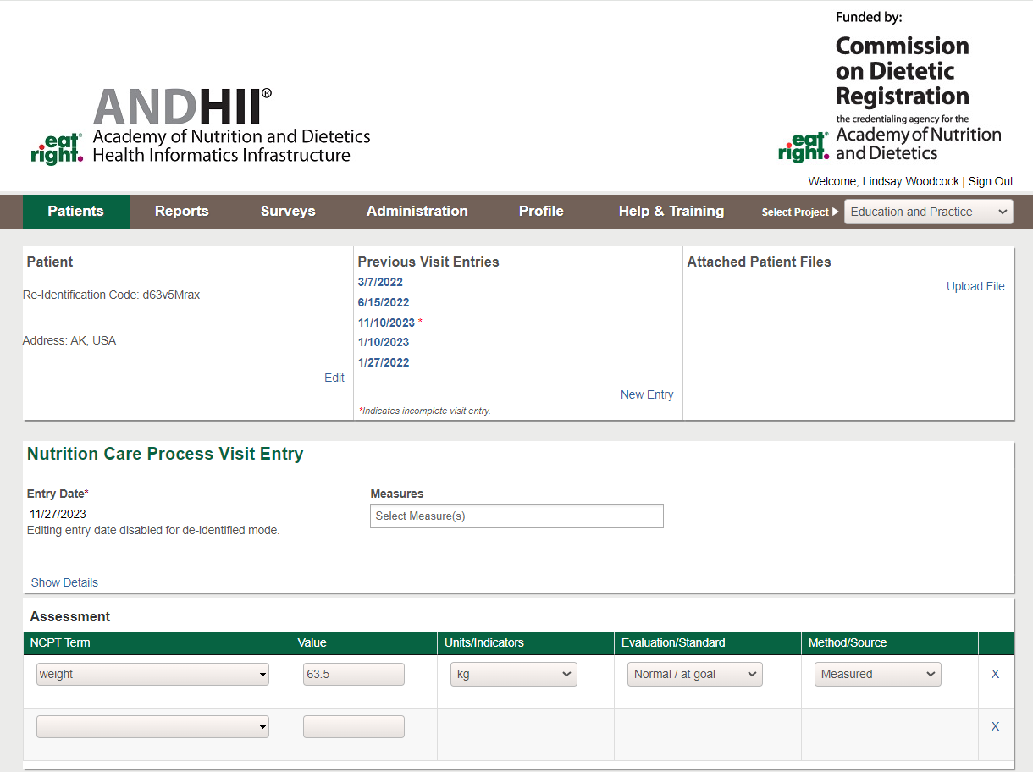


Development of ANDHII FHIR API
Coding using HL7 FHIR
Hospital API
ANDHII API
https://www.youtube.com/watch?app=desktop&v=xP2nOx9D8qk
This project was supported, in part by grant number 90INNU0045, from the Administration for Community Living, U.S. Department of Health and Human Services, Washington, D.C. 20201. Grantees undertaking projects with government sponsorship are encouraged to express freely their findings and conclusions. Points of view or opinions do not, therefore, necessarily represent official ACL policy.

Slide 5
Upcoming Meetings
There is a regular call typically on the 3rd Monday of each month at 19:00 UTC.
May 20, 2024 at 19:00 UTC
June 17, 2024 at 19:00 UTC
All are welcome
https://confluence.ihtsdotools.org/display/NDCRG/Nutrition+and+Dietetics+Clinical+Reference+Group

