Slide 1



Improving the modeling of the immune hypersensitivity disorder content
Suzanne Santamaria,
Farzaneh Ashrafi
January 11, 2024

Slide 2
Introduction
We would like input from the Allergies and hypersensitivities CRG on drafting a final proposal for improving the modeling of the immune hypersensitivity disorder content.
Once a proposal has been agreed by the CRG, then it can be considered for implementation when allocating resources in the future.
‹#›

Slide 3
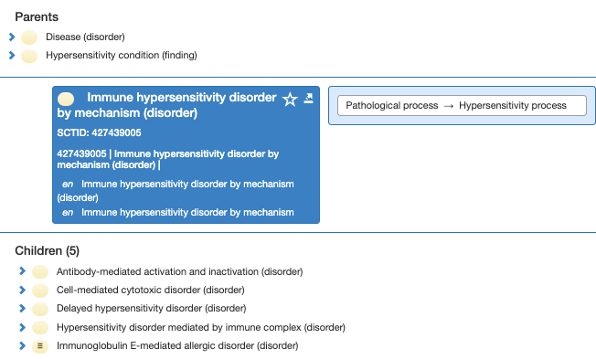
Immune hypersensitivity disorder by mechanism (disorder)
Inactivate 427439005 |Immune hypersensitivity disorder by mechanism (disorder)|:
  Non-conformant to editorial policy as it is an intermediate primitive which is not clinically useful
  Currently there is an extra relationship of "Pathological process = Hypersensitivity process" added to some of the descendants because the ancestor 427439005 |Immune hypersensitivity disorder by mechanism (disorder)| has this relationship. Having that relationship (usually appearing outside of a group) doesn’t seem appropriate: E.g. 353295004 |Graves' disease (disorder)|
‹#›

Slide 4
Immune hypersensitivity disorder by mechanism (disorder) subtypes
Are current subtypes of 427439005 |Immune hypersensitivity disorder by mechanism (disorder)) clinically useful:
  362985009 |Antibody-mediated activation and inactivation (disorder)| - Currently primitive
  426871003 |Cell-mediated cytotoxic disorder (disorder)| - Currently primitive
  426760008 |Delayed hypersensitivity disorder (disorder)| (seems to be useful) - Currently primitive
  426065008 |Hypersensitivity disorder mediated by immune complex (disorder)| - Currently primitive
    Note only has one subtype so does not conform to editorial policy but may be a useful concept
  422076005 |Immunoglobulin E-mediated allergic disorder (disorder)| - SD
‹#›

Slide 5
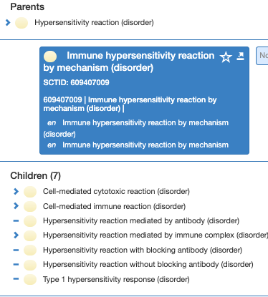
Immune hypersensitivity reaction by mechanism (disorder)| hierarchy
Is there any overlap with << 609407009 |Immune hypersensitivity reaction by mechanism (disorder)| hierarchy? This is a small hierarchy (20 concepts) with mostly primitive concepts. Consider inactivation and/or remodeling and/or consolidation of concepts.
‹#›

Slide 6
New process qualifier value concepts?
Create new process qualifier value concepts as subtypes of 472963003 |Hypersensitivity process (qualifier value) to sufficiently define remaining relevant disorder concepts (Originally proposed by Bruce via an associated JIRA ticket)?
  Antibody-mediated activation and inactivation process (qualifier value)
  Antibody-mediated cytolysis process (qualifier value)
    Question - Should this be cytotoxicity rather than cytolysis?
  Cell-mediated cytotoxic process (qualifier value)
    Question - Do we need to add additional subtype concepts based on the newer classifications of this process?
  Delayed hypersensitivity process (qualifier value)
    Question - Should this be parent of any of these types?
      Immune complex mediated process (qualifier value)
      Immunoglobulin E-mediated process (qualifier value)
‹#›

Slide 7
Content changes
Text definitions would need to be included for any new process qualifier value concepts in this area.
  Some remodeling of existing process concepts may be needed if/when the new ones are created.
Use new process concepts to remodel the relevant disorder concepts. There are currently 268 subtypes of 427439005 |Immune hypersensitivity disorder by mechanism (disorder)|.
  Consider whether automated processing could be utilized. Some manual remodeling work would be needed.
  Noted by Bruce: “One issue I encountered dealt with how to specify a disease such as allergic contact dermatitis as both an allergic disorder and a delayed hypersensitivity disorder, as delayed hypersensitivity disorders are not necessarily allergic disorders.”
Editorial Guideline may need to be updated
‹#›

Slide 8
References to consider:
https://onlinelibrary.wiley.com/doi/epdf/10.1111/all.15889
https://www.ncbi.nlm.nih.gov/books/NBK513315/
‹#›

Slide 9

Thank You

