Slide 1
Updates….
….February 2024

Slide 2
(International) Units
Following on from a problem where an FSN became too long, there was an evaluation about the use of what “international unit” really means, especially when compared to “unit”
Various inconsistencies where found – for example:
781921003 | Product containing precisely heparin calcium 25000 unit/1 milliliter conventional release solution for injection (clinical drug)
But heparin units are in fact “international units”, it is just that by convention, we never say so

Slide 3
(International) Units Editorial Guidance
So, after due consideration, the Editorial Guidance is
International Unit as a description is arbitrary, and to be understood, each product requires reference to a particular bioefficacy specification for that entity. Therefore, “international unit” is neither a meaningful nor comparable description at Clinical Drug level. International unit will be represented as unit in Clinical Drug descriptions. Abbreviations will not be used.

Slide 4
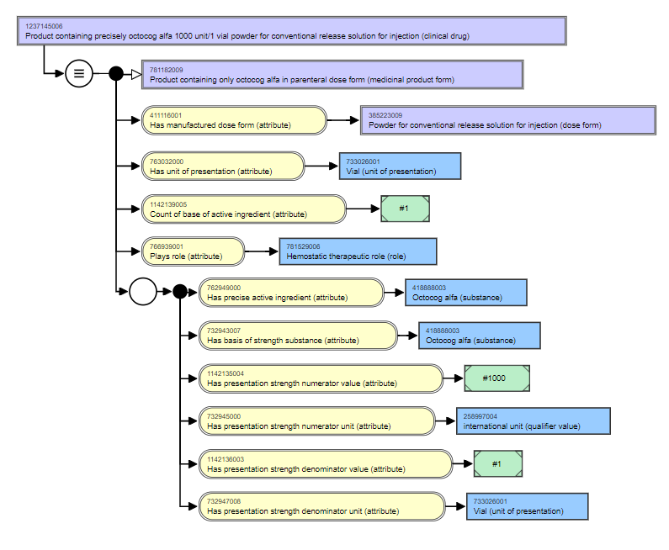
Units Example
1237145006 |Product containing precisely octocog alfa 1000 unit/1 vial powder for conventional release solution for injection (clinical drug)|
  PT - Octocog alfa 1000 unit powder for solution for injection vial
The |Has presentation strength numerator unit| can continue to have a value of |International unit (qualifier value)| even though unit is stated in the FSN and PT.

Slide 5
Administration method updates
From feedback from a country doing translation in the Medication domain, the terming of two administration method concepts has been updated to be clearer and to avoid overlap with procedure concepts
  Although we have always acknowledged that the administration of a medicine is conceptually a very specialised type of procedure ☺
1231460007 |Dialysis system (administration method)| - updated so as to be clear that the method of medicine administration is in/through the dialysis system and is not the dialysis process
827107003 |Implantation (administration method)| - updated to be clear that the concept is about the method of administering a medicine within the tissue of the body, rather than about the object being implanted (“implant” being both a noun and a present participle – in English)

