Slide 1
LOINC – SNOMED CT
Cooperation on Content
IHTSDO Business Meetings: IPaLM SIG &
Observable and Investigation model project
April 2016
London, England

Slide 2
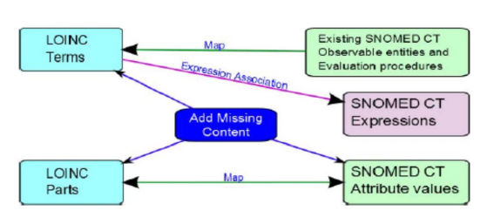
Background
Cooperative agreement between RII and IHTSDO, July 2013
  Builds on strengths of each terminology
  Minimize and manage duplication
  SNOMED CT and LOINC work better together
  Provide links between LOINC and SNOMED CT

Slide 3
Project scope
Scope
  Laboratory LOINC
  Vital signs
  Physiologic measurements
  Anthropomorphic measurements and evaluations
Phases
  Initial
    Top 2000 lab LOINC tests
    Microbiology
    Chemistry
    Vital signs
  Subsequent
    Remainder of lab LOINC
    Measurements

Slide 4
Roadmap
Alpha prototype (owl)
Alpha release – Phase 1-3
Map LOINC parts
to SNOMED
Candidate baseline Release (Beta)
Map LOINC codes
to SNOMED
expressions
Develop
distribution
format
LOINC Answer sets mapped to SNOMED codes
Business Meeting
Business Meeting
Business Meeting
Business Meeting
April 2014
September 2015
August 2016
Jan 2014
October 2014
April 2016

Slide 5
Alpha release – Phase 3
Released on April 1, 2016 with documentation
    Main objective: Change format of expressions from nested to flat
    Included minor changes in content, based on the feedback on the previous releases
      4051 LOINC Parts in LOINC Part to SNOMED CT RefSet
      13620 LOINC Terms in LOINC Term to Expression RefSet
    Due date to provide feedback: May 31, 2016

Slide 6
Next steps
  Evaluation of feedback on Alpha release, Phase 3 – Spring 2016
  Prepare and release Candidate Baseline– Summer 2016
  Finalize map of LOINC Parts to SNOMED CT concepts – Pending receiving full set from RII
  Resolve some known/upcoming complex content issues
  Implement SNOMED CT Observables model to define existing pre-coordinated SNOMED CT concepts – Pending implementation of Observable model and development of tooling

Slide 7
Contact information
Feedback on Alpha release – phase 3 (using JIRA Tracking Tool in Confluence)
  https://confluence.ihtsdotools.org/display/OBSERVABLE/LOINC+Alpha+Release+Feedback
General queries to IHTSDO Project Team
  info@ihtsdo.org
  Subject: LOINC – SNOMED CT Cooperation Project

Slide 8
LOINC - SNOMED CT
Issue discussion – IPaLM SIG

Slide 9
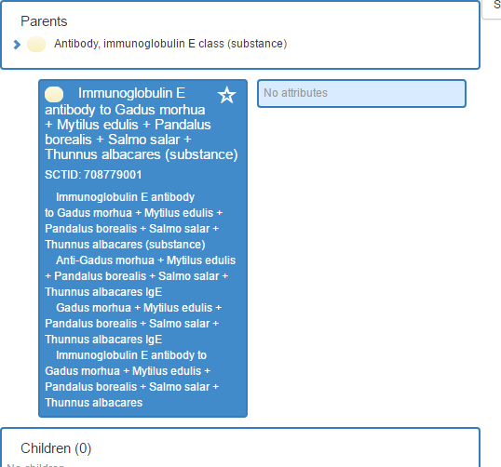
Mapping - Multidisk allergen assays
  E.g.
    (Gadus morhua+Mytilus edulis+Pandalus borealis+Salmo salar+Thunnus albacares) Ab.IgE:Threshold:Pt:Ser:Ord:Multidisk

Slide 10
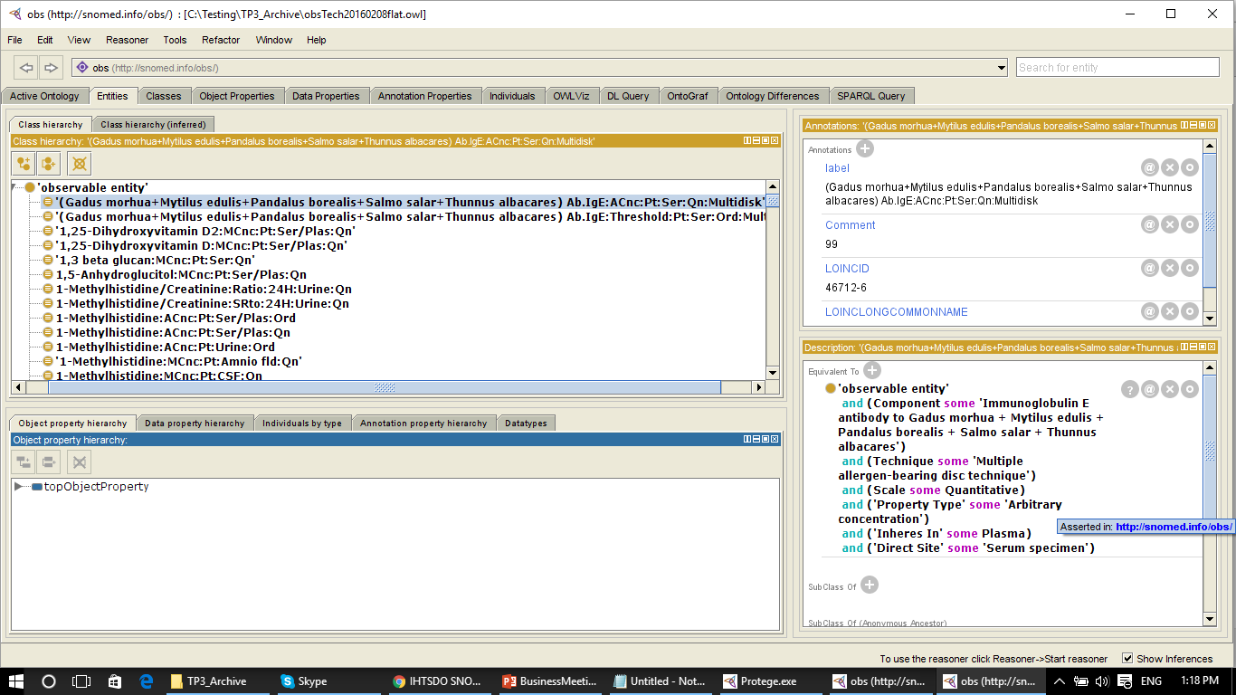

Slide 11
Mapping - Multidisk allergen assays
“The component for the multidisk allergen assays is problematic. The antibody is not a single substance directed against all of the allergen but one or more antibodies directed against one or more allergens.”
We have other terms that include “+” sign
  "Neisseria meningitidis B+Escherichia coli K1 Ag:ACnc:Pt:CSF:Ord"

Slide 12
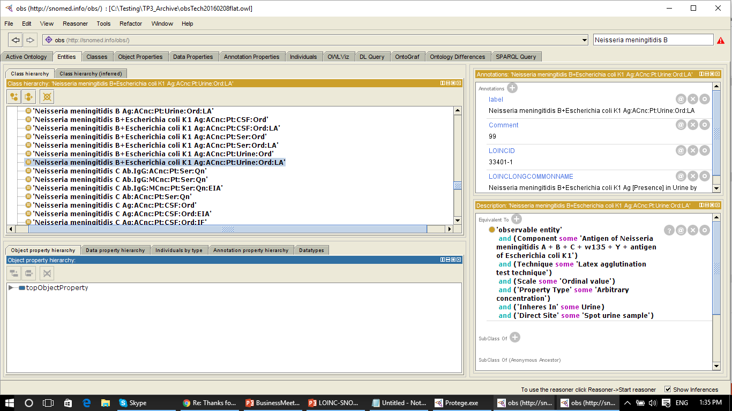

Slide 13
Mapping X + Y concepts
LOINC manual:
  “If two or more constituents are measured as one quantity, each constituent should be named and the component separated by a plus sign, e.g., Cyclosporine+metabolites or Human papilloma virus 16+18+31+33+35+45+51+52+56 DNA. If multiple analytes are measured separately, the analytes are separated by an ampersand (&) surrounded by spaces. Two cases that use the ampersand convention are the names of panel terms and impression terms."
X + Y concepts in SNOMED CT
Do we need multiple components in the model?
Can this be related to “X + Y (substance)” subsumption issues?

Slide 14
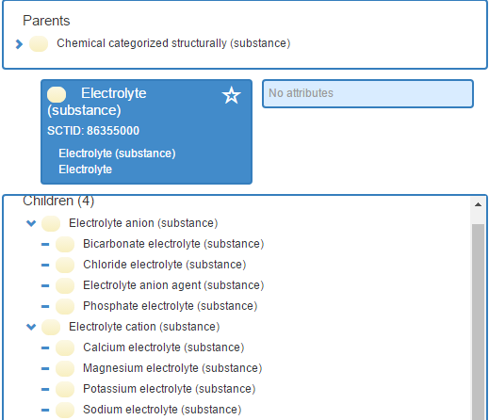
Substance vs. Electrolyte

Slide 15
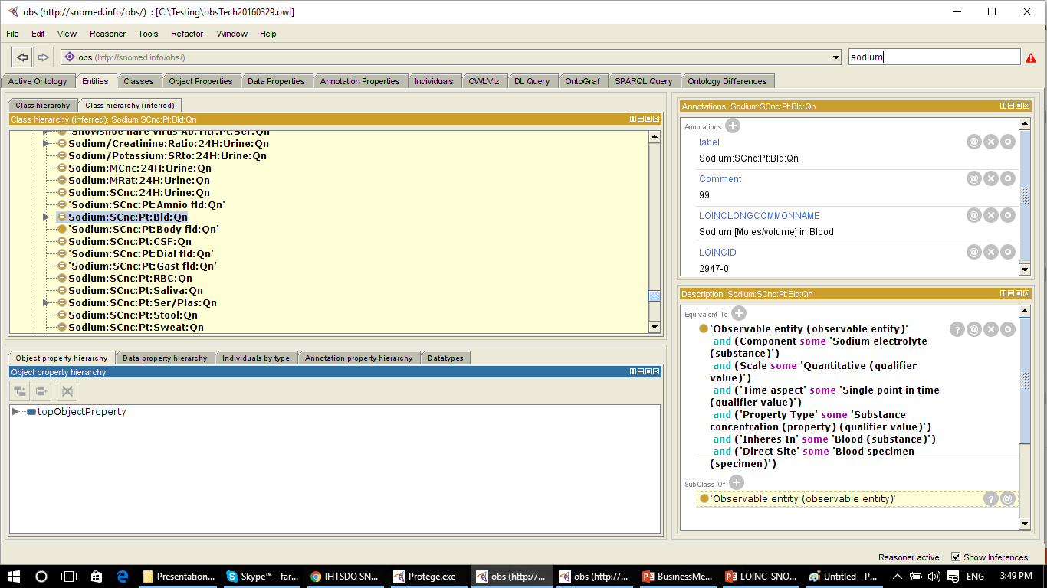

Slide 16
LOINC - SNOMED CT
Issue discussion – Observable and Investigation Model project

Slide 17
Subsumption
Outstanding subsumption issues:
  Component - X + Y Substance
  Property - Ratio subsuming SRto and Mrto
  Property - NCnc subsuming LNCnc
  Bacteria biotype

Slide 18

X + Y Substance
In many instances X + Y is subsumed by X and/or Y.
  RII feedback: “in the example it looks like X+Y and Y are subsumed by X. And wouldn’t it be more accurate to have X+Y as a parent of both X and Y?”
  RII feedback: “wouldn’t it be more accurate to have C4-DC+C5-OH as a parent of both?”

Slide 19

X + Y substance – ctd.
  RII feedback: «Why not:
    Neisseria meningitidis B + E coli K1
    Neisseria mening B + E Coli K1…:LA
    E coli K1
    E coli K1…:LA»
  RII feedback: «glycine, alanine and sarcosine are distinct, though sometimes alanine and sarcosine can overlap…”

Slide 20
X + Y substance – ctd.
Discrepancy to the rule?

Slide 21

Properties
Is the following to be expected?
  RII feedback: “No, I don’t think this one is correct. The property “Ratio” isn’t a more generic parent of MRto and SRto, rather, it means that the numerator and denominator have different properties. So MRto means mass/mass, SRto means moles/moles, and for this particular term, Ratio means moles/mass.”
  RII feedback: “I think this one is correct, but you might want to verify that with a mathematician or statistician.”

Slide 22
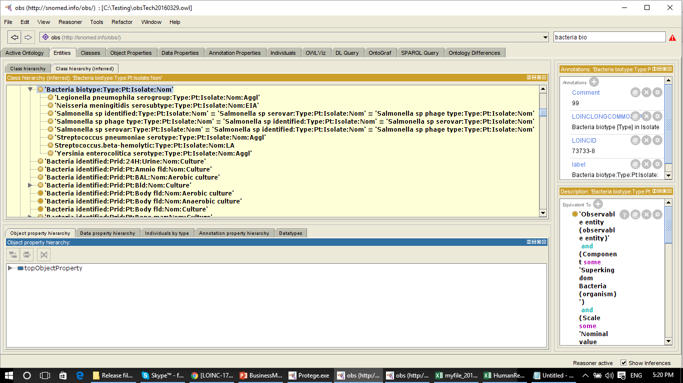
Bacteria biotype

Slide 23
Bacteria biotype
RII feedback: “I don’t know much about “biotype”, but the description makes me think that it should not be a parent of serovar/serotype terms:
Bacteria biotypes (biovars) are strains that are differentiated by biochemical or other non-serological means usually by numbers and letters. In contrast, a serotype (serovar) is a strain differentiated by serological means.”

Slide 24
Problem with Component attribute
“ the Component attribute while working with the snomed2owl script: it is role grouped when used with Procedures and not role grouped when used with Observables. Can think of three solutions:
  Amend the role grouping rules in the tooling to allow for this difference (could be complex for implementers and susceptible to human error)
  Make two "component" attributes
  Role group observables”

Slide 25
Inheres in + Component vs.
Inheres in + Inherent location
‘Presence OR identity’
  333 observables have both property type Prid and a specified component.
  While Presence as a property type is debatable, it should not be modeled as a relational observable, i.e. component should not be used.
‘Presence’
  73 observables have both property type Presence and a specified component. Same as Prid

Slide 26
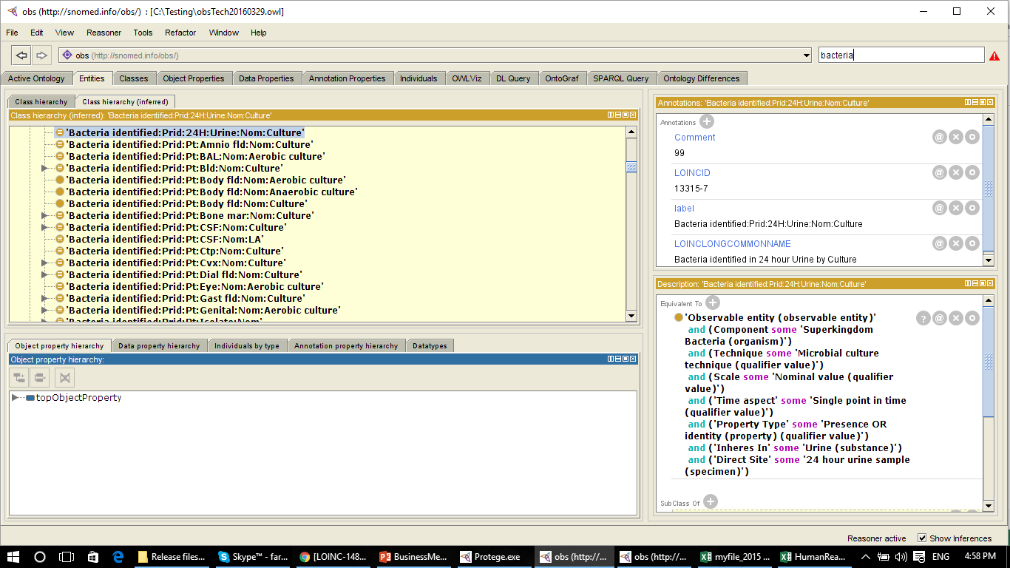

Slide 27
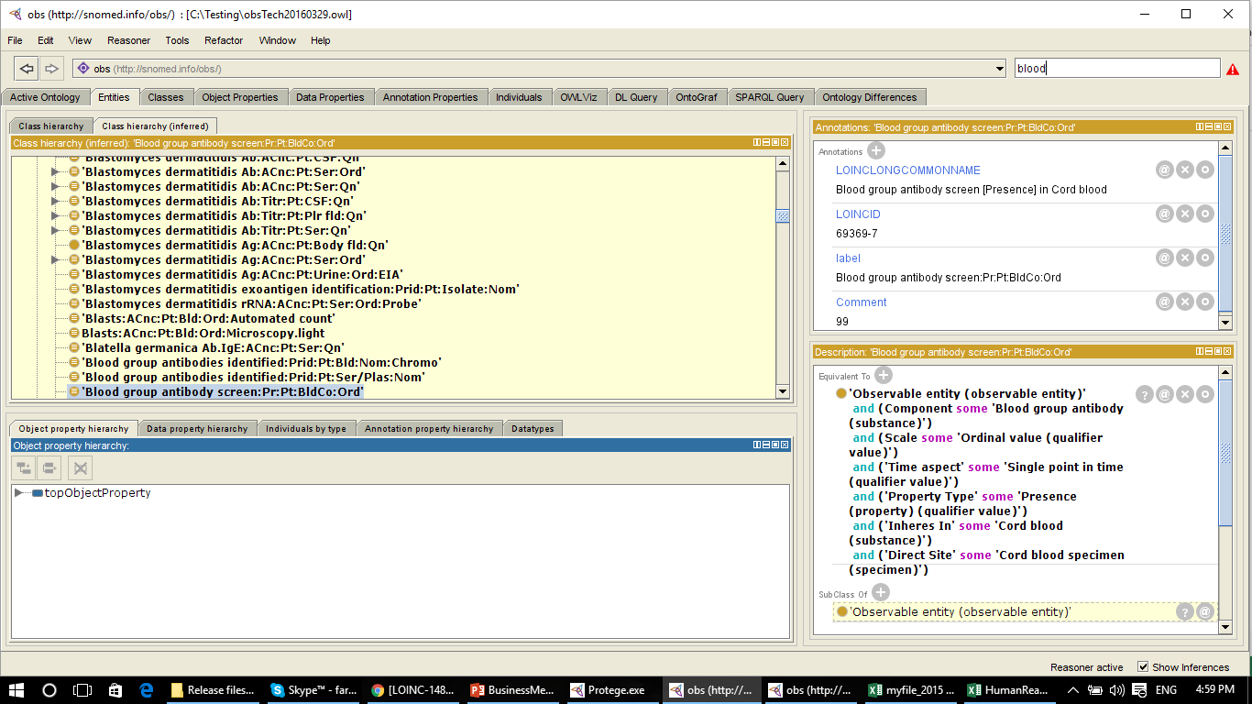

Slide 28
Observables defining/
Defined by observables
There are Observables as values for the attributes:
  Property type: 30
    Appearance
    Color
  Characterizes: 401 observables which uses Characterizes
    63911002 | Excretory function (observable entity) | Processes and Observables should be in different hierarchies. A new Qualifier value sub-hierarchy? Needed for Functioning observables as well.
  Component: 39
    Anion gap (calculated observable)
    Coagulation and sedimentation (process observables)
    Findings
    Specimen source
    Motile spermatozoa (subclassification of cell)

Slide 29
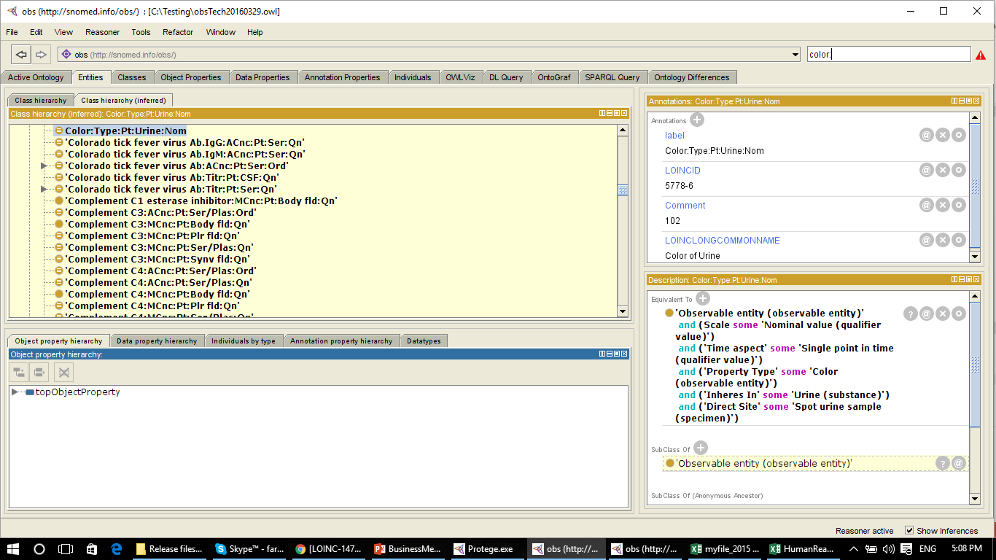

Slide 30
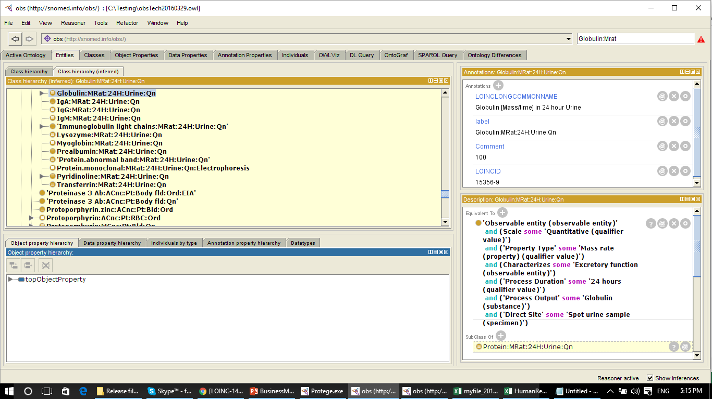

Slide 31
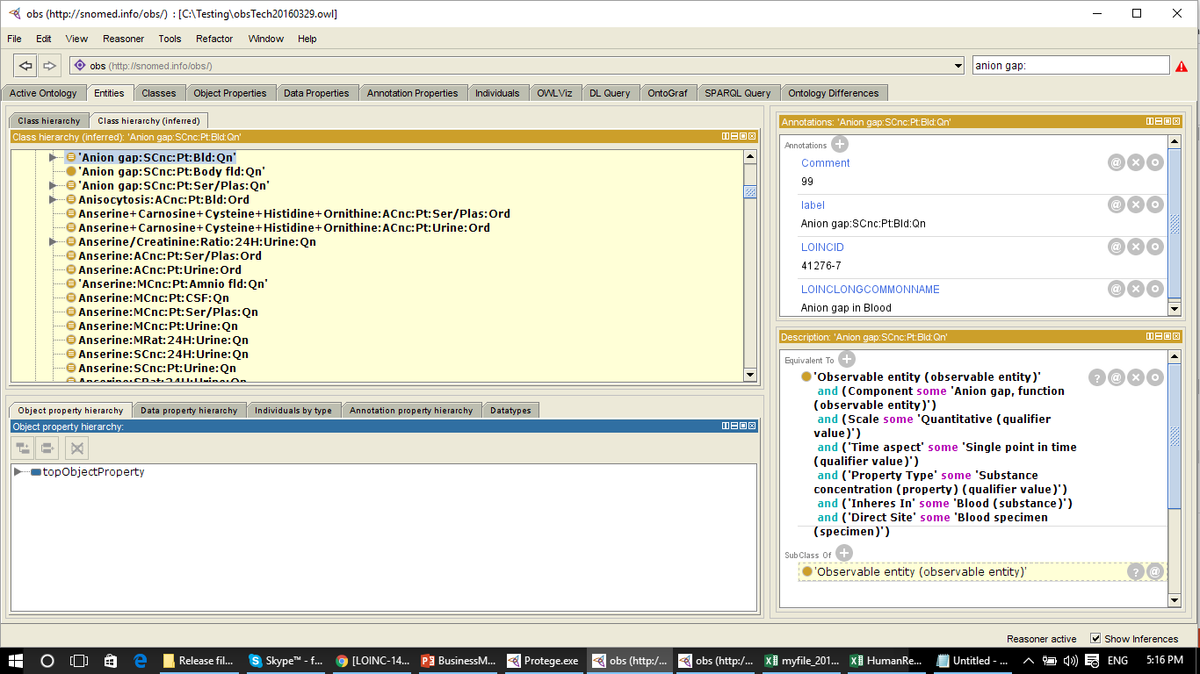

Slide 32
Mapping timed specimens
Where Property is rates (SRat, MRat, VRat, NRat, etc.):
  create a process observable, with no change in Time and Direct site values (stays the same as LPs)
Where Property is anything but rates (Mcnc, Scnc, Acnc, etc.) AND System = urine AND Time = 24 hrs, we create a quantity observable:
  Specimen = Change map from Urine → 276833005 24 hour urine sample (specimen)
  Time = Change 24hrs → 123029007 Single point in time (qualifier value)
  Inheres in stays the same
The question is if the same applicable to other systems? e.g. 24 hour dialysis - should it modelled as 24 hour urine is?

Slide 33
Other discussion items
Evaluation procedure
Orderables and Panels

