Slide 1
Adverse Drug Reactions and Hypersensitivity
Bruce Goldberg MD, PhD

Slide 2
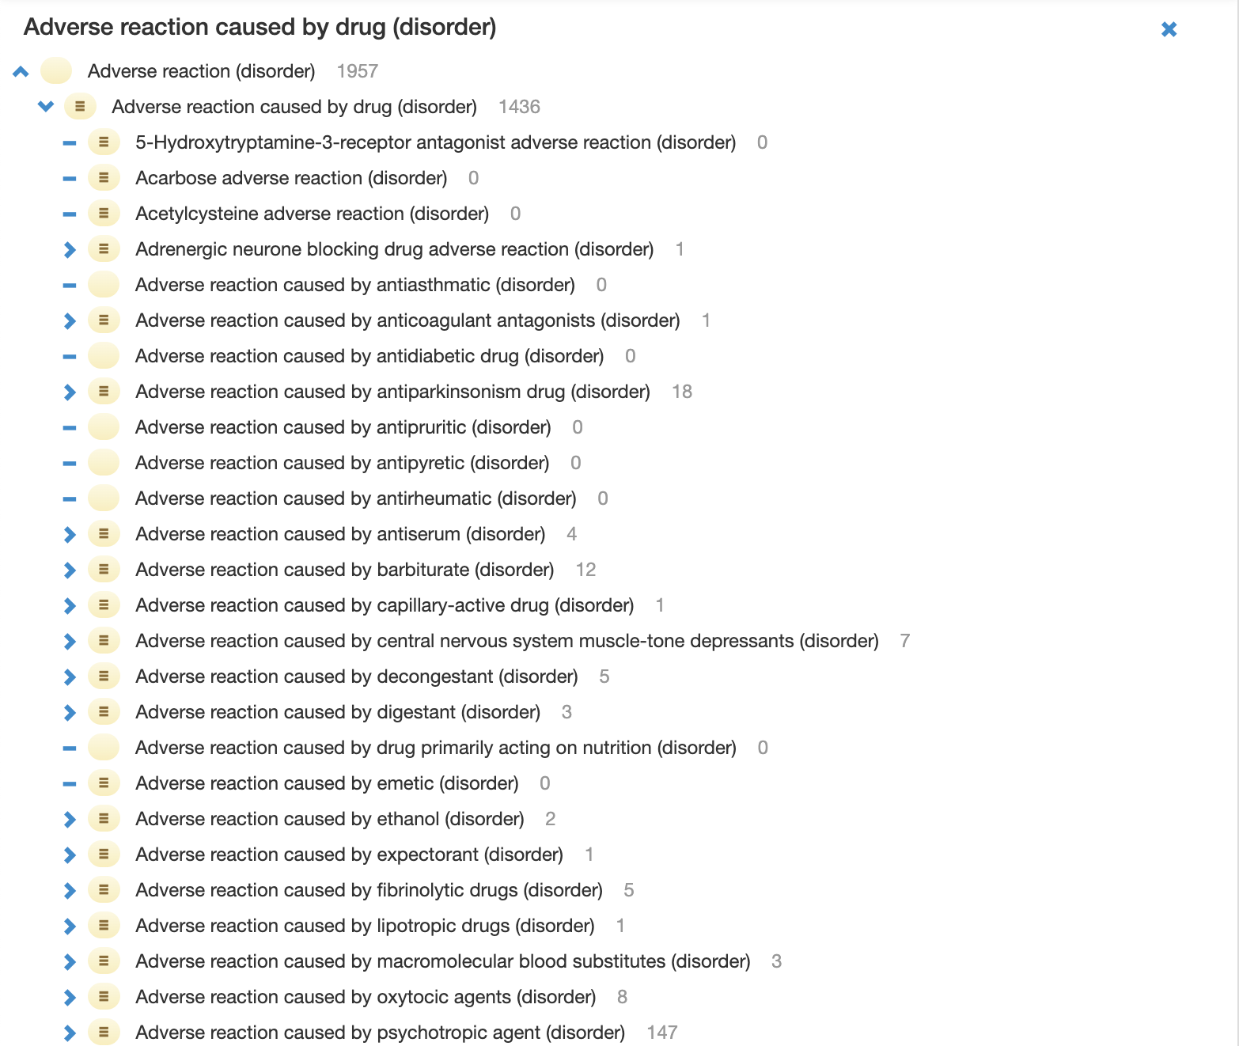
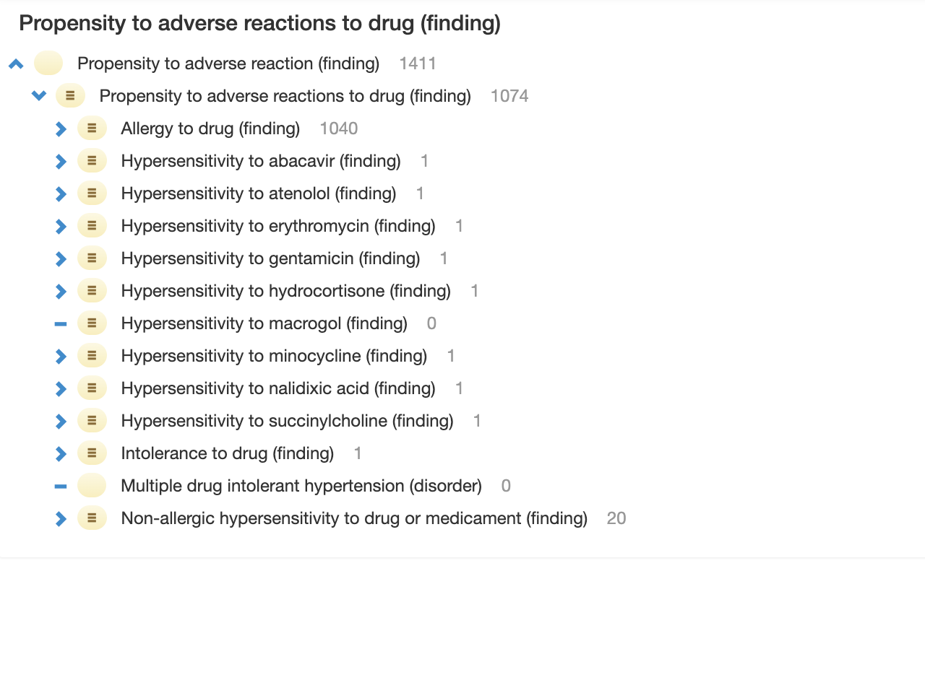
Adverse drug hierarchies in SNOMED CT

Slide 3
Classification of adverse drug reactions
Type A reactions
  Represent the majority of reactions, can affect any individual, and are predictable from the known pharmacologic properties of a drug.
    Examples
      Toxicity
      Side-effects
      Interactions with other drugs
Type B reactions (Hypersensitivity)
  Immune mediated
    Allergy
      Specific IgE (Type I)
      Types II-IV
    Other immunologic reactions
      Drug-induced autoimmunity
      Fixed drug eruptions
  Non-allergic reactions
    Pseudoallergy
    Intolerance
    Idiosyncrasy

Slide 4
Definitions
Adverse Reaction | An undesirable physiological effect resulting from exposure to a substance.
Allergic condition | The disposition to develop an allergic reaction, the allergic reaction itself or its consequences
Allergic disposition | The disposition to develop an allergic reaction
Allergic reaction | A pathological immune process generally directed towards a foreign antigen, which results in tissue injury, which is usually transient. It is the realization of the allergic disposition. It is most often applied to type I hypersensitivity but other hypersensitivity types especially type IV (e.g. allergic contact dermatitis) may be involved
Intolerance | Any undesirable effect of exposure to low or usual amounts of a substance. Specifically excludes allergy and nonallergic hypersensitivity
Drug intolerance | An undesirable pharmacologic effect that may occur at low or usual doses of the drug. Humoral or cellular immune mechanisms are not thought to be involved, and a scientific explanation for such exaggerated responses has not been established (eg, aspirin-induced tinnitus at low doses). Intolerance encompasses drug idiosyncrasy.
Drug idiosyncrasy | An abnormal and unexpected effect that is unrelated to the intended pharmacologic action of a drug and has an unknown mechanism. It is not mediated by a humoral or cellular immune response but is reproducible on readministration. It may be due to underlying abnormalities of metabolism, excretion, or bioavailability(eg,: quinidine-induced drug fever).

Slide 5
Immune mediated (hypersensitivity) drug reactions
Further classified by onset immediate vs. delayed
  Immediate (Immediate reactions are generally considered to occur within 1 hour but in some cases ≤6 hours of exposure to the drug).
    IgE mediated drug reactions
    720588004 |Non-immunoglobulin E-mediated drug sensitivity (disorder)|
    33845003 |Idiosyncratic drug effect (disorder)|
    59037007 |Intolerance to drug (finding)|
  Delayed (Delayed HSRs often evolve over days or, in some cases, weeks following exposure to the drug).
    702617007 |Acute generalized exanthematous pustulosis (disorder)|
    702809001 |Drug reaction with eosinophilia and systemic symptoms (disorder)|
    403609001 |Stevens-Johnson syndrome caused by drug (disorder)|
    403608009 |Serum sickness caused by drug (disorder)|

Slide 6
Drug hypersensitivity by immune hypersensitivity mechanism
Type I – Immediate in onset and mediated by IgE and mast cells and/or basophils.
Type II – Delayed in onset and caused by antibody (usually IgG) mediated cell destruction.
Type III – Delayed in onset and caused by IgG:drug immune complex deposition and complement activation.
Type IV – Delayed in onset and T cell mediated. Of note, this classification was established before a detailed analysis of T cell subsets and functions was technically possible. As new immunologic tools were developed, type IV reactions were further subdivided into types IVa, IVb, IVc, and IVd
  Type IVa
    Preferentially activate and recruit monocytes
  Type IVb
    Preferentially activate and recruit eosinophils
  Type IVd
    Preferentially activate and recruit neutrophils
  Type IVc
    Cytotoxic functions by either CD4+ or CD8+ T cells - participate in all type IV reactions.
Medications cause types I and IV reactions far more commonly than types II and III, which usually follow prolonged, higher dose therapy. Most medications cause just one type, although certain drugs, such as penicillin, can induce all four types.

Slide 7
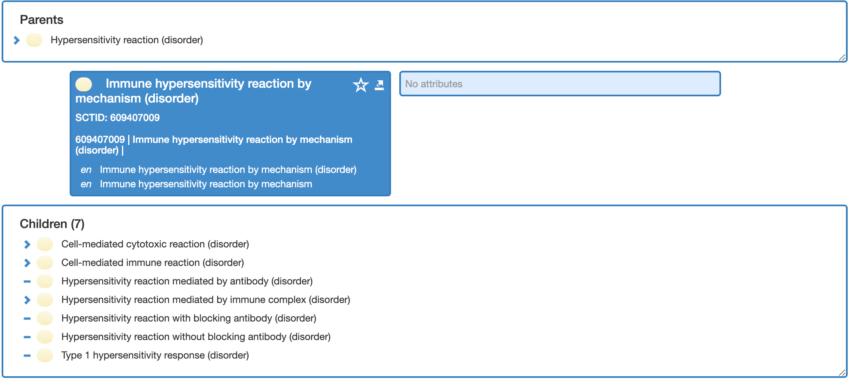
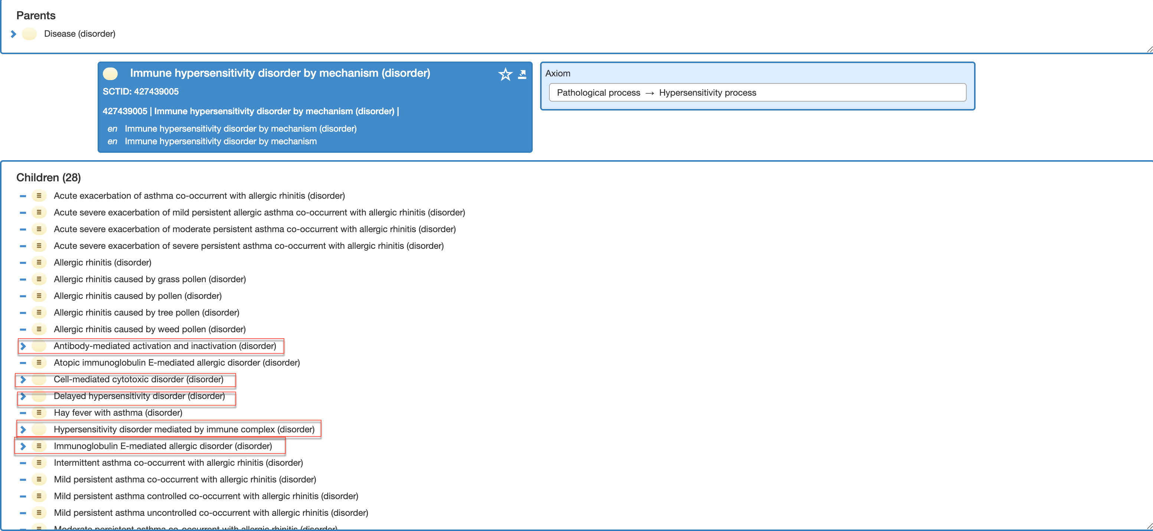
Immune hypersensitivity mechanisms (Gell and Coombs classification)

Slide 8
Pharmacologic interaction with immune receptors (p-i reactions)
Immune-mediated DHR is frequently due to binding of a drug to immune receptor proteins, such as HLA proteins and T cell receptors (TCR) thereby activating T-cells.
  Examples
    403609001 |Stevens-Johnson syndrome caused by drug (disorder)|
    702809001 |Drug reaction with eosinophilia and systemic symptoms (disorder)|
    426364002 |Allergic hepatitis (disorder)|
If the drug binds preferentially to a certain HLA-protein (eg, abacavir to HLA-B*57:01), then the reactions disproportionately or exclusively affect individuals with these alleles
  Other examples
    Carbamazepine allopurinol, dapsone, and flucloxacillin
    HLA testing of patients is recommended before administering abacavir and carbamazepine in populations in which there is a significant prevalence of the genotype.

Slide 9
Drug pseudoallergy (609398007 |Non-allergic hypersensitivity to drug or medicament (finding)|)
Pseudoallergic reactions resemble immunologic drug reactions but lack evidence of specific immune system involvement (drug-specific IgE, IgG, or specifically activated T cells)
The signs and symptoms of most pseudoallergic reactions are similar to IgE-mediated (immediate) allergic reactions, appearing rapidly and may involve urticaria, angioedema, or anaphylaxis due to mast cell degranulation.
May represent diverse mechanisms
  Complement Activation-Related Pseudo-Allergy (CARPA)
  Recently, drug binding to the Mas-related G protein-coupled receptor X2 (MRGPRX2) on mast cells has been found to be responsible for non-IgE–mediated reactions to neuromuscular blocking agents, fluoroquinolones and opiates
    Examples
Vancomycin | Morphine
Atracurium | Ciprofloxacin
Mivacurium | Levofloxacin
Cisatracurium | Moxifloxacin
Rocuronium

Slide 10
Organ-specific delayed drug reactions
There are also a number of organ-speciﬁc delayed drug reaction phenotypes (often without cutaneous manifestations) including drug-induced cytopenias, liver injury, interstitial nephritis, and vasculitis to name a few.

Slide 11
Side effects
Hormone replacement therapy side effects (finding)
Warfarin side effects (finding)
Cardiac drug side effects (finding)
Thyroid drug side effects (finding)
Diabetic drug side effects (finding)
Psychiatric drug side effects (finding)
Neurological drug side effects (finding)
Concepts to the left are all subtypes of specific disease monitoring status (e.g. 243860001 |Diabetic monitoring status (finding)|which are children of 243851009 |Chronic disease monitoring status (finding)|but not of 170563001 |Chronic disease - drug side effects (finding)|

Slide 12
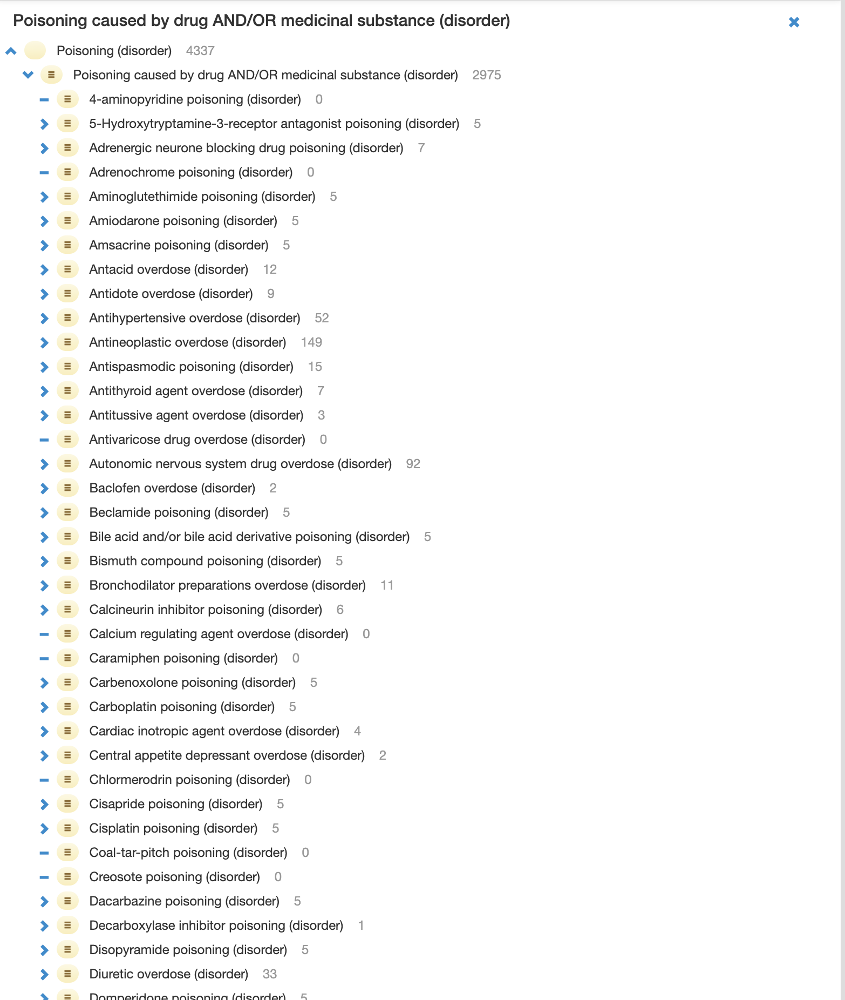
Drug Toxicity

Slide 13
Question from Farzaneh Ashrafi
Question: “I understand that you noted that 62014003 |Adverse reaction caused by drug (disorder)| sub-hierarchy (1436 concepts) would be the likely candidate for the proposed changes. I was wondering if the change will be applicable to 416098002 |Allergy to drug (finding)| (1040 concepts) as well?”
Answer:
  There are 1,040 descendants of 416098002 |Allergy to drug (finding)| but only 12 descendants of 416093006 |Allergic reaction caused by drug (disorder)|
  416098002 |Allergy to drug (finding)| will not be subsumed under 62014003 |Adverse reaction caused by drug (disorder)|
  62014003 |Adverse reaction caused by drug (disorder)|represents a process while 416098002 |Allergy to drug (finding)| represents a disposition (propensity). In order to relate these under a single hierarchy, a new class representing an adverse drug condition and modeled using GCIs would need to be created similar to the hypersensitivity/allergy models

Slide 14
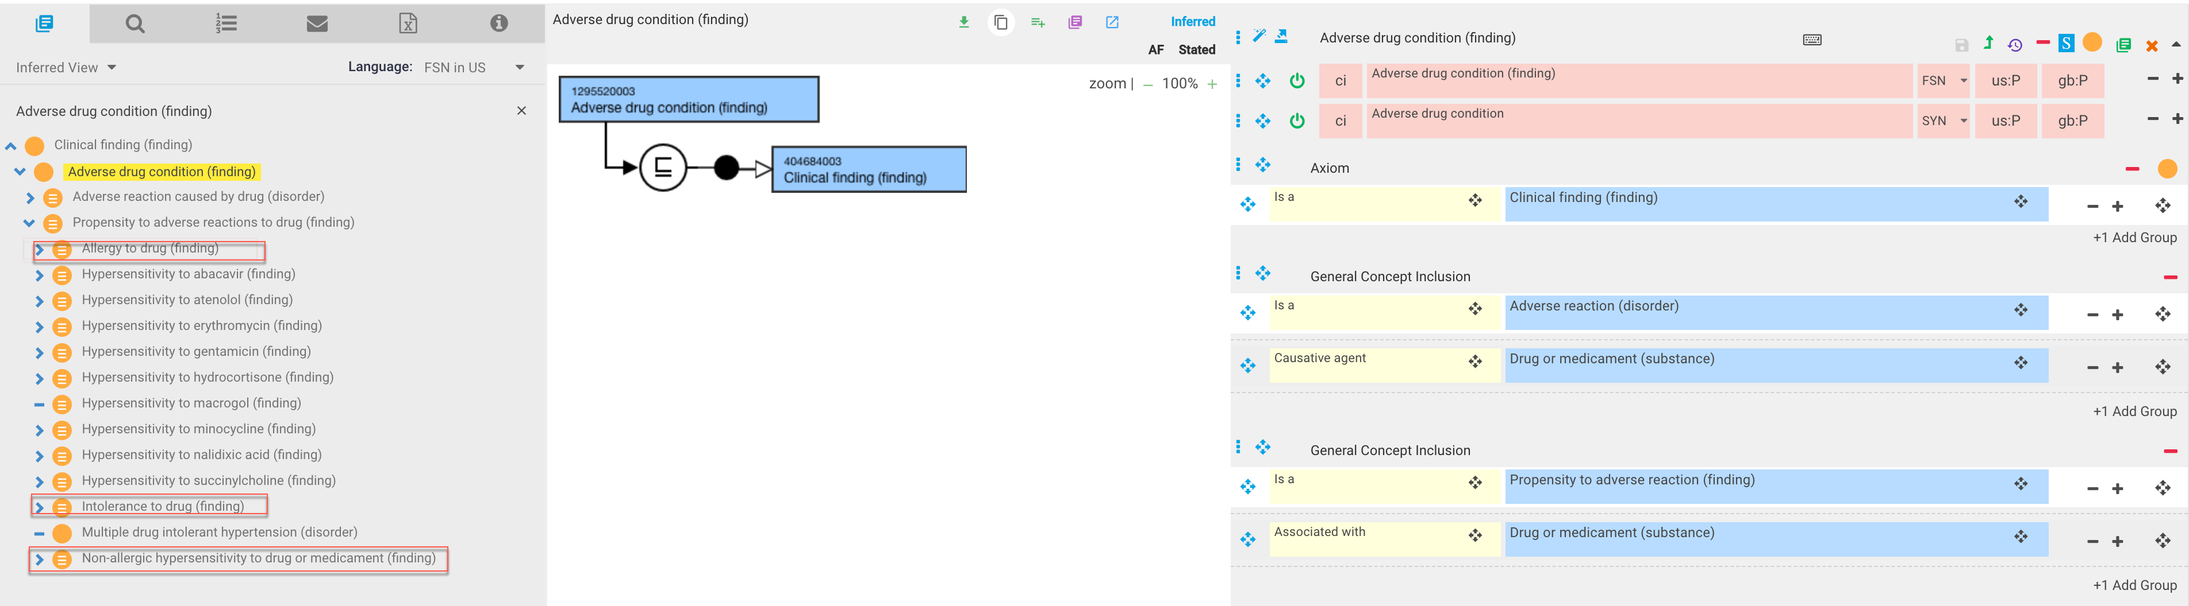
Proposed model for Adverse drug condition

Slide 15
Proposed hierarchy changes and additions
Adverse drug condition (finding)
  62014003 |Adverse reaction caused by drug (disorder)|
    Type A reaction caused by drug (disorder)
      7895008 |Poisoning caused by drug AND/OR medicinal substance (disorder)|
    Type B reaction to drug (disorder)
      Hypersensitivity reaction to drug (disorder)
        416093006 |Allergic reaction caused by drug (disorder)|
        241947002 |Non-allergic anaphylaxis caused by drug (disorder)|
        80258006 |Drug-induced lupus erythematosus (disorder)|
        400072006 |Fixed drug reaction (disorder)|
      33845003 |Idiosyncratic drug effect (disorder)|
    Adverse drug reaction characterized by onset (disorder)
      Immediate adverse drug reaction (disorder)
        IgE mediated drug reactions
        720588004 |Non-immunoglobulin E-mediated drug sensitivity (disorder)|
        33845003 |Idiosyncratic drug effect (disorder)|
        59037007 |Intolerance to drug (finding)|
      Delayed adverse drug reaction (disorder)
        702617007 |Acute generalized exanthematous pustulosis (disorder)|
        702809001 |Drug reaction with eosinophilia and systemic symptoms (disorder)|
        403609001 |Stevens-Johnson syndrome caused by drug (disorder)|
        403608009 |Serum sickness caused by drug (disorder)|
Adverse drug reaction due to pharmacologic interaction with immune receptors
  403609001 |Stevens-Johnson syndrome caused by drug (disorder)|
  702809001 |Drug reaction with eosinophilia and systemic symptoms (disorder)|
  426364002 |Allergic hepatitis (disorder)|
  Hypersensitivity reaction caused by abacavir associated with HLA-B*57:01genotype (disorder)
  Hypersensitivity reaction caused by allopurinol (disorder)
  Hypersensitivity reaction caused by dapsone (disorder)
  Hypersensitivity reaction caused by flucloxacillin (disorder)
  Stevens Johnson syndrome AND toxic epidermal necrolysis overlap caused by carbamazepine associated with HLA-B*57:01 (disorder)
419511003 |Propensity to adverse reactions to drug (finding)|
  416098002 |Allergy to drug (finding)|
  59037007 |Intolerance to drug (finding)|
  609398007 |Non-allergic hypersensitivity to drug or medicament (finding)|
    Non-allergic hypersensitivity associated with Mas-related G protein-coupled receptor X2 (finding)
      Non-allergic hypersensitivity to neuromuscular blocking agents (finding)
        Non-allergic hypersensitivity to Vancomycin (finding)
        Non-allergic hypersensitivity to Atracurium (finding)
        Non-allergic hypersensitivity to Mivacurium (finding)
        Non-allergic hypersensitivity to Cisatracurium (finding)
        Non-allergic hypersensitivity to Rocuronium (finding)
      Non-allergic hypersensitivity to opiates
        Non-allergic hypersensitivity to morphine
      Non-allergic hypersensitivity to fluoroquinolones
        Ciprofloxacin
        Levofloxacin
        Moxifloxacin
    Complement Activation-Related Pseudoallergy associated with liposomal agents (finding)

