Slide 1


Vaccination Care Set / Belgian FHIR resource
SNOMED on FHIR
15th of November 2022
Marie-Alexandra Lambot, MD
Adjunct to the Medical Direction, CHU St Pierre, Brussels
Community Support on Clinical Terminologies (CSCT) coordinator

Slide 2


The Be-SafeShare project
The Be-Safeshare (Belgian Coordination Authority for Secure Standardized Multidisciplinary Health Data Exchange) project, correspond to point 4.1 of the Belgian e-Health 3.0 roadmap “multidisciplinary electronic data exchange”. It is managed by the INAMI-RIZIV.
It requires the creation of information models called Care Sets:
  Functional logical models adapted to the needs of the Belgian healthcare providers
  Base for the creation of the corresponding Belgian HL7 FHIR profiles (HL7 is the data exchange standard adopted by the Belgian e-Health plan 2019-2021)
  National value sets in SNOMED CT, the international multilingual healthcare terminology chosen by the Belgian e-Health plan 2013-2018
  Creation based on effective use-cases from the field (Business rules workgroups)
Notes:
Anne

Slide 3
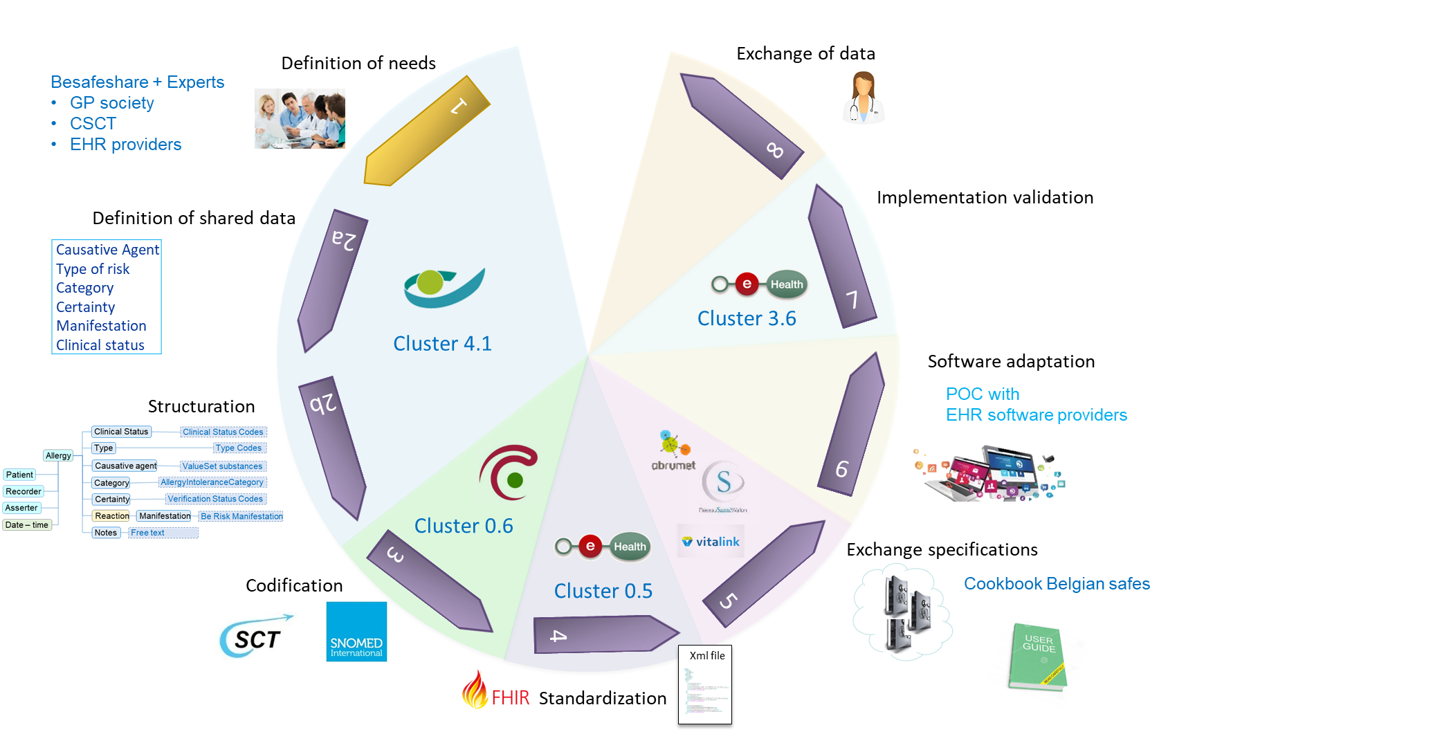
Care Set life cycle
Notes:
Anne

Slide 4
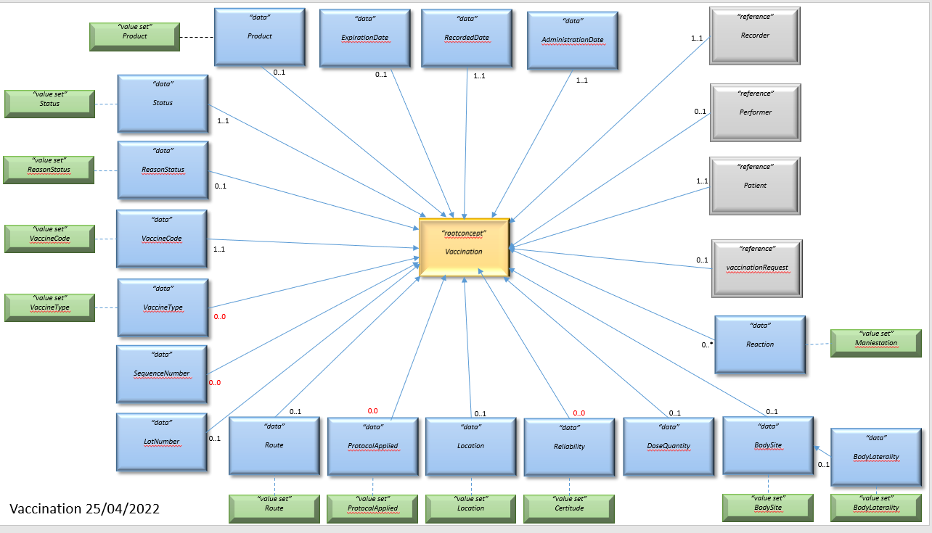
Vaccination logical model
https://simplifier.net/ehealthplatformfederalprofiles/bevaccination
Notes:
M-A

Slide 5
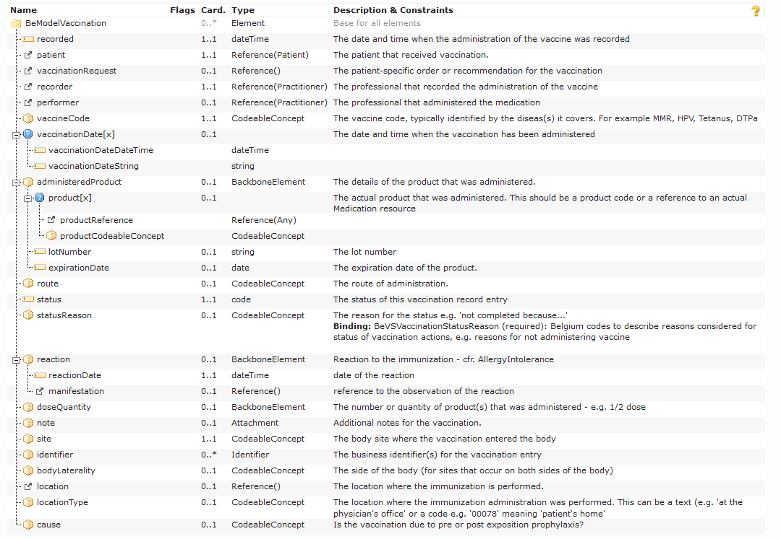



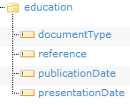
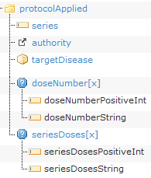

Vaccination FHIR resource
originalOrder
SNOMED CT
Regional competency...
AllergyIntolerance.reaction
confirmationStatus
SNOMED CT, equivalent to AllergyIntolerance verificationStatus
Notes:
M-A

Slide 6

Thanks for your attention
BE-Safeshare team
Anne Nerenhausen
Sarah François
contact: besafeshare@riziv-inami.fgov.be More info: https://besafeshare.be
Community for Support for Clinical Terminologies (CSCT)
Dr Lambot Marie-Alexandra, coordinator
Main site: https://csct.be Support: https://csct.be/helpdesk
contact: info@csct.be

