Slide 1
Editorial Advisory Group 20210901
Lateralization of procedures
Monica Harry

Slide 2
Problem - 2 statements in ed. guide:
“The name of the site should follow the name of the action “ ...
Anatomical site: https://confluence.ihtsdotools.org/display/WIPEG/Procedure+Naming+Conventions
An anatomical site is the direct object of the action. e.g. 175253007 |Repair of pulmonary artery (procedure)
action is repair, site is pulmonary artery.
Conflicts with guidance on Procedure modelling: https://confluence.ihtsdotools.org/display/WIPEG/Bilateral+procedures
The naming pattern is as follows:
FSN: X procedure of bilateral X (procedure)
PT: Bilateral X procedure
SYN: X procedure of both Xs
Other synonyms may be added if requested, e.g. left and right X
Notes:
Current guidance conflicting as we say:

Slide 3
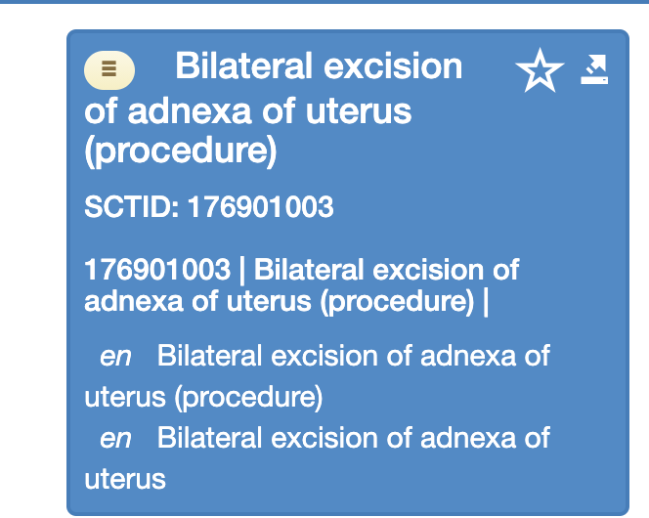
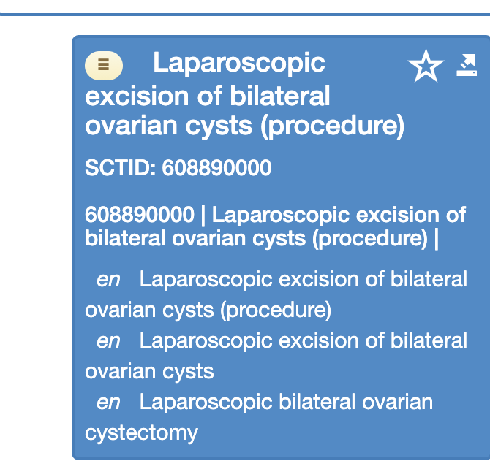
Procedure naming - 50/50 in browser between 2 patterns:

Slide 4
Either
For lateralizable procedures what is better choice:
FSN: [Method/action] of [lateralized] body structure
PT: [Method/action] of [lateralized] body structure
eg. Repair of bilateral cleft lip (existing)
OR
Bilateral repair of cleft lip
OR
FSN: [lateralized] body structure [Method/action]
PT: [lateralized] body structure [Method/action]
eg. Bilateral partial fallopian removal (existing)
OR
Removal of bilateral partial fallopian

Slide 5
Recommend
FSN: [Method/action] of [lateralized] body structure
PT: [Method/action] of [lateralized] body structure
FSN: Repair of bilateral cleft lip (existing)
PT: Repair of bilateral cleft lip
FSN: X procedure of bilateral X (procedure)
PT: Bilateral X procedure
PT: X procedure of bilateral X
Other synonyms may be added if requested, e.g. left and right X; both X

