Slide 1
Role of Advisory Groups
E-Learning Advisory Group meeting 2015-10-27
David Markwell
Head of Education

Slide 2
Role of Advisory Groups
Advisory Groups are established to conduct specific activities that contribute to the fulfillment of the Management Team's responsibilities or the organization's mandate
Advisory Groups will be considered to be agile in nature, given the changing needs and direction of the organization, and therefore each group will be reviewed on an annual basis to determine if the group is still required …
The role of each Advisory Group is to provide advice to the applicable Management Team member on specific areas that are included in the Terms of Reference to further the knowledge and direction of the organization

Slide 3
Scope of the E-Learning Advisory Group
The E-Learning Advisory Group supports the work plan of IHTSDO. Therefore its activities will reflect the current priorities and objectives identified in that plan.
The scope of the E-Learning Advisory Group includes advising on, supporting, encouraging …
  development of IHTSDO E-Learning products and services to address the needs of IHTSDO Members and other stakeholders
  effective approaches to sharing of IHTSDO E-Learning resources with and between IHTSDO Members, in particular, enabling Members to reuse and translate IHTSDO E-Learning resources
  Member educational priorities, such as the need to train key groups to facilitate national initiatives
Sharing information between IHTSDO, its Members and other stakeholders about relevant educational materials and activities at national and regional levels

Slide 4
Scope of the E-Learning Advisory Group
Not in scope
  Tooling or services used for E-Learning development and delivery
  Matters relating to progress, assessment and outcomes of individual students

Slide 5

Questions and Discussion
Contact: info@ihtsdo.org
Website: www.ihtsdo.org

Slide 6
E-Learning Status Report
E-Learning Advisory Group meeting 2015-10-27
David Markwell
Head of Education

Slide 7
Education KPIs 2015 Q3 (slide 1 of 3)
Presentations available at end of reporting period Public accessible presentations Course-specific presentations | Q2 5 38 | Q3 5 48
Assessments available at end of reporting period Public accessible assessments Course-specific assessments | 1 4 | 1 7
E-Learning development and delivery during reporting period Presentations developed Assessments developed Interactive webinars delivered as part of E-Learning courses | 20 4 8 | 10 3 24
Usage of public E-learning materials during reporting period Public accessible presentation views Public accessible assessments taken Average mark for assessment taken | 143 243 48% | 2153 133 68%

Slide 8
Education KPIs 2015 Q3 (slide 2 of 3)
Course enrollment and completion during reporting period Students starting Foundation Course Students currently taking Foundation Course Students successfully completing Foundation Course Drop out/did not successfully complete Foundation Course Students starting Implementation Course Students currently taking Implementation Course Students successfully completing Implementation Course Drop out or did not successfully complete Implementation Course | Q2 521 522 275 99 0 0 0 0 | Q3 622 905 186 53 51 49 0 2
Course demand in this reporting period New Foundation Course applicants New Implementation Course applicants | 890 112 | 365 132
Unmet course demand at end of reporting period – Students applying for… Foundation Course with confirmed place allocated in next 6 months Foundation Course without a confirmed place in next six months Implementation Course with confirmed place allocated in next 6 months Implementation Course without a confirmed place in next 6 months | 700 0 112 0 | 365 0 162 2

Slide 9
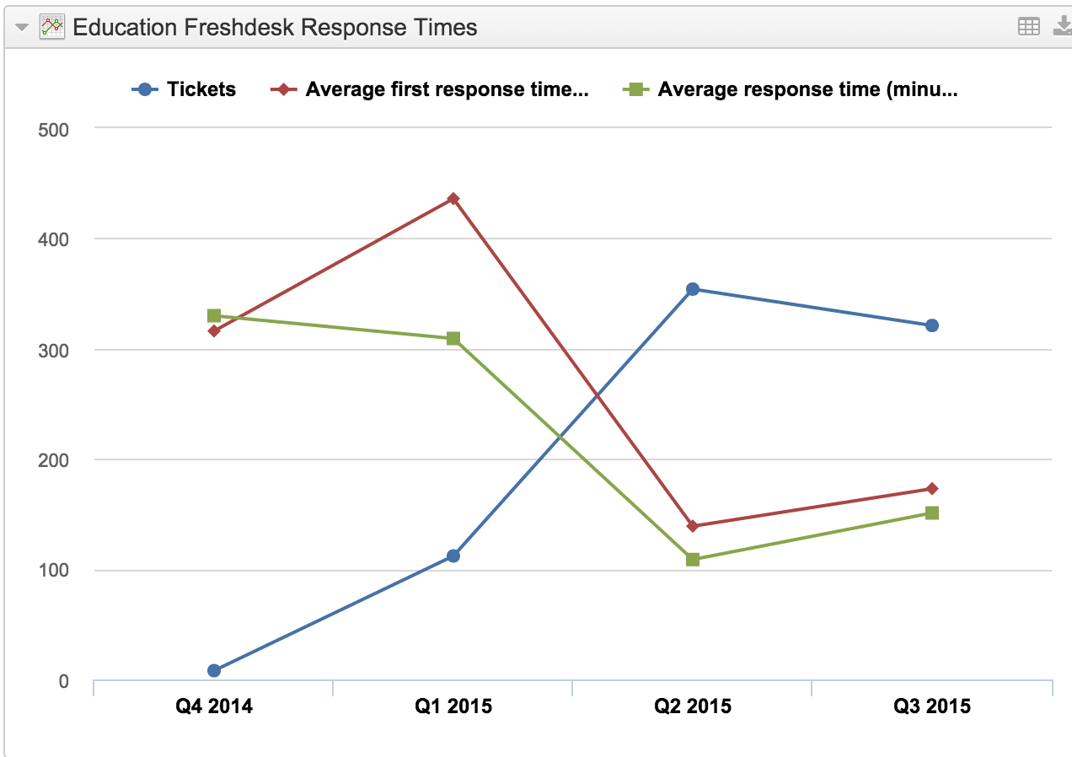
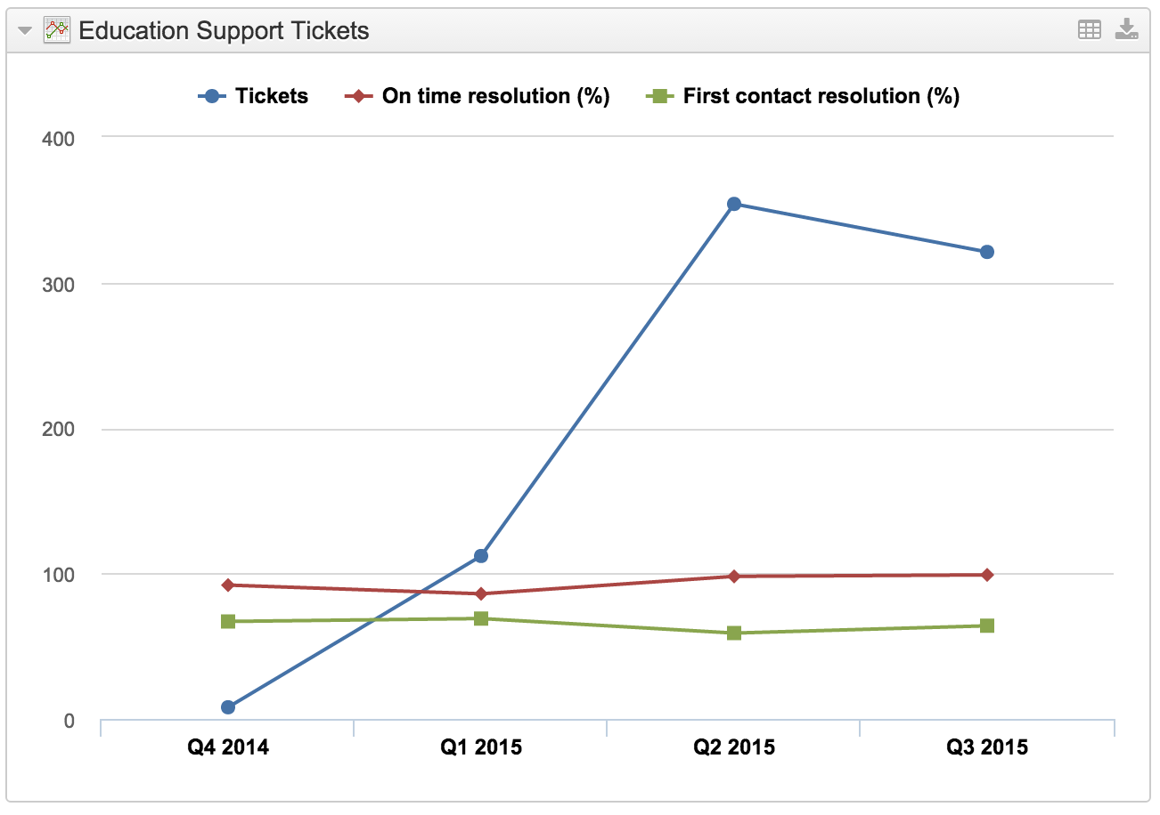
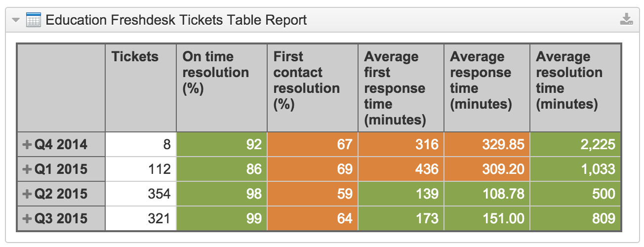
Education KPIs 2015 Q3 (slide 3 of 3)
Helpdesk tickets and response times and resolution rates

Slide 10
Education – 2015 Q3 Achievements
Foundation course
  186 people successfully completed course in Q3
    Cumulative completions for year so far: 461
  522 people entered course in Q2
    Cumulative intake for year so far: 1,518
  Now running on demand
    Start within 3 to 8 weeks of application
    Self-paced within 4 month timeframe
Implementation course
  49 people start course July 6th (6 now delayed)
    108 will start in October
    60+ will start in January
  24 interactive webinars delivered
    will double to 16 per month from October
  Development delayed slightly
    So far only 10 day delay to pilot group progress

Slide 11
Education – 2015 Q4 Key Objectives
Foundation course
  Revision of course based on feedback
  Regular monthly intakes – to match demand
  Intakes from July and September complete course
Implementation Course
  Development of course materials complete
  Pilot intake completion (most likely to complete early January)
  Second intake starts (108)
  Applications remain open for more people to join course
Content Development Theory course
  Initial ‘pilot’ intake ready to start in January

Slide 12
Questions and Discussion
Contact: info@ihtsdo.org
Website: www.ihtsdo.org

Slide 13
E-Learning Advisory Group Work Plan Development
E-Learning Advisory Group meeting 2015-10-27
David Markwell
Head of Education

Slide 14
I&E 2016 Work Items or Sub-items
Relevant to ELAG
E-Learning Service Delivery
  Sub-item: Support for national experts engaged in delivery of webinar and interactive course support in member countries
E-Learning Course Maintenance and Sharing
  Sub-item: Updating training materials based on feedback
  Sub-item: Facilitating sharing of materials with Members
  Sub-item: Facilitating Member translation of materials
E-Learning Course Development
  Advice on approaches to development of additional E-Learning materials and repackaging existing materials to meet different requirements
    Note: This is constrained to meet priorities identified by MF for 2016 (see next slide)
Documentation updates
  Advice on proposals for update and reorganization of documentation to align with E-Learning modules and presentations

Slide 15
I&E 2016 Priorities for Work Items
Relevant to ELAG
E-Learning Course - Specific development priority
  Develop education materials to support information analysts accustomed to processing data with ICD-10 type coding scheme, so that they understand how to analyze data coded in SNOMED CT
Other identified priorities which may be relevant when considering course modularization
  Publication of guidance of refset management
  Development of guidance on use of SNOMED CT in decision support
  Support for SIG-led development of implementation guidance on cancer

Slide 16
Questions and Discussion
Contact: info@ihtsdo.org
Website: www.ihtsdo.org

Slide 17
E-Learning Advisory Group
Next Steps for E-Learning – Discussion Topic
E-Learning Advisory Group meeting 2015-10-27
David Markwell
Head of Education

Slide 18
Next Phase of E-Learning Development
Current work reaches “steady state” – What next?
By end of 2015
  Foundation course – in place and running (steady state)
    Will need maintenance updates based on feedback
    Requires routine support (admin and responses to questions)
  Implementation course – piloted, second intake half-way with third intake starting in late January (potential steady state)
    Will need maintenance updates based on feedback
    Requires routine support (admin and responses to questions)
    Requires roughly 50 hours of webinars per month to support two overlapping intakes of 100 people
  Content Development Theory course – ready to start pilot
    Pilot commitment and then follow on webinars and maintenance
    By mid 2016 should reach steady state

Slide 19
Next Phase of E-Learning Development
Some of the possible options for focused action
Additional developments
  More courses?
  Repackaging?
  Add-on modules?
  One off additional presentations?
Other ideas to consider
  More open access presentations?
  Course material access without assessments and completion certificates?
  Facilitating Members to translate course materials?
  Assisting Members to co-support webinar delivery allowing increases in course capacity?
  Documentation restructuring to match courses more closely?

Slide 20
Next Phase of E-Learning Development
Some of the possible options for focused action
More courses?
  It is unlikely to be realistic to create any completely new course from scratch in 2016
Add-on modules?
  Small packages of 3 or 4 presentations adding coverage of a specific area
Repackaging as customized courses?
  Meeting different needs by different mixes of existing modules
    E.g. Less technical implementation perspective
  Repackaging could be fixed course or courses with optional modules to choose between
One off additional presentations?

Slide 21
Questions and Discussion
Contact: info@ihtsdo.org
Website: www.ihtsdo.org

