Slide 1
Anaphylaxis severity grades

Slide 2
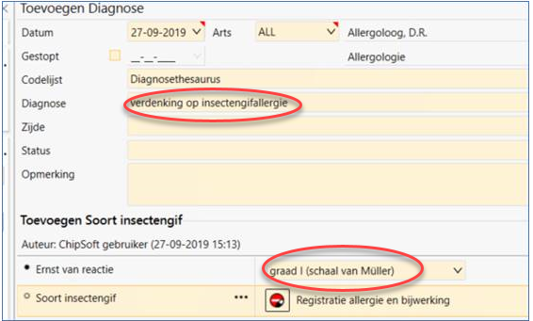
Request from the Netherlands to add grading system for severity of anaphylaxis (Mueller) to SNOMED CT

Slide 3
Mueller grading system for anaphylaxis
grade I systemic reaction is characterised by generalised urticaria or erythema, itching, malaise or anxiety
grade II reactions may include symptoms associated with grade I reactions as well as generalised oedema, tightness in the chest, wheezing, abdominal pain, nausea and vomiting, and dizziness
grade III reactions may include symptoms associated with grade I or II reactions as well as symptoms of dyspnoea, dysarthria, hoarseness, weakness, confusion, and a feeling of impending doom
grade IV reactions may include symptoms associated with grade I, II or III reactions as well as loss of consciousness, incontinence of urine or faeces, or cyanosis

Slide 4
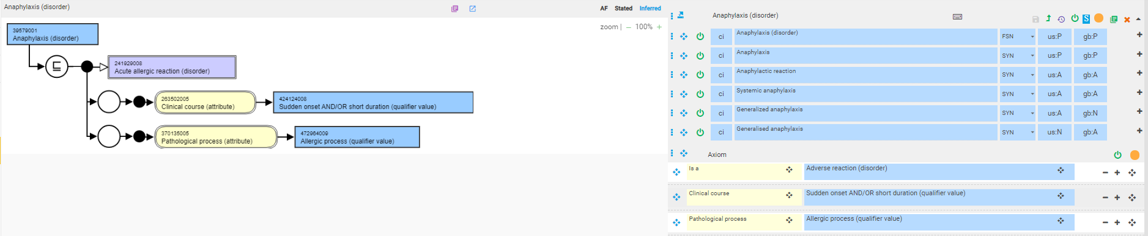
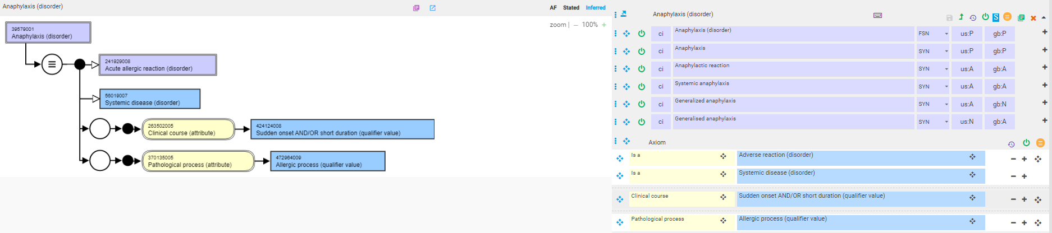
39579001 |Anaphylaxis (disorder)|
Current model
Proposed model
Add

Slide 5
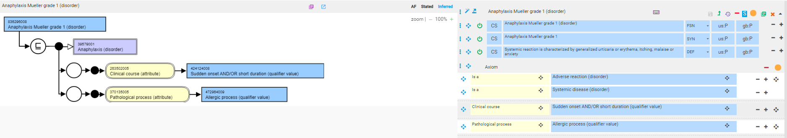
836296008 |Anaphylaxis Mueller grade 1 (disorder)|

Slide 6
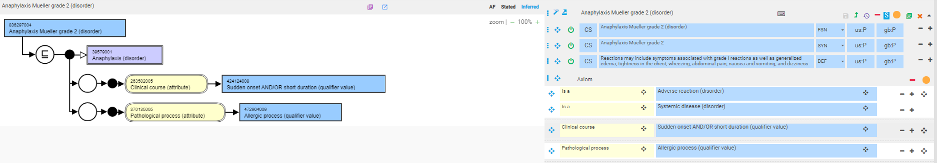
836297004 |Anaphylaxis Mueller grade 2 (disorder)|

Slide 7
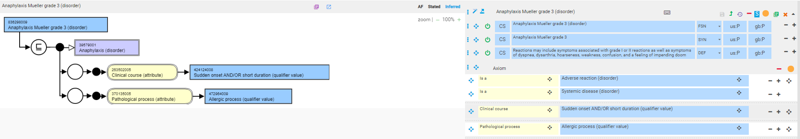
836298009 |Anaphylaxis Mueller grade 3 (disorder)|

Slide 8

836299001 |Anaphylaxis Mueller grade 4 (disorder)|

