Slide 1

Alpha-gal allergy

Slide 2
Types of alpha-gal allergy
Alpha-gal (galactose-alpha-1,3 galactose) is an oligosaccharide found in non-primate mammalian muscle, porcine kidney, the antineoplastic agent, cetuximab and other biologicals derived from mammalian systems
Allergy implicated in the following scenarios:
  Delayed allergic reactions including anaphylaxis 3-6 hours after eating red meat. Caused by bite of the lone star tick in the U.S. Found throughout the world in relation to bite from other tick species
  Immediate allergic reactions to cetuximab experienced on first exposure
  Immediate allergic reactions to pork kidney

Slide 3
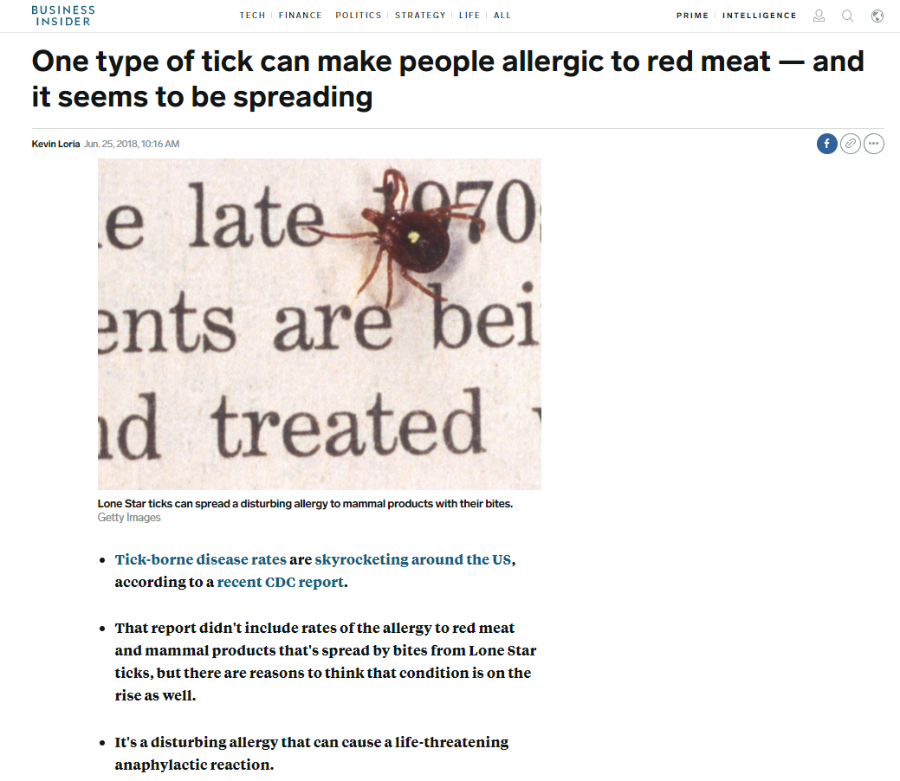

Alpha-gal and red meat allergy

Slide 4
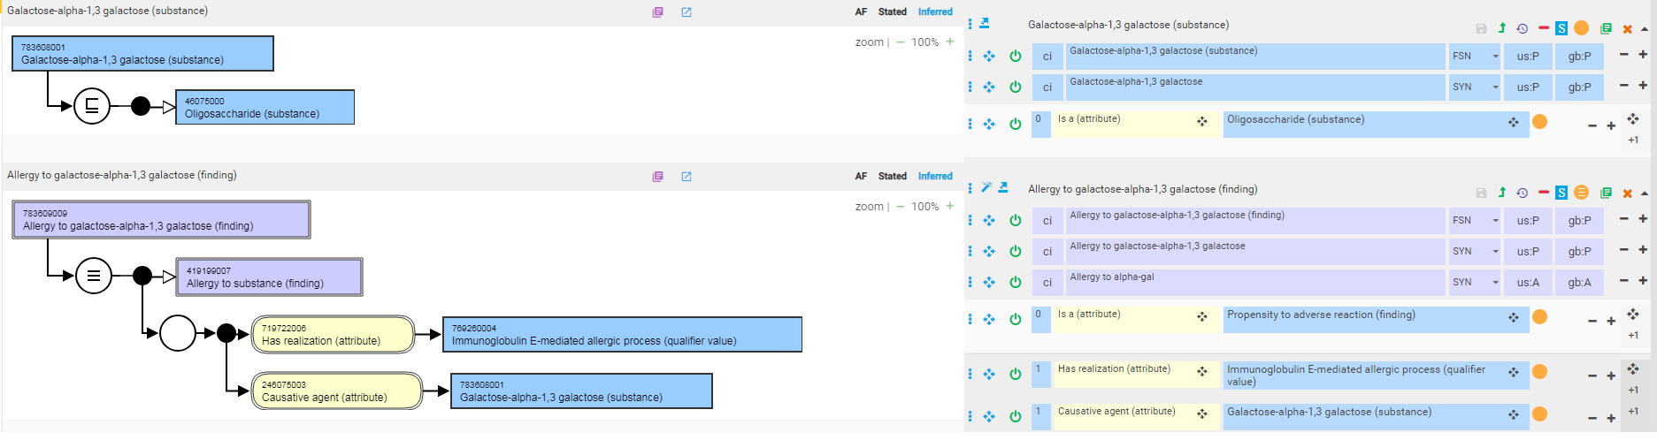
Allergy to galactose-alpha-1,3 galactose (finding)

Slide 5
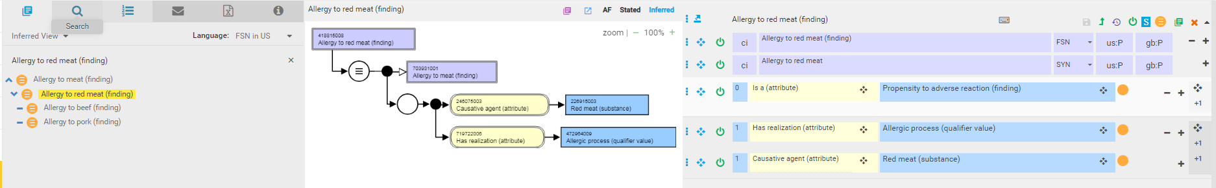
Allergy to red meat (finding)
Allergy to red meat may be related to allergens other than alpha-gal (e.g. allergy to beef may be due to bovine serum albumin)
Distinguishing features of red meat allergy related to alpha-gal are delayed onset and tick bite trigger

Slide 6
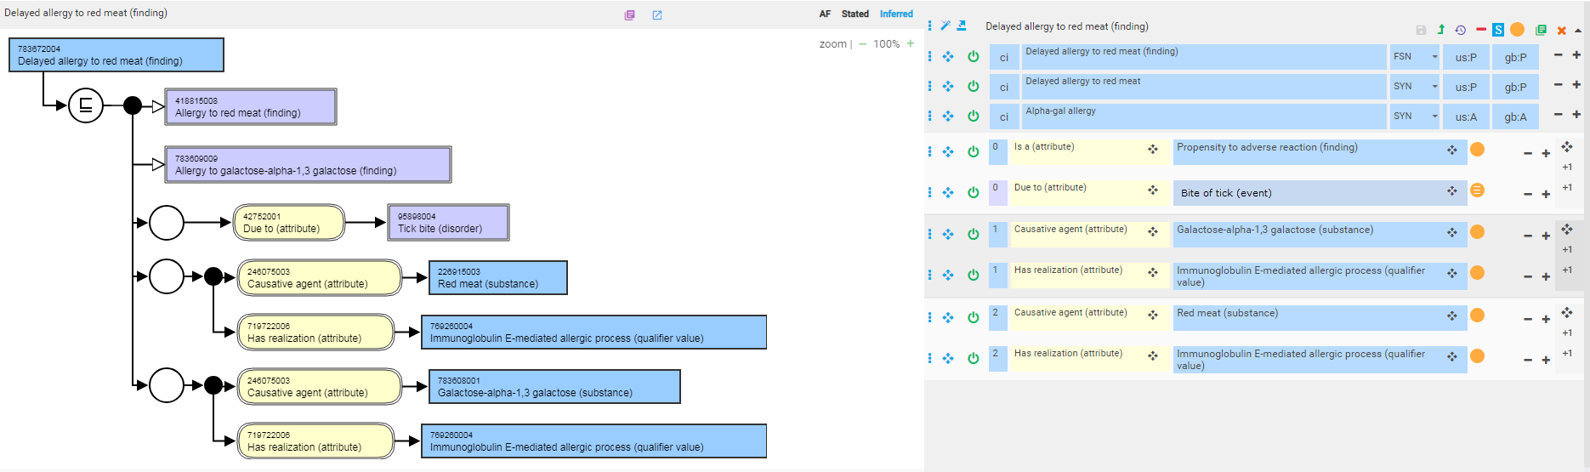
Delayed allergy to red meat (finding)

Slide 7
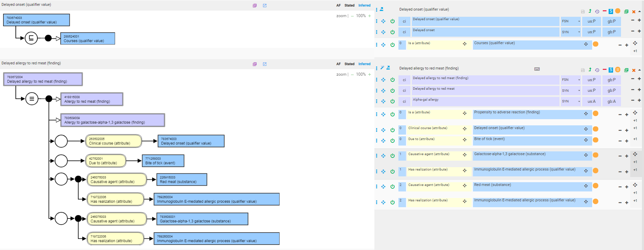
Delayed allergy to red meat (finding) – fully defined with revised mode

Slide 8
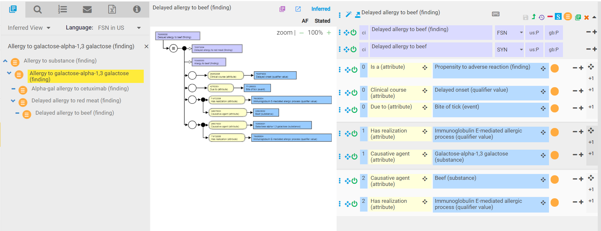
Delayed allergy to beef (finding)

Slide 9
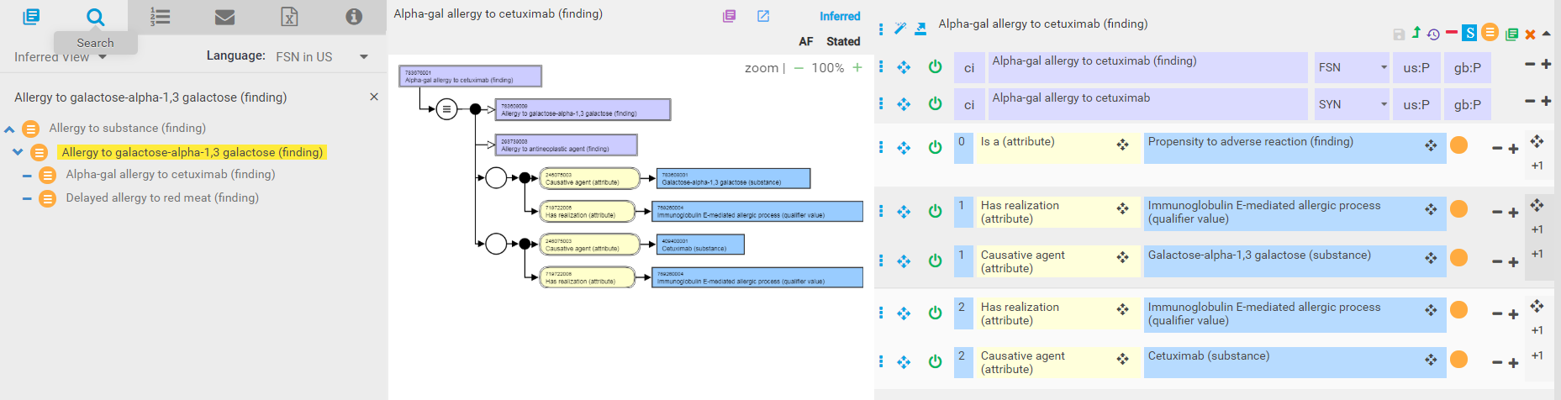
Alpha-gal allergy to cetuximab

