Slide 1
Allergy to animals

Slide 2
Allergy to living organisms
Allergies are the result of a specific pathological immune process (potentially representing >1 mechanism) caused by a substance
Allergy to living organisms (plants, animals, microorganisms) are due to substances derived from the organism and not the organism itself
Allergenic substances are usually proteins and peptides.
  Small molecules that bind to protein carriers (haptens) can be allergens e.g. penicillin
  Carbohydrates can be allergens e.g. galactose α 1-3 galactose
The allergen content of an organism is usually composed of several distinct proteins
  Dog allergens – Can f 1, Can f 2, Can f 3, Can f 4, Can f 5, Can f 6,

Slide 3
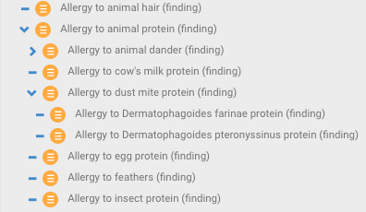
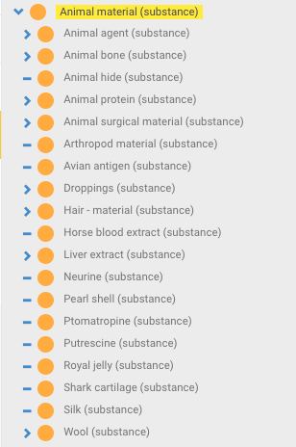
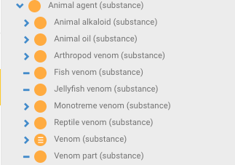
Representation of animal allergy and animal substances in SNOMED CT

Slide 4
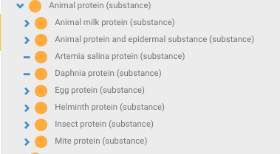
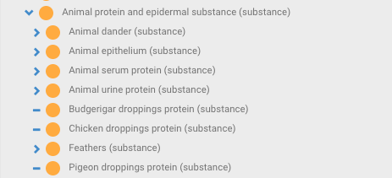
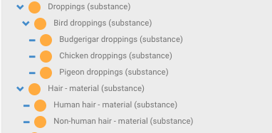
Animal proteins

Slide 5
Dander, epithelium, hair, feathers - 1
Epithelium represented in SNOMED CT as substances (for animals) and as a body structure
  31610004 |Epithelium (body structure)|
  256406004 |Animal epithelium (substance)|
Same with hair
  386045008 |Hair structure (body structure)|
  276310004 |Non-human hair - material (substance)|
Dander and feathers are represented in SNOMED CT as substances
  264287008 |Animal dander (substance)|
  256435007 |Feathers (substance)|

Slide 6
Dander, epithelium, hair, feathers - 2
Should we represent dander, epithelium, feathers, hair as both body structures and substances derived from those structures?
Dander, epithelium, feathers, hair are not allergens.
Allergens may be proteins either produced by the above structures or transferred to those structures from other sites such as saliva
In terms of allergy content, unless otherwise specified, all animal danders, epithelia, hair, feathers, droppings should contain “protein” in the FSN
  This is a little tricky for allergens which are fully or partially transferred from other sites
    Fel d1, the major allergen of cats may be transferred from cat saliva although most is produced by the epithelial cells and dispersed by the dander
Mechanism for associating organisms with body structures and substances needs to be developed

Slide 7
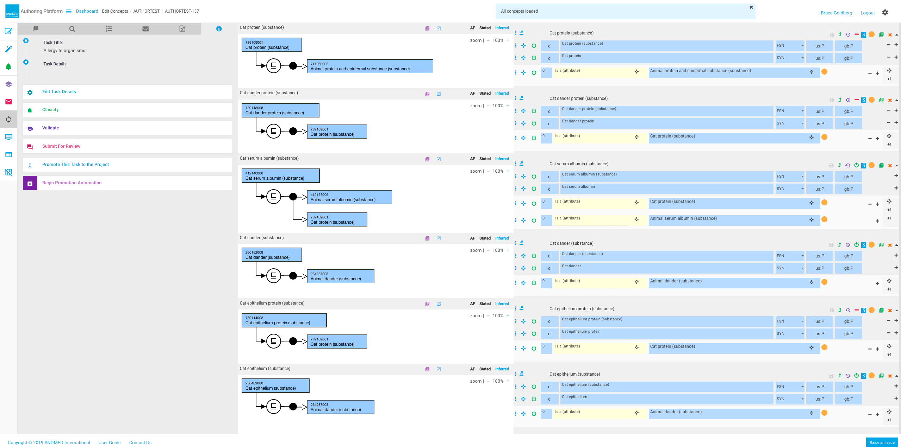
Example – Cat protein

Slide 8
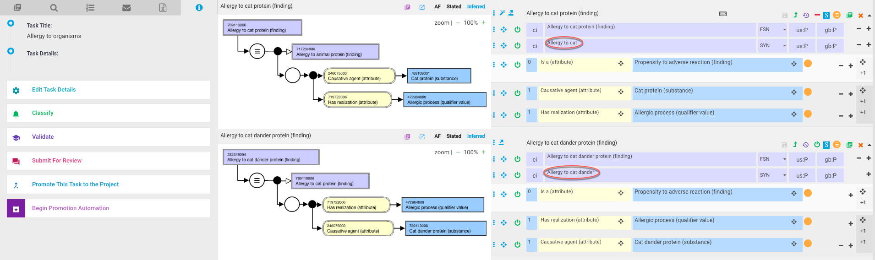
Allergy to cat

Slide 9
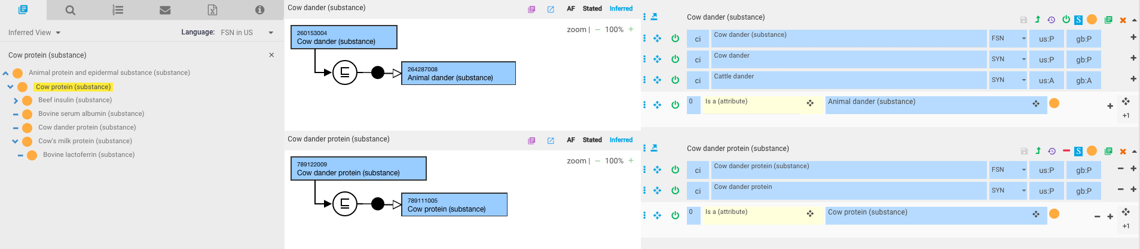
Example – Cow protein

Slide 10
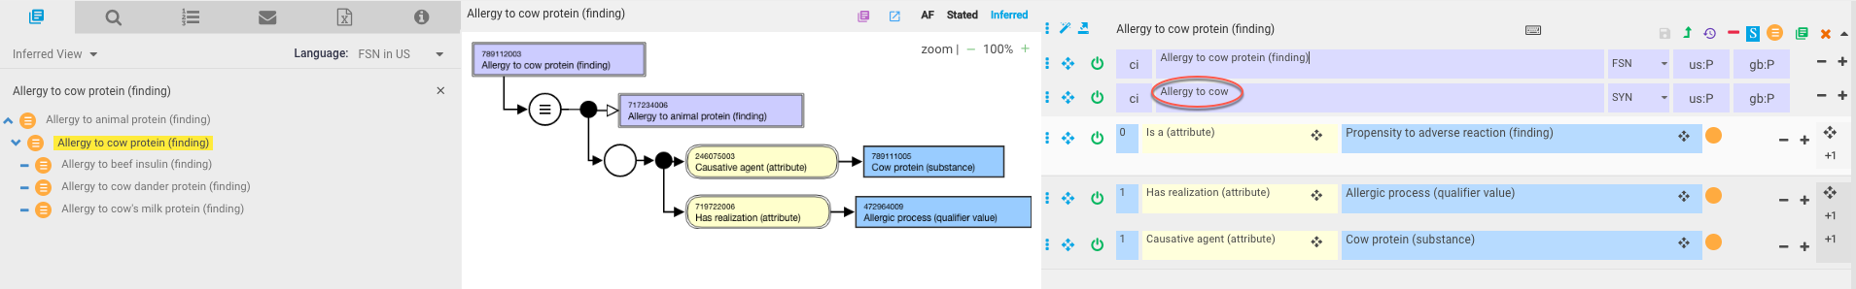
Allergy to cow

