Slide 1
Allergy to animals
Follow-up

Slide 2
Summary
There are several concepts in SNOMED of the type Allergy to animal x dander (finding) but none of just Allergy to animal x (finding).
Animal dander is not an allergen but rather a structure on which allergenic proteins may adhere.
Allergy to animal x dander concepts are not clinically useful as avoidance would be focused on the animal itself rather than a part of the animal and most would not recognize a specific source from which the actual allergen is derived.
In addition, the same allergenic protein may be found in several different sources.
The group would like the CMAG to consider a request to inactivate Allergy to animal x dander (finding) concepts and replace with new Animal protein x (substance) and Allergy to animal x (finding concepts) with the following model:
  FSN=Allergy to animal x protein (finding)
  PT=Allergy to animal x
  === 420134006 |Propensity to adverse reaction (finding)|: { 719722006 |Has realization (attribute)| = 472964009 |Allergic process (qualifier value)|, 246075003 |Causative agent (attribute)| = |Animal protein x (substance)| }

Slide 3
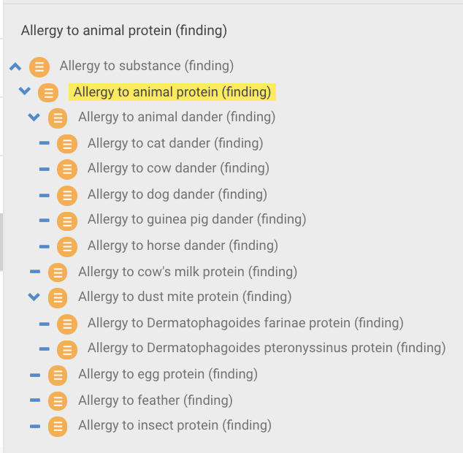
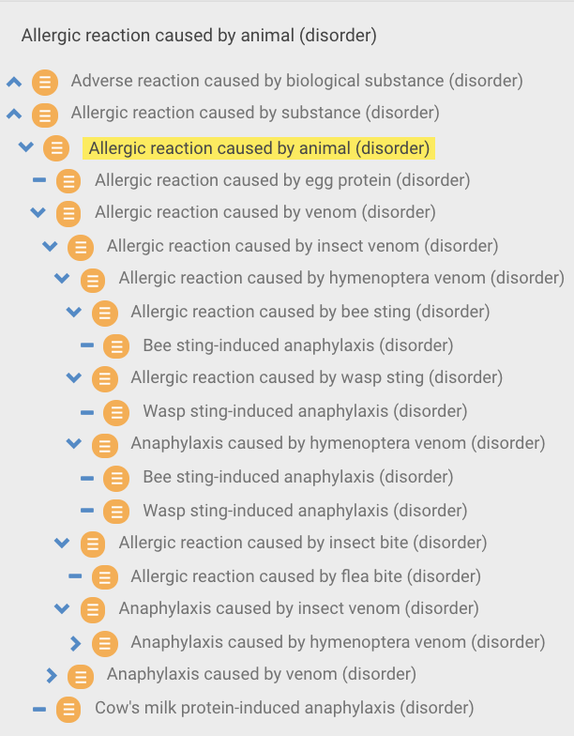
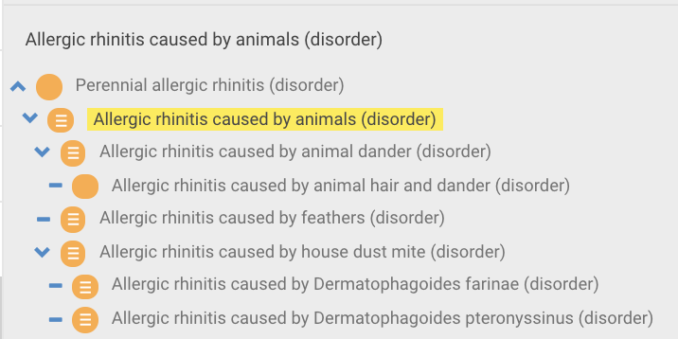

Hierarchies representing Animal allergies

Slide 4
Proposal
Inactivate allergy to animal dander and hair concepts and point to newly created allergy (dispositions/disorders and reactions) to X animal protein concepts
  FSN=
    Allergy to animal x¹ protein (finding)
    Allergic reaction caused by animal x¹ protein (disorder)
    Allergic disorder (e.g. rhinitis) caused by animal x¹ protein (disorder)
  PT=
    Allergy to animal x²
    Allergic reaction caused by animal x²
    Allergic disorder (e.g. rhinitis) caused by animal x²
    ¹Latin name
    ²Common name

Slide 5
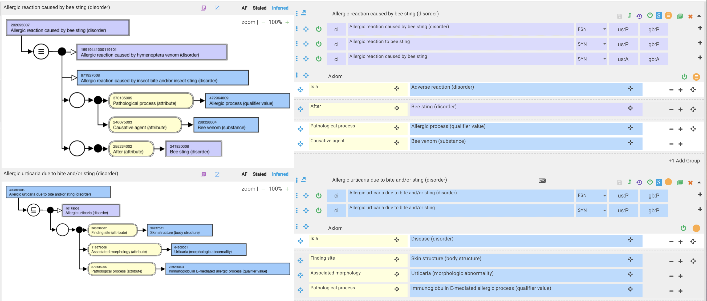
Allergic reactions/diseases due to insect stings

Slide 6
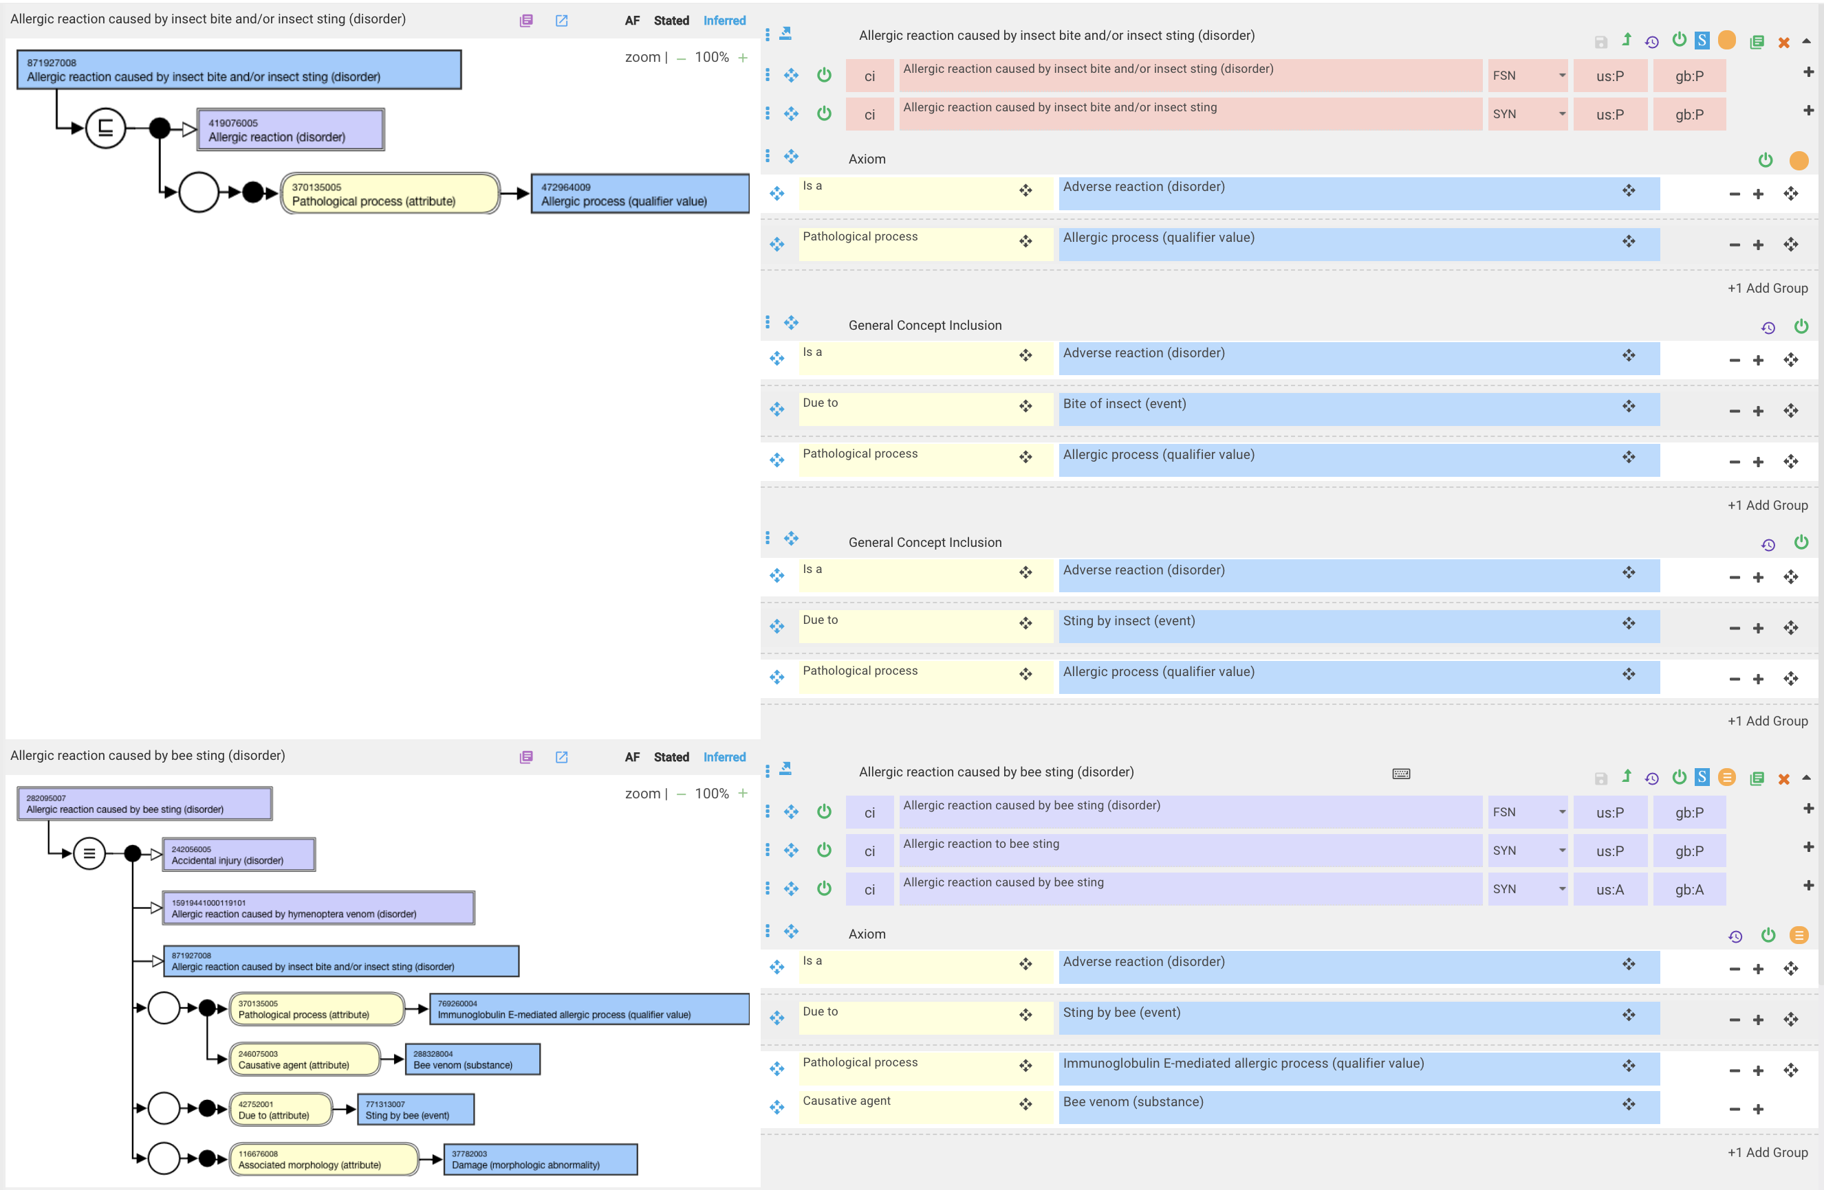
Allergic reactions/diseases due to insect bite/stings – revised models

Slide 7
Allergy to non-epithelial (hair, dander)-derived animal constituents
Animal derived foods – milk, egg, meat
Feathers
Serum and urine proteins
Droppings

Slide 8
Existing content in SNOMED
Allergy to edible animals
  Allergy to egg protein
  Allergic reaction caused by egg protein
  Cow’s milk protein-induced anaphylaxis
  Allergy to food
Allergic reaction caused by insects
  Dust mites
  Stings
  Bites
  Venom
Allergy to animal hair
Allergic rhinitis
  Dander
  Hair and dander
  Dust mites
  Feathers
Allergic urticaria
  Bite and/or sting
  Ingested food
  Food-induced angioedema-urticaria

Slide 9
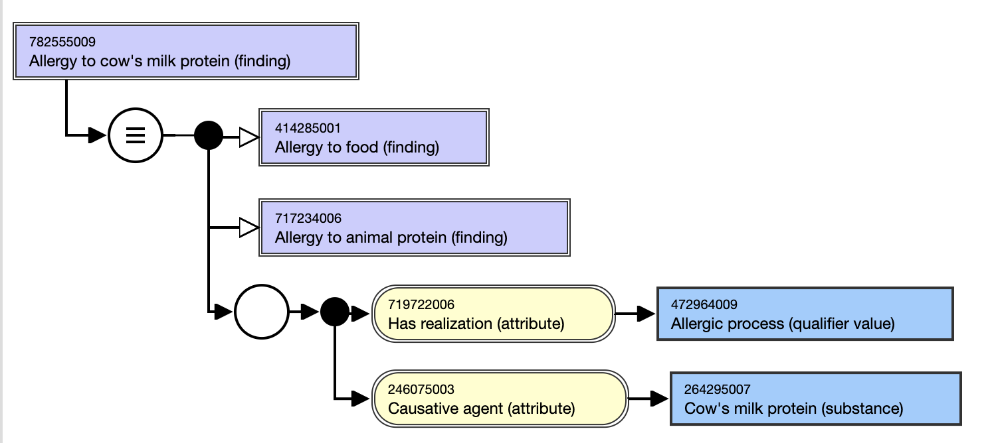
What is the relationship between allergy to dander, meat and milk?
One allergenic protein, BSA is found in milk, beef and dander and IgE antibodies to BSA react with dander, meat and milk not only from cows but other animals as well

Slide 10
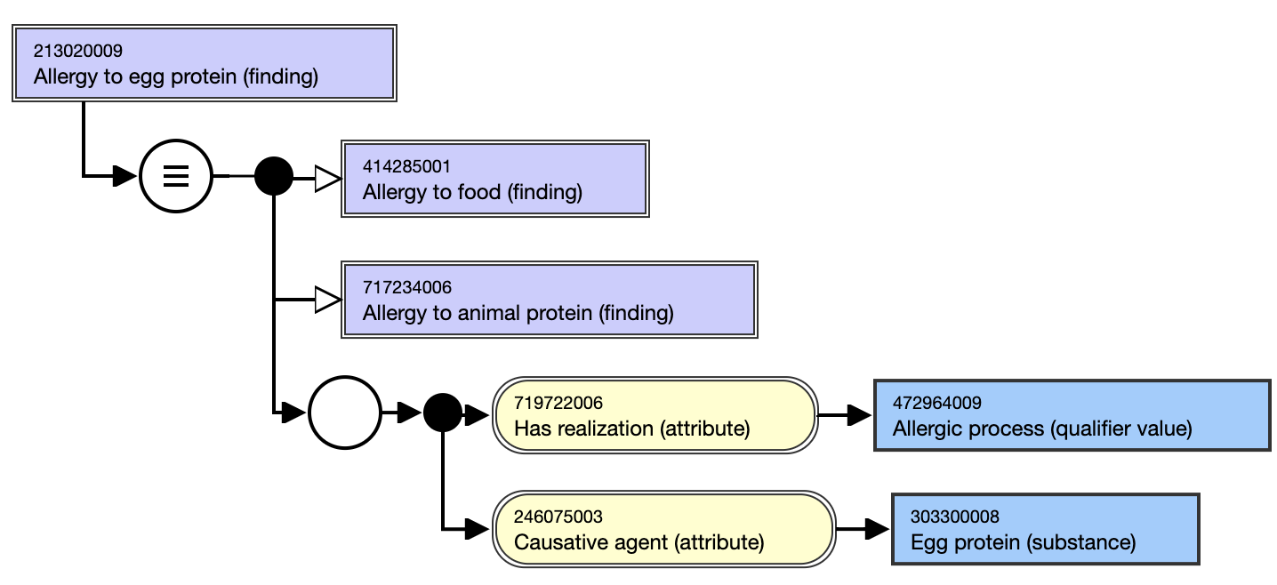
What is the relationship between allergy to feathers, droppings, meat and eggs?
Bird-egg syndrome
  Sensitization to serum albumin (α-livetin, Gal d 5)
  Found in all tissues including feathers, muscles, egg yolk
  Sensitization can occur via respiratory route
  Symptoms can occur via ingestion of poultry, exposure to feathers or eating eggs.

Slide 11
CRS requests related to specific animal proteins

Slide 12
Nomenclature
Due to the need for translation to different languages, the FSN for organisms and organism proteins should be the Latin name while The PT can be a common name

Slide 13
Rules for naming
FSN
  In all cases, the FSN will be the scientific name and the concept will retain a synonym with the scientific name alone.
PT
  If a unique common name exists for an organism in primary references, then it could be used as the preferred term for the organism (without being annotated with the scientific name)
  If a common name is shared between more than one organism, the preferred term should adhere to the following format: Scientific Name with annotated common name to prevent confusion. A dash may be used to separate the two names.
  Examples
    Unique common name
      256340003 |Artemisia vulgaris (organism)| will have a preferred term: 'Mugwort'
      256293000 |Artemisia vulgaris pollen (substance)| will have a preferred term: 'Mugwort pollen'
      22481000122100 |Allergy to Artemisia vulgaris pollen (finding)| has a preferred term: 'Allergy to mugwort pollen’.
    Shared common name
      112476003 |Dermatophagoides farina-house dust mite (organism)|
      711092006 |Dermatophagoides farinae protein-house dust mite (substance)|
      264401009 |Dermatophagoides pteronyssinus-house dust mite (organism)|
      711094007 |Dermatophagoides pteronyssinus protein-house dust mite (substance)|

Slide 14
Highly specific terms
  FSN=Capreolus capreolus protein (substance)
    PT=Western roe deer protein
  FSN=Oryctolagus cuniculus protein (substance)
    PT=European rabbit protein

Slide 15
Highly specific terms - 2
I have concerns regarding the addition of very specific genus + species names that may represent organisms that are geographically restricted to certain areas of the world (e.g. Western roe deer, European rabbit) and may be better included in a local extension rather than the international release.
My feeling is that we should only include common organisms that have a worldwide distribution.
As a guide to what may be relevant in terms of allergy, if you look at the catalogs of the major allergen extract/vaccine (Hollister-Stier, Alk-Abello) and in-vitro test (Thermo Fisher) vendors all of which are international corporations, you can get a feeling for what is considered a relevant allergen.
If Western Roe deer and European rabbit are not included, these may be considered to be either of minor importance or there is no need to distinguish them from the more general terms.
For some cases we might consider creating concepts like Capreolus species protein and Oryctolagus species protein.

Slide 16
Common animals
Represented as allergy/allergic reaction/allergic disease | Represented only as diagnostic or therapeutic extracts
Cat | Pigeon
Cow | Parrot
Guinea pig | Finch
Horse | Duck
Dog | Goose
Dust mites | Canary
Bees | Hamster
Wasps | Gerbil
 | Rabbit
 | Budgerigar
 | Mouse
 | Rat

