Slide 1
Allergy to animals
Alternate model

Slide 2
Background
Request to add Allergy to animal X (finding)
  Example Allergy to cat (finding)
  Currently SNOMED only has 232346004 |Allergy to cat dander (finding)|
  Allergens may be located in saliva, urine, and dander. Non-specialist physicians will not make a distinction
  There is no association between cat dander and cat organism in SNOMED
  Model proposed using role chaining

Slide 3
Alternate model
420134006 |Propensity to adverse reaction (finding)|
42752001 |Due to (attribute)|=Exposure to animal X organism (event)
246075003 |Causative agent (attribute)|=animal X allergenic substance

Slide 4
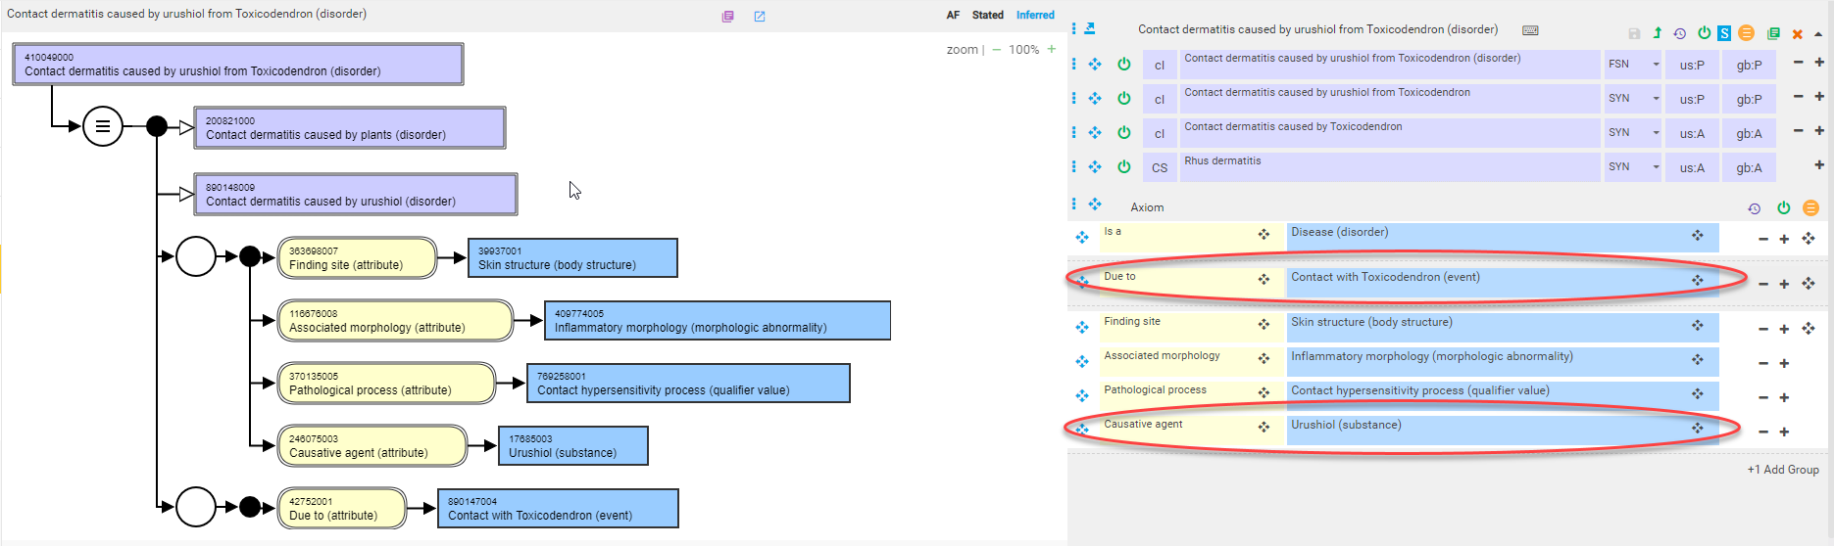
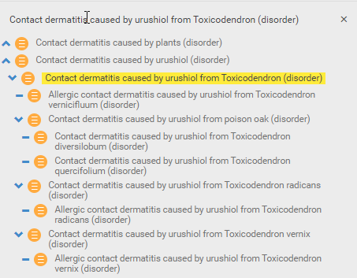
Existing precedence for alternate model

Slide 5
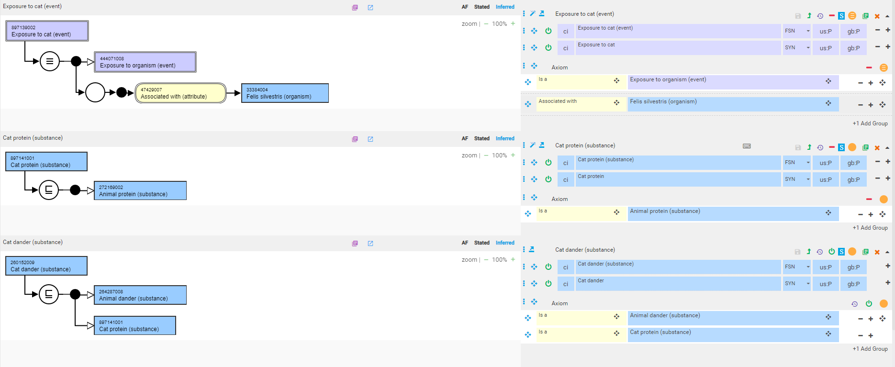
Allergy to cat - 1

Slide 6
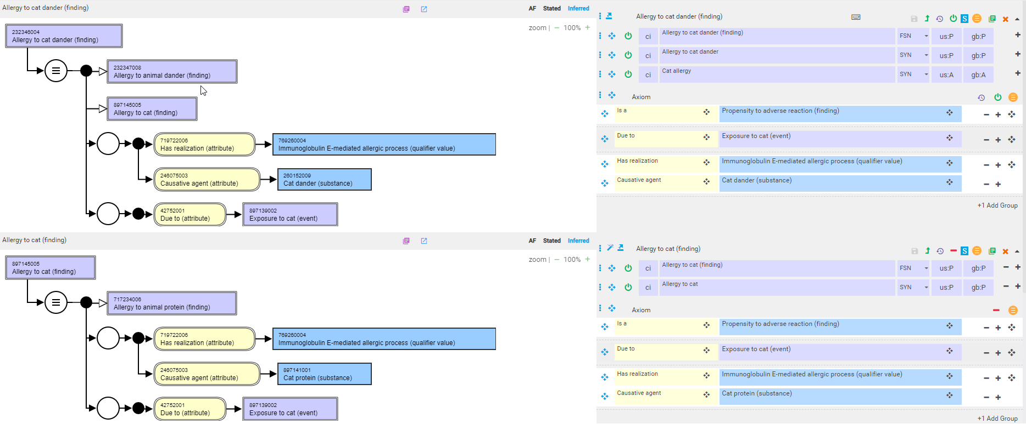
Allergy to cat - 2

Slide 7
Allergy to cat - 2
Cat dander refers to minute particles of skin shed from cats.
Cat dander along with Cat saliva, urine and serum is the source of several allergenic proteins that are the actual causative agents of cat allergy
As 264287008 |Animal dander (substance)|and its children is designated as a substance rather than a body structure or morphology and is only used to define allergy terms, it should be interpreted as substance derived from animal dander.
  Should <<264287008 |Animal dander (substance)|be inactivated and be replaced by << Substance derived from animal dander (substance)?

