Slide 1
SNOMED on FHIR
Allergy-Intolerance Binding

Slide 2
4.4.0 Value Sets Defined in FHIR for Allergy-Intolerance
Name | Definition | Source | Id
allerg-intol-substance-exp-risk | The risk of an adverse reaction (allergy or intolerance) for this patient upon exposure to the substance (including pharmaceutical products). | Other | 940
allergy-intolerance-category | Category of an identified substance associated with allergies or intolerances. | Internal | 133
allergy-intolerance-criticality | Estimate of the potential clinical harm, or seriousness, of a reaction to an identified substance. | Internal | 129
allergy-intolerance-type | Identification of the underlying physiological mechanism for a Reaction Risk. | Internal | 131
allergyintolerance-clinical | Preferred value set for AllergyIntolerance Clinical Status. | Other | 1372
allergyintolerance-code | This value set includes concept codes for specific substances/pharmaceutical products, allergy or intolerance conditions, and negation/exclusion codes to specify the absence of specific types of allergies or intolerances. | Other, SNOMED CT | 137
allergyintolerance-verification | Preferred value set for AllergyIntolerance Verification Status. | Other | 1370

Slide 3
General FHIR Value sets that supplement
4.4.1.115 Value Set http://hl7.org/fhir/ValueSet/substance-code
4.4.1.496 Value Set http://hl7.org/fhir/ValueSet/clinical-findings
4.4.1.269 Value Set http://hl7.org/fhir/ValueSet/route-codes

Slide 4
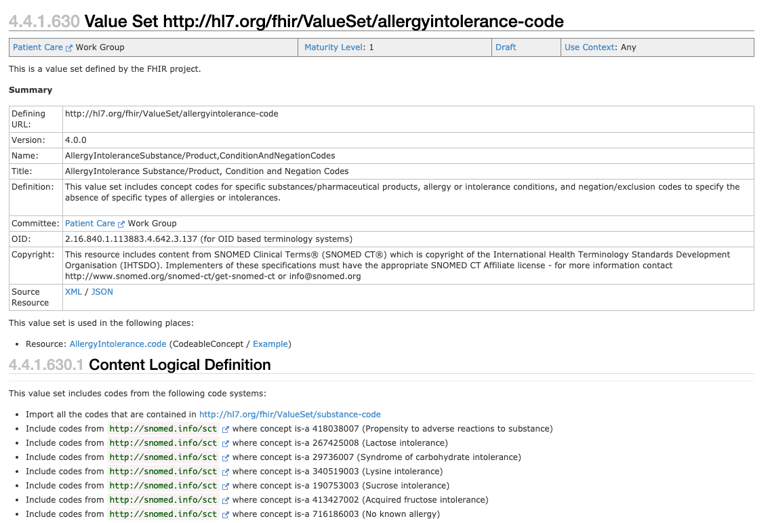

Slide 5
AllergyIntoleranceSubstance/Product,ConditionAndNegationCodes Value Set - 1
Code for an allergy or intolerance statement (either a positive or a negated/excluded statement).
This may be a code for:
  A substance or pharmaceutical product that is considered to be responsible for the adverse reaction risk (e.g., "Latex")
  An allergy or intolerance condition (e.g., "Latex allergy")
  A negated/excluded code for a specific substance or class (e.g., "No latex allergy") or a general or categorical negated statement (e.g., "No known allergy", "No known drug allergies").
The substance for a specific reaction may be different from the substance identified as the cause of the risk, but it must be consistent with it.
  It may be a more specific substance (e.g. a brand medication) or a composite product that includes the identified substance.

Slide 6
AllergyIntoleranceSubstance/Product,ConditionAndNegationCodes Value Set - 2
Making different choices within the value set may lead to lack of interoperability, e.g. 293584003|Allergy to paracetamol (disorder)| is not equivalent to 387517004 |Paracetamol (substance) but "transforms" can be made in some cases through the concept model
  e.g. code = 293584003 |Allergy to paracetamol (disorder)| → code = 387517004 |Paracetamol (substance)| and vice versa
When a substance or product code is specified, the "default" semantic context is that this is a positive statement of an allergy or intolerance condition to the specified substance/product.
  In the corresponding SNOMED CT allergy model, the specified substance/product is the target (destination) of the "Causative agent" relationship.

Slide 7
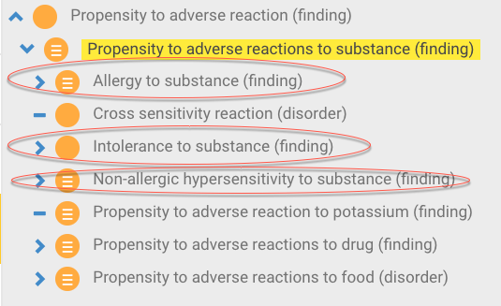
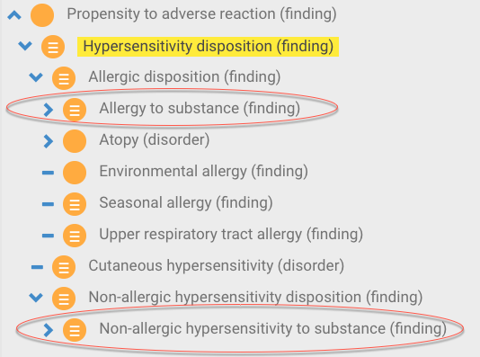
Allergy/Intolerance FHIR and SNOMED CT - 1
Adverse reactions may be*:
  an allergy (typically type I hypersensitivity, plus other "allergy-like" reactions, including pseudoallergy)
  an intolerance (typically non-immune adverse reactions that are not determined or perceived to be allergic or "allergy-like", and are to some degree idiosyncratic and/or individually specific [i.e. are not a reaction that is expected to occur with most or all patients given similar circumstances])
  *FHIR R4 9.1 Resource AllergyIntolerance - Content

Slide 8
Allergy/Intolerance FHIR and SNOMED CT - 2
Hypersensitivity, allergic and non-allergic hypersensitivity disposition concepts are defined with a role group containing a causative agent relationship to a substance and a has realization relationship to a pathological process
Intolerance to substance and its descendants are modeled with an associated with relationship to a substance due to the difficulty defining what is meant by an intolerance process
The validity of 609404002 |Non-allergic hypersensitivity process (qualifier value)|for defining 609396006 |Non-allergic hypersensitivity disposition (finding)|needs to be reexamined

Slide 9
Value Set http://hl7.org/fhir/ValueSet/substance-code
This value set contains concept codes for specific substances. It includes codes from SNOMED where concept is-a 105590001 (Substance (substance)) and where concept is-a 373873005 (Pharmaceutical / biologic product (product))
Used in
  Used in: AllergyIntolerance.reaction.substance
  Question: What about the ~300 drugs accounting for ~95 % of the entries identified by the HL7 Patient Care Workgroup from a database of over 100 million allergy list entries from several US sources: VA, Kaiser, Cerner, Optum ?

Slide 10
Value Set http://hl7.org/fhir/ValueSet/clinical-findings
This value set includes all the "Clinical finding" SNOMED CT codes - concepts where concept is-a 404684003 (Clinical finding (finding))
Used in Resource: AllergyIntolerance.reaction.manifestation
Question: Should a SNOMED CT value set containing only the clinical findings that are likely the result of hypersensitivity or intolerance or at least to those conditions that have a high frequency of documentation in EHRs (U. of Nebraska, KP) in order to discourage inappropriate documentation?

Slide 11
4.4.1.269 Value Set http://hl7.org/fhir/ValueSet/route-codes
This value set includes all Route codes from SNOMED CT
  Used in Resource: AllergyIntolerance.reaction.exposureRoute
Question: Should a SNOMED CT value set containing only the following routes be created specifically for allergy/intolerance ?
  6064005 |Topical route (qualifier value)|
  26643006 |Oral route (qualifier value)|
  447694001 |Respiratory tract route (qualifier value)|
  445755006 |Intravascular route (qualifier value)|
  78421000 |Intramuscular route (qualifier value)|
  54485002 |Ophthalmic route (qualifier value)|
  34206005 |Subcutaneous route (qualifier value)|
  372464004 |Intradermal route (qualifier value)|

Slide 12
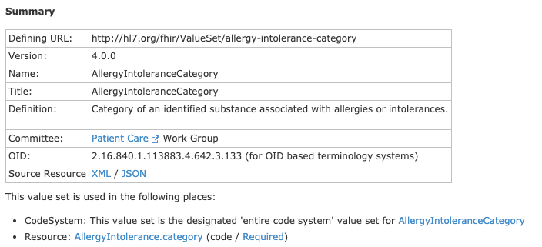
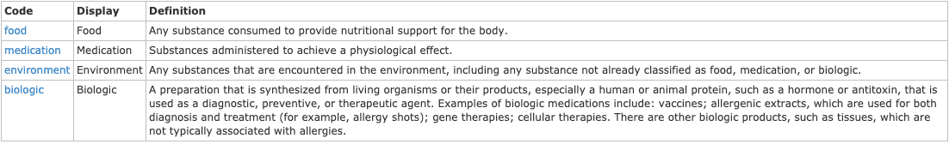
Value Set http://hl7.org/fhir/ValueSet/allergy-intolerance-category

Slide 13
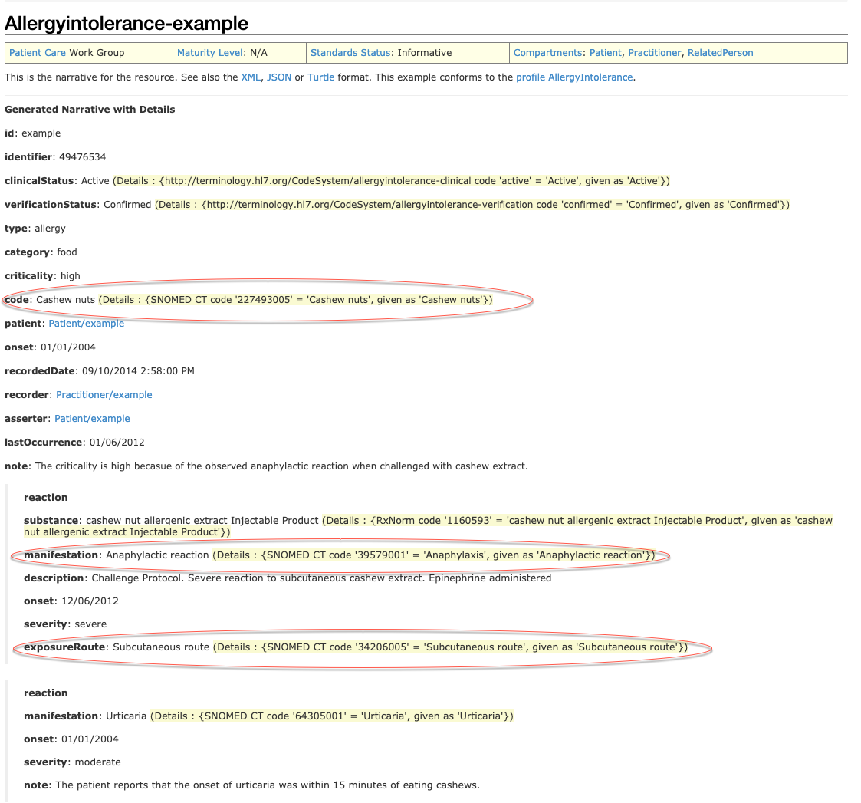
Allergy/Intolerance example document

