Slide 1

Allergy/Adverse reaction to substances/products
Joint CRG meeting
Yongsheng Gao 23/04/2020

Slide 2
Background
Allergies or adverse reactions (including allergic reactions) have been modelled by substances only in SNOMED CT.
Most of these conditions could be reported by either substances or products. There are requirements for supporting modelling by product as well.
Product is allowed by the MRCM for postcoordinations, and the update of MRCM in this release will allow product for precoordinated content.
In particular, allergy/adverse reaction to multiple substances or vaccines are more likely reported by products rather than allergy to a specific substance.
The challenge is how concept modeling can support both substance and product for clinical records and retrieval. The model should also support other conditions caused by substances or products
Related topics that are not covered in this proposal:
  Recording substances or products in information model without finding/disorder codes
  Suspected or reported conditions caused by substances or products

Slide 3
Inactive ingredients - modeling and classification
Patient could be allergic to any substance contained in a product, though it is rarely caused by inactive ingredients.
Should inactive ingredients be included for classification of these conditions?
YES,
  Subsumption cannot be determined if inactive ingredients are not specified in the model.
  As a result, it is not useful that all concepts for allergy/Adverse reaction to products should be siblings

Slide 4
Excipients are considered for classification
If excipients are used for classification, the following two allergy would not subsume because excipient in one product might not be the same to the other
Allergy to product containing penicillin
  Allergy to product containing amoxicillin
Allergy to product containing penicillin ( and excipients )
Allergy to product containing amoxicillin ( and excipients )

Slide 5
Relationship between allergy to substance/product
Allergy to substance
  Allergy to product (substance of product)
  Allergy to plant (substance of plant)
Allergy to substance
Allergy to product
Allergy to plant
Allergy to product
  Allergy to substance
Allergy to plant
  Allergy to substance
Allergy to substance = Allergy to product = Allergy to plant
Allergy to X substance
  Allergy to X product (substance of product)
  Allergy to X plant (substance of plant)
Allergy to X substance
Allergy to X product
Allergy to X plant
Allergy to X product
  Allergy to X substance
Allergy to X plant
  Allergy to X substance
Allergy to X substance = Allergy to X product = Allergy to X plant

Slide 6
Inactive ingredients - modeling and classification
Should inactive ingredients be included for classification of these conditions?
YES, if and only if inactive ingredients are modelled
  The classification of inactive ingredients will be like active ingredients.
  The unspecified inactive ingredients are ignored by classification
NO,
  Allergy/Adverse reaction to a single active ingredient product
  is like Allergy/Adverse reaction to a substance of this ingredient.
  The only difference is that one is recorded by product and the other is recorded by substance.

Slide 7
Allergy to inactive ingredients
How do we represent a patient who is allergic (or has adverse reaction) to inactive ingredients, though that is rare?
  Record allergy/adverse reaction to substance – an inactive ingredient is explicitly represented by a substance
  Record allergy/adverse reaction to product – Implies that it is different from allergy/adverse reaction to substance, e.g. the cause could be inactive ingredient. However, classification cannot support inactive ingredient(s) that are not modeled.

Slide 8
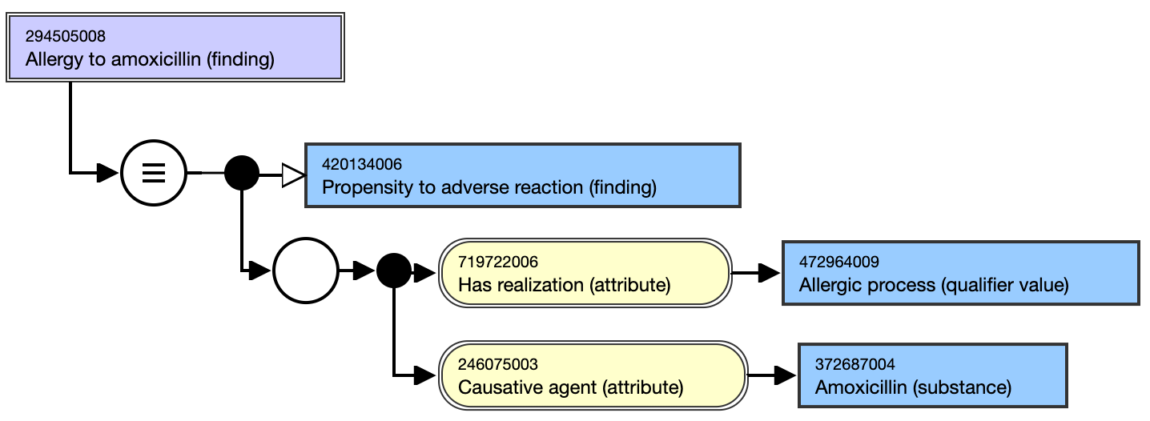
Model: causative agent as a single substance

Slide 9
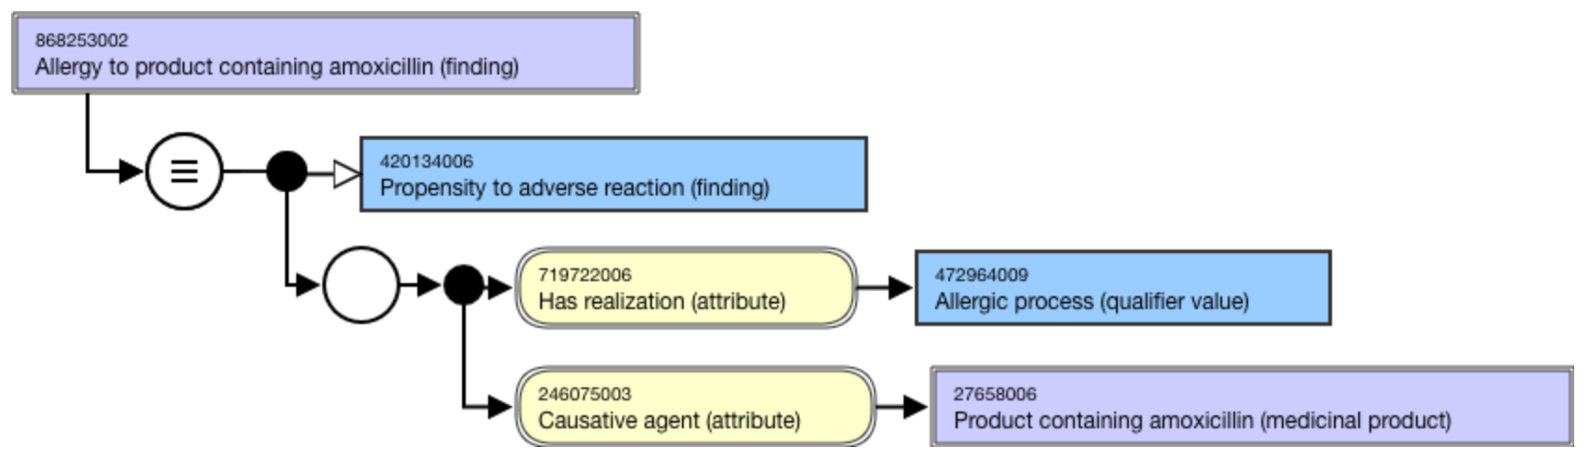
Model: causative agent as a medicinal product

Slide 10
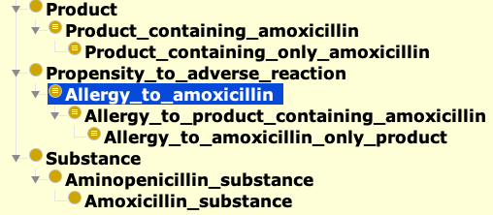
Classification results by role chain approach

Slide 11
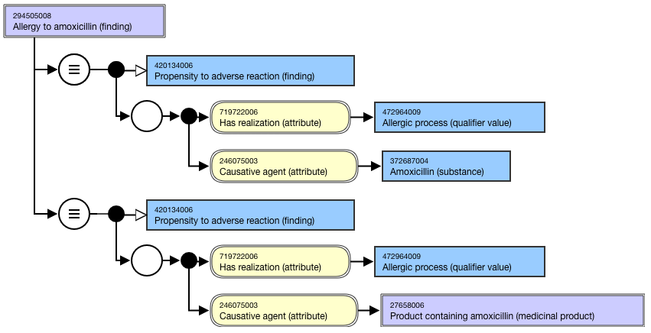
Model by multiple axioms approach

Slide 12
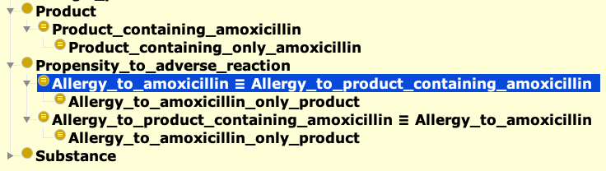
Classification results by multiple axioms

Slide 13
Pros and Cons of each approach
Role chain
Assumption:
Allergy/adverse reaction to a substance Subsumes - Allergy/adverse reaction to a product containing the substance
Pros:
Flexibility to model conditions by either substances or products. The subsumption between them is supported
No change to the existing modeling.
A single role chain axiom is
the only needed addition
Cons:
Role chain is already specified in the Logic profile. Tooling support is required for role chain over three or more properties and transitive reduction for inferred relationships
Multiple axioms
Assumption:
Allergy/adverse reaction to a substance
Equivalent to = Allergy/adverse reaction to a product containing the substance
Pros:
Less demands on tooling support
Cons:
Lack of ability to distinguish
  a condition confirmed by a lab test from
  a condition caused by product, which is reported by patient
A large number of additional axioms need to be added to the existing concepts

Slide 14
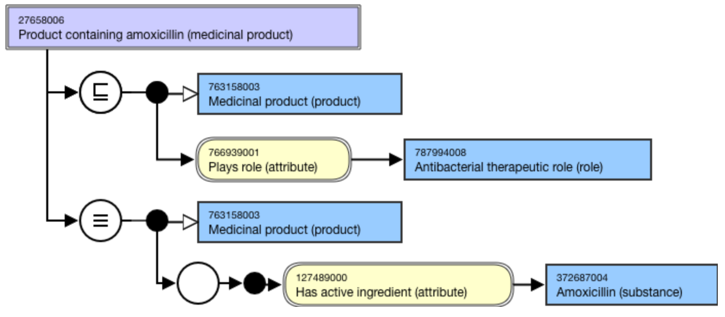
Allergy to product with a role
Examples of product with a role: Vaccine, adhesive agent, antibacterial agent

Slide 15
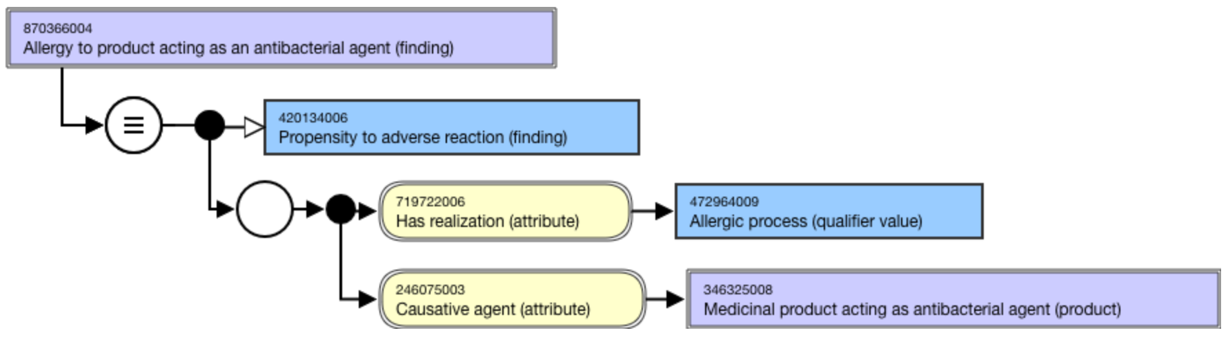
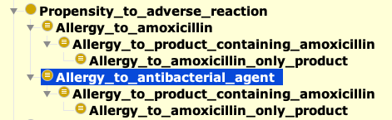
Allergy to product with a role

Slide 16
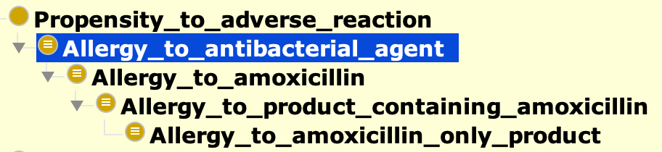

‘Condition of production role’ subsumes ‘condition of substance’ and impact

Slide 17
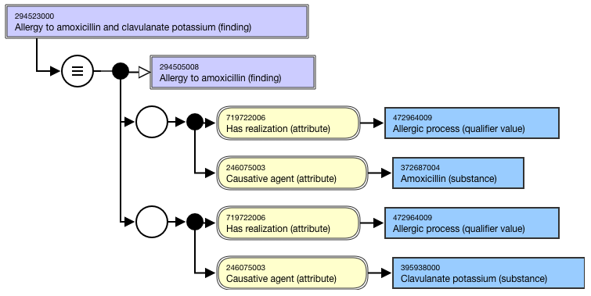
Conditions modelled by multiple substances
Currently, conditions caused by multiple substances are modelled by multiple role groups. The model below suggests that a condition is caused by all substances. However, the intended clinical meaning is that a patient might be allergic to one or more of these substances.

Slide 18
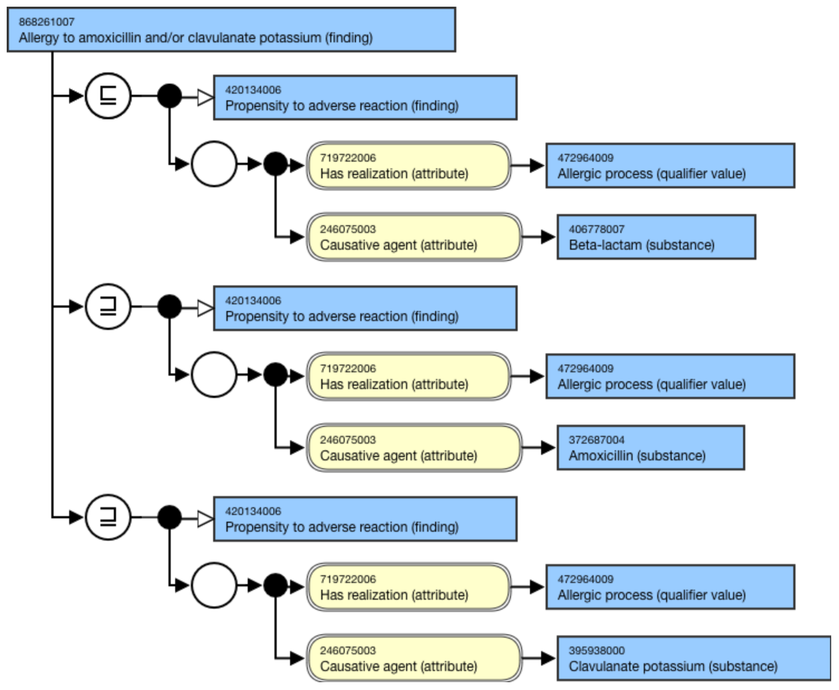
Allergy to amoxicillin and/or clavulanate potassium (finding)
  Allergy to product containing amoxicillin (finding)

Slide 19
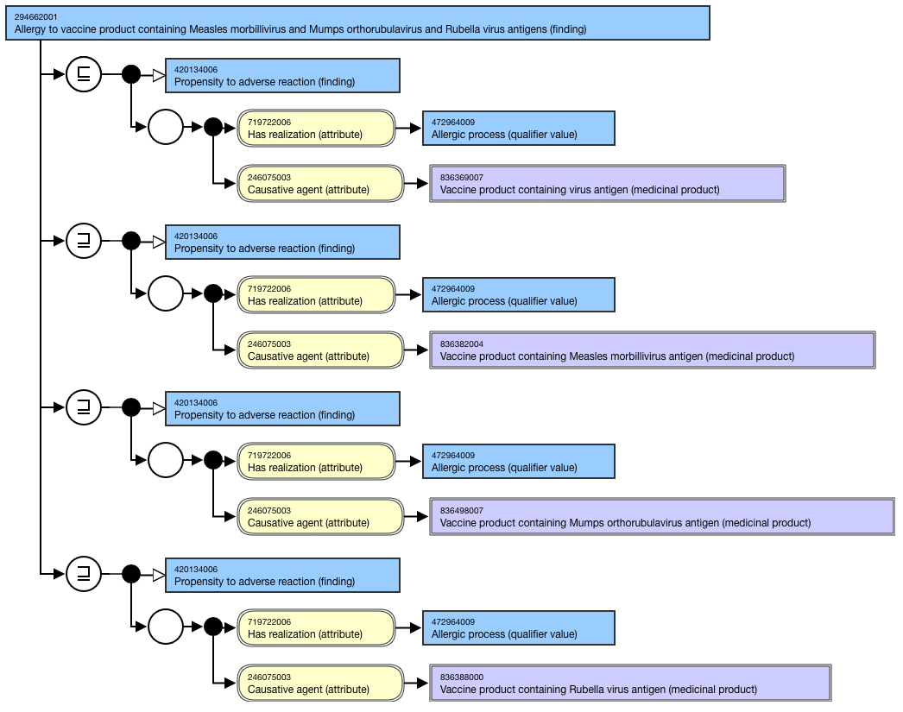
Allergy to vaccine modelled by medicinal product
Notes:
The disjunctive meaning should be represented by GCIs. In this example, two GCIs represent disjunctive meaning that Allergy to amoxicillin, or calvualnate potassium, or all of them.

Slide 20
Classification result
294662001 |Allergy to vaccine product containing Measles morbillivirus and Mumps orthorubulavirus and Rubella virus antigens (finding)|
  294650000 |Allergy to vaccine product containing Mumps orthorubulavirus antigen (finding)|
  294656006 |Allergy to vaccine product containing Rubella virus antigen (finding)|

Slide 21
An example of hierarchical relationships
Allergy to substance
  Allergy to amoxicillin and/or clavulante potassium (finding)
      Allergy to amoxicillin (finding)
        Allergy to product containing amoxicillin (finding)
      Allergy to product containing amoxicillin and clavulanate potassium (finding)
        Allergy to product containing amoxicillin (finding)
  Allergy to product
      Allergy to antibacterial agent
        Allergy to product containing amoxicillin and clavulanate potassium (finding)
          Allergy to product containing amoxicillin (finding)

Slide 22
Product role subsumes substance
Allergy to substance
  Allergy to amoxicillin and/or clavulante potassium (finding)
        Allergy to amoxicillin (finding)
          Allergy to product containing amoxicillin and clavulanate potassium (finding)
            Allergy to product containing amoxicillin (finding)
  Allergy to product
      Allergy to antibacterial agent
        Allergy to amoxicillin (finding)
          Allergy to product containing amoxicillin and clavulanate potassium (finding)
            Allergy to product containing amoxicillin (finding)

Slide 23

In summary
Most allergies or adverse reactions (including allergic reactions) should be modelled by substances in the International Edition in SNOMED CT. A single role chain axiom will provide subsumptions of concepts modelled by products.
Allergies or adverse reactions to medicinal products can be represented in national extensions or by postcoordinated expressions in applications.
Allergies or adverse reactions to inactive ingredients should be recorded by either the substance or the product that contains it. The classification would only be based on explicitly modelled inactive ingredients.
Allergies (or adverse reactions) to multiple ingredients should be modelled by GCIs to represent the disjunctive meaning.
A small number of concepts related to allergies or adverse reactions to a product role, such as vaccine, antibacterial agent or adhesive agent, should be modelled by medicinal products containing substances.
The Editorial Guide will be developed to support implementation. The model option is also applicable for other conditions caused by substance or product.
Decision support systems based on the SNOMED CT hierarchy may need to traverse up and down in both directions.

Slide 24

Thank
you!
Please contact Yongsheng Gao | yga@snomed.org for further information.
24

