Slide 1
Allergen components

Slide 2
Basis of allergen components
Allergens derived from plant and animal sources consist of multiple distinct proteins.
Testing for specific IgE against whole allergen extracts can identify binding to one or more of these protein antigens but not which ones(s)
Protein allergens from a single species may have homology (similar structures) with proteins from closely related or unrelated species leading to cross reactivity
Allergenicity in large part determined by protein stability with proteins that are easily denatured by heat or digestive enzymes generally resulting in tolerance or milder symptoms than stable proteins
Persistence of allergic symptoms is associated with specific protein allergens

Slide 3
Why are allergen components important?
Particularly for food allergic individuals allergen components are related to:
Potential severity of an allergic reaction
Persistence of the allergy past childhood
Whether an individual may be able to tolerate the food they are allergic to if heated
Whether an individual may react to other foods or other plant or animal-derived allergens

Slide 4
Allergen Nomenclature
First 3 letters of genus
first letter of species
Number usually representing order in which discovered
Example Bet v 1
  First allergen component discovered for Betula vericossa (Birch tree pollen).

Slide 5
Major Plant and Animal -Derived Protein Allergen Classes- Panallergens
PR-10 protein, Bet v1 homologue
A heat labile protein, cooked foods are often tolerated
Often associated with local symptoms such as oral allergy syndrome (OAS)
Often associated with allergic reactions to fruit and vegetables in northern Europe
LTP (non-specific Lipid Transfer Protein, nsLTP)
A protein stable to heat and digestion causing reactions also to cooked foods
Often associated with systemic and more sever reactions in addition to OAS
Often associated with allergic reactions to fruit and vegetables in southern Europe
Profilin
Seldom associated with clinical symptoms but may cause demonstrable or even severe reactions in a small minority of patients
Storage Protein
Protein found in seeds serving as source material during the growth of a new plant
Often stable and heat-resistant proteins causing reactions also to cooked foods
CCD (cross-reactive carbohydrate determinants)
Seldom associated with clinical symptoms but may cause demonstrable or even severe reactions in a small minority of patients
Lipocalcin
Very stable proteins; allergen components displaying limited cross-reactivity between species
Parvalbumin
A major allergen in fish
A marker for cross-reactivity among different species of fish and amphibians
A protein stable to heat and digestion causing reactions also to cooked foods
Serum albumin
A common protein present in different species of fish and amphibians
A protein stable to heat and digestion causing reactions also to cooked foods
Tropomyosin
An actin-binding protein in muscle fibers
A marker for cross-reactivity between crustaceans, mites, and cockroaches

Slide 6
Major Animal-Derived Protein Allergen Classes- Panallergens
Protein family | Examples of animal-derived allergen sources
Lipocalin | Bla g 4 (german cockroach) Bos d 2 (cow) Can f 1 (cat) Fel d 4 (cat)
Parvalabumin | Gad c 1 (cod) Cyp c 1 (carp) Hip h 1 (halibut)
Serum albumin | Fel d 2 (cat) Gal d 5 (chicken) Bos d 6 (cow)
Tropomysin | Der p 10 (house dust mite) Cra c 1 (shrimp) Per a 7 (cockroach)

Slide 7
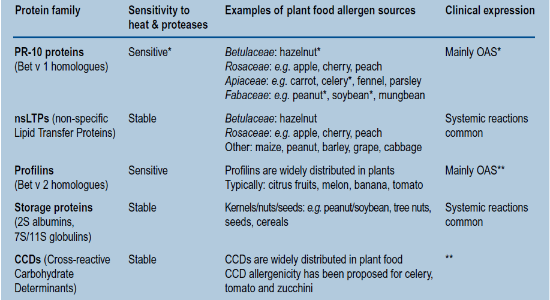
Major Plant-Derived Protein Allergen Classes- Panallergens

Slide 8
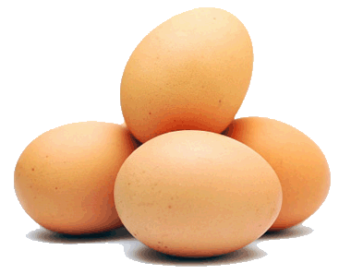
With case history of Hen’s Egg Allergy
f1 Egg White
Positive
f233 Ovomucoid Component
Negative Positive
-mild egg allergy -confirmed egg allergy
-will probably tolerate -Will not tolerate any egg
cooked, baked egg.

Slide 9
Suspicion of peanut allergy
Is it allergy? Risk for severe reactions?
●  
Ara h 2 – ImmunoCAP® f423 rAra h 2
Often associated with systemic and severe reactions.
Associated with cross-reactivity to tree nuts, e.g. almond and brazil nut.
A peanut storage protein.
Ara h 1 – ImmunoCAP® f422 rAra h 1
Often associated with clinical reactions.
Associated with cross-reactivity to nuts and legume seeds, e.g. lentil and pea.
A peanut storage protein.
Ara h 3 – ImmunoCAP® f424 rAra h 3
Often associated with clinical reactions.
Associated with cross-reactivity to lupin and soybean.
A peanut storage protein.
Ara h 9 – ImmunoCAP® f427 rAra h 9
Often associated with systemic and more severe reactions in addition to Oral Allergy Syndrome (OAS).
In peanut however, severe reactions to LTP are not well documented.
Stable to heat and digestion, risk for reactions also to cooked food.
A LTP (Lipid Transfer Protein).
Ara h 8 – ImmunoCAP® f352 rAra h 8
Often associated with local reactions such as OAS.
A marker for birch-pollen related cross-reactions to peanut.
A heat labile protein, cooked food is often tolerated.
A PR-10 protein.
CCD – ImmunoCAP® Ro214 MUXF3
Rarely associated with clinical reactions.
A marker for sensitization to cross-reactive carbohydrate determinants (CCD).
Present in all plants.
● 
● 
● 
●
●
References: Astier C et al. J Allergy Clin Immunol 2006;118:250, Flinterman AE et al. Clin Exp Allergy 2007;37:1221, Koppelman S.J et al. Clin Exp Allergy 2004;34:583,
McDermott RA et al. Clin Exp Allergy 2007;37:752, Mittag D et al. J Allergy Clin Immunol 2004;114:1410, Peeters KA et al. Clin Exp Allergy 2007;37:108

Slide 10
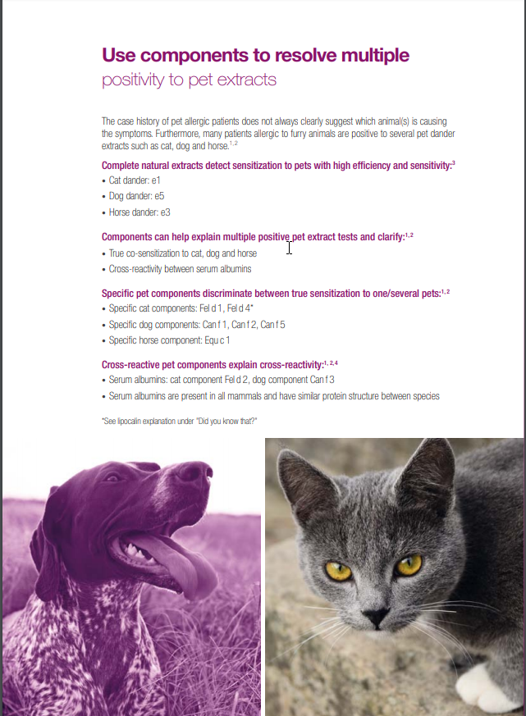
Pet allergens

Slide 11
Potential representation of allergenic materials in SNOMED
Organism
Source
Allergen
Example allergen components
448169003 |Felis catus (organism)|
260152009 |Cat dander (substance)|
412140006 |Cat serum albumin (substance)|
Cat sebaceous gland protein
Cat urine protein
Fel d1
Fel d2 (aka 412140006 |Cat serum albumin (substance)|
264401009 |Dermatophagoides pteronyssinus (organism)|
Dust mite feces
720687003 |Dust mite protein (substance)|
Der p1

Slide 12
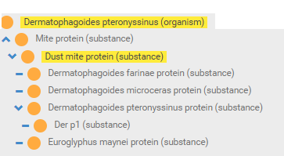
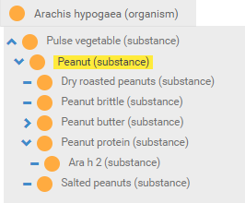
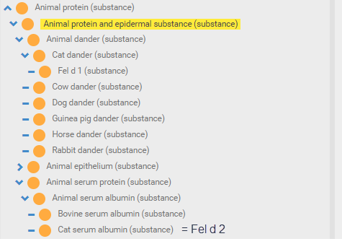
Theoretical allergen hierarchies

Slide 13
Important allergen components to consider
Peanut
  Ara h1, 2, 3, 6, 8, 9
Milk
  Bos d 4 (Alpha-lactalbumin)
  Bos d 5 (Beta-lactoglobulin)
  Bos d 6 (Bovine serum albumin)
  Bos d 8 (Casein)
Egg
  Ovomucoid (nGal d 1)
  fOvalbumin (nGal d 2)
  Conalbumin (nGal d 3)
  Lysozyme (nGal d 4)
Cat
  Fel d 1
  Fel d 2
  Fel d 4
Dog
  Can f 1
  Can f 2
  Can f 5

