Slide 1
Social Determinants of Health & CRANE: What measures for research?
Jim Campbell
Carol R Geary
Jerrod Anzalone
University of Nebraska Medical Center
Omaha, NE, USA

Slide 2
Objectives
Inventory Nebraska EHR and public domain datasets for available SDH facts
Organize and standardize SDH datasets for clinical research into interoperable SDH facts database for CRANE; develop ontology metadata for SDH
Organize and present SDH data within the relevant workflows of the EHR to support Nebraska Medicine caregivers

Slide 3
Social Determinants of Health: Observable Datasets
“Social determinants of health (SDOH) are the conditions in the environments where people are born, live, learn, work, play, worship, and age that affect a wide range of health, functioning, and quality-of-life outcomes and risks”
Healthy People 2030; USHHS-Office of Disease Prevention and Health Promotion
“The social determinants of health (SDH) are the non-medical factors that influence health outcomes. They are the conditions in which people are born, grow, work, live, and age, and the wider set of forces and systems shaping the conditions of daily life. These forces and systems include economic policies and systems, development agendas, social norms, social policies and political systems.”
https://WHO.int/health-topics/social-determinants-of-health
Equities community primarily focuses on racial, ethnic, cultural and
socioeconomic status variables

Slide 4
SDOH Domains (HP2030)
Economic Stability
Education Access and Quality
Healthcare Access and Quality
Community, Neighborhood and Built Environment
Social and Community Context
Datapoints regarding
  Observations on Personal Socioeconomic Roles and Characteristics from EHR or PRO
  Community Infrastructure, Environment, Socioeconomics and Societal Attitudes (that can be referenced to patient’s neighborhood

Slide 5
Pragmatic Data Review
Examine the semantics of structured data found in Nebraska Medicine EHR, looking for data elements relevant to the HP2030 domains
Extract the data elements and associated datasets to a SDH metadata library
Code with LOINC or SNOMED CT as available to standardize for interoperation per ONC
Consult with domain experts in sociology for relevant geocoded national public datasets
Extend standardization for interoperation to include community-level data items from public sources
Support access to these public domain sets of facts instantiated for patient residence and coded with SNOMED CT or LOINC

Slide 6
Pragmatic SDOH Domain Analysis: Economic stability
Economic stability/ Financial security:
  P: EHR social history
  P: PRAPARE (NACHC) (Protocol for Responding to Patient Assets Risks and Experiences)
  C:Households receiving public assistance (DoC/American Community Survey(ACS))
  C:Households at or near poverty level
  C: Social Vulnerability Index (CDC) (Socioeconomic status)

Slide 7
Pragmatic SDOH Domain Analysis: Economic stability
Nutritional security
  P: EHR Social and nutritionist history
  P: EHR weight loss history
  P: Nursing Braden scale assessment
  C: Availability of grocery stores (DOA/Food Environment Atlas)

Slide 8
SDOH Domain Analysis: Healthcare Access and Quality
Healthcare Access
  P: Health insurance coverage
  P: ED/pricare health visits
  P: Use of healthcare web portal
  C: PRAPARE
Personal disability
  P: Computable phenotype EHR: Physical/clinical disability

Slide 9
SDOH Domain Analysis: Social and Community Context
Social Stress includes minority issues
  C: Bird and Wisconsin indices (ACS)
  P: Race, gender identity, sexual preference, marital status
  P: PRAPARE
  P: PROMIS (NIH)(Patient reported outcomes measures)
  P: PHENX Social isolation protocol
  P: FACIT (Functional assessment of chronic illness therapy)
  C: Race, ethnicity, age distributions (ACS)
  C: SVI (CDC) Composite flags count

Slide 10
SDOH Domain Analysis: Social and Community Context
Violence and Abuse
  P: Computable phenotypes – victim status, gender identity disorders, mental health problems
  P: EHR history; staff assessments of abuse
  P: HARK questionnaire
  P: PRAPARE

Slide 11
SDOH Domain Analysis: Social and Community Context
Transportation / Occupation
  P: PRAPARE, PHENX, SAMHSA, ESRD, WellRX, CUBS
  C: Transportation to work (ACS)
  C: Occupation profile (ACS)
  C: Rural Urban Community Access codes(DOA/ERS)

Slide 12
SDOH Domain Analysis: Social and Community Context
Social context
  P: Race and ethnicity, language preference, aging and development
  P: Gender at birth and gender identity
  P: Sexual orientation
  P: Substance use
  P: Mental health history and screen (PHQ-9)
  C: SVI Minority status and Language

Slide 13
SDOH Domain Analysis: Education Access and Quality
P: Personal report of schooling from EHR
P: PHENX
P: PRAPARE
C: Residents report of schooling completed (ACS)

Slide 14
SDOH Domain Analysis: Neighborhood and Built Environment
Communication:
  P: Patient access and use of communication utilities
  C: Households with internet access and computers (ACS)
Residential environment:
  C: Age of facilities; plumbing and kitchen facilities (ACS)
  C: SVI Housing type & Transportation
  C: CACES(EPA) pollution data

Slide 15
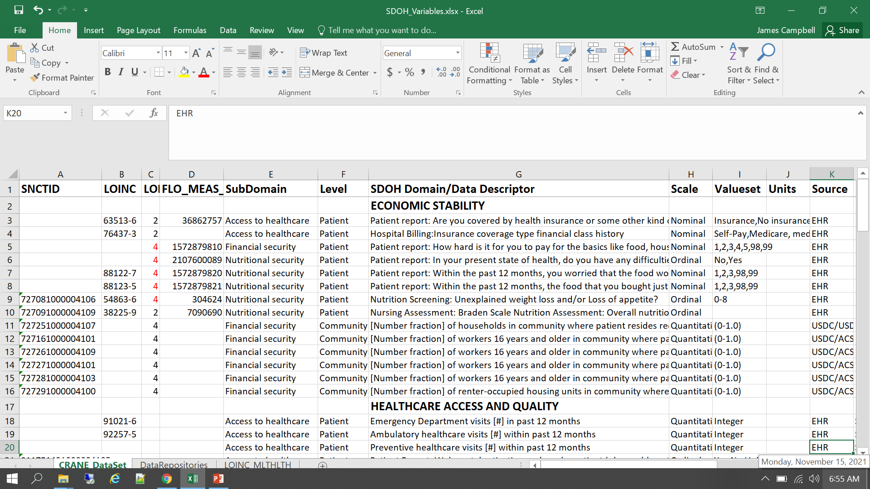
SDOH: Data Inventory

Slide 16
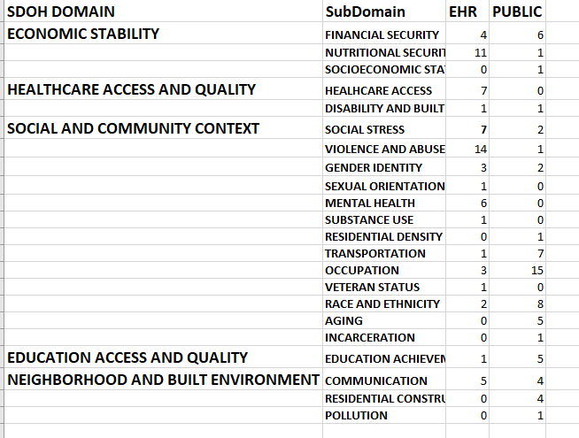
CRANE SDoH Data Summary

Slide 17
Interoperation of
Patient-Level Data Points
Sources: EHR, Patient assessment scales and surveys, Patient-reported outcomes from surveys and interviews
What race am I?
What was my gender assigned at birth?
What gender identity do I choose to be today?
What is the gender history of patient?
ONC specifies LOINC as domain terminology for SDoH; however LOINC coding available for 67% of patient-level data and NO community-level facts that we have deployed

Slide 18
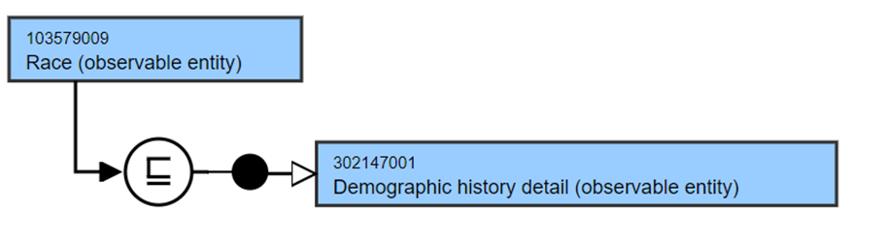
What is race?
Whoopi Goldberg says it is about blackness (and slavery?)
Holocaust survivors say that they are the Jewish race singled out by Hitler for extermination
Census data allows one to be of multiple races…
What race your community assigns to your person probably has the most to do with your healthcare outcomes, but where is that documented?

Slide 19
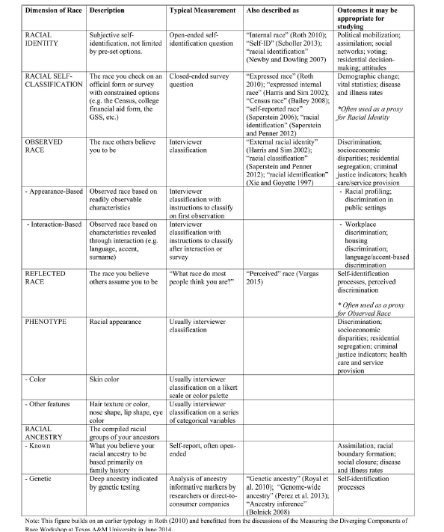
Is there one race assignment per person?
Roth-W. The multiple dimensions of race. Ethnic and Racial Studies; 39(8): 1310-1338.

Slide 20
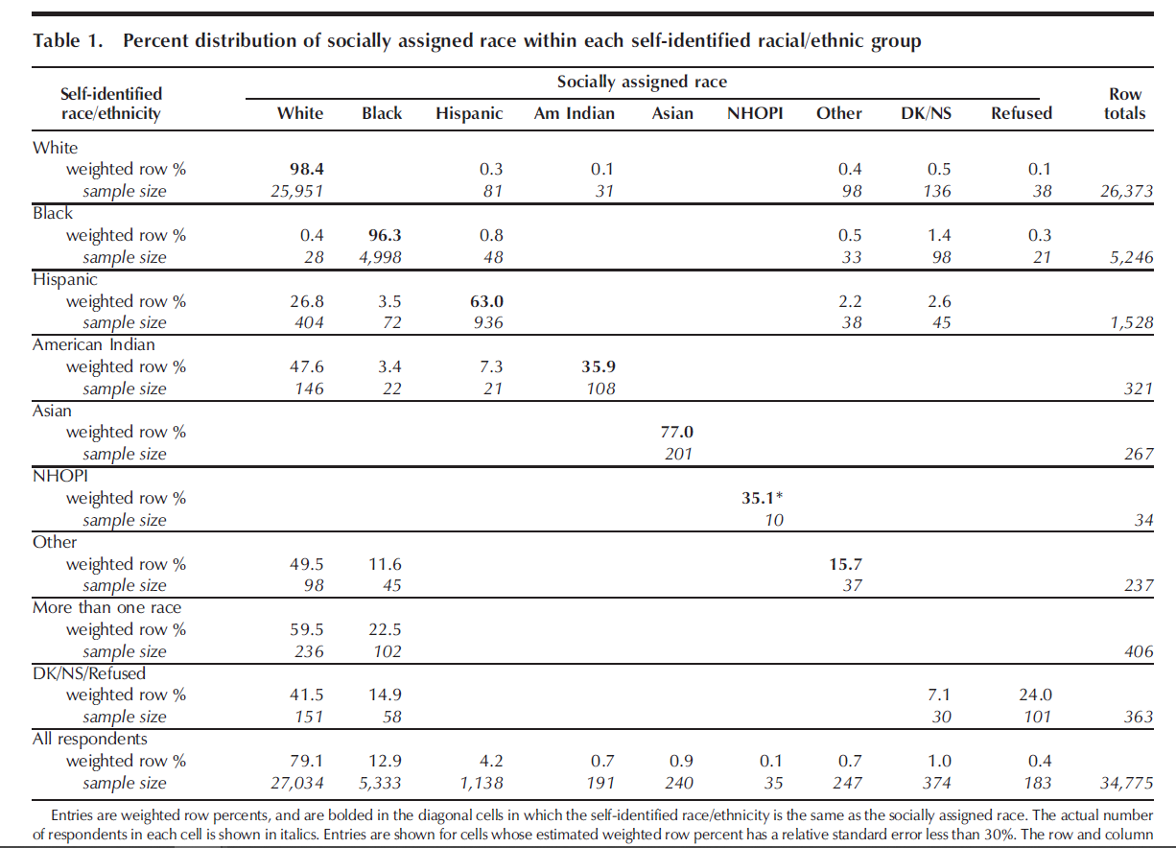
Jones-CP et all. Using Socially assigned Race to probe “White” advantages in health status. Ethnicity and Disease; Vol18, Autumn 2008.

Slide 21
Office of National Coordinator for HIT: Race
LOINC
32624-9|Race|Type|Pt|^Patient|Nominal|
HL7 PID|10
American Indian or Alaska Native LA6155-1
Asian LA6156-9
Black or African American LA10610-6
Native Hawaiian or Pacific Islander LA10611-4
White LA4457-3
Unknown LA4489-6
American Indian or Alaska Native |  |  | LA6155-1
Asian |  |  | LA6156-9
Black or African American |  |  | LA10610-6
Native Hawaiian or Other Pacific Islander |  |  | LA10611-4
White |  |  | LA4457-3
Unknown |  |  | LA4489-6
NOT=BIOLOGICAL SEX!

Slide 22
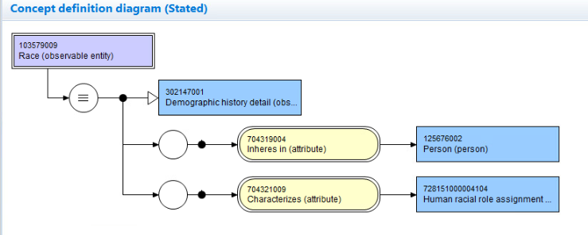
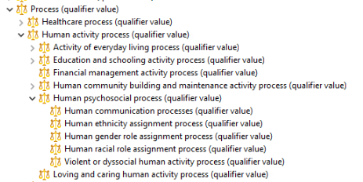
103579009|Race (observable entity) proposed

Slide 24
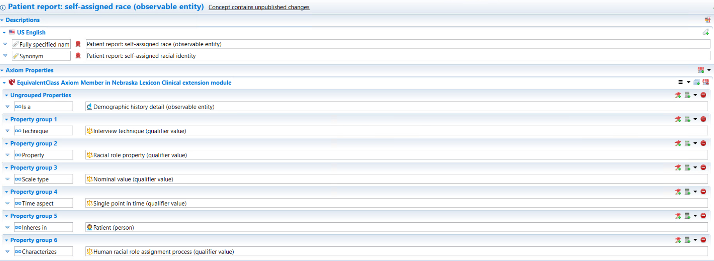
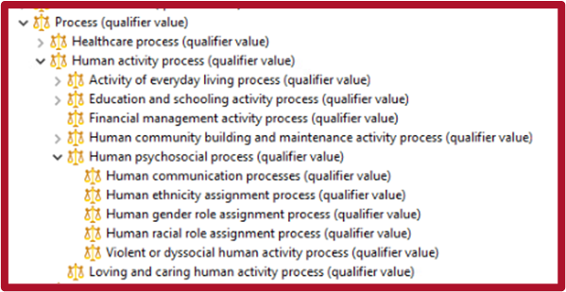
LOINC:32624-9 Patient report of self-assigned racial identity
32624-9|Race|Type|Pt|^Patient|Nominal|
NOT=BIOLOGICAL SEX!

Slide 25
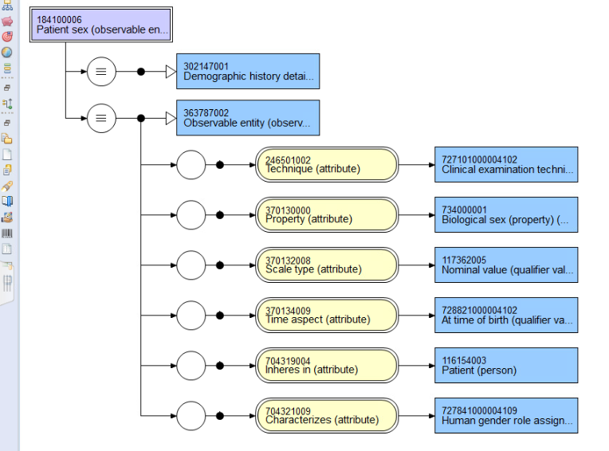
184100006|Patient sex (observable entity)
ONCHIT Sex or Gender
HL7 PID|8
46098-0 Sex|Type|Pt|^Patient|Nom

Slide 26
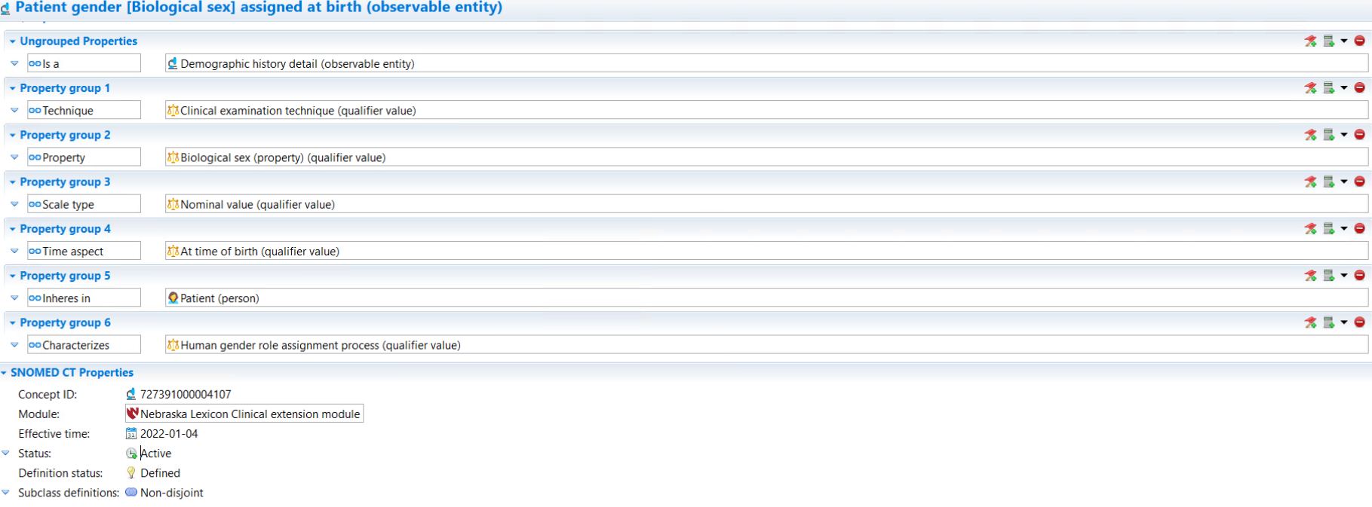
LOINC: 46098-0 Patient gender [Biological sex] assigned at birth (observable entity)
<<Gender role property

Slide 27
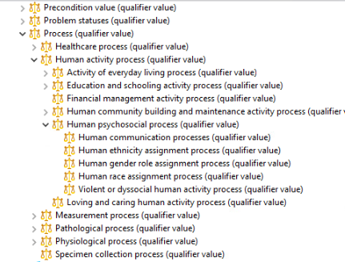
Proposed Extension to 719982003|Process (qualifier)

Slide 28
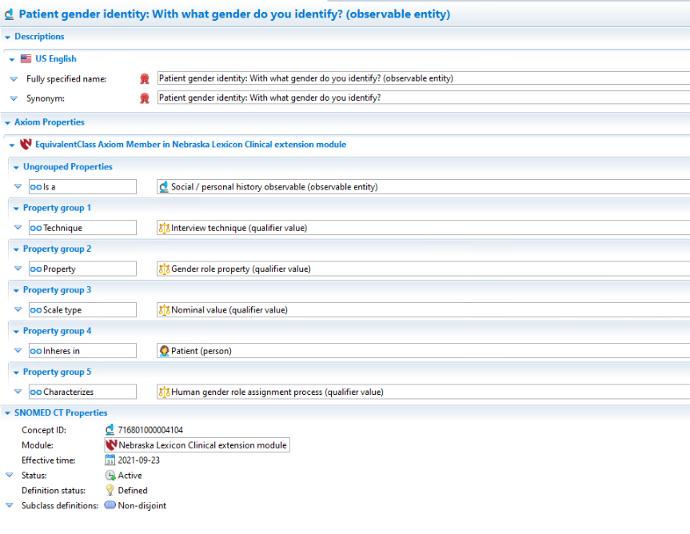
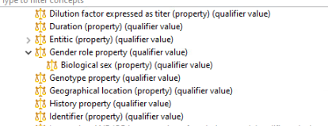
Patient gender identity (observable entity)
76691-5|Gender Identity|Type|Pt|^Patient|Nom|Reported
NOT=BIOLOGICAL SEX!

Slide 29
Who cares about ontology metadata?
What data do I have in my warehouse about gender identity?
…about educational attainment?
…about race and ethnicity?
…about nutritional security?

Slide 30
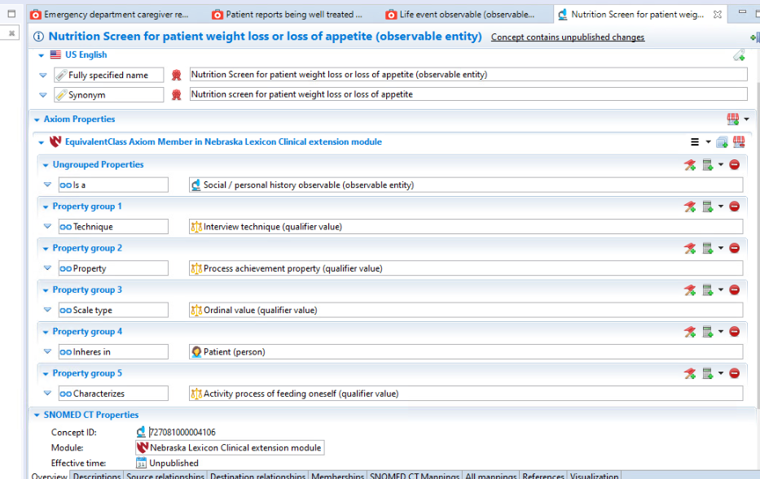
Nutrition screen for patient weight loss or loss of appetite (observable entity)

Slide 31
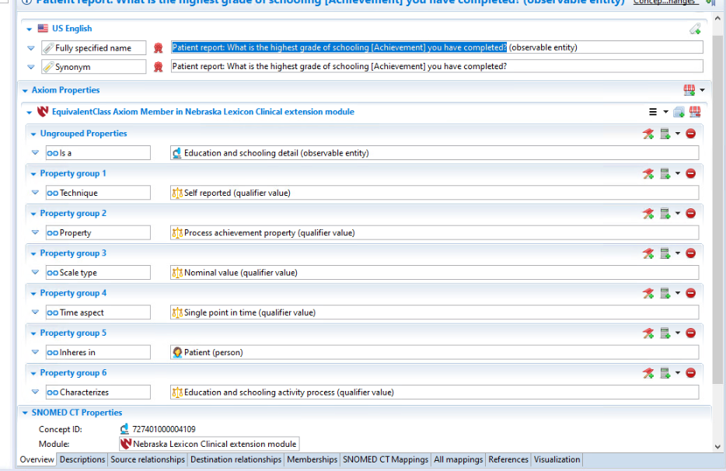
Loinc:63504-5 Patient report: What is the highest grade of schooling [Achievement] that you have completed (observable entity)

Slide 32
Community-Level Data Points
Sources: DOC American Community Survey, DOA RUCA class, DOA Food Access maps, DOJ Crime statistics,
What is the number of families in my community who receive food stamps/SNAP?
What is the number of adults in my community who live below the poverty level?
How easy is it to get to the doctor’s office from my home?
Deployed into research data warehouse as virtual data elements to be instantiated into research dataset computationally from geocoded link to patient residence

Slide 33
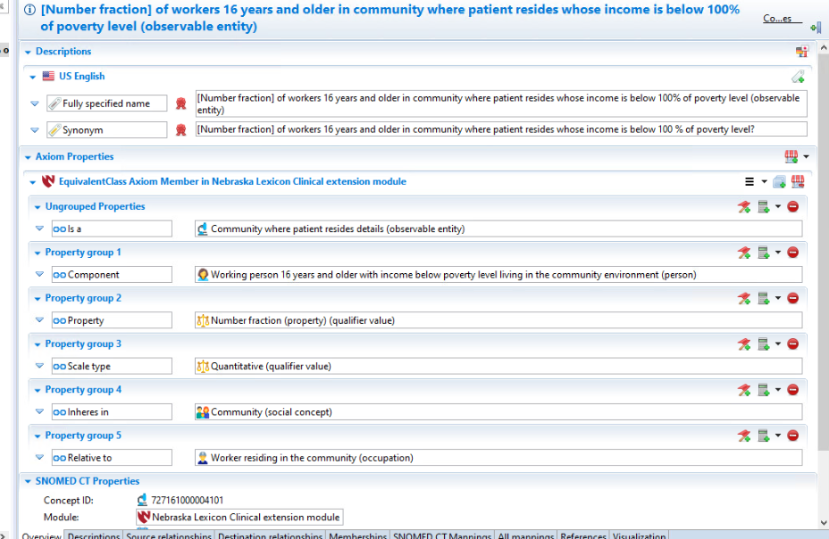
[Number fraction] of workers 16 years and older in community where the patient resides whose income is below 100% of poverty level (observable entity)

Slide 34
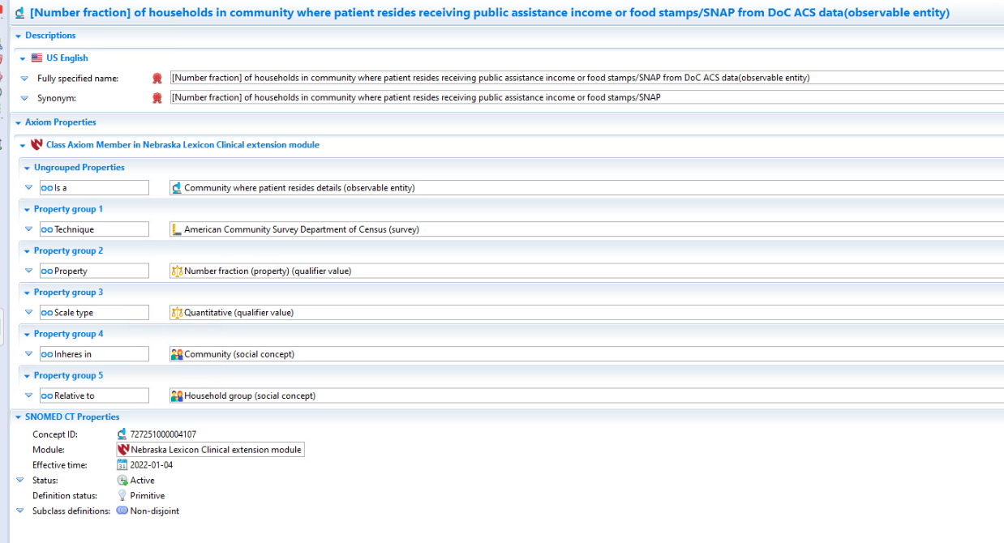
[Number fraction] of households in community where patient resides receiving public assistance income or food stamp/SNAP from DoC ACS (observable entity)

Slide 35
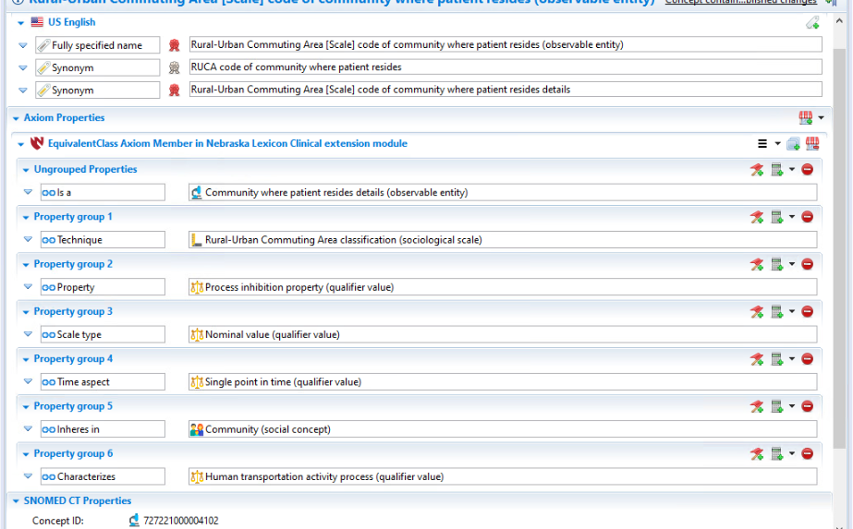
Rural-Urban Commuting Area [Scale] code of community where patient resides (observable entity)

Slide 36
Issues for Observables
Expand MRCM concept model valuesets for Component and Relative_to to include Social concepts
Expand Process and Property Qualifier hierarchies to include sociological processes

