Slide 1
SNOMED within FDB Solutions

Slide 2
Outline of Solutions
Multilex: Point-of-care drug database and decision support solution for UK market displaying safety alerts on prescriptions
OptimiseRx: Point-of-care solution displaying messages to users to optimise prescribing and monitoring decisions (cost, best practice)
AnalyseRx: Population-based solution identifying cohorts of patients suitable for intervention (monitoring, treatment change)

Slide 3

Multilex
Drug database and clinical decision support (safety) solution for UK market
Condition Checks
Generates alerts on prescription of a drug
Alerts take into account drug prescribed and conditions recorded in a patient record
FHIR Interoperability
Provides SNOMED-encoded data to support details such as formulation and route to be assembled in FHIR messages for pharmacy or discharge forms

Slide 4
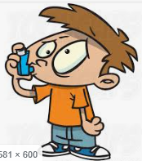
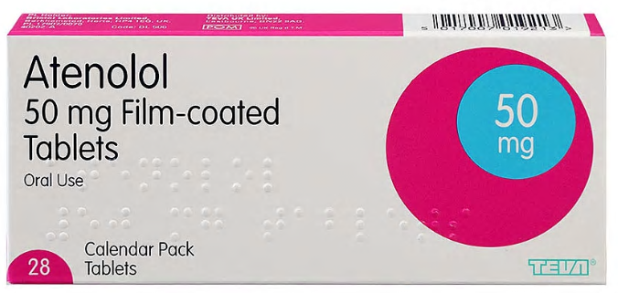


Multilex Clinical Decision Support (CDS)
Multilex (Condition Checking) provides alerts on prescribing a drug when a condition in the PMR would contraindicate this
Example: Atenolol is prescribed to a patient with atrial fibrillation and asthma
CONTRAINDICATED
ASTHMA
β - blocker
MLX ALERT

Slide 5


Receiving SNOMED Codes (Multilex)
INPUT
OUTPUT
Drug codes
Internal mapping from SNOMED to Multilex IDs
Multilex IDs
SNOMED
Non-drug codes
SNOMED codes
MULTILEX
Drug codes are received as dm+d ConceptIDs
These are mapped to MultilexIDs within Multilex for use by Multilex/OptimiseRx
Allows use of drugs not yet added to dm+d
Non-drug concepts (diseases, procedures, etc) are received as SNOMED codes

Slide 6
Disease Information in Multilex
Medical terminology codes recorded at the point of care are numerous (hundreds of thousands of codes) and very detailed
Such detail is not required for contraindication checking against drugs
Granular terminology codes are grouped into categories sufficient to support alert authoring requirements
Detect at level of upper GI haemorrhage
Acute DU with haemorrhage
Acute DU with haemorrhage and obstruction
Acute DU with haemorrhage and perforation
Acute GU with haemorrhage
Acute GU with perforation
Acute GU with obstruction
Acute haemorrhagic enterocolitis
Upper GI haemorrhage
Metoclopramide
SNOMED codes
Grouper for all related terminology codes

Slide 7
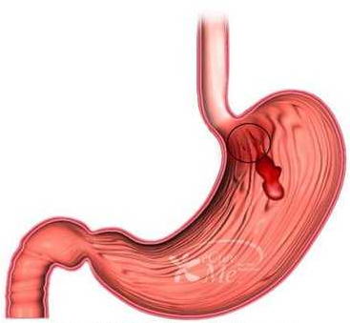
Different Granularities of Disease Grouping
Different uses of medical conditions require different granularities for alerting
Metoclopramide is contraindicated in GI haemorrhage
Such disorders include: Haemorrhagic colitis, rectal bleed, upper GI haemorrhage
These more granular groupings may be required for alerts on particular drugs
GI haemorrhage
Upper GI haemorrhage
Haemorrhagic colitis
Rectal bleed

Slide 8


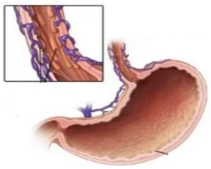
Multilex CDS Pathway
PMR: 282825002
NAUSEA/VOMITING
GI haemorrhage*
* SNOMED codes are linked to these internal grouper items
Upper GI haemorrhage*
Haemorrhagic colitis*
Rectal bleed*
MLX ALERT
PMR: 17709002 | Bleeding oesophageal varices (disorder)

Slide 9
Multilex Data Items holding Disease Information
SNOMED codes are linked hierarchically to disease groupers e.g.
Grouper: Upper gastrointestinal haemorrhage holds all SNOMED concepts under the SNOMED hierarchy:
<< 37372002 | Upper gastrointestinal haemorrhage (disorder)
Groupers linked manually to concepts from other SNOMED hierarchies e.g. procedures/situations, or individual concepts excluded e.g. Head injury (grouper) can be linked to:
  << 82271004 | Injury of head (disorder) |
  EXCEPT (e.g.) 283325003 | Insect bite of ear region (disorder) |
UNION 400976006 |Head injury advice given (situation)|
Currently a manual process using parent-child SNOMED relationships; we hope to refine process using more SNOMED functionality e.g. SNOMED Query Language

Slide 10
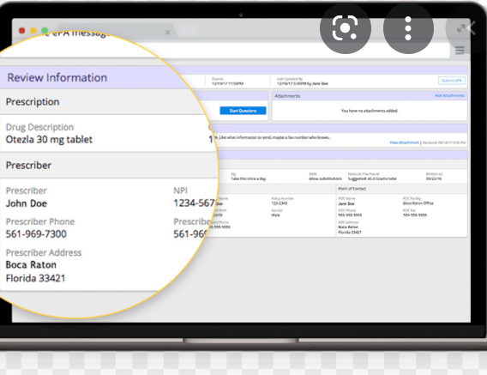
Sensitivity Checking
FDB internal links used to trigger allergy alerts on a given product
Prescription
SCT Concept
FDB Internal links
PMR
28770611000001108 |Otezla 30mg tablets (Amgen Ltd) (product)|
ING: Apremilast
SCT: 703350008 | Apremilast (substance)
703350008 | Apremilast
ALERT!

Slide 11
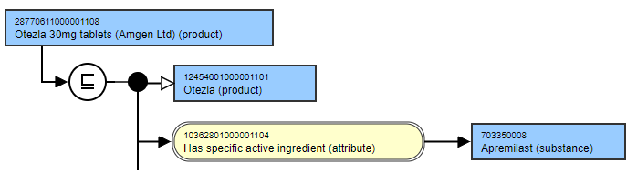
Sensitivity Checking (Ideal SNOMED-based)
Prescription
SCT Concept
PMR
28770611000001108 |Otezla 30mg tablets (Amgen Ltd) (product)|
703350008 | Apremilast
ALERT!

Slide 12
Issues with SNOMED-based Allergy-checking
|Has active ingredient| relationships were not reliably modelled at the time links were created (2005)
Most customers were/are using Multilex and Multilex IDs for prescribing
We plan to use enhanced SNOMED relationships to perform allergy checking more effectively

Slide 13





OptimiseRx
Patient-specific, point-of-care medicines optimisation solution
Uses patient characteristics (age, sex), conditions and drugs to logically evaluate against a set of criteria
Triggers during consultation on a drug prescription
Suggests more optimal therapy (Best practice, Cost) or gives advice
Based on local or national guidance

Slide 14

AnalyseRx
Identifies opportunities for optimisation of management of long term conditions among a patient population (at practice level)
Based on national guidance
Uses patient characteristics (age, sex), conditions and drugs to logically evaluate against a set of criteria
Identifies opportunities (a set of patients) for healthcare professional intervention

Slide 15
Receiving SNOMED Codes
SNOMED codes are either
  Received natively
  Processed from Read codes from historical records using cross-maps
INPUT
CROSS-MAPPING
OUTPUT
Read2 (ORx)
Data Migration
Primary Care Refset (reverse)
PBCL
CodesWithValuesAlternateMaps
SNOMED
CTV3 (ORx)
ORx/ARx Engine
SNOMED (ORx/ARx)

Slide 16
OptimiseRx/AnalyseRx
Patient characteristics
Drugs (from Multilex)
Conditions (Read/SCT)
Investigations (Read PBCL, SCT)
Age, sex
PEFR, latest sodium level
ORx Engine: Evaluate against query logic
Rules Engine: Evaluate against logical expression
TRUE?
TRUE?
N
Rule Silent
Y
User message with advice for single patient
FIRE RULE
User message with advice
List of patients suitable for intervention
OptimiseRx
AnalyseRx

Slide 17
AnalyseRx: Intensify antihypertensive treatment in diabetics with high BP
Age > 17
Diabetes mellitus*
SBP>140
DBP>80*
Age, sex
ORx Engine: Evaluate against query logic
ARx Engine: Evaluate against logical expression
TRUE?
TRUE?
N
Rule Silent
* SNOMED concepts linked to FDB Term
Y
Identify patients
Advice to intensify antihypertensive treatment
List of patients

Slide 18
Use of SNOMED Concepts
SNOMED definition for Condition Entities:
  ( << 73211009 | Diabetes mellitus (disorder) |
  EXCEPT <<11687002 | Gestational diabetes mellitus (disorder) | )
  OR 161445009 |History of diabetes mellitus (situation)|
Currently SQL equivalent, but working towards the development of a dedicated SNOMED editor e.g. using Refset Management Tool to implement SNOMED Query Language
Drug entities defined using SQL to retrieve Multilex IDs, but may use native SNOMED-based definitions using drug model attributes in future
Diabetes mellitus

Slide 19
Future Ideas
Use of SNOMED Query Language to define collections of SNOMED concepts to link to grouper items in Multilex or use in OptimiseRx
Use of SNOMED Query Language to define collections of drug concepts
Allergy checking using SNOMED relationships rather than internal links

