Slide 1
E2O Phase 1
Semantic Interoperation of Laboratory Results
James R. Campbell
Sarah Harry
Daniel Karlsson

Slide 2
Step 1 Plan
Scope: <<Evaluation procedure + Method=Measurement action + Lab context OR <<Lab procedure (~12290 concepts)
Proceed with assembling priority set for study and migration from systems in use: UK NHS
?Identify ambiguous or duplicate concepts for retirement (for discussion)
Redefine supertype 🡺ISA Observable entity
Retire invalid attribute-values from the Procedure concept model and convert definition to Observable concept model (Some procedure attributes provide similar semantics with different value sets; eg Method 🡺Technique)
?Structured FSN: [Component] [Property] [Inheres In] [Direct_Site_Substance][Precondition]
Equivalent to an existing Observable entity? Then retire observable as duplicate and retain SCTID of Evaluation procedure for the concept due to the presumption of standing bodies of work
Later: Revise Clinical findings concept model to exclude Evaluation Procedures from Includes attribute Value

Slide 3
NHS Evaluation Procedure Usage (READ code maps)
EvaluationProcedureID | EvaluationProcedureTERM | 2011-2019 Usage
113075003 | Creatinine measurement, serum | 278893220
104934005 | Sodium measurement, serum | 263533050
271236005 | Serum potassium measurement | 263083990
271026005 | Haemoglobin level estimation | 250937900
442673006 | Measurement of total haemoglobin concentration using dipstick | 250937900
391558003 | Total white blood count | 249562990
767002 | White blood cell count | 249562990

Slide 4
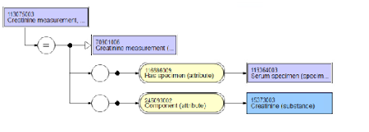
113075003|Creatinine measurement, serum (procedure)|

Slide 5
Lab Templates:
Assumptions & Pragmatics
The most specific Substance will be chosen based upon FSN and/or COMPONENT value to specify the Observables COMPONENT
If specimen is specified in SCT definition, INHERES_IN will be populated with that substance; otherwise the FSN will be reviewed for the appropriate substance grouper
If “measurement” is specified in FSN, then PROPERTY will be populated with the most general MEASUREMENT_PROPERTY that is consistent with laboratory test deployment eg: 118594004|Quantity concentration(qualifier)|
DIRECT_SITE will not be routinely employed unless a particular specimen preparation is specified in the FSN:

Slide 6
Migration Model Requirements
INHERES_IN = what we are testing
COMPONENT = what we are testing for
PROPERTY = the aspect of the tested
RELATIVE_TO = if a COMPONENT ratio requires a denominator
TECHNIQUE = if a specified method
PRECONDITION = how the patient was prepared for testing
DIRECT_SITE = only if a specific specimen preparation

Slide 7
Phase 1 Procedures Prep for Classification Testing
Use UK Procedures codes in use for Phase 1 migration assessment (1730 concepts)
Identify Orderables and Process-model Observables by examining FSN and HAS_SPECIMEN and remove those from UK Procedure codes use case (1436 concepts)
Review Specimens and FSN and develop candidates for INHERES_IN
Review Components and FSN and develop candidates for COMPONENT
Assemble candidates for additional defining attributes: PROPERTY, TECHNIQUE, RELATIVE_TO, PRECONDITION, DIRECT_SITE

Slide 8
HAS_SPECIMEN Values in Procedure concept defs
SCTID | FSN | #
NULL | null | 689
122592007 | Acellular blood (serum or plasma specimen | 50
119350003 | Calculus specimen | 6
276833005 | 24 hour urine sample | 29
119364003 | Serum specimen | 313
122575003 | Urine specimen | 110
258442002 | Fluid sample | 16
119361006 | Plasma specimen | 118

Slide 9
Phase 1 Sample Preparation for Classification Testing
1730 Procedure concepts verified in use for lab results coding in UK
211 Orderables: “73718004|Urine protein electrophoresis (procedure)” removed from sample
8 Process Observables model: “395135003|Activated partial thromboplastin time 50:50 mix” (urinary excretion rates, PT, PTT and clotting tests) removed from sample
1511 UK procedure concepts in use for lab results coding for phase 1

Slide 10
INHERES_IN assumptions for discussion…
“Fluid sample” 🡺 3346305|Liquid (substance) (16 concepts)
“Plasma” 🡺 50863008|Plasma (substance) (149)
“Serum” 🡺 67922002|Serum (substance) (391)
“Urine” 🡺 78014005|Urine (substance) (138)
“Unspecified” 🡺 256906008|Blood material (substance) (584)
“Acellular blood” 🡺 762634006|Acellular blood (substance) (46)
“Fecal” 🡺 39477002|Feces (substance) (13)
“CSF” 🡺 65216001|Cerebrospinal fluid (substance) (8)

Slide 11
Issues with assigning INHERES_IN
Half of Evaluation Procedures had no defining features for HAS_SPECIMEN
Unspecified types of blood tests: “271062006|Fasting blood glucose (procedure)” appeared to be blood tests of some type
DECISION: OK TO USE BLOOD MATERIAL AS INHERES_IN FOR NOW BUT REEVALUATE AFTER CLASSIFICATION EXPERIMENT
Blood cell studies: “Erythrocyte protoporphyrins”, “Leukocyte alkaline phosphatase”
DECISION: MODEL AS INHERES_IN = CELL STRUCTURE

Slide 12
Issues with assigning COMPONENT
Blood counts; discrepancy with modelling of tech preview: “74765001|Lymphocyte count (procedure)” do we use the cell structure or the “population of cells in fluid”
DECISION: IDENTIFY THIS AND SIMILAR TESTS UNSPECIFIED AS TO AMBIGUOUS AND REMOVE FROM PHASE 1 SCOPE

Slide 13
Issues with defining ‘total’ as denominator
271215008| Plasma free/total protein S ratio measurement (procedure)
DECISION: PROCEED WITH MODELING COMPONENT=FREE PROTEIN S, RELATIVE_TO = PROTEIN S;
CONTACT TONI MORRISON WITH CONCERNS THAT FREE PROTEIN S IS NOT A SUBTYPE OF PROTEIN S

Slide 14
Issues with assigning DIRECT_SITE
401102003|Blood spot thyroid stimulating hormone level (procedure): INHERES_IN = “Blood material”?, DIRECT_SITE = “Blood spot specimen”?
DECISION: OK FOR NOW…

Slide 15
Issues with assigning PROPERTY
415732003|Total treponema antibody measurement (procedure): PROPERTY = 118556004|Quantity concentration?
DECISION: USE QUANTITY CONCENTRATION
408239004Treponema pallidum gelatin agglutination test (procedure): PROPERTY = 705057003|Presence + TECHNIQUE = Gelatin agglutination technique

Slide 16
Meeting 14 discussion
20210721
Previous issues:
  Procedures “COMPONENT” a candidate for Observables COMPONENT
  Sparing use of DIRECT_SITE
  “Measurements”: PROPERTY = Quantity concentration

Slide 17
Followup from Farzaneh
https://confluence.ihtsdotools.org/display/OBSERVABLE/Free%2C+bound%2C+and+Total+substances
The current plan is to represent the base substance, the bound and the free substance as three siblings with a "substance X and derivatives" common supertype
This would support the Observables use cases of allowing querying for substances without regard for "bound-ness", and to distinguish between bound, free, and total.
Three patterns for Observables would be:
  Free X Observable === Observable & component = Free X
  Bound X Observable === Observable & component = Bound X (or X bound to Y)
  Total X Observable === Observable & component X (base substance concept)
FOLLOWUP WITH FARZANEH AND GROUP

Slide 18
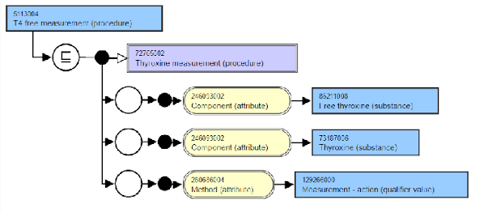
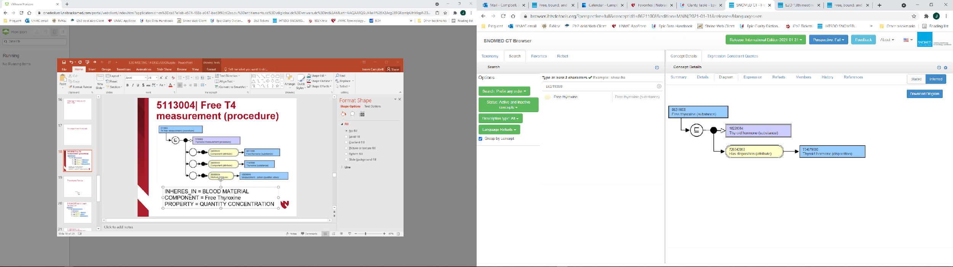
5113004| Free T4 measurement (procedure)
INHERES_IN = BLOOD MATERIAL
COMPONENT = Free Thyroxine
PROPERTY = QUANTITY CONCENTRATION

Slide 19
5113004| Free T4 measurement (procedure)
DELIVERABLE: APPROACH FARZANEH WITH
CONCERNS OF TEAM THAT ‘BOUND SUBSTANCE’
MAY NOT HAVE USE CASE; QUESTION
DEPLOYMENT PLAN FOR SNOMED CT
INHERES_IN = BLOOD MATERIAL
COMPONENT = Free Thyroxine
PROPERTY = QUANTITY CONCENTRATION

Slide 20
Procedures Review
1% Process observables: “Prothrombin time”
6% Orderables: “HIV type 1 and 2 antibodies and antigen”
1% Ambiguous: “Rheumatoid arthritis latex test”
Not “Measurement” but rather:
  “Protein C Assay” ?LEAVE OUT PROPERTY?
  “Liver antibody level” USE QUANTITY CONCENTRATION
  “Malaria antigen test” LEAVE OUT PROPERTY
  Cell counts…

Slide 21
Procedures Review
1% Process observables: “Prothrombin time”
6% Orderables: “HIV type 1 and 2 antibodies and antigen”
1% Ambiguous: “Rheumatoid arthritis latex test”
Not “Measurement” but rather:
  “Protein C Assay” ?LEAVE OUT PROPERTY?
  “Liver antibody level” USE QUANTITY CONCENTRATION
  “Malaria antigen test” LEAVE OUT PROPERTY
  Cell counts…
DELIVERABLE: EXPLORE ‘ASSAY’ USE CASE
NEXT CALL WITH MORE EXAMPLES TO FLESH
OUT CONTEXT

Slide 22
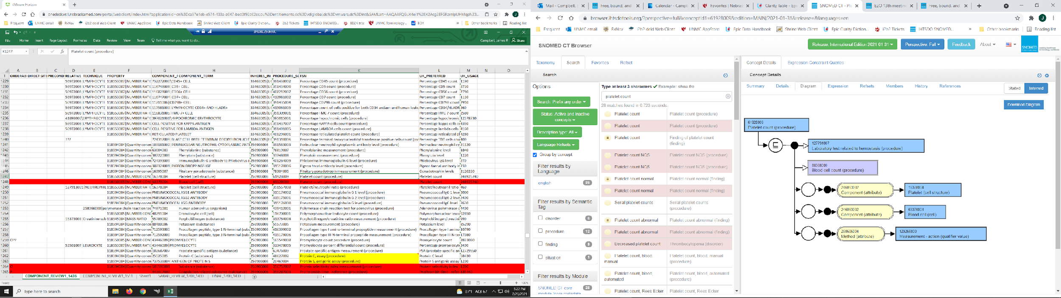
61928009|Platelet count (procedure)
INHERES_IN = FLUID SUBSTANCE
COMPONENT = Platelet (cell)
PROPERTY = NUMBER CONCENTRATION

Slide 23
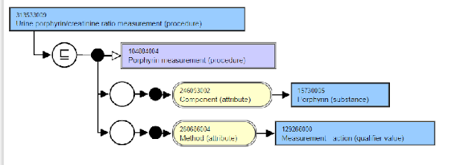
313533009|Urine porphyrin/creatinine ratio (procedure)
INHERES_IN = URINE
COMPONENT = Porphyrin
RELATIVE_TO = Creatinine
PROPERTY = Ratio

Slide 24
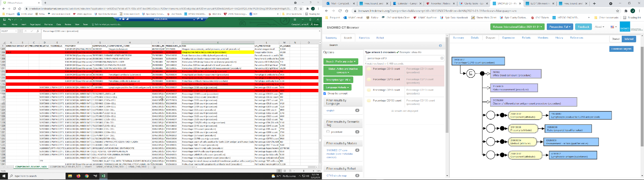
391305007|Percentage CD10 count (procedure)
INHERES_IN = FLUID
COMPONENT = Cell positive for CD10 antigen
RELATIVE_TO = Lymphocyte
PROPERTY = Fraction

Slide 25
391305007|Percentage CD10 count (procedure)
DELIVERABLE: DANIEL TO APPROACH MODELLING
TEAM WITH REQUIREMENT THAT FRACTION
PROPERTY MUST BE SUBTYPE OF RATIO IN
QUALIFIERS\PROPERTY
JIM TO CHECK DEFAULT CELL TYPE FOR
DENOMINATOR
INHERES_IN = FLUID
COMPONENT = Cell positive for CD10 antigen
RELATIVE_TO = Lymphocyte
PROPERTY = Fraction

Slide 26
END DISCUSSION 20210721
Karim: At the last E2O I attended I had a some reservation about the general “measurement” concepts as observable entity codes because in theory any value type could go against the code – quantitative or qualitative. I think Daniel said that even the qualitative result of positive/negative is still ordinal (might have misheard). I am wondering whether the problem runs deeper if the proposal is to model these high level “measurement” concept with a property of 118556004|Quantity concentration

Slide 27
Followup Issues
1511🡺1304 concepts excluding orderables, process observables and ambiguous procedure concepts
“Fluid lactate dehydrogenase measurement (procedure)”; Property = “Catalytic concentration” will be revised to QUANTITY CONCENTRATION except those specifying ‘activity’ in the FSN

Slide 28
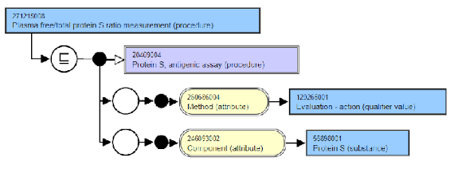
271215008|Plasma free/total protein S ratio measurement (procedure)
INHERES_IN = PLASMA
COMPONENT = FREE PROTEIN S
PROPERTY = QUANTITY FRACTION?
RELATIVE_TO = PROTEIN S
DK has submitted to SNOMED: Fraction will be a subtype of ratio

Slide 29
E2O 15: Properties Review
Not “Measurement” but rather:
  “Clostridium difficile toxin detection” Agreed out of scope
  “Clotting factor XX assay” use Agreed use QUANTITY_CONCENTRATION
  “Anti-nuclear factor titer” (vs Antinuclear antibody measurement) Agreed out of scope
  “ “Red cell (Erythrocyte) B2 level” Agreed out of scope; will advance issue to Observables call for discussion

Slide 30
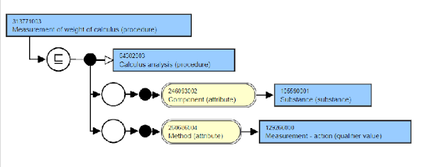
313771003|Measurement of weight of calculus (procedure)
Agreed PROPERTY = ‘Mass’

Slide 31
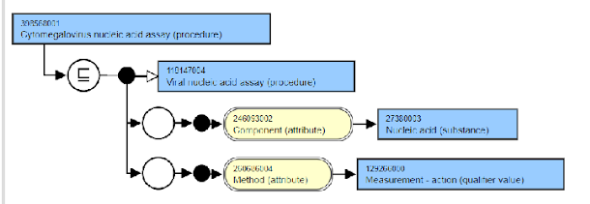
398568001|Cytomegalovirus nucleic acid assay (procedure)
Since nucleic acids may include RNA and DNA and
their subtypes specific to a species, do we extend
modeling of ‘Nucleic acids’ or use that specific to
the viral type?
29604-6|Cytomegalovirus DNA [#/volume] in Blood by
NAA with probe detection
RNA for Dengue and RNA viruses?
JCASE: these procedures are candidates for
inactivation and replacement; Out of scope for
this conversion

Slide 32
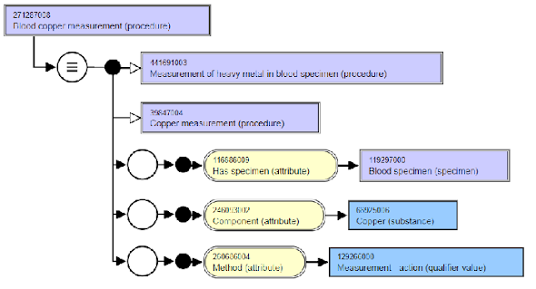
271284001|Blood copper measurement (procedure)
No electrolyte form in SNOMED CT nor
for many other soluble minerals
No action; continue with modelling as available

Slide 33
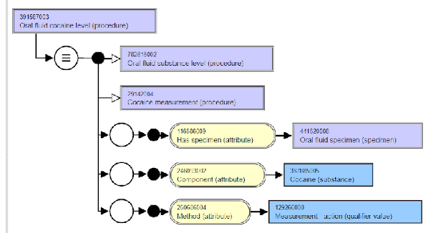
391567003|Oral fluid cocaine level (procedure)
INHERES_IN = LIQUID SUBSTANCE
COMPONENT = COCAINE
INHERENT_LOCATION = ORAL CAVITY
PROPERTY = QUANTITY CONCENTRATION

Slide 34
END DISCUSSION
20210804

Slide 35
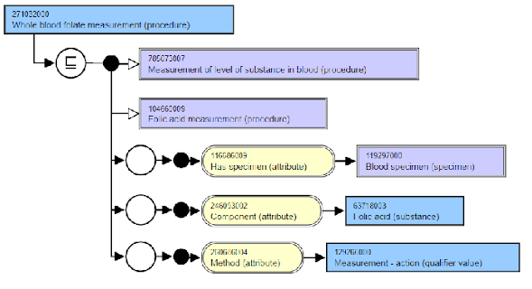
271032000|Whole blood folate measurement (procedure)
INHERES_IN = 420135007|WHOLE BLOOD SUBSTANCE
COMPONENT = FOLIC ACID
DIRECT_SITE = BLOOD SPECIMEN
PROPERTY = QUANTITY CONCENTRATION

Slide 36
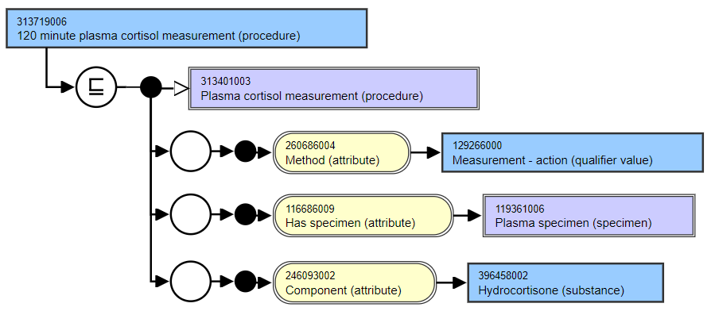
313719006| 120 minute plasma cortisol measurement (procedure)
INHERES_IN = PLASMA
COMPONENT = CORTISOL
PROPERTY = QUANTITY CONCENTRATION
PRECONDITION = ADMINISTRATION OF CRH
INSTANCE TIME STAMP IN INFO MODEL IS THE PREFERRED IDENTIFIER FOR SEQUENTIAL EXAMS

Slide 37
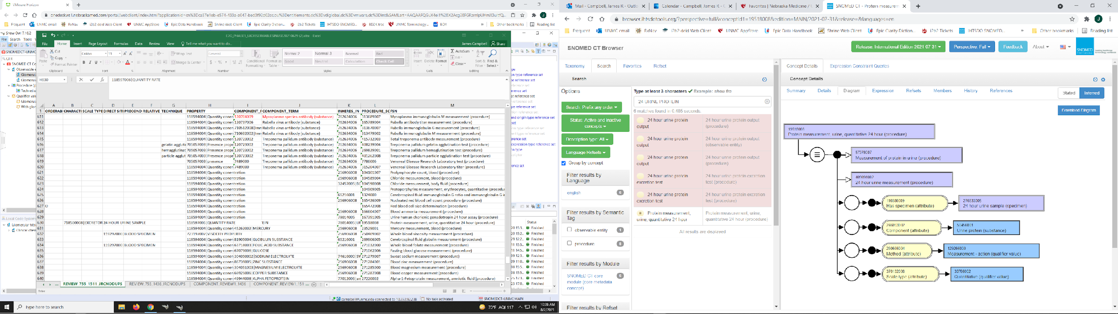
Protein measurement, urine, quantitative 24 hour(procedure)
INHERES_IN = URINE
COMPONENT = PROTEIN
DIRECT_SITE = 24 HOUR URINE SPECIMEN
PROPERTY = QUANTITY RATE
CHARACTERIZES = EXCRETORY PROCESS
DEFERRED FOR OBSERVABLES DELIBERATION

Slide 38
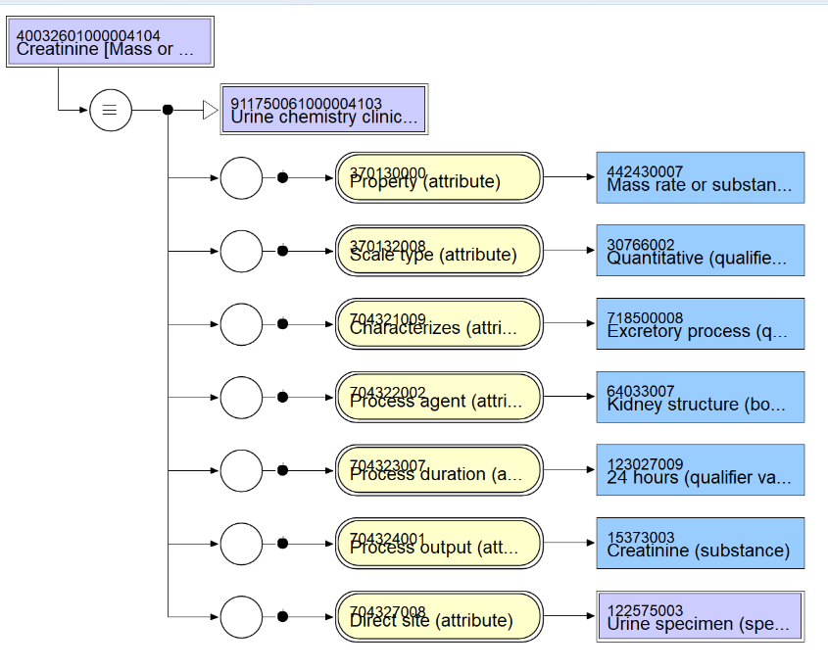
40032601000004104|Creatinine [Mass or Moles] in 24 hour urine (procedure)

Slide 39
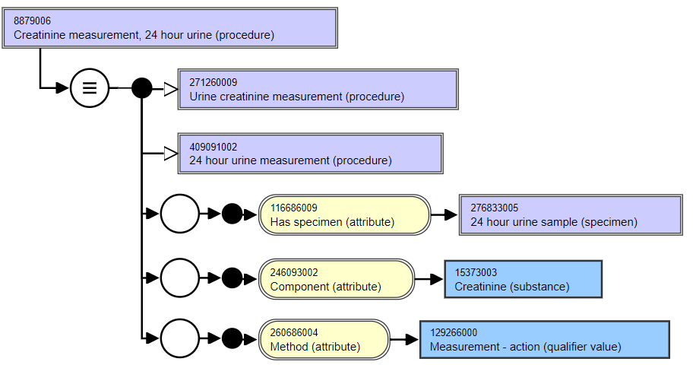
8879006|Creatinine measurement, 24 hour urine (procedure)
INHERES_IN = URINE
COMPONENT = CREATININE
PROPERTY = QUANTITY CONCENTRATION
DIRECT SITE = 24 HOUR URINE SPECIMEN
DEFERRED TO OBSERVABLES DELIBERATION

Slide 40
END DISCUSSION
20210818

Slide 41
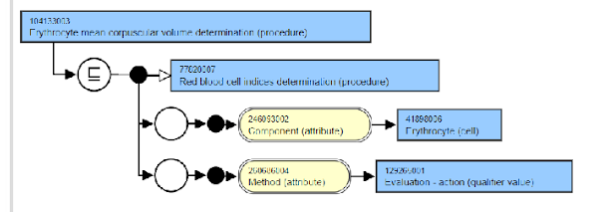
104133003|Erythrocyte mean corpuscular volume determination (procedure)
INHERES_IN = ERYTHROCYTE
INHERENT_LOCATION=POPULATION OF ALL ERYTHROCYTES IN PORTION OF FLUID
PROPERTY = ENTITIC VOLUME

Slide 42
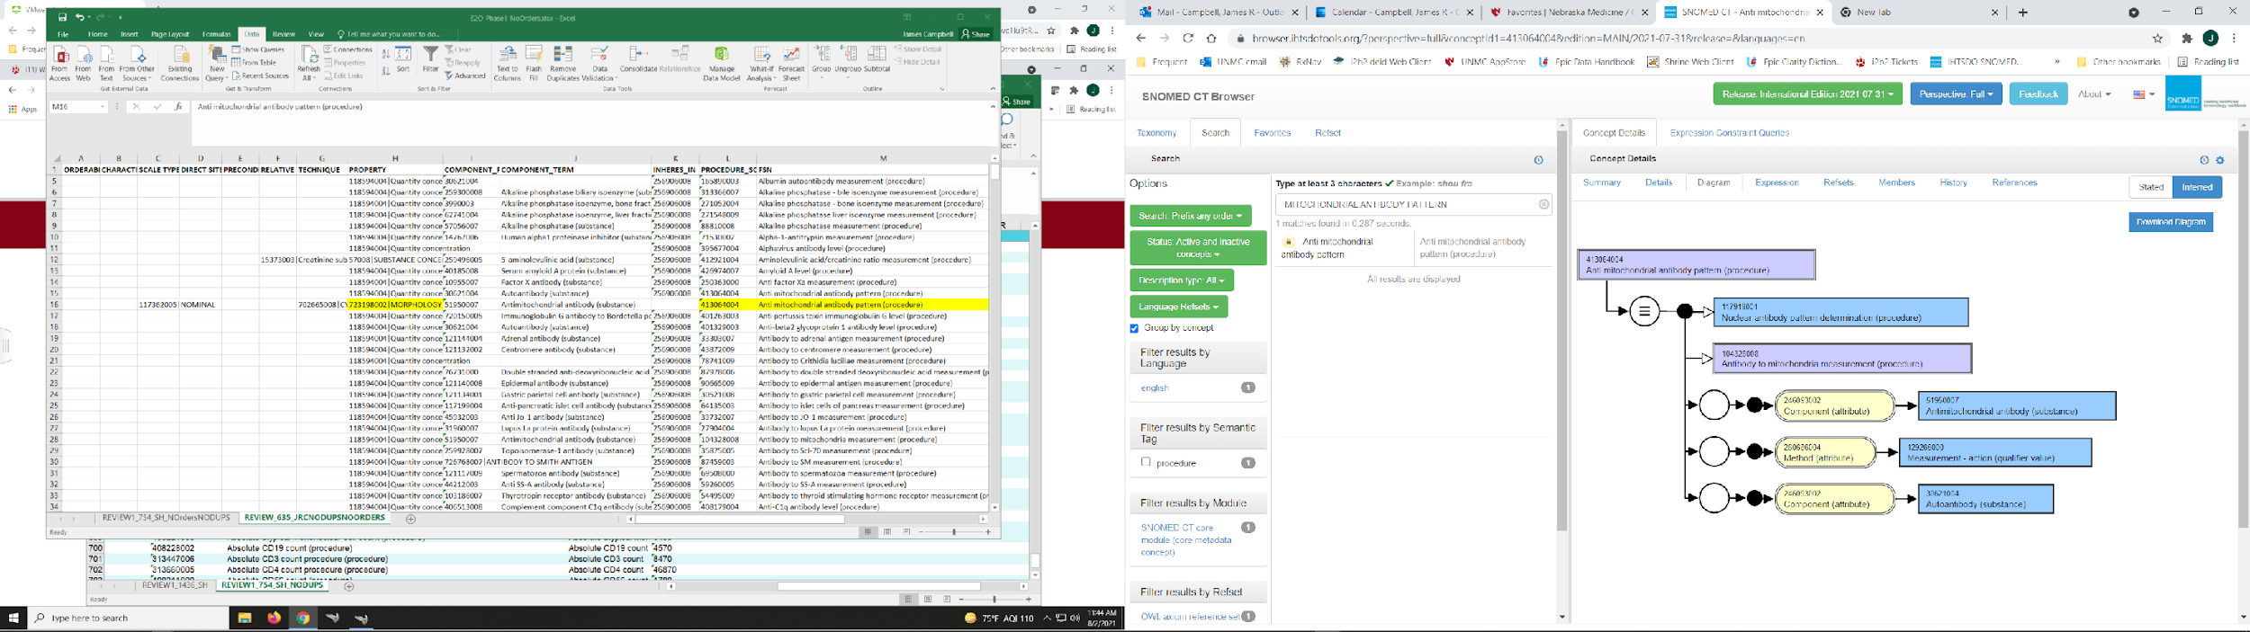
Anti-mitochondrial antibody pattern (procedure)
INHERES_IN = CELL?
COMPONENT = ANTI-MITOCHONDRIAL ANTIBODY
SCALE_TYPE = NOMINAL
PROPERTY = MORPHOLOGY NEEDS DISCUSSION DEFERRED TO COMMITTEE
TECHNIQUE = CYTOLOGY STAINING

Slide 43
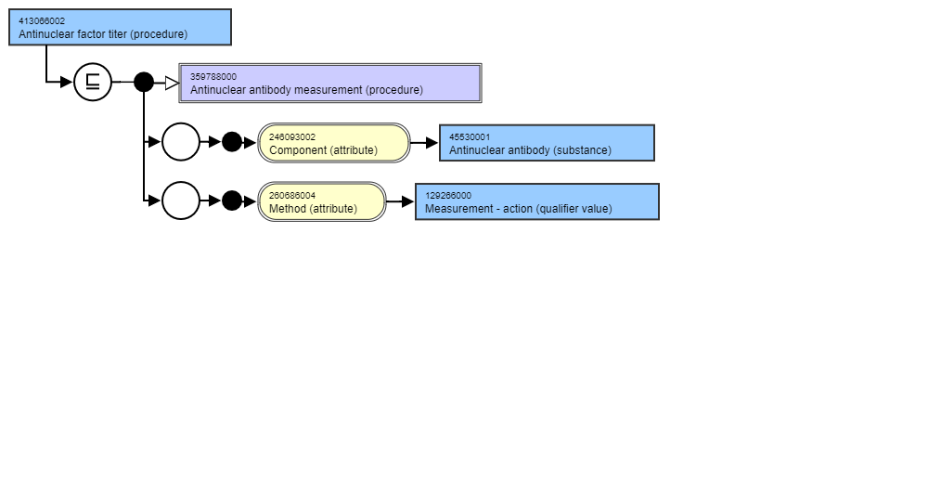
413066002|Antinuclear factor titre (procedure)
INHERES_IN = CELL NUCLEUS
COMPONENT = ANTINUCLEAR ANTIBODY
SCALE_TYPE = ORDINAL?
PROPERTY = TITRE DISCUSSION DEFERRED TO COMMITTEE
TECHNIQUE = CYTOLOGY STAINING

Slide 44
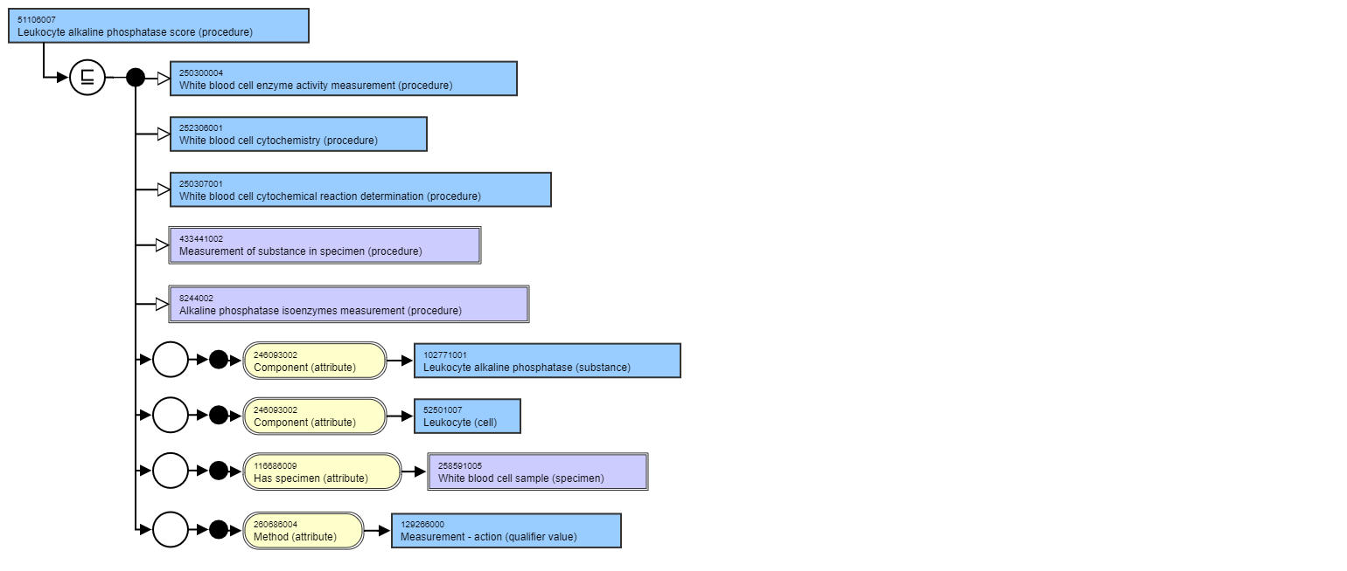
Leukocyte alkaline phosphatase score (procedure)
INHERES_IN = LEUKOCYTE (CELL)
COMPONENT = LEUKOCYTE ALKALINE PHOSPHATASE
SCALE_TYPE = ORDINAL
PROPERTY = MORPHOLOGY NEEDS DISCUSSION BY OBSERVABLES
TECHNIQUE = LAP SUPRAVITAL STAINING, MICROSCOPY

Slide 45
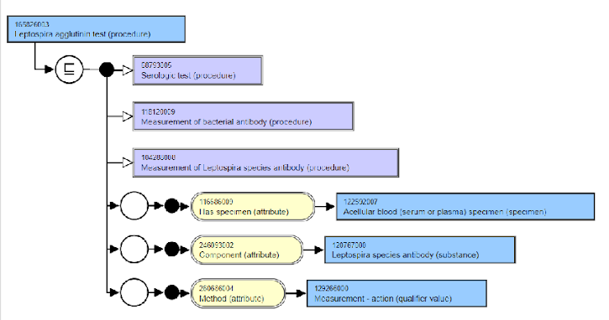
165826003|Leptospira agglutinin test (procedure)
INHERES_IN = BLOOD MATERIAL?
COMPONENT = LEPTOSPIRA ANTIBODY
SCALE_TYPE = ORDINAL
PROPERTY = PRESENCE
TECHNIQUE = LATEX AGGLUTINATION TECHNIQUE

Slide 46
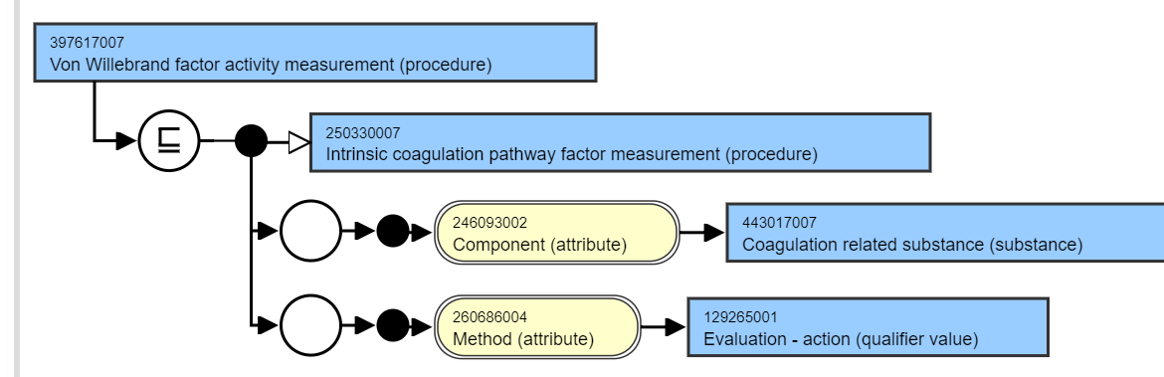
397617007|VonWillebrand factor activity measurement (procedure)
INHERES_IN = BLOOD MATERIAL
COMPONENT = VONWILLEBRAND FACTOR
PROPERTY = CATALYTIC CONCENTRATION?
TECHNIQUE =?OUT OF SCOPE AS PROCESS OBSERVABLE

Slide 47
Phase 1 Body of Work Revisions for Transfer Axioms: JRC and SH
Compile to OWL, classify with SNOMED CT and edit modelling errors; 40-50 modelling changes
Added some ‘supertype’ E2O Procedures to assure logically complete build
Final scope: 1208 <EvaluationProcedures with axioms (E2O_PHASE1_FINAL_JRC_SH20211029.XLSX) (e20_20211029.owl)
Imported into Protégé and classified with SNOMED CT 20210630, Nebraska LOINC Technology Preview and Nebraska Lexicon 20210924 (SNOMEDCT_LOINC_20210924.owl)

Slide 48
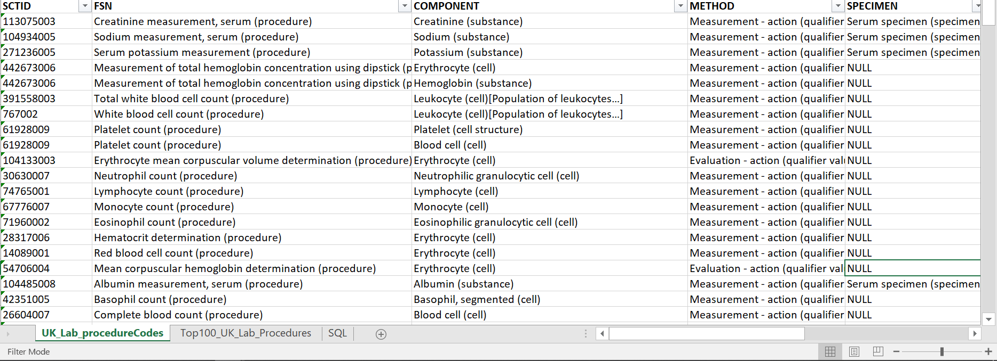
High Frequency UK Lab Codes

Slide 49
High Frequency UK lab classes for templates
Laborary Test Class | Exemplar
Chemistry concentration measurements on some liquid | Creatinine measurement, serum (procedure)
Electrolyte concentration measurements on some liquid | Sodium measurement, serum (procedure)
Chemistry concentration relative to some chemical concentration on some liquid | Urine albumin/creatinine measurement (procedure)
Antibody measurement expressed as a titer | Antimitochondial antibody titer (procedure)
Cell counts in some liquid | White blood cell count (procedure)
Cell counts in blood | Complete blood count (procedure)

Slide 50
Interoperation Use cases for Discussion
Creatinine measurement, serum
Serum sodium measurement
Total hemoglobin measurement using dipstick
White blood cell count

Slide 51
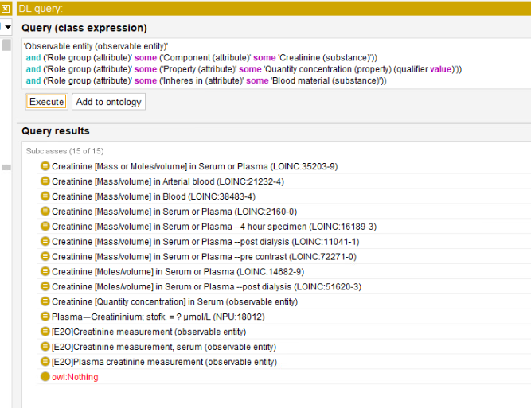
70901006|E2O Creatinine measurement (observable entity)

Slide 52
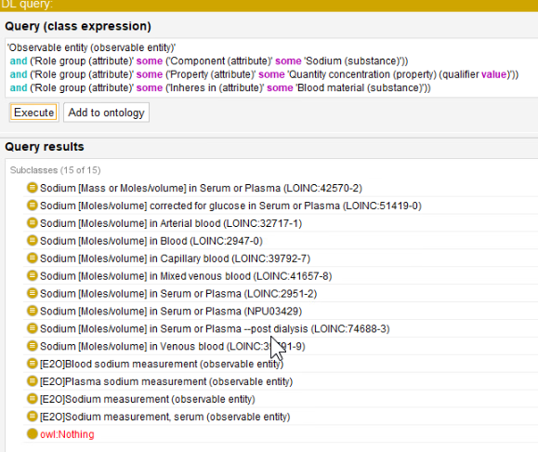
Observables Blood Sodium Measurements

Slide 53
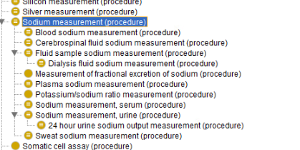
Sodium Measurements Procedures Classification
TO OBSERVABLES…
TO OBSERVABLES…
TO OBSERVABLES…
TO OBSERVABLES…
TO OBSERVABLES…
TO OBSERVABLES…
TO OBSERVABLES…

Slide 54
Semantic Objectives of Migration?
Support interoperation within Observables of Evaluation Procedure lab concepts that have been frequently employed by members for lab results coding
Move all Evaluation Procedures to Observable entities”
  Inactivate Procedures without viable clinical use cases as Orderables or Reportables
  Transfer entire subhierarchies as practicable in single move for integrity of Procedures

Slide 55
Meeting 20 Start

Slide 56
Sodium Measurements Procedures Classification
INACTIVATE…
TO OBSERVABLES…
ADD…
TO OBSERVABLES…
ADD…
PROCEDURAL?…
TO OBSERVABLES…
ADD…
TO OBSERVABLES…
TO OBSERVABLES…
ADD…
TO OBSERVABLES…

Slide 57
Proposal
Adjust scope as needed to migrate ‘subtrees’ of Evaluation procedures; agree to set scope <<Measurement of substance (procedure) UNION <<15220000|Laboratory test (procedure)
Standardize FSN terming for all Evaluation procedures to be migrated
{Component/Relative to}[Property]{Direct site/Inheres in}{Precondition}
“Sodium measurement [Quantity concentration] in blood (observable entity)”
Establish templates with exemplar concepts for all recurring use cases across laboratory testing domain

Slide 58
Electrolyte measurement [Quantity concentration] in liquid substance (observable entity)
363787002|Observable entity| :
{Component = < Electrolyte cation OR <Electrolyte anion),
Inheres in| = ^(<<Liquid substance OR <Acellular blood),
Property| = <<Quantity concentration,
Scale type| = (Quantitative OR Ordinal),
Time aspect| = <Time frame,
Technique| = <Technique,
Precondition = <Precondition value }
Acellular blood is also a liquid!

Slide 59
Chemistry laboratory measurement [Quantity concentration] in liquid substance (observable entity)
363787002|Observable entity| :
{Component = <Chemical,
Relative_to = <Chemical,
Inheres in| = ^(<<Liquid substance OR <Blood material),
Property| = ^(<<Quantity concentration OR Dilution factor expressed as titer (property)),
Scale type| = <Scales type,
Time aspect| = <Time frame,
Technique| = <Technique,
Precondition = <Precondition value}

Slide 60
Toxicology laboratory measurement [Quantity concentration] in liquid substance (observable entity)
363787002|Observable entity| :
{Component = <Chemical,
Relative_to = <Chemical,
Inheres in| = ^(<<Liquid substance OR <Acellular blood),
Property| = ^(<<Quantity concentration OR Dilution factor expressed as titer (property)),
Scale type| = <Scales type,
Time aspect| = <Time frame,
Technique| = <Technique,
Precondition = <Precondition value}

Slide 61
Microbiology serology laboratory antibody measurement [Quantity concentration] in blood material (observable entity)
363787002|Observable entity| :
{Component = <<Antimicrobial antibody,
Inheres in| = <Blood material,
Property| = ^(<<Quantity concentration OR Dilution factor expressed as titer (property)),
Scale type| = <Scales type,
Time aspect| = Single point in time,
Technique| = <Technique),
Precondition = <Precondition value}
Move Dilution factor expressed as titer
to < Quantity concentration

Slide 62
Allergy laboratory antibody measurement [Quantity concentration] in blood material (observable entity)
363787002|Observable entity| :
{Component = <Allergen specific immunoglobulin,
Inheres in| = <Acellular blood,
Property| = ^(<<Quantity concentration OR Dilution factor expressed as titer (property)),
Scale type| = <Scales type,
Time aspect| = Single point in time,
Technique| = <Technique,
Precondition = <Precondition value}

Slide 63
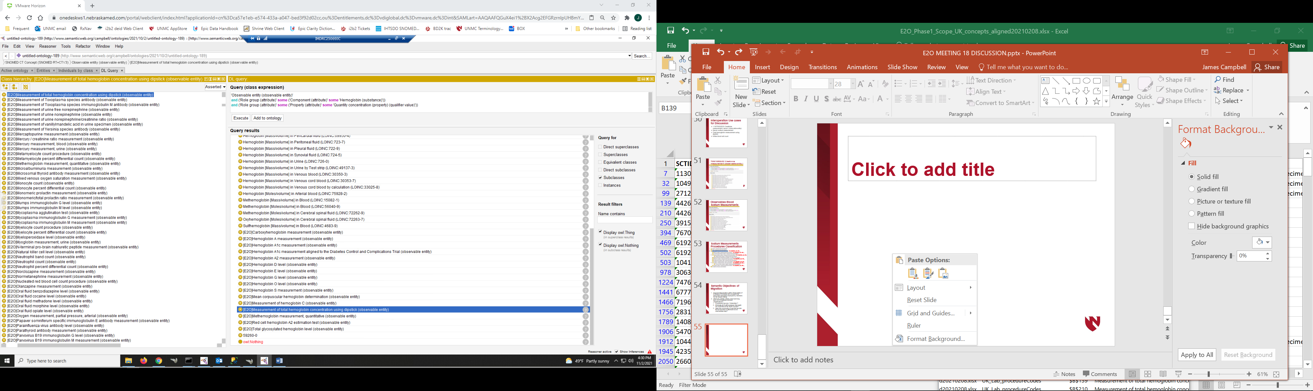
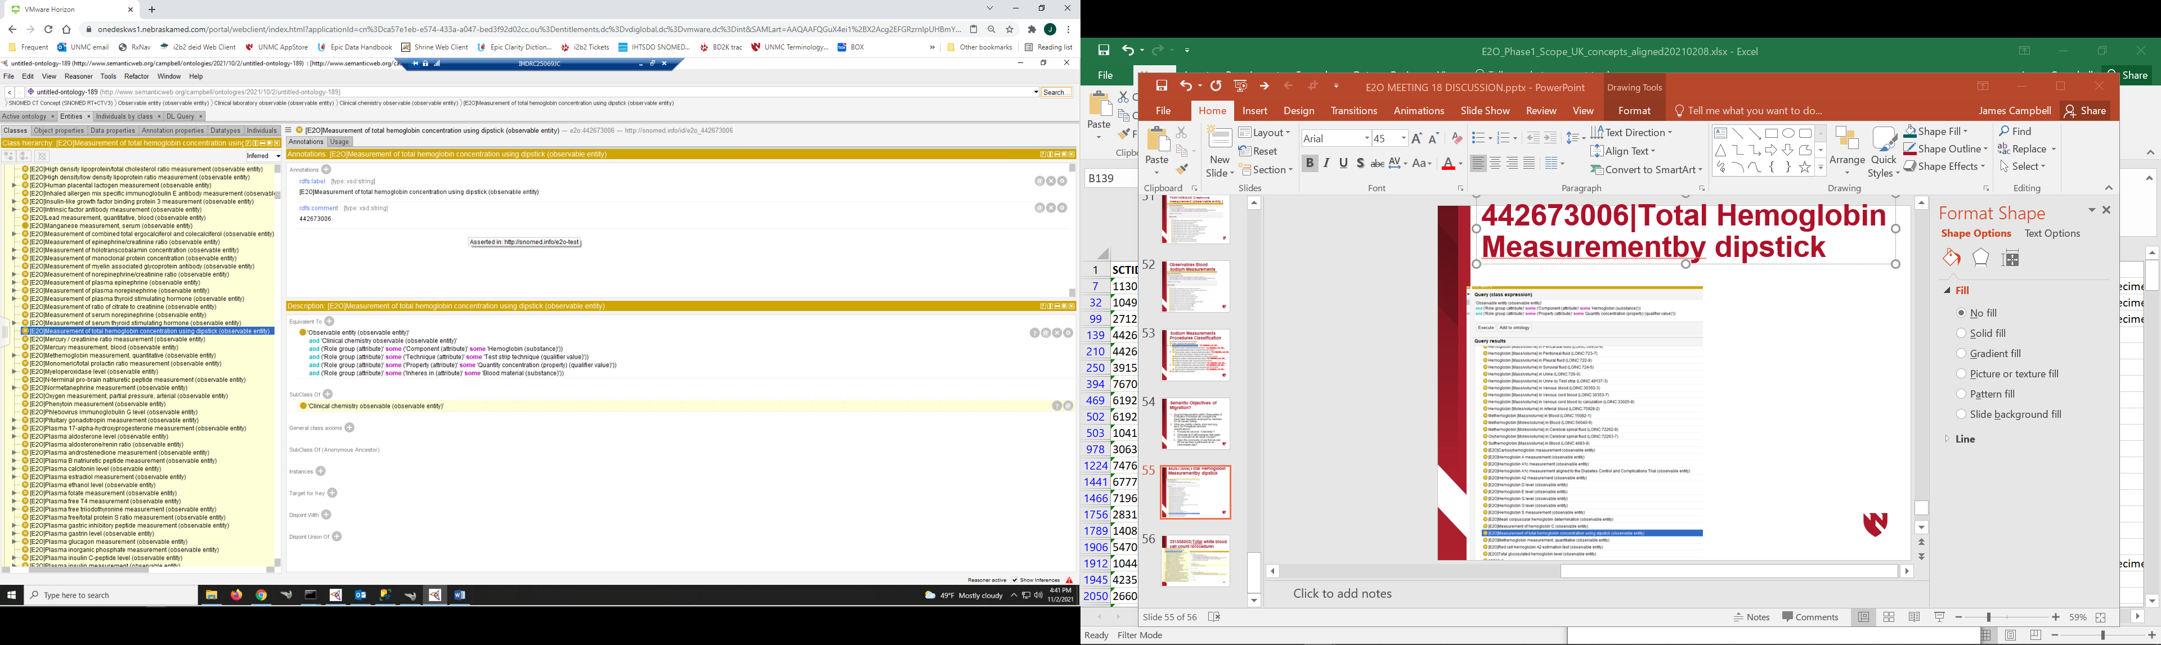
442673006|Total Hemoglobin Measurement by dipstick (procedure)
Hematology lab will be a challenge

Slide 64
Hemoglobin Measurements

Slide 65
442673006|Total Hemoglobin Measurement by dipstick (procedure)
Proposal: Inactivate

Slide 66
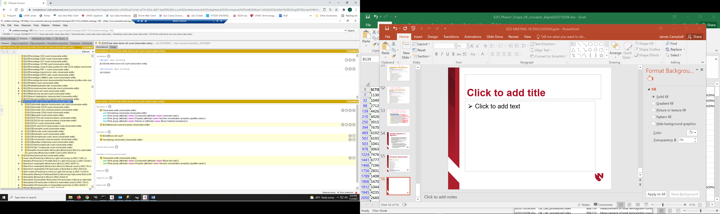
391558003|Total white blood cell count (procedure)
FSN is ambiguous:
-Leukocyte [Number Concentration] in blood?
-Population of all leukocytes [Number] in blood?

Slide 67
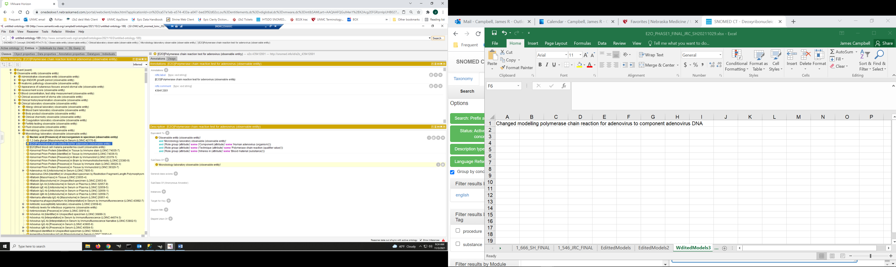
439412001|Polymerase chain reaction test for adenovirus (procedure)
Must change modelling for nucleic acid
detection Component to ‘Nucleic acid
sequence with specificity for Adenovirus’
This will require new content in Substances

