Slide 1
Inactivation of Ambiguous Concepts
Concept Inactivation Group – EAG 22 September 2021

Slide 2
Problematic Examples
208493001 |Open fracture finger distal phalanx, multiple (disorder)|
208488004 |Open fracture finger middle phalanx, multiple (disorder)|
208482003 |Open fracture finger proximal phalanx, multiple (disorder)|

Slide 3
Issues
These concepts were derived from ICD-9
It is not clear whether this should be interpreted as:
  Open fracture of multiple distal phalanges
  Open fracture of multiple sites of distal phalanx
Resolving the ambiguity would result in 2 potential targets:
  “Open fracture of distal phalanx of multiple fingers”
  “Multiple open fractures of distal phalanx of finger”
A review of the literature suggests there is little evidence to support the concept of multiple fractures of an individual phalanx
  Multi-fragmentary and comminuted fractures are recognized within some classifications of finger fractures but do not currently exist in SCT

Slide 4
Solution 1 – Fully Resolve the Ambiguity
Create 2 POSSIBLY_EQUIVALENT_TO target concepts:
  Open fracture of multiple distal phalanges
  Open fracture of multiple sites of distal phalanx
  Inactivate “Open fracture of multiple sites of distal phalanx” as “nonconformance to editorial policy” as it is a concept that is not a clinically useful (e.g. we can find no evidence that multiple fractures of a single phalanx occurs) and replace with a new concept “Open multi-fragmentory fracture of distal phalanx”
Pro’s:
  Provides all POSSIBLY_EQUIVALENT_TO’s
  Retains integrity of historical data
Con’s:
  Creation of a concept that is never released
  Time consuming exercise
  Tooling does not currently support this solution

Slide 5
Solution 2 – Create new concept(s) for
Multi-fragmentary and/or comminuted fractures
Create a new concept to represent Multi-fragmentary/comminuted fracture of the distal phalanx
Inactivate 208493001 |Open fracture finger distal phalanx, multiple (disorder)| as “Ambiguous”
  POSSIBLY_EQUIVALENT_TO: Open fracture of distal phalanx of multiple fingers
  POSSIBLY_EQUIVALENT_TO: Open comminuted fracture of distal phalanx

Slide 6
Option 2 - continued
Pro’s:
  Satisfies the requirements for inactivation of an ambiguous concept
  Avoids creation of a new concept that will never be released
  Is less damaging to the integrity of historical data than option 3
Con’s:
  Potentially a small amount of degradation to historical data
Note: The guidance for use of ICD states that every effort should be made to record the fractures applicable to each individual phalanx and usage data for 208493001 |Open fracture finger distal phalanx, multiple (disorder)| suggests that there has been very little live usage.

Slide 7
Solution 3 – Inactivate as a “Classification derived concept”
Inactivate as "Classification derived concept” as it is derived from 816.13 Open fracture of multiple sites of phalanx or phalanges of hand.
  REPLACED_BY “Open fracture of distal phalanx of multiple fingers”
Pro’s:
  Simple to implement
  Will account for most of the instances in the clinical record
Con’s:
  There will be some degradation of historical data integrity
  There is no way of recording Multi-fragmentary and comminuted fractures of the distal phalanx

Slide 8
General Comments
The example given is a specific us case and, in this instance, discussion reveals a number of potential solutions.
It is our considered opinion that most of the ambiguous inactivations will be resolvable by identifying all of the potential POSSIBLY_EQUIVALENT_TO targets and where necessary creating new concepts where they do not currently exist.
However, some ambiguous concepts will be difficult to resolve and where it is found that usage of the concept is high, care must be taken to safeguard historical data integrity and patient safety

Slide 9
Moving Forward
While we all agree that maintenance of historical data integrity is important, we do not have concrete evidence of the magnitude of the problem raised by existing ambiguous inactivations.
In the absence of concrete evidence, it is difficult to establish whether it is necessary to pursue ‘purity’ in the solution.
A review of the inactivation statistics since 2002 shows:

Slide 10
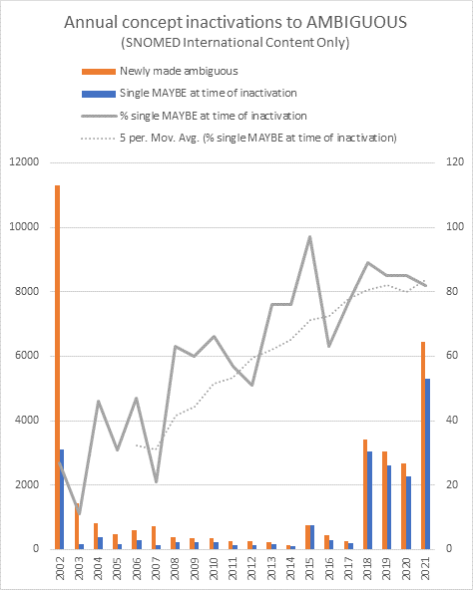

Slide 11
Why the sudden increase in Ambiguous inactivations
The QI project has identified content that either is out of scope for SCT or does not conform to current editorial policy
Current inactivation reasons and historical associations are inadequate:
  Inability to assign “Classification derived concept”
  Non-conformance to editorial policy does not support a historical association
  Etc.
We know that many inactivations have used ambiguous as a work around for content that should be inactivated as nonconformance to editorial policy

Slide 12
Proposal – Assess the size of the problem
We suggest that we go back 5 years:
  For those ambiguous inactivations that have a single POSSIBLY_EQUIVALENT_TO, identify those that need to be reallocated to a more appropriate inactivation reason and tag them for reassignment (many already have an appropriate historical association)
  The remainder should be reviewed and divided into:
    Those that could be improved with the addition of further clinically useful concepts
    Those that legitimately represent classification derived concepts or other inactivation reasons
    Those that fall into the “difficult” category
Bring the results back to the EAG for further discussion

