Slide 1
SNOMED CT Canadian Immunization Project
July 22, 2021
Linda Parisien, SNOMED CT Manager, Infoway

Slide 2
Agenda
Brief historical review of the immunization content in Canada
Benefits
Challenges
Redesign and enhanced model
Questions

Slide 3
Brief Historical Review of the Immunization Content in Canada

Slide 4
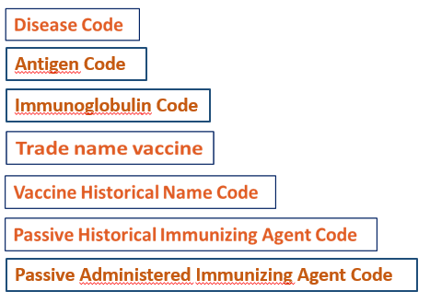
SNOMED CT Immunization (developed in 2013)
Referencing Core SNOMED CT
CA Edition SNOMED CT
Substance (CORE)
Medicinal Entity (I)
Medicinal Entity (I)
SubsetS
+ Concept SCTID
+ Fully Specified Name (FSN)
+ Concept SCTID
+ Fully Specified Name (FSN)
+ Synonym SCTID
+ Concept SCTID
+ Fully Specified Name (FSN)
+ Synonym SCTID
Disease
Substance (CA Extension)
+ Concept SCTID
+ Fully Specified Name (FSN)
+ Concept SCTID
+ Fully Specified Name (FSN)
Proprietary Medicinal Product (I)
Editorial Guidelines
+ Concept SCTID
+ Fully Specified Name (FSN)
+ Synonym SCTID
Immunization
General EN Editorial Guidelines
General FR Editorial Guidelines

Slide 5
Initial Business Use cases
Administration of vaccine
Historic information
Immunization forecast
Analytics
Notes:
Use SNOMED CT as a recognised terminology standard
to identify in an easier manner the patients that received immunizations
to allow trending of the immunization data
to standardize trade name concepts using unique descriptions
Subsets developed for:
recording administration of vaccines (current and past)
inventory management
immunization forecasting
To capture products
by TradeName when administered to pt
In a more generic manner for products we don’t know the TradeName
For data forecasting (Proactively identify patients who need a vaccine)
Proactively identify patients who need a vaccine
“Patient X had dose 1 of Twinrix® 12 months ago; overdue for dose 2” - reminder to be sent
For and analytics (to support mgt information)
Analytics (various levels) to support management of information
To allow consolidating all single component and combination products to calculate coverage for a particular antigen
e.g. injectable polio vaccine (IPV) / oral polio vaccine (OPV)
e.g. diphtheria, pertussis, tetanus, polio (DPTP); DPTP-Hib; Polio

Slide 6



Vaccine Administrable Subsets
Active recording
  Patient Y has received administration of Varilrix® at the clinic today
  The public health nurse can:
                select the proper product available in Canada from a drop down menu
  enter the specific product trade name being administered to the patient
6
Notes:
Linda

Slide 7
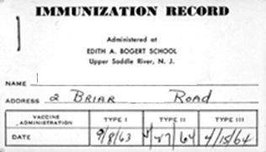
Vaccine Historic Subsets
Historic recording
  Patient X had a ‘varicella’ vaccination in 1987
  No idea which actual product was used
  The public health nurse enters a ‘generic’ vaccine name
GENERIC
Var varicella unspecified
7
Notes:
Linda

Slide 8

Active Ingredient Subsets
Antigen
Immunoglobulin
ANTIGEN
Antigen of Human alphaherpesvirus 3 recombinant surface glycoprotein E
IMMUNOGLOBULIN
Varicella-zoster virus antibody

Slide 9
Benefits
Canadian implementations
In Panorama:
  Ontario
  Manitoba
  Saskatchewan
  British-Columbia
Other systems:
  Canadian Forces
Public Health Agency of Canada (PHAC)
Notes:
Use of a recognized reference terminology standard within the PHS network
Share understanble and accepted terms

Slide 10
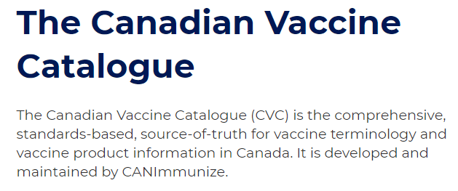

Benefits
Leveraged for the Canadian Vaccine Catalogue (CVC)
Leveraged for the CanImmunize App

Slide 11
Initial Challenges
Work around:
  Product and substance hierarchies outdated
  Strengths (standard dose, low dose)
No business requirements
  Units of presentation (vial, ampoule, pre-filled syringe)
  Antigen details (for example, split virion/surface antigen)
  Adjuvanted, unadjuvanted, adsorbed

Slide 12
Initial Challenges Impacts
Not done
  Concept modeling
  Alignment on DIN
  Year for Influenza
Inconsistencies
  Different ways to represent the strengths for trivalent, quadrivalent and other types of vaccines
  When more than two (2) active ingredients, the strength is not part of the FSN

Slide 13
Redesign in 2020 and enhanced model

Slide 14
Reasons for Redesign
1. To align on the International Drug Model and Guidelines
  Enhancements in many hierarchies
    Qualifier value
    Pharmaceutical / biologic product (product)
    Substance
2. To support the new Public Health Community requirements
  Two or More Active Ingredients
  Influenza Vaccines Strains vs Strengths
  Better alignment with the Health Canada Drug Product Database (DPD)
  Influenza Vaccines DIN/Year
  Specific Preferred Terms
  Immunization Subsets scope changes
  Product lifecycle (active, inactive, deprecated) (CCDD alignment)
Notes:
Minor issues - Resolved
Change concepts Manufacturer for MAH
Request for changes submitted for change of manufacturer/MAH
Canadian Immunization Guidelines updated

Slide 15
Approach
Weekly meetings with the Public Health Community (TermMed and Infoway)
  Kick off meeting
  Influenza vaccines
  Complex combined DPT-Polio-Hib-HB
  Refsets
  Naming conventions for vaccines
Communication to/from the Community
Canadian Daily Build Browser
Publication of the presentations on the Health Terminologies Community Forum

Slide 16
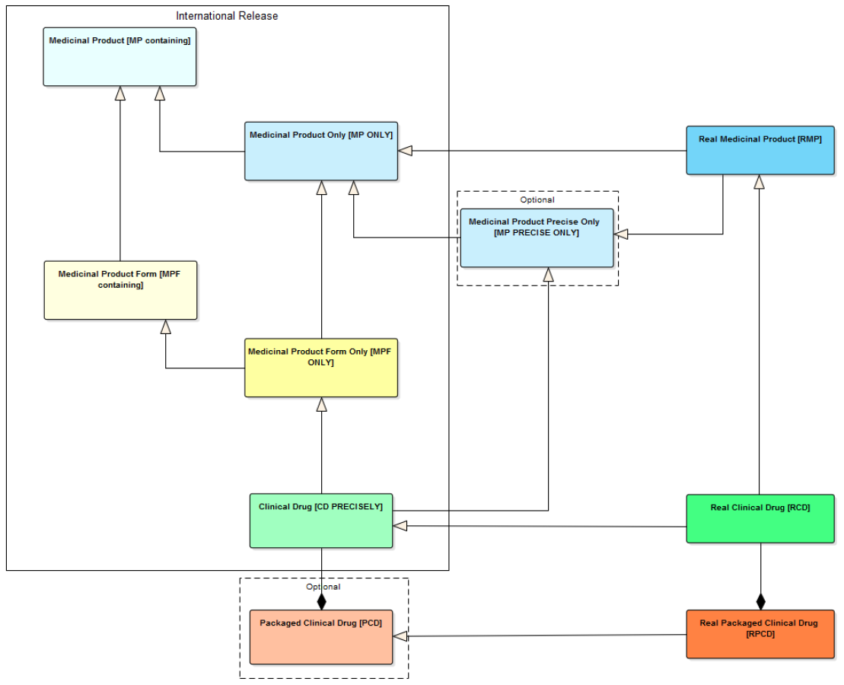
Proposed National Model - SI
CA EDITION
FOCUS
Integrated International - National Model
Notes:
RCD - supported use case:
In prescribing and in medication statements, especially in situations where the patient should always use a particular manufactured product
In dispensing and administration, to identify exactly which product was provided/used
For reimbursement: national or local systems may set pricing or eligibility against particular manufactured products, regardless of how they are supplied (i.E. With no reference to pack size)
Allergy checking of specific excipients (if described)
Pharmacovigilance

Slide 17
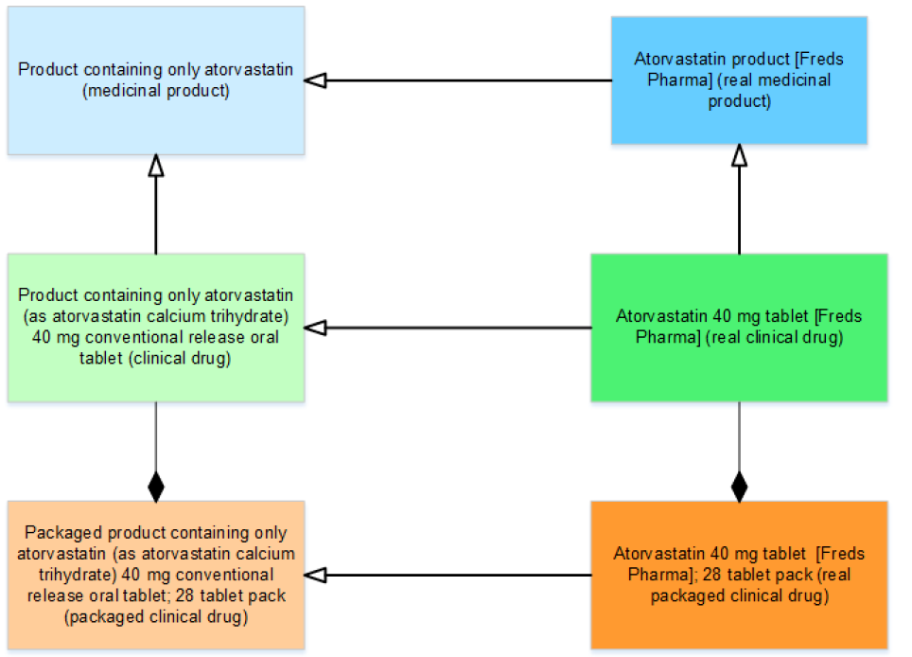
Support Immunization Active Recording, Forecasting and Analytics Management
Use cases supported by Real Clinical Drug
Support medication process activities: prescribing, dispensing, administration and medication statements.
Notes:
RCD - supported use case:
In prescribing and in medication statements, especially in situations where the patient should always use a particular manufactured product
In dispensing and administration, to identify exactly which product was provided/used
For reimbursement: national or local systems may set pricing or eligibility against particular manufactured products, regardless of how they are supplied (i.E. With no reference to pack size)
Allergy checking of specific excipients (if described)
Pharmacovigilance

Slide 18
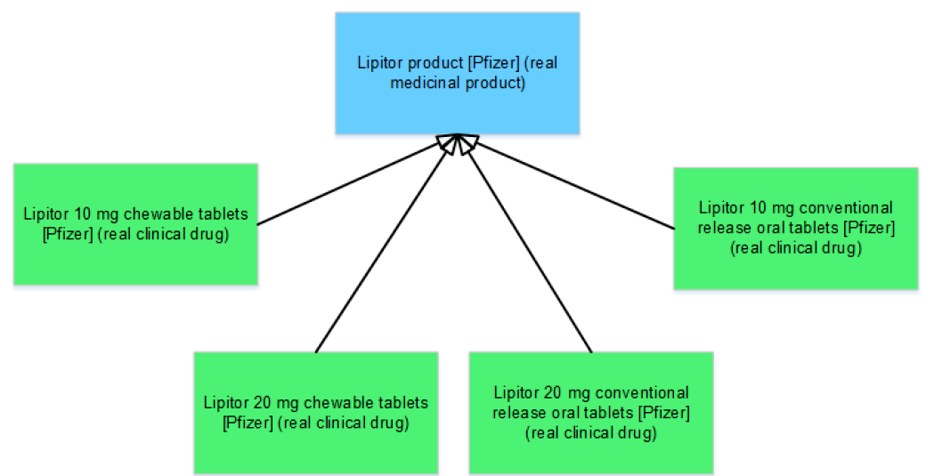
Support the Manufacturer or
Market Authorization Holder (MAH)
Definition: The (name of the) organisation that holds the authorisation for marketing or supply of the medicinal product
Manufacturer vs Market Authorization Holder (MAH)

Slide 19
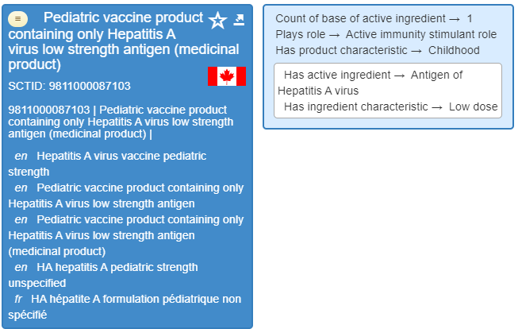
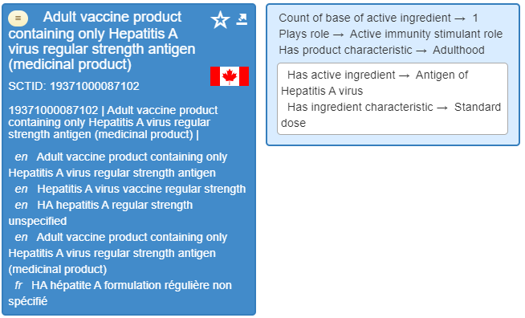
Strengths and Intended Population

Slide 20
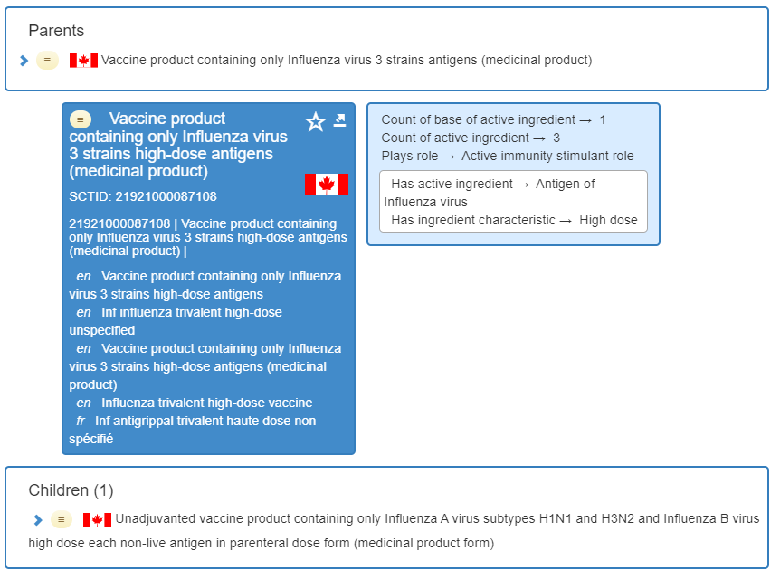
Strains and Dose Form

Slide 21
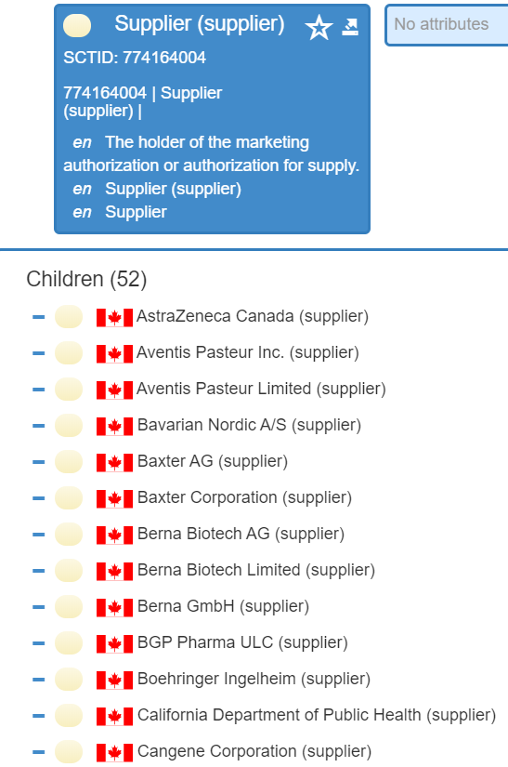
MAH: Supplier’s List

Slide 22
Comparison between 2013 and 2020 models
2019
2020 (July)
Vaccine name is ambiguous
  different interpretations depending on open/closed world assumptions
Vaccine grouper primitive
Vaccine product has ingredient vaccine substance
Primitive hierarchy
Vaccine classes for open (MP-contain) and closed (MP-Only) world assumptions
Vaccine grouper is sufficiently defined with role
Vaccine product has ingredient antigen(s)
Defined hierarchy

Slide 23
What Was Kept
Canadian Concept ID
Canadian preferred synonyms

Slide 24
What Was Changed
Vaccine products names
Antigen hierarchy adding greater granularity (based on Canadian and Argentinean extension antigen coverage)
MP-contain and MP-Only classes are added, as well as MP-forms

Slide 25
In Summary: What was achieved
Remodeling of the existing Canadian immunization concepts
  Manual and batch editing
  New concepts added to maintain the hierarchical structure
  Implementation of the Clinical Drug and Vaccine Models (dose form, real product, etc)
Better support the Public Health Community’s requirements
Notes:
A description of the strength of the product (e.g. "low strength" or "adult strength“)
A description of the intended population for the product (e.g. "for children")
A description of the dose form as it appears in the name (e.g. “parenteral dose form” or “oral dose form")
A new model for the representation of medicinal products related to immunization use cases
Updated editorial policies for the incremental adoption of the SNOMED International Clinical Drug Model in the Canadian Extension content, based on local priorities
A draft transition plan for the transition of the content to the adopted model and terminological resources.
The main issue is related to the naming convention of the tradename
A remodeled representation of existing medicinal products in the Canadian edition, related to immunization use cases. The remodeling is accomplished manually by TermMed clinical editors and Canada Health Infoway editors and SMEs, batch editing, and QA and pattern detection rules
A remodeled representation and edition of auxiliary content required to support the Clinical Drug model at the local level (e.g. extending dose forms, representing local suppliers, trade product names, etc.)
Better support for complex use cases – many of those have been expressed in the new PHS requirements

Slide 26
Conclusion
Notes:
CVC group very active and leading the community’s requests for change.
There are discussions to create a map between CCDD and SNOMED CT vaccines to allow CA stakeholders that already are using SNOMED CT codes to still access them while using CCDD for the other Drugs.
More discussion required for:
Influenza Vaccines DIN/Year
Specific Preferred Terms
Immunization Subsets scope changes
Product lifecycle (active, inactive, deprecated) (CCDD alignment)

Slide 27
Questions

Slide 28
Thank you!
Standards@Infoway-inforoute.ca

