Slide 1
Canadian Clinical Drug Data Set
Thursday August 5th 2021
Jo-Anne Hutsul, Health Canada

Slide 2
Outline
Canadian Clinical Drug Data Set (CCDD)
  Background
  Model
  Scope
CCDD Immunization Content
SNOMED CT Mapping and Issues

Slide 3
CCDD Background
Need identified to develop a national terminology to allow digital interoperability, particularly for e-prescribing
Infoway and Health Canada established a partnership to provide a national drug terminology that is freely available based on Health Canada’s Drug Product Database (DPD)
Engaged an advisory group to guide development
  Jurisdictional representatives, Institute of Safe Medicines Practices, knowledge based vendors (e.g., First Databank, Vigilance Santé), Infoway, Health Canada, Canadian Pharmacists Association, Canadian Institute of Health Informatics)
Editorial Guidelines established
First published September 2017 with monthly updates
French content added December 2019

Slide 4
The CCDD
An open source drug terminology
Interchange terminology vs interface terminology
Used by various knowledge base vendors in pharmacy and medical software systems
  e.g., First Databank, Vigilance Santé, Cerner Multum
Help facilitate adoption of national e-prescribing
Supports Health Canada’s preparations for broader adoption of international standards

Slide 5
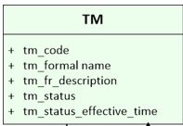
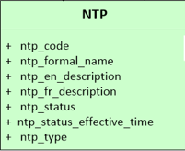
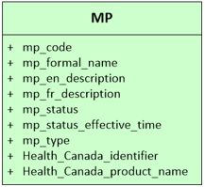
CCDD Model and Classes
Model Class | Definition and Description | Example (formal name)
Therapeutic Moiety (TM) | The functional and clinically significant part of the active ingredient substance(s) present in a medicinal product, and as such the TM class is an abstract representation of a medicinal product without reference to strength and dose form, focusing only on active ingredient substance(s). | amlodipine
Non-proprietary Therapeutic Product (NTP) | A brand independent and clinically oriented representation of a manufactured (therapeutic) product. An NTP is described by the set of active ingredient substance(s) (both precise active ingredient substance and basis of strength substance, if different) and their strength(s), the dosage form, and for some products, their unit of presentation | amlodipine (amlodipine besylate) 2.5 mg oral tablet
Manufactured Product (MP) | A brand specific drug that is or, within the lifetime of the CCDD, has been available for prescribing and dispensing in Canada. | ACT AMLODIPINE (amlodipine (amlodipine besylate) 2.5 mg oral tablets) ACTAVIS PHARMA COMPANY
has NTP
is available as
has TM
has NTP

Slide 6
The Therapeutic Moiety (TM)
The Therapeutic Moiety concepts are a representation of a medicinal product without reference to strength and dose form, focusing only on the “functional” active ingredient substance. Examples include:
Therapeutic Moiety (functional active ingredient) | Precise Active Ingredient (in the NTP)
methadone | methadone hydrochloride
acyclovir | acyclovir sodium
pantoprazole | pantoprazole magnesium pantoprazole sodium

Slide 7
The Non-Proprietary Therapeutic Product (NTP)
A grouping type of concept for a group of products that share the same defining information. The formal name unambiguously reflects those defining characteristics as outlined below.
<<Basis of Strength Substance (Precise ingredient substance)>> <<Strength value and unit of measure>> <<Dose Form>> <<Unit of presentation>>
Non-proprietary Therapeutic Product
acyclovir (acyclovir sodium) 500 mg per 10 mL solution for injection vial
Unit of Presentation
The products presented in a continuous phase must have their strength represented as a concentration ratio, with the denominator usually an SI unit (e.g. 25 mg per 2 mL)
acyclovir (acyclovir sodium) 500 mg per 10 mL solution for injection vial
&
acyclovir (acyclovir sodium) 1000 mg per 20 mL solution for injection vial
Substance Strength Set
Basis of strength substance
(Precise active ingredient substance)
Presentation strength (not concentration)
acyclovir (acyclovir sodium) 500 mg per 10 mL
Dose Form
Manufactured dose form or in some cases administrable dose form
solution for injection

Slide 8
The Manufactured Product (MP)
A CCDD Manufactured Product concept is a brand specific medicinal product that is, or within
the lifetime of the CCDD has been, available for prescribing and dispensing in Canada
<<PRODUCT NAME>><<(ntp formal name)>><<COMPANY NAME>>
Manufactured Product
ACYCLOVIR SODIUM FOR INJECTION (acyclovir (acyclovir sodium) 500 mg per 10 mL solution for injection vial) STERIMAX INC
Company Name
Market Authorization Holder
STERIMAX INC
Product Name
Licensed trade name
ACYCLOVIR SODIUM FOR INJECTION
NTP
Associated NTP placed in brackets
(acyclovir (acyclovir sodium) 500 mg per 10 mL solution for injection vial)

Slide 9
CCDD Files
CCDD consists of 8 files:
  Therapeutic Moiety (TM)
  Nonproprietary Therapeutic Product (NTP)
  Manufactured Product (MP)
  Device Nonproprietary Therapeutic Product (Device-NTP)
  Relationship File (TM-NTP-MP)
  Relationship File (French)
  Special Groupings
  Coded Attributes

Slide 10
Encoding CCDD concepts
All TM, NTP and MP concepts have unique CCDD-assigned codes
For the MPs, the Identifier may be the Drug Identification Number (DIN) assigned by Health Canada upon regulatory approval, or an identifier specific to the Canadian Clinical Drug Data Set
Not mapped to SNOMED CT content

Slide 11
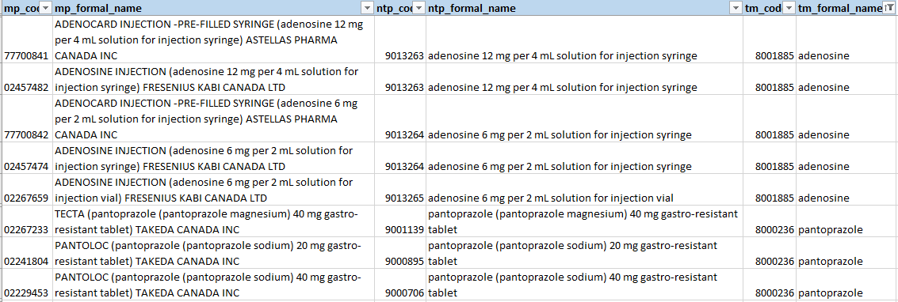
CCDD English Relationship File

Slide 12
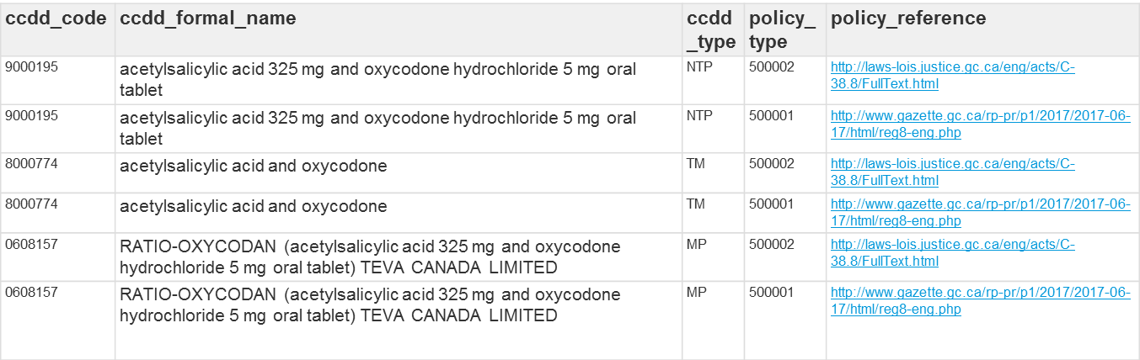
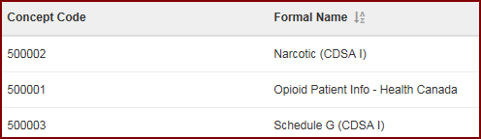
Special Groupings
This file provides for a grouping of concepts to enable a nationally consistent approach to assist jurisdictions with special programs (e.g., prescription monitoring)
A relationship table associates the desired "special grouping" to any/all appropriate concepts in the CCDD
Coded attribute

Slide 13
CCDD Scope
The intended scope for the CCDD is to include medicinal products (including immunizing agents), over-the-counter products, natural health products and a limited number of medical devices for human use within Canada
However…

Slide 14
CCDD Scope (exclusions)
  Currently under development for addition to CCDD
    Immunizing agents
  Currently out of scope for now (but part of the initial scope)
    Products present in the Licensed Natural Health Products Database (LNHPD)
The following highly specialized hospital products, that might not be prescribed in the usual manner for medications and/or included in the patient profile, are out of scope:
Hospital Use Products | General care products
dialysis and hemofiltration fluids | Sunscreens
parenteral nutrition products | Disinfectants
large volume intravenous fluids | Products whose primary use is cosmetic
antidotes for poisoning
allergens for sensitivity testing
imaging products (x-ray contrast media etc.)
antiseptics used for skin cleansing

Slide 15
CCDD Immunization content

Slide 16
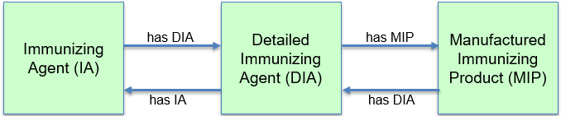
CCDD Immunization Model
Three classes
  Two levels of “generic” immunizing agent concepts
    Immunizing Agent (IA)
    Detailed Immunizing Agent (DIA)
  Manufactured immunizing product concept
    Manufactured Immunizing Product (MIP)

Slide 17
CCDD Immunization File Format
Published with existing CCDD content, but in separate files
File format and content would be different
Five additional files
  Immunizing Agent (IA)
  Detailed Immunizing Agent (DIA)
  Manufactured Immunizing Product (MIP) – length of formal names up to 1000 characters
  Relationship file (IA-DIA-MIP)
  French relationship file
Use Health Canada-generated identifiers to encode the concepts

Slide 18
Concept Naming Patterns
IA formal name - generic vaccine or passive agent name (vaccine preventable disease or organism)
  <<vaccine preventable disease/organism>> <<vaccine>>
    e.g., pneumococcal vaccine
DIA formal name - generic vaccine name (vaccine preventable disease or organism) and vaccine type plus any relevant differentiating detail (groups/types, route of administration, culture method, qualitative strength and valency)
  <<vaccine preventable disease/organism>> <<vaccine type>> <<valency>> <<strength>> <<vaccine>>
    e.g., pneumococcal polysaccharide 23-valent vaccine

Slide 19
Concept Naming Patterns (cont’d)
MIP formal name
<<Product name>> <<(detailed product description)>> <<Company name>>
Detailed product description would follow the pattern,
  <<ingredient>> <<strength>> <<dose form>> <<unit of presentation>>
  e.g., IXIARO (Japanese encephalitis virus SA14-14-2 strain inactivated 6 mcg per 0.5 mL suspension for injection syringe) VALNEVA AUSTRIA GMBH

Slide 20
Immunization Relationship File (as proposed)
mip_code | mip_formal_name | dia_code | dia_formal_name | ia_code | ia_formal_name
33300009 | GARDASIL 9 (Papillomavirus human recombinant L1 capsid protein [type 11 40 mcg and type 16 60 mcg and type 18 40 mcg and type 31 20 mcg and type 33 20 mcg and type 45 20 mcg and type 52 20 mcg and type 58 20 mcg and type 6 30 mcg] per 0.5 mL suspension for injection syringe) MERCK CANADA INC | 1000136 | Papillomavirus human recombinant 9-valent vaccine | 2000931 | Papillomavirus human vaccine
33300010 | GARDASIL 9 (Papillomavirus human recombinant L1 capsid protein [type 11 40 mcg and type 16 60 mcg and type 18 40 mcg and type 31 20 mcg and type 33 20 mcg and type 45 20 mcg and type 52 20 mcg and type 58 20 mcg and type 6 30 mcg] per 0.5 mL suspension for injection vial) MERCK CANADA INC | 1000136 | Papillomavirus human recombinant 9-valent vaccine | 2000931 | Papillomavirus human vaccine
02342227 | CERVARIX (Papillomavirus human recombinant L1 capsid protein [type 16 20 mcg and type 18 20 mcg] per 0.5 mL suspension for injection syringe) GLAXOSMITHKLINE INC | 1000135 | Papillomavirus human recombinant bivalent vaccine | 2000931 | Papillomavirus human vaccine

Slide 21
SNOMED CT Mapping and Issues
Canadian Vaccine Catalogue
  Uses SNOMED CT
Mapping to SNOMED CT to CCDD Immunization concepts
Mapping Issues?

Slide 22
Thank you!
Access to CCDD https://tgateway.infoway-inforoute.ca/ccdd.html

Slide 23
Questions?

