Slide 1
Australian Medicines Terminology
National Clinical Terminology Service
Presented by: Sorya Pordeli and Pan Teng

Slide 2
National Clinical Terminology Service (NCTS)
Operated by the Australian Digital Health Agency.
Responsible for managing, developing and distributing national clinical terminologies and related tools and services to support the digital health requirements of the Australian healthcare community.
This responsibility includes being the Australian National Release Centre for SNOMED CT® on behalf of SNOMED International.
The NCTS’s terminology solutions include SNOMED CT-AU and the Australian Medicines Terminology (AMT).
https://www.healthterminologies.gov.au/

Slide 3
Terminology Content Team
Responsible for the authoring of terminology content
Team consists of:
  Terminology Content Manager
  Terminology Coordinator
  10 x Terminologists
    Backgrounds in
      Pharmacy
      Medicine
      Pathology
      Public Health
    Utilise clinical and scientific backgrounds to ensure that the content is clinically safe and relevant, and the model structure is fit for intended use cases within the Australian healthcare sector
Notes:
These clinical and scientific backgrounds are used to ensure that the content is clinically safe and relevant and the model structure is fit for the intended uses cases within the Australian healthcare sector.

Slide 4
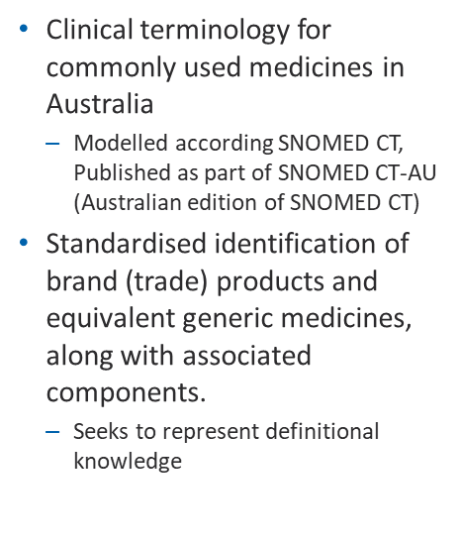
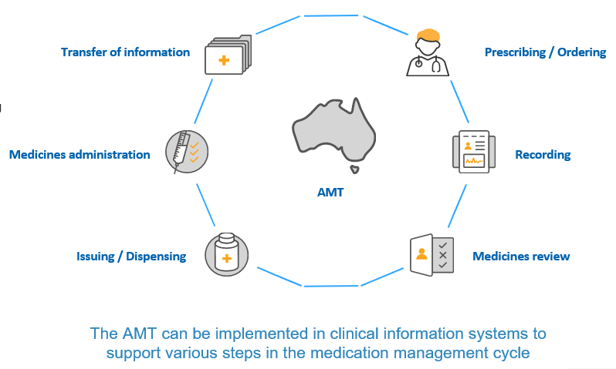
Australian Medicines Terminology (AMT) overview
Notes:
The (AMT) is a clinical terminology for medicines.
It is modelled according to the international terminology SNOMED CT, and is published within SNOMED CT-AU. We create the AMT locally as part of our extension because around the world, there is variation in medicines that are approved for use and it doesn’t make sense for that to be managed in international core content.
The AMT delivers standardised identification of brand (or trade) products and their equivalent generic medicines along with their associated components, which are things that help define medicines like dose form and strength.
It seeks to represent definitional knowledge that is, things that are always true about that medicine, and continuously evolves as there are more medicines that are developed over time.
It supports the medication management cycle, including prescribing, recording, review, dispensing, administration and transfer of information between systems.

Slide 5
AMT first created
Fully defined & classified model, RF2 + concrete domains (AMT v3)
Combined release of SNOMED CT-AU & AMT
NCTS created (FHIR APIs, terminology server)
Production status (AMT v2)
2008
2015
2007
2014
2016
Notes:
This is a quick time line of how AMT has developed over the years. Looking at the history of AMT, it was first created in 2007. Following this, the v2 version was released in 2008. It continued to be released in the v2 version until 2014 where it had its first release of fully defined and classified model. 2015 saw the first combined release of the SNOMED-CT AU and AMT. For the Australian Medicines Terminology, most of the data is sourced from the Therapeutic Goods Administration. AMT has continued to be released every month reaching to a phenomenal 41065 containered trade product packs and 7041 medicinal product unit of use.

Slide 6
AMT
Data sourced from
    The Australian Therapeutic Goods Administration (TGA)
      - Product registration data
    The Australian Pharmaceutical Benefits Scheme (PBS)
7041 medicinal product unit of use and 41065 packages (as of April 2021)
Notes:
For the Australian Medicines Terminology, most of the data is sourced from the Therapeutic Goods Administration. AMT has continued to be released every month reaching to a phenomenal 41065 containered trade product packs and 7041 medicinal product unit of use.

Slide 7
Implementations

Slide 8
Implementation Overview
How many organisations are implementing terminology and what are they implementing?
76 organisations with software products that are live with terminology
22 organisations with software products that are in progress with terminology

Slide 9
What kinds of organisations are live with terminology?
1
11
2
2
60

Slide 10
What kinds of products (target sectors) are live with terminology?

Slide 11
How have organisations implemented terminology in live products?
Types of live AMT implementations
Types of live SNOMED CT implementations

Slide 12
What are the use cases being supported in live products?

Slide 13
What terminology content is being used in live products?

Slide 14
How are organisations accessing terminology content and what tools are in use (live products)?

Slide 15
AMT and SNOMED CT Comparison

Slide 16
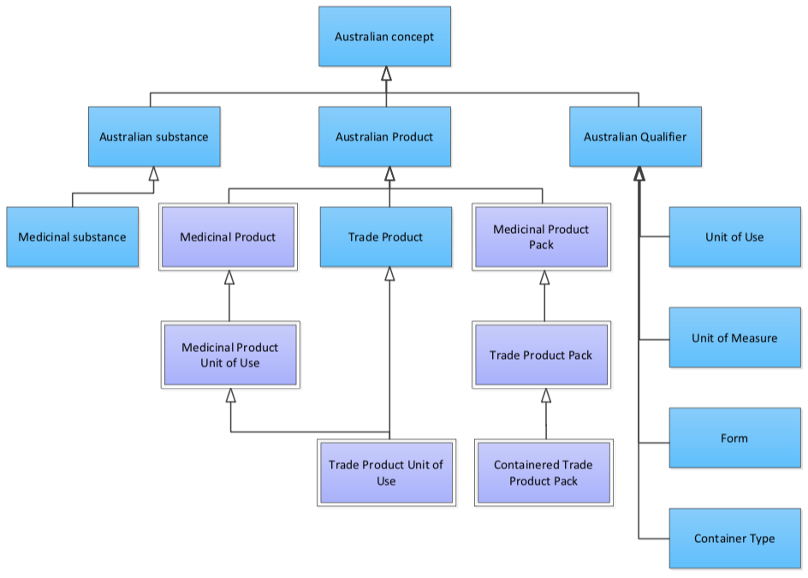
AMT V3 Model
Notes:
I would like to thank Dion McMurtie for providing us with some of the slides that I am presenting today. This is a simplistic view of the AMT model. At the top sits the Australian concept and this has the attributes of Australian substance, Australian product and Australian qualifier. The Australian substance can be described as the medicinal product here. Then we have the Australian product which includes the medicinal product, medicinal product unit of use and medicinal product pack on the medicinal side. The trade side on the other hand contains the Trade product. Trade product unit of use, trade product pack and finally the Containered trade product pack. The last attribute refers to the Qualifiers and these include the UoU, Uomeasure. Form and container type which are all attributes of the given product.

Slide 17
AMT model – Amoxil example
Identifies the
Medicinal Products
Identifies the
Trade Products
Medicinal Product
amoxicillin
(SCTID: 21415011000036100)
Trade Product
Amoxil
(SCTID: 3738011000036101)
Medicinal Product Unit of Use
amoxicillin 500 mg capsule
(SCTID: 23551011000036108)
Trade Product Unit of Use
Amoxil 500 mg capsule
(SCTID: 6140011000036103)
Medicinal Product Pack
amoxicillin 500 mg capsule, 20
(SCTID: 28237011000036107)
Trade Product Pack
Amoxil 500 mg capsule, 20
(SCTID: 12849011000036104)
Containered Trade Product Pack
Amoxil 500 mg capsule, 20, blister pack
(SCTID: 19578011000036100)
* Images are examples only and derived from the World Wide Web
Notes:
Here is the AMT model in more details. It has 7 notable concepts. The orange boxes represent the medicinal or generic products, and the blue boxes represents the trade equivalent. Each of the boxes represents different levels of detail, so for example going down the model you will start to see the qualifier attributes things like strength, dose form, pack size and container type. Each of the different concepts support a different use case.
In this example we have Amoxil and we’ve shown each of the different concepts that are associated with the representation of this product. Starting from the topmost blue box which is the ‘Trade Product’, we can see it represents the brand name of ‘Amoxil’. Moving down to the next blue box, the ‘Trade product unit of use’ describes the single unit of a dose form containing a specified amount of an active ingredient, in this case ‘Amoxil 500 mg capsule’. The ‘Trade product pack’ has more information that this is a pack size of 20 capsules, and then the ‘Containered trade product pack’ shows us that it comes in a blister pack.
These trade concepts are linked back to their medicinal or generic counterparts which are in the orange boxes, so ‘amoxicillin’ is the ‘Medicinal Product’ which represents the intended active ingredients. ‘amoxicillin 500 mg capsule’ is the ‘Medicinal Product Unit of Use’ and ‘amoxicillin 500 mg capsule, 20’ is the ‘Medicinal Product Pack’. These last two product classes help to group different brands together that have the same or similar composition.

Slide 18
Notes:
Comparing the 2 models, we can see where the AMT concepts may fit. While AMT MP is subsumed by the medicinal product in the SCT model. The Medicinal product unit of use in the AMT has a relationship with the medicinal product form in the SCThowever on a closer look it is more like the Clinical drug where it is described by its attributes of ‘is a’ medicinal product, ‘has manufactured dose form’, ‘has unit of use’ and ‘has intended active ingredient’ and lastly ‘is a Australian product’

Slide 19
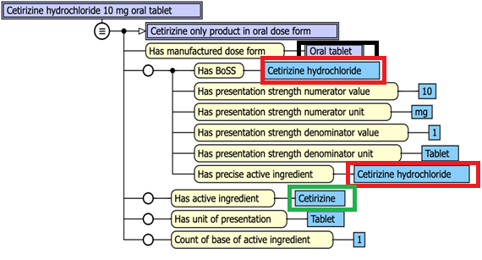
SNOMED CT MODEL
AMT MODEL
Notes:
If we have a closer look at the 2 models with an example here, we could see some of the similarities between the 2 models. For example the ‘has IAI’ in the AMT model and ‘has active ingredient’ in the SNOMED Drug model is describing the same concept of ‘Cetrizine’. We can also see ‘has Australian BoSS and has BoSS describes the same concept of ‘Cetrizine hydrochloride’., however, SNOMED Drug model has an extra relationship of ‘has precise active ingredient of Cetrizine hydrochloride. The other relationship that Is describing the same concept is the ‘has manufactured dose form’ of ‘tablet’ in the AMT model and ‘has manufactured dose form’ of ‘oral tablet’ in the SNOMED CT model. I just wanted to point out here that our dose forms were recently reviewed and simplified so for example a dose form of ‘tablet: film coated’ was simplified to just ‘tablet.

Slide 20
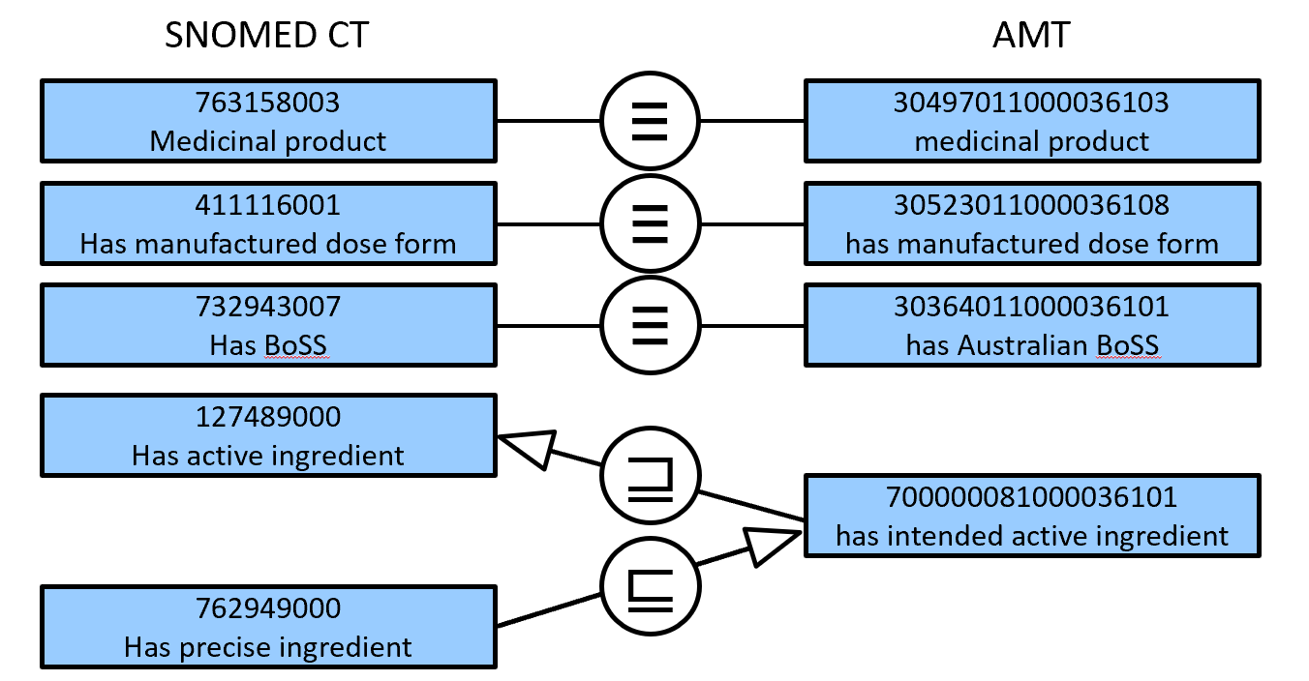
Notes:
Here is a diagrammatical account of the similarities I just mentioned so again, MP is equivalent to AMT MP. The ‘Has manufactured dose form’ attribute is equivalent. Relationship of ‘has BoSS’ is equivalent to ‘has Australian BoSS. However, ‘Has precise ingredient’ is subsumed by ‘has intended active ingredient’ and ‘Has active ingredient’ subsumes ‘has IAI.

Slide 21
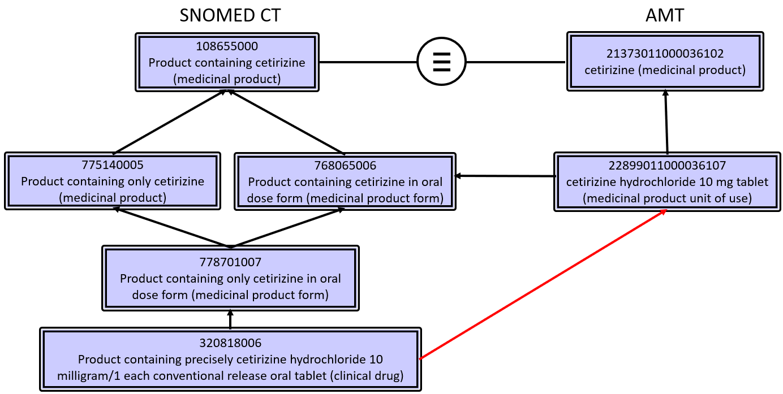
Notes:
In this modelling we can see that while Medicinal product for the SNOMED CT model is equivalent to medicinal product in the AMT model, for the medicinal product unit of use is a little different. In the Snomed CT modelling, the MP + the oral dose form makes up the medicinal product form of , Product containing only cetirizine in oral dose form. This MPF is then given the strength presentation to make the clinical drug.

Slide 22
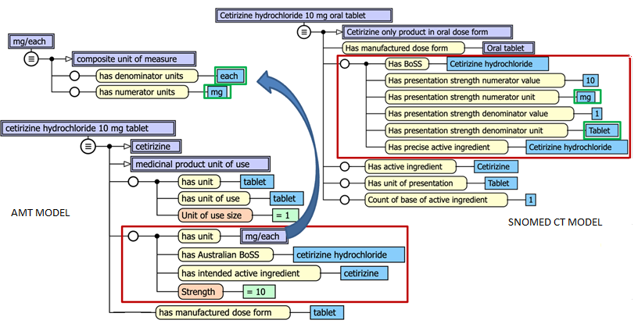
Notes:
If we look at the presentation of the strength in both modelling, here we can see that ('has unit forms the ('composite unit of measure ’ where it 'has denominator units of‘each unit (AU qualifier) AMT’) and ('has numerator units ‘milligram unit and ('Strength reference set AMT' value 10) EquivalentTo (‘Has presentation strength numerator value’ ’10 and (‘Has presentation strength numerator unit ‘Milligram and (‘Has presentation strength denominator value’ of ‘1 and (‘Has presentation strength denominator unit’ Tablet . So basically 10 milligrams/each in AMT is equivalent to 10 Milligrams per 1 Tablet (unit) in SNOMED CT
These differences in denominator aren’t a problem – SNOMED CT concepts are always ‘1 (qualifier value)’
However presentation/concentration strength distinction in SNOMED CT is a problem

Slide 23
Strength General Concept Axioms (GCAs)
('has unit (attribute) AMT' some
('composite unit of measure (AU qualifier) AMT’
and ('has denominator units (attribute) AMT' some ‘each unit (AU qualifier) AMT’)
and ('has numerator units (attribute) AMT' some ‘milligram unit (AU qualifier) AMT’)))
and ('Strength reference set (foundation metadata concept) AMT' value 10)
EquivalentTo
(‘Has presentation strength numerator value’ some ’10 (qualifier value)’)
and (‘Has presentation strength numerator unit’ some ‘Milligram (qualifier value)’)
and (‘Has presentation strength denominator value’ some ‘1 (qualifier value)’)
and (‘Has presentation strength denominator unit’ some ‘Tablet (unit of presentation)’)
i.e. 10 milligrams/each in AMT is equivalent to 10 Milligrams per 1 Tablet (unit) in SNOMED

Slide 24
Differences in units
('has unit (attribute) AMT' some
('composite unit of measure (AU qualifier) AMT’
and ('has denominator units (attribute) AMT' some ‘each unit (AU qualifier) AMT’)
and ('has numerator units (attribute) AMT' some 'gram unit (AU qualifier) AMT’)))
and ('Strength reference set (foundation metadata concept) AMT' value 1)
EquivalentTo
('has unit (attribute) AMT' some
('composite unit of measure (AU qualifier) AMT’
and ('has denominator units (attribute) AMT' some ‘each unit (AU qualifier) AMT’)
and ('has numerator units (attribute) AMT' some ‘milligram unit (AU qualifier) AMT')))
and ('Strength reference set (foundation metadata concept) AMT' value 1000)
i.e. 1g per “each” is equivalent to 1000mg per “each”

Slide 25
Unit of use/presentation GCAs
‘Role group’ some
(('has unit (attribute) AMT' some 'each unit (AU qualifier) AMT’)
and ('has unit of use (relationship type) AMT' some 'tablet unit of use (AU qualifier) AMT’)
and ('Unit of use size reference set (foundation metadata concept) AMT' value 1))
EquivalentTo
‘Has unit of presentation’ some 'tablet unit of use (AU qualifier) AMT’
i.e. AMT unit of use 1 tablet is equivalent to SNOMED CT presentation unit of tablet
But this is only possible where the AMT unit of use size is 1, which covers only “discrete” products
Works for tablets, capsules, suppositories etc.
Doesn’t work for creams, fluids for injection etc.

Slide 26
Summary
Integration at the ingredient level requires
  Substance map (equivalent and subclass axioms)
  A few equivalent and subproperty axioms
Integration at the ingredient plus form level additionally requires
  Form map (equivalent and subclass axioms)
Notes:
So when looking at Integration,

Slide 27
Summary
Integration at the strength and form level additionally requires
  Unit of use / presentation map (equivalent and subclass axioms)
  Generated GCAs for
    strength representation differences including data properties
    different units and hence size values for ingredients
    unit of use / presentation differences

Slide 28
Summary
Integration will require effort
  Greater the depth, the greater the effort
Ongoing integration requires harmonising to reduce effort
  substances, forms, units, etc
  strength representation properties and data values

Slide 29
Challenges
  Hydration no hydration
    Currently use of hydration in SCT clinical drug model is inconsistent
    Alignment with IHIN required
  Dose form mismatches
    Some SCT clinical drug uses manufactured dose form and some use administrable dose form
  BoSS/precise ingredient mismatch
    BoSS and PAI in some SCT clinical drug does not match the real product
  Presentation strengths
    Strengths are normalised in SCT clinical drug where again not the same as what is on the product

Slide 30
Questions?
Notes:
Question time!

Slide 31
Contact us
Help Centre
1300 901 001
Email
help@digitalhealth.gov.au
Website
healthterminologies.gov.au
digitalhealth.gov.au
Twitter
twitter.com/AuDigitalHealth
OFFICIAL
Notes:
Thank you for attending this presentation – if you have any further questions, please contact us via the Australian Digital Health Agency Help Centre, details are on the slide here.

