Slide 1

Update from HL7 International
Anesthesia Working Group
Martin Hurrell, Ph.D, Co-Chair, HL7 Anesthesia Work Group
martinjhurrell@gmail.com

Slide 2
Introduction
What is HL7 (Health Level 7)
What is an HL7 Work Group
Current focus of the HL7 Anesthesia Work Group
HL7 Anesthesia WG & SNOMED Anaesthesia CRG
HL7 Anesthesia WG also works with …

Slide 3
What is HL7 (Health Level 7)
HL7 and its members provide a framework (and related standards) for the exchange, integration, sharing, and retrieval of electronic health information.
These standards define how information is packaged and communicated from one party to another, setting the language, structure and data types required for seamless integration between systems.
HL7 standards support clinical practice and the management, delivery, and evaluation of health services, and are recognized as the most commonly used in the world.
Hl7.org. (2016). Introduction to HL7 Standards | HL7 International. [online] Available at: https://www.hl7.org/implement/standards/
Notes:
In its most complete expression, a Domain Analysis Model(DAM) is a collection of artifacts at the conceptual level that represents a well-defined subject-area-of-interest. The semantics – both static/informational and dynamic/behavioral – that are expressed in the various artefacts that collectively define a DAM must – first and foremost – be of use to domain experts and non-technical stakeholders who have an interest in seeing the DAM’s semantics explicitly and unambiguously expressed using standardized, understandable representations (e.g. UML diagrams, concept maps, etc.).

Slide 4
What is an HL7 Work Group
There are currently nearly 60 active work groups within HL7 of which more than 40 are dedicated to specialized areas of interest such as Mobile Health and Electronic Health Records
The Anesthesia Work Group is one of these.
These work groups are directly responsible for the content of the standards

Slide 5
Current focus of the
HL7 Anesthesia Work Group
The current focus of the Anesthesia WG is a Domain Analysis Model for the Intra-procedural phase of Anesthesia
Increasingly, anesthetic records are created by electronic systems that are good at displaying and analyzing their own data
However, they may struggle to exchange data with other systems that have different information models and semantics
The DAM helps to solve this problem – even though the internal models may differ, information can be mapped to a common reference model allowing sharing and aggregation between systems, sites and even countries

Slide 6
HL7 Anesthesia WG &
SNOMED Anaesthesia CRG
The groups work closely together - several members work in both
The Anaesthesia CRG has identified some 5,000 SNOMED CT concepts for use by the specialty
The HL7 Anesthesia WG is looking to bind these terms to elements of the DAM – for example, procedures, positioning, devices etc.
In this way the DAM offers a general reference model and the CRG term set provides a controlled vocabulary to facilitate semantic interoperability
Notes:
In its most complete expression, a Domain Analysis Model(DAM) is a collection of artifacts at the conceptual level that represents a well-defined subject-area-of-interest. The semantics – both static/informational and dynamic/behavioral – that are expressed in the various artefacts that collectively define a DAM must – first and foremost – be of use to domain experts and non-technical stakeholders who have an interest in seeing the DAM’s semantics explicitly and unambiguously expressed using standardized, understandable representations (e.g. UML diagrams, concept maps, etc.).

Slide 7
HL7 Anesthesia WG also works with …
HL7 Devices Work Group
UK Society for Computing & Technology in Anaesthesia (SCATA)
ASA Electronic Media and Information Technology Cmte. (EMIT)
Standards organizations – ISO/IEEE 11073, ISO 19223
… and many individual domain experts
Notes:
In its most complete expression, a Domain Analysis Model(DAM) is a collection of artifacts at the conceptual level that represents a well-defined subject-area-of-interest. The semantics – both static/informational and dynamic/behavioral – that are expressed in the various artefacts that collectively define a DAM must – first and foremost – be of use to domain experts and non-technical stakeholders who have an interest in seeing the DAM’s semantics explicitly and unambiguously expressed using standardized, understandable representations (e.g. UML diagrams, concept maps, etc.).

Slide 8
Intra-procedural Anesthesia Domain Analysis Model (DAM
What is a Domain Analysis Model?
Sources used in development
Modeling process
Key building blocks

Slide 9
What is a Domain Analysis Model?
A DAM is a collection of artifacts at the conceptual level that represents a well-defined subject-area-of-interest - in our case, anesthesia.
The semantics must – first and foremost – be of use to domain experts (e.g. anesthesiologists) and non-technical stakeholders (e.g. administrators)
The semantics should be explicitly and unambiguously expressed using standardized, understandable representations (e.g. UML diagrams, concept maps, etc.) and ideally, standardized vocabularies (e.g. SNOMED CT, ISO 11073, LOINC)
Notes:
In its most complete expression, a Domain Analysis Model(DAM) is a collection of artifacts at the conceptual level that represents a well-defined subject-area-of-interest. The semantics – both static/informational and dynamic/behavioral – that are expressed in the various artefacts that collectively define a DAM must – first and foremost – be of use to domain experts and non-technical stakeholders who have an interest in seeing the DAM’s semantics explicitly and unambiguously expressed using standardized, understandable representations (e.g. UML diagrams, concept maps, etc.).

Slide 10
Sources used in development
VA hospitals anesthetic record
ASA guidelines for the intra-operative anesthetic record
UK proposed standard anaesthetic record (Richard Griffiths)
AAGBI Information management - Guidance for Anaesthetists
Operating Theatres Phase 2 – Anaesthetic Record Data Standards (NHS Scotland)
American Association of Nurse Anaesthetists Anesthesia Record
Around 20 records from other US and UK sites

Slide 11
Modeling process
Get storyboards from domain experts / users
Perform content analysis to identify classes, attributes and methods
Create formal use case (behavioural) and class / package (logical) diagrams (other types of diagram may be used as well e.g. activity and sequence, state, requirements etc.)
Document the model
Build system (everything is traceable, test plans can be derived)

Slide 12
Key Building Blocks
Entities | Acts
People (patient, performer) Devices Medications | Medication/substance administration Observation Procedure Device placement and insertion

Slide 13
Putting it all together
- A Practical Example
Intra-procedural overview
Generic clinical procedures
Example Term binding – Arm Positions

Slide 14
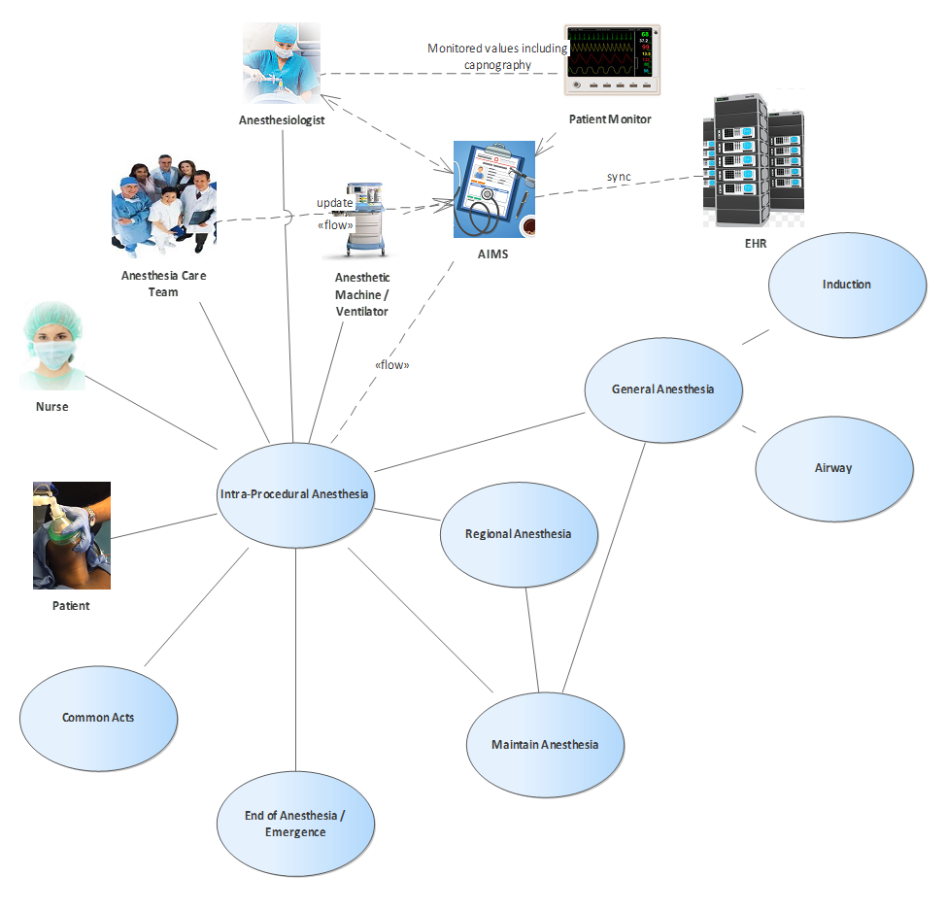
Intra-procedural overview

Slide 15
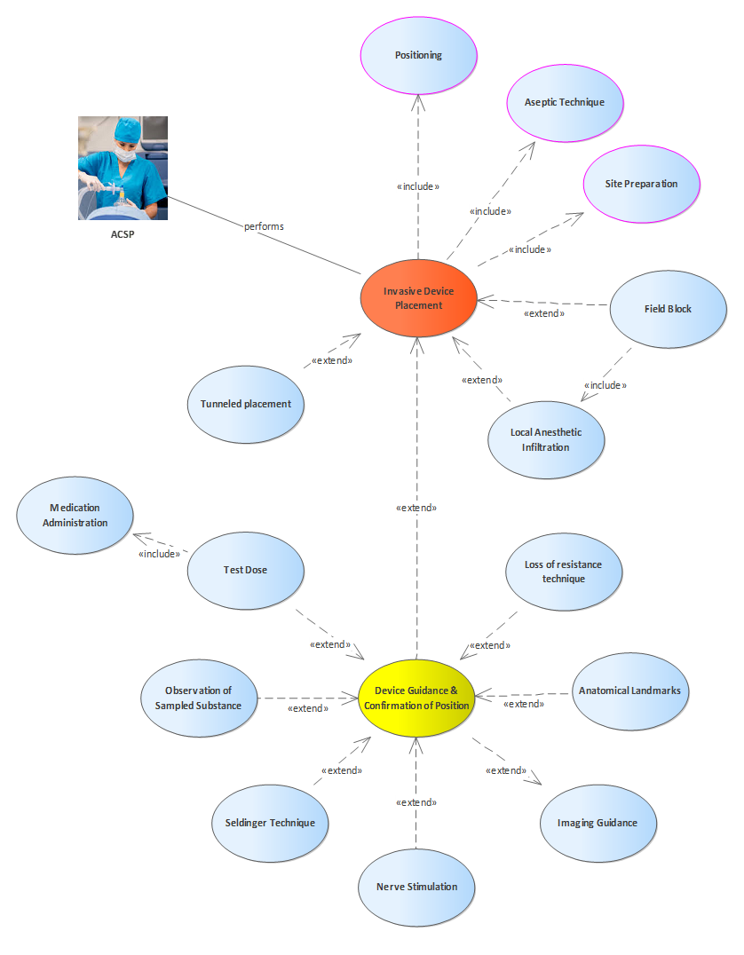
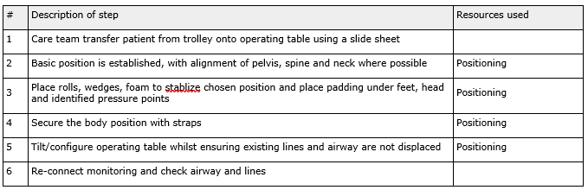
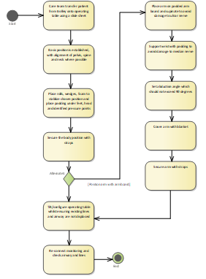
Generic Clinical
Procedures
Some views of ‘Positioning’
Structured scenario
Activity diagram
Class diagram

Slide 16
Example Term Binding
– Arm Positions
229984009 | arm positions
304634006 | arm positioned out on arm board
230000003 | arm support position
733507000 | arm positioned across torso
733508005 | arm positioned at side

Slide 17
Next steps
Publication of DAM and Merger with Devices WG
Second iteration of the DAM
HL7 FHIR Implementation Guide

Slide 18
Publication of DAM
Merger with Devices WG
We have successfully balloted V1 of the DAM and are intending to publish it pending final approval
We are finalizing arrangements to merge the Anesthesia WG with the Devices WG

Slide 19
Second iteration of the DAM
The next iteration of the DAM will include:
between 10 and 20 additional detailed procedural use cases
the specification of a 'clinical note' for each use case (effectively, fragments of the e-record)
appropriate SNOMED CT term-bindings for each clinical note. It may be that we will also need to reference specialized device nomenclature that is part of existing standards and may not all be reflected in SNOMED CT e.g.ISO 19223 (ventilators), ISO/IEEE 11073-10101 (poc device nomenclature)

Slide 20
HL7 FHIR Implementation Guide
A final step will be the development of a FHIR implementation guide
This will support both messaging and persistent records e.g. a standard electronic anesthesia record
The term-bindings will be ported from the DAM to the implementation guide
The implementation guide will be a practical resource for systems implementers and users

