Slide 1

Update on HL7 International
Anesthesia Working Group
Martin Hurrell, Ph.D, Co-Chair, HL7 Devices Work Group

Slide 2
Introduction
What is HL7 (Health Level 7)
What is an HL7 Work Group
Merger of Anesthesia and Devices Work Groups
DEV-A also works with …
HL7 DEV-A & SNOMED Anaesthesia CRG
Current focus and planned activities for DEV-A

Slide 3
What is HL7 (Health Level 7)
HL7 and its members provide a framework (and related standards) for the exchange, integration, sharing, and retrieval of electronic health information.
These standards define how information is packaged and communicated from one party to another, setting the language, structure and data types required for seamless integration between systems.
HL7 standards support clinical practice and the management, delivery, and evaluation of health services, and are recognized as the most commonly used in the world.
Hl7.org. (2016). Introduction to HL7 Standards | HL7 International. [online] Available at: https://www.hl7.org/implement/standards/
Notes:
In its most complete expression, a Domain Analysis Model(DAM) is a collection of artifacts at the conceptual level that represents a well-defined subject-area-of-interest. The semantics – both static/informational and dynamic/behavioral – that are expressed in the various artefacts that collectively define a DAM must – first and foremost – be of use to domain experts and non-technical stakeholders who have an interest in seeing the DAM’s semantics explicitly and unambiguously expressed using standardized, understandable representations (e.g. UML diagrams, concept maps, etc.).

Slide 4
What is an HL7 Work Group
There are currently nearly 60 active work groups within HL7 of which more than 40 are dedicated to specialized areas of interest such as Mobile Health and Electronic Health Records
The Anesthesia Work Group was one of these.
The work groups are directly responsible for the content of the standards

Slide 5
Merger of Anesthesia and Devices Work Groups
In January 2021 the Anesthesia Work Group dissolved and was merged with the Devices Work Group.
The Anesthesia WG Co-Chairs became Co-Chairs of the Devices Work Group which has assumed responsibility for current and future anesthesia-related projects
In the remainder of this presentation the term DEV-A will be used to denote those activities within the Devices Work Group with specific relevance or application to anesthesia. This is an informal notation in the context of this presentation, not an HL7 definition.

Slide 6
HL7 DEV-A &
SNOMED Anaesthesia CRG
These groups work closely together - several members work in both
The Anaesthesia CRG has identified some 5,000 SNOMED CT concepts for use by the specialty
DEV-A is looking to bind these terms to elements of the DAM – for example, procedures, positioning, devices etc. The Devices WG as a whole is in dialogue to implement the MDC terms in SNOMED-CT to the extent possible.
In this way the DAM offers a general reference model and the CRG term set provides a controlled vocabulary to facilitate semantic interoperability
Notes:
In its most complete expression, a Domain Analysis Model(DAM) is a collection of artifacts at the conceptual level that represents a well-defined subject-area-of-interest. The semantics – both static/informational and dynamic/behavioral – that are expressed in the various artefacts that collectively define a DAM must – first and foremost – be of use to domain experts and non-technical stakeholders who have an interest in seeing the DAM’s semantics explicitly and unambiguously expressed using standardized, understandable representations (e.g. UML diagrams, concept maps, etc.).

Slide 7
HL7 Anesthesia WG also works with …
HL7 Devices Work Group
UK Society for Computing & Technology in Anaesthesia (SCATA)
ASA Electronic Media and Information Technology Cmte. (EMIT)
Standards organizations – ISO/IEEE 11073, ISO 19223
… and many individual domain experts
Notes:
In its most complete expression, a Domain Analysis Model(DAM) is a collection of artifacts at the conceptual level that represents a well-defined subject-area-of-interest. The semantics – both static/informational and dynamic/behavioral – that are expressed in the various artefacts that collectively define a DAM must – first and foremost – be of use to domain experts and non-technical stakeholders who have an interest in seeing the DAM’s semantics explicitly and unambiguously expressed using standardized, understandable representations (e.g. UML diagrams, concept maps, etc.).

Slide 8
Current focus and planned activities of
HL7 DEV-A
The current focus of the Anesthesia WG is on a second iteration of the Domain Analysis Model for the Intra-procedural phase of Anesthesia (the first was approved by ballot in May, 2020). A follow-on project will be a FHIR implementation guide for the anesthesia record
Increasingly, anesthetic records are created by electronic systems that are good at displaying and analyzing their own data
However, they may struggle to exchange data with other systems that have different information models and semantics
The DAM helps to solve this problem – even though the internal models may differ, information can be mapped to a common reference model allowing sharing and aggregation between systems, sites and even countries

Slide 9
Intra-procedural Anesthesia Domain Analysis Model (DAM
What is a Domain Analysis Model?
Sources used in development
Modeling process
Key building blocks

Slide 10
What is a Domain Analysis Model?
A DAM is a collection of artifacts at the conceptual level that represents a well-defined subject-area-of-interest - in our case, anesthesia.
The semantics must – first and foremost – be of use to domain experts (e.g. anesthesiologists) and non-technical stakeholders (e.g. administrators)
The semantics should be explicitly and unambiguously expressed using standardized, understandable representations (e.g. UML diagrams, concept maps, etc.) and ideally, standardized vocabularies (e.g. SNOMED CT, ISO 11073, LOINC)
Notes:
In its most complete expression, a Domain Analysis Model(DAM) is a collection of artifacts at the conceptual level that represents a well-defined subject-area-of-interest. The semantics – both static/informational and dynamic/behavioral – that are expressed in the various artefacts that collectively define a DAM must – first and foremost – be of use to domain experts and non-technical stakeholders who have an interest in seeing the DAM’s semantics explicitly and unambiguously expressed using standardized, understandable representations (e.g. UML diagrams, concept maps, etc.).

Slide 11
Sources used in development
VA hospitals anesthetic record
ASA guidelines for the intra-operative anesthetic record
UK proposed standard anaesthetic record (Richard Griffiths)
AAGBI Information management - Guidance for Anaesthetists
Operating Theatres Phase 2 – Anaesthetic Record Data Standards (NHS Scotland)
American Association of Nurse Anaesthetists Anesthesia Record
Around 20 records from other US and UK sites

Slide 12
Modeling process
Get storyboards from domain experts / users
Perform content analysis to identify classes, attributes and methods
Create formal use case (behavioural) and class / package (logical) diagrams (other types of diagram may be used as well e.g. activity and sequence, state, requirements etc.)
Document the model
Build system (everything is traceable, test plans can be derived)

Slide 13
Key Building Blocks
Entities | Acts
People (patient, performer) Devices Medications | Medication/substance administration Observation Procedure Device placement and insertion

Slide 14
Putting it all together
- A Practical Example
Intra-procedural overview
Generic clinical procedures
Example Term binding – Arm Positions

Slide 15
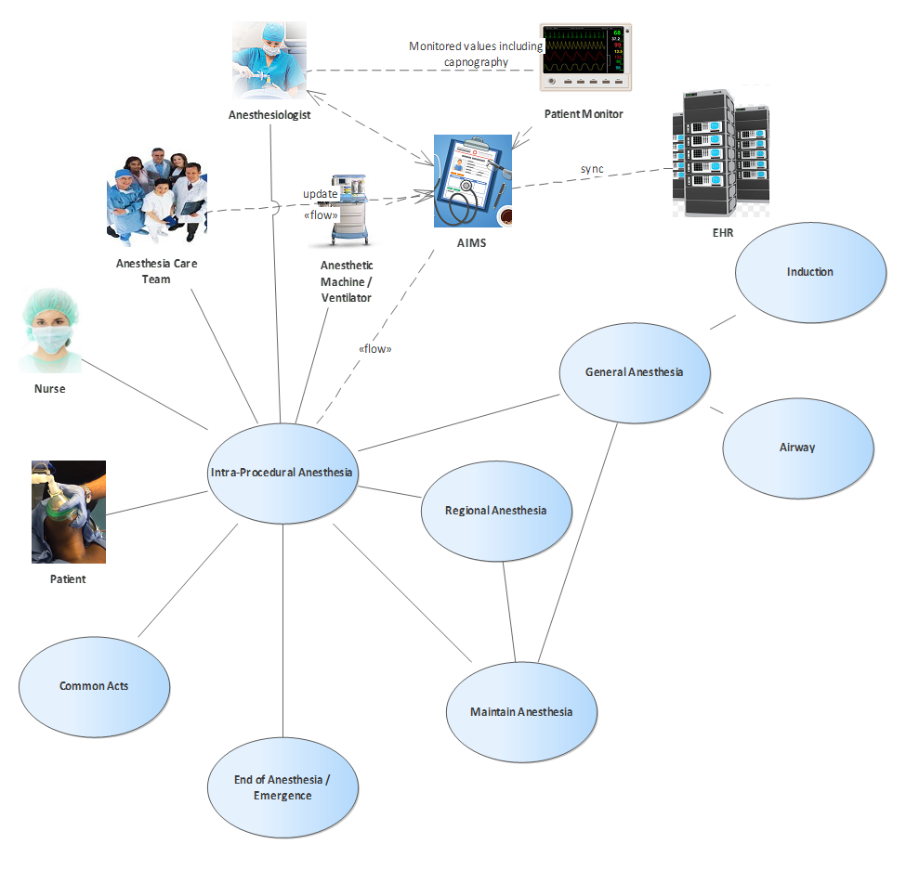
Intra-procedural overview

Slide 16
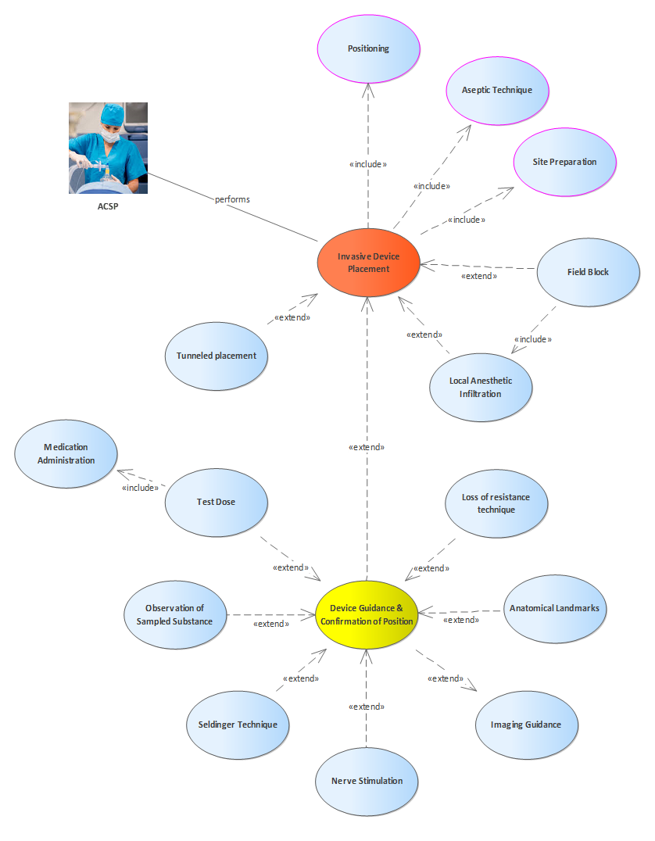
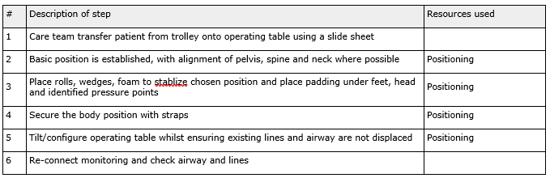
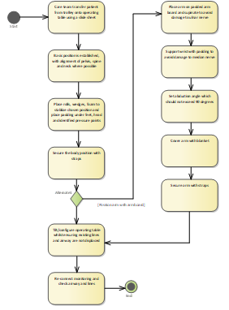
Generic Clinical
Procedures
Some views of ‘Positioning’
Structured scenario
Activity diagram
Class diagram

Slide 17
Example Term Binding
– Arm Positions
229984009 | arm positions
304634006 | arm positioned out on arm board
230000003 | arm support position
733507000 | arm positioned across torso
733508005 | arm positioned at side

Slide 18
Next steps
Second iteration of the DAM
HL7 FHIR Implementation Guide

Slide 19
Publication of DAM
Merger with Devices WG
Version 1 of the DAM was successfully balloted in May 2020 and is now published as an informative standard
The Anesthesia Work Group has been dissolved and has merged with the Devices Work Group.

Slide 20
Second iteration of the DAM
The next iteration of the DAM will include:
between 10 and 20 additional detailed procedural use cases
the specification of a 'clinical note' for each use case (effectively, fragments of the e-record)
appropriate SNOMED CT term-bindings for each clinical note. It may be that we will also need to reference specialized device nomenclature that is part of existing standards and may not all be reflected in SNOMED CT e.g.ISO 19223 (ventilators), ISO/IEEE 11073-10101 (poc device nomenclature)

Slide 21
HL7 FHIR Implementation Guide
A final step will be the development of a FHIR implementation guide
This will support both messaging and persistent records e.g. a standard electronic anesthesia record
The term-bindings will be ported from the DAM to the implementation guide
The implementation guide will be a practical resource for systems implementers and users

