Slide 1
Anesthesia Clinical Reference Group
Dr Andrew Norton
Clinical Lead
SNOMED Anesthesia CRG

Slide 2
History of anesthesia related content in SNOMED CT (1)
NHS Clinical Terms Project (1990’s)
Development of CTV3 (Clinical terms version 3) including content for anesthesia, pain management, critical care
Merger of CTV3 and SNOMED RT (NHS Information Authority and College of American Pathologists)
Inclusion in SNOMED CT from 2002

Slide 3
History of anesthesia related content in SNOMED CT (2)
The Anesthesia Patient Safety Foundation (APSF) endorses and advocates the use of automated record keeping in the perioperative period and the subsequent retrieval and analysis of that data to improve patient safety ” (APSF Board of Directors 2001)
Establishment of a Data Dictionary Task Force
Memorandum of Understanding with College of American Pathologists regarding content development for SNOMED CT

Slide 4
Anesthesia input to SNOMED over time
DDTF – Data Dictionary Task Force 2001-2003
  Leaders: Terri Monk, David Reich, Iain Sanderson
IOTA – International Organisation for Terminology in Anaesthesia (following expansion of DDTF to include participants from UK and Canada) 2003-2007
  Leaders: Terri Monk, David Reich, Martin Hurrell, Andrew Norton
IHTSDO Anesthesia SIG 2007-2018 – Following the formation of the International Health Terminology Standards Development Organisation
  Leaders: Terri Monk, Andrew Norton
SNOMED Anesthesia CRG 2018-present – following review of SNOMED International clinical engagement strategy and clinical groups

Slide 5
Anesthesia records : drivers for standardisation
The anesthetic record
  Medico-legal
  ‘On-line’ document
  Audit & research
Data sharing
  Common record structure : to identify clinical context
  Common terminology : for aggregation and analysis
  Common model : to enable AI applications, reasoning and decision support
The common model is an ontology and it requires the use of newer, more expressive and more powerful languages to capture the richness of the domain
Notes:
There are a number of things driving the development of information management systems in anesthesia. Firstly, we have a medico-legal obligation to create a complete and accurate anesthetic record. This record can also be an on-line resource which is an aid to memory for the anesthesiologist. It can also provide a foundation for on-line decision support. It is also used as a source of information for billing, clinical audit, quality improvement and research.
A busy practice might complete over 10,000 anesthetic cases per year and the opportunity to aggregate data from many similar facilities is obvious. With these numbers of cases, it is possible to identify markers for outcomes and patterns in the data which would not be significant in smaller samples.
In order for data to be aggregated and shared, we need a common vocabulary and a common view of the structure of the anesthetic record. The IOTA terming mechanisms is working toward the common terminology and record structure. The common model is an ontology which is the way we use language to capture the richness of the domain.

Slide 6
Ideal Foundations for Anesthesia Information Management Systems (AIMS)
Terminology:Text elements
Schema: record structure
Ontology: domain model
Notes:
Change to three layer pyramid/iceberg with:
Terminology
Schema
Ontology
As layers

Slide 7
  Anesthesia CRG Areas of Interest
Anesthesia | Preoperative assessment
Airway management | Perioperative medicine
Circulatory access and devices | Pain management
Measurement and monitoring | Critical care medicine
Artificial ventilation | Checklists
Anesthetic drugs, gases and vapours | Clinical safety
Intravenous fluids
Blood and blood products
Local anesthetic blockade
Assessment scales
Adverse events and complications

Slide 8
  Collaborations
HL7 Anesthesia SIG, HL7 Devices
  HL7 Anesthesia SIG has previously published Domain Analysis Models for preoperative assessment and intra-operative anesthesia
  HL7 Anesthesia SIG merging into Devices
  Liaison with ISO/IEEE 11073
ISO TC121/SC4
  Liaison with development of ISO 19223 Lung ventilators and related equipment – vocabulary and semantics
Other SNOMED CRGs
  Notably Nursing
Professional relationships
  Royal College of Anaesthetists, Association of Anaesthetists, ASA EMIT Committee, Anesthesia Patient Safety Foundation

Slide 9
Current activity
Work on assessment scales in SNOMED
  Addressing identified gaps in clinical utility and description for enabling SNOMED encoded assessment scale completion
  Work on exemplars – Cormack Lehane Scale, Glasgow Coma Scale
  Suggestions for standard approach to SNOMED Modelling Advisory Group
  Identified gaps in assessment scales for use in Critical Care
Inclusion of ISO 19223 content - Ventilator and related equipment: vocabulary and semantics
  Initial requests for inclusion of standardised ventilator mode terminology
  Updating respiratory physiology terms and inclusion of definitions

Slide 10
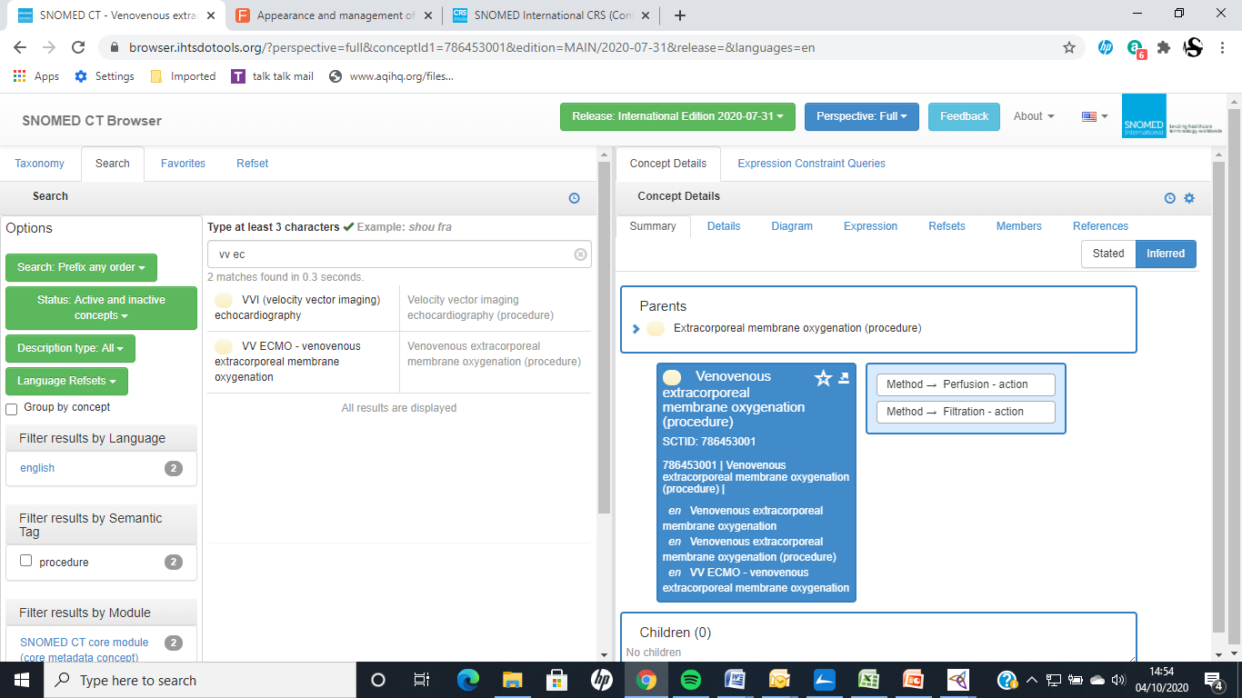
Tools – SNOMED Browser

Slide 11
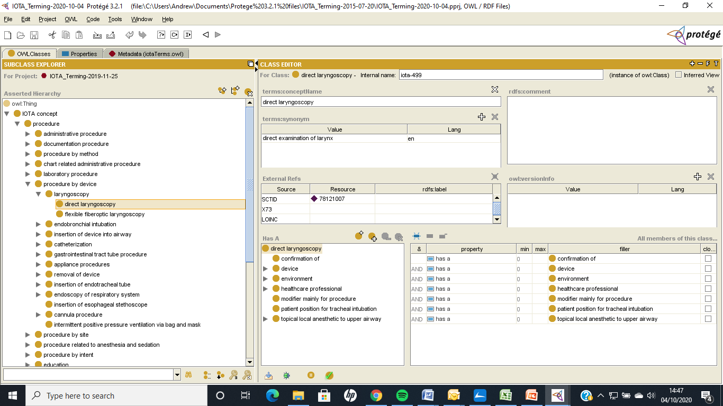
Tools – Protégé terminology modeling

Slide 12
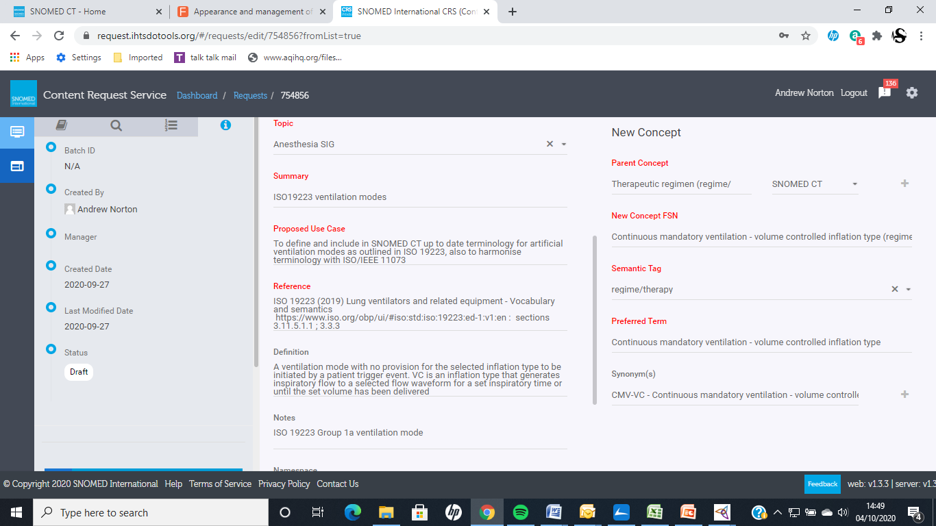
Tools – SNOMED Content Request System

Slide 13
Recent issues and CRG activity
Terms for COVID-19 principally related to Critical Care
  Anesthesia CRG collaborated with NHS Digital in the review of some terms for critical care of use during COVID-19 including suggestions for additional terms and
Review of top level and groupers for anesthetic drugs in the revised SNOMED CT substance hierarchy
Modelling IV fluids in the revised SNOMED medicinal product hierarchy

Slide 14
Clinical Leadership
Anesthesia CRG Clinical Leads
Patrick McCormick, MD. Sloan Kettering Memorial Cancer Center, New York City, USA
Andrew Marchant, FRCA. Western General Hospital, Edinburgh, UK
Andrew Norton, FRCA, FFICM, United Lincolnshire Hospitals, UK

Slide 15
  Anesthesia CRG on SNOMED Confluence
https://confluence.ihtsdotools.org/display/ACRGT/Anesthesia+Clinical+Reference+Group
Notices and news
Meeting dates
Meeting notes and agendas
Discussions pages – hot topics, modeling and terming issues
Membership list
Reference files

Slide 16
Meeting Schedule
Normally 4th Tuesday of odd months (Jan, Mar, May etc)
Normally 19:00 UTC (20:00 UK, 21:00 Western Europe, 15:00 US EST, 12:00 US Pacific)
Meetings generally 1.5 hrs
Meetings on Zoom
Anesthesia CRG frequently meets during the spring and autumn SNOMED International business meetings

Slide 17
Thank you
New members are always welcome
Contact: andrew.norton@tiscali.co.uk
Any Questions?

