Slide 1
Valueset Proposal for Interoperation of Observables with SNOMED CT

Slide 2
Proposal: Valuesets
SCALE_TYPE will define the scale of the result value and the associated valuesets within SNOMED CT:
    All values for a given coded valueset will be from the same SNOMED hierarchy
    Ordinal or quantitative will be used for scale scores that are meant to use arithmetic in their deployment but are not truly quantitative – eg Glasgow Coma Scale scores; valuesets will be from <<Findings values if not an integer
    Ordinal for all other ordered, non-quantitative structured text; valuesets will be taken from <<Findings values
    Nominal can have value sets defined from any SNOMED CT hierarchy and may be defined extensionally or intensionally by DL query
    Quantitative is reserved for results which are numeric

Slide 3
Nominal versus Ordinal?
Observables will not be modelled and defined in SNOMED unless the analytics use cases exist for manipulating the Values data
Observables will be modelled for recording discrete observational data and assessment scales with a scale type that fits the recording use case of choice:
  When the valueset is small and data is typically recorded in ‘flowsheet’ or ‘checksheet’ entry forms, then Ordinal scale type will be employed
  When the valueset is extensive and/or the data recording is preferred as a SNOMED concept – eg problem list or diagnosis or anatomical site - then Nominal scale type may be employed but all of the findings must be precoordinated SNOMED CT of the appropriate hierarchy

Slide 4
Proposal: Valueset Definitions and Relationships
A refset will be developed for all ordinal and small (extensional) primitive nominal valuesets which will define the meaning of the values indexed to the observable
The refset may support logical relationships between values for purposes of analytics (eg “Retrieve cohort of all colorectal cancer cases more poorly differentiated than grade G1”)

Slide 5
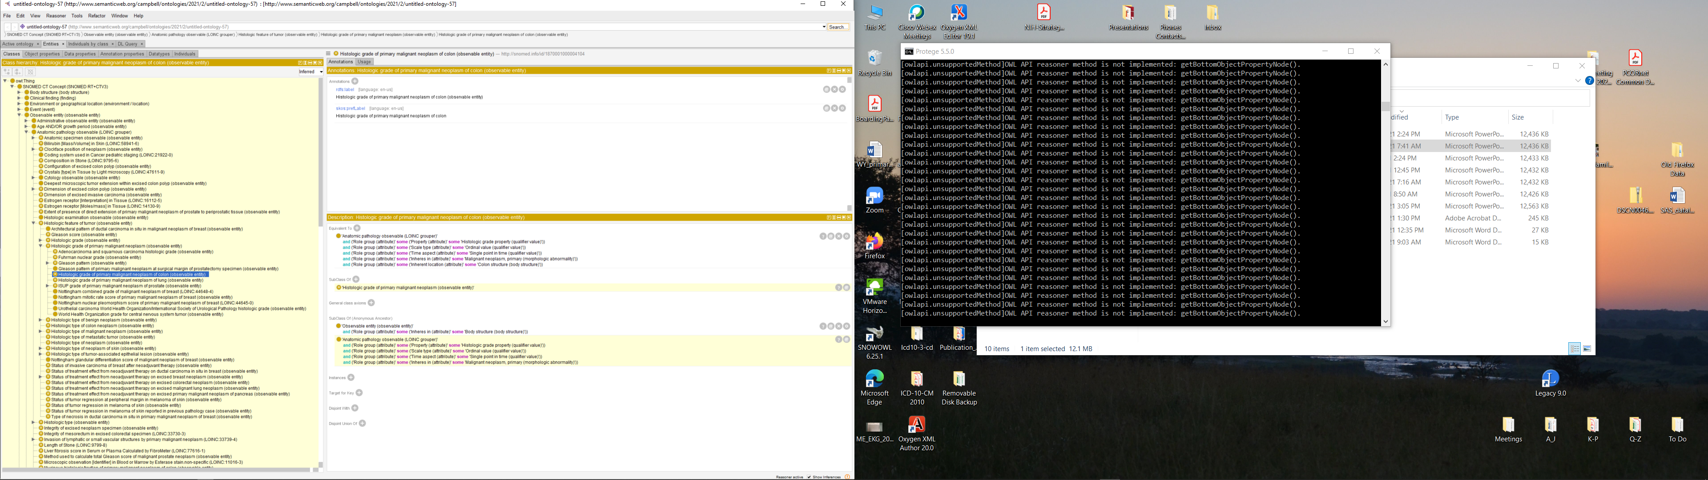
1870001000004104|Histologic Grade of primary malignant neoplasm of colon (observable entity)

Slide 6
Valueset in Qualifiers
Findings values(qualifier)\Grades values\...
    123456|G1 (qualifier)
    123457|G2…
    123458|G3…
    123459|GX…

Slide 7
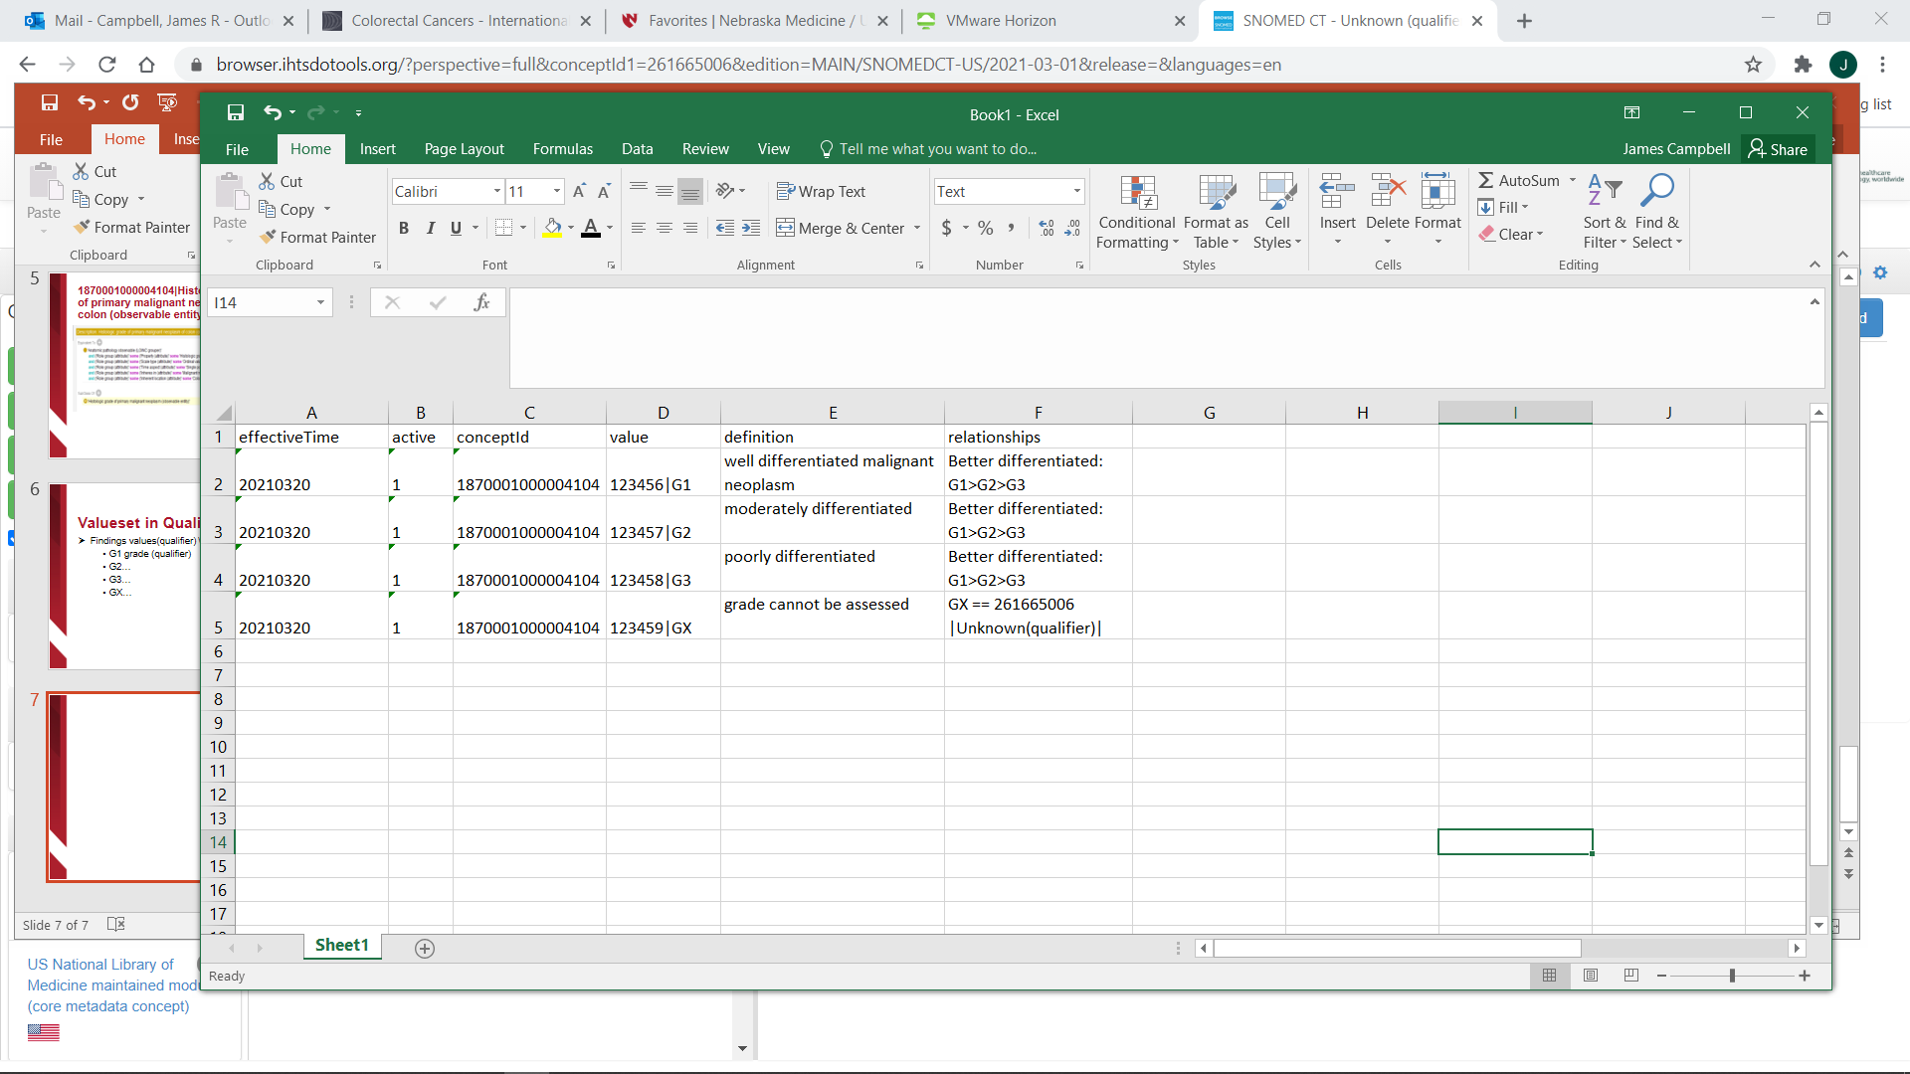
Findings values\
Grade values\ 123456|G1…

Slide 8
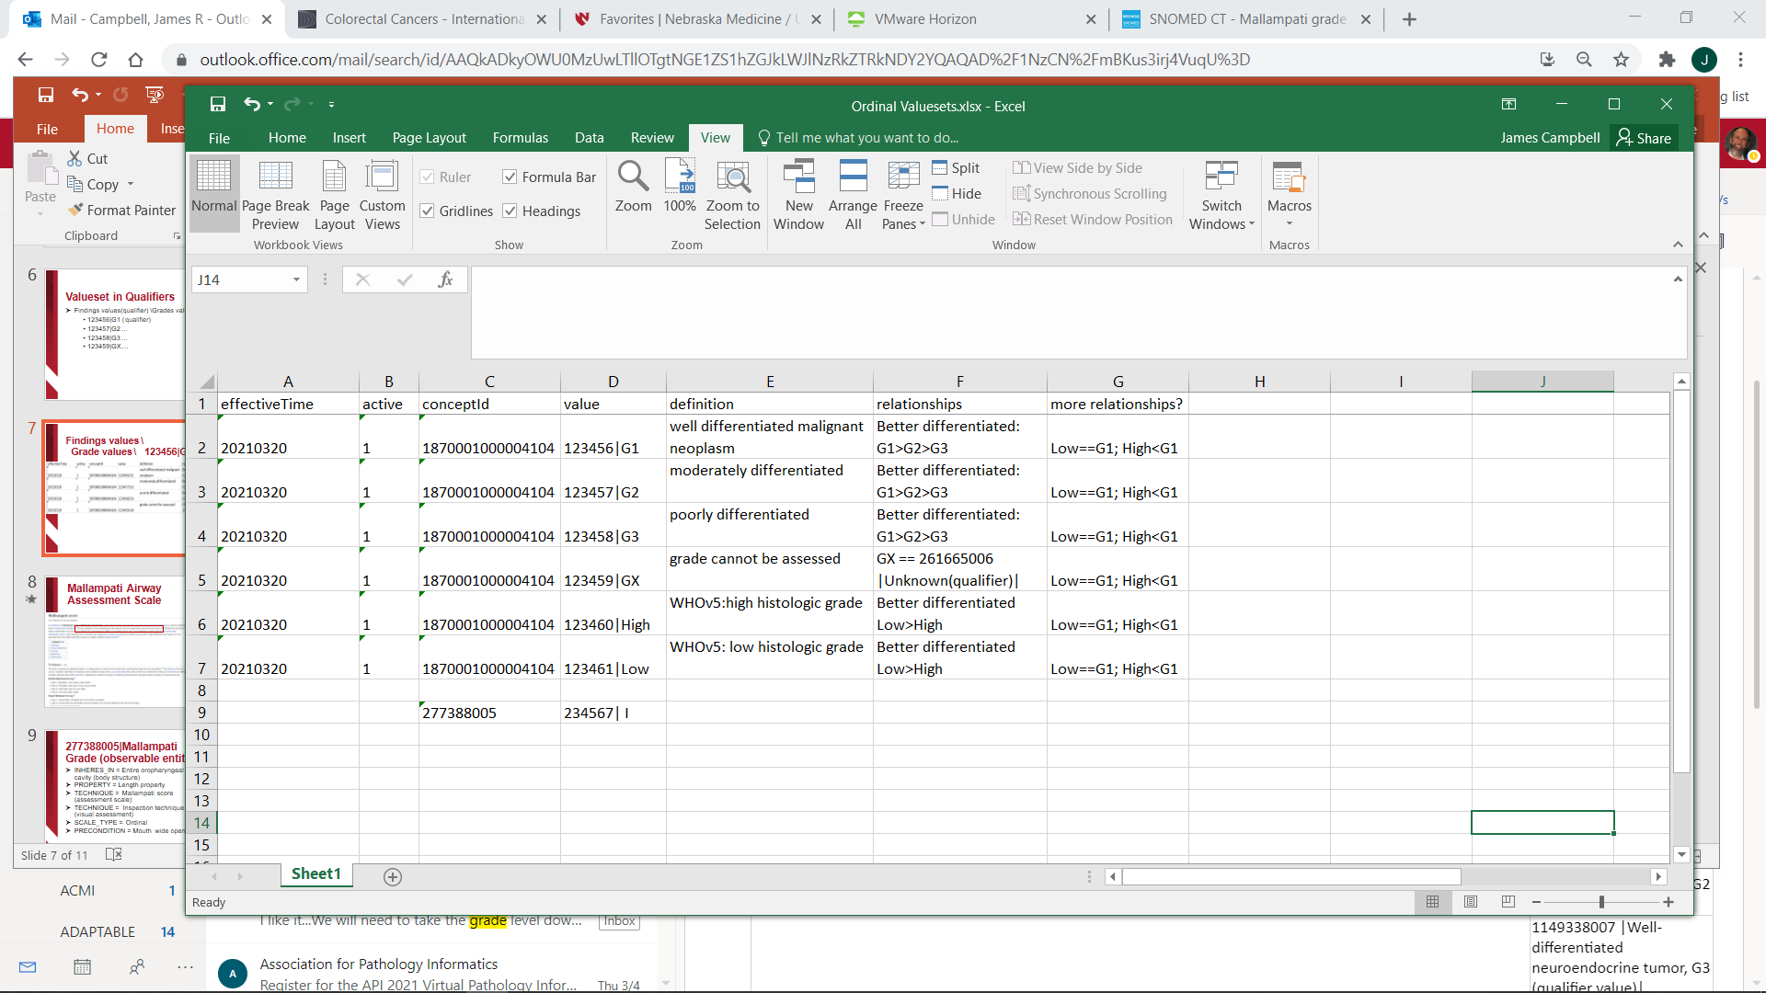
Managing Alternative Valuesets?

Slide 9
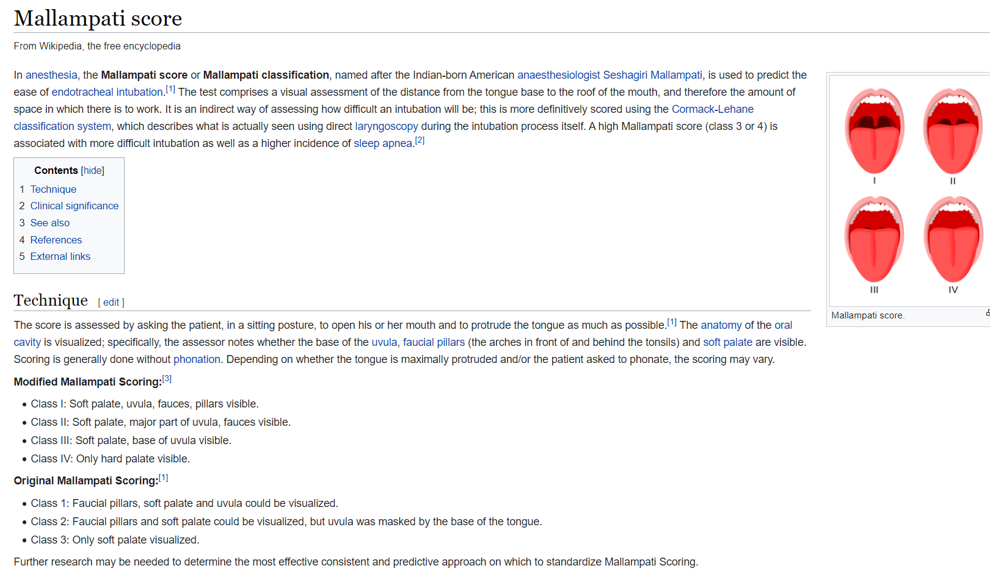
Mallampati Airway Assessment Scale

Slide 10
277388005|Mallampati Grade (observable entity)
INHERES_IN = Entire oropharyngeal cavity (body structure)
PROPERTY = Length property
TECHNIQUE = Mallampati score (assessment scale)
TECHNIQUE = Inspection technique (visual assessment)
SCALE_TYPE = Ordinal
PRECONDITION = Mouth wide open

Slide 11
Valueset in Qualifiers
Findings values(qualifier)\Anesthesia values\...
    234567| Grade I (qualifier)
    234568| Grade II…
    234569| Grade III…
    234560| Grade IV…

Slide 12
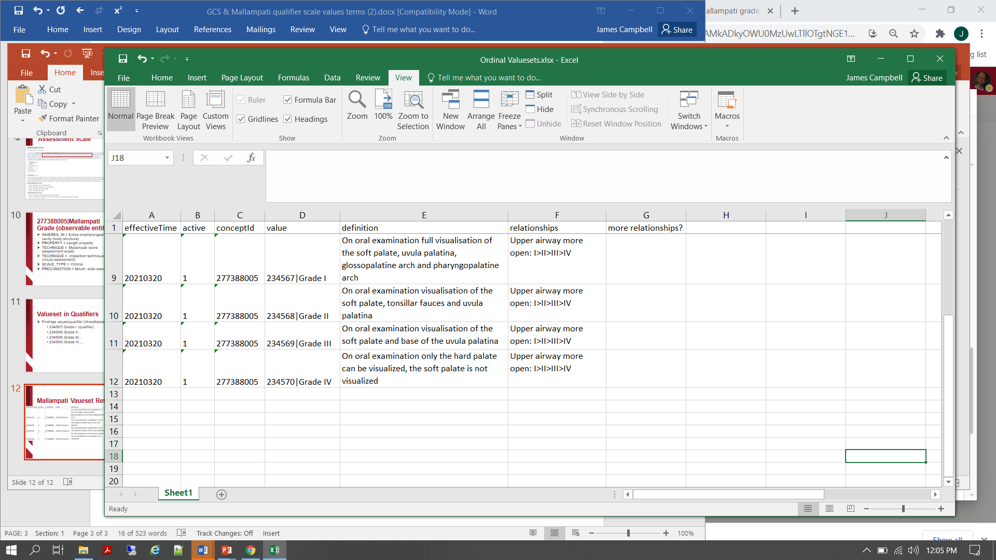
Mallampati Vaueset Refset

