Slide 1
Contact dermatitis
Further considerations

Slide 2
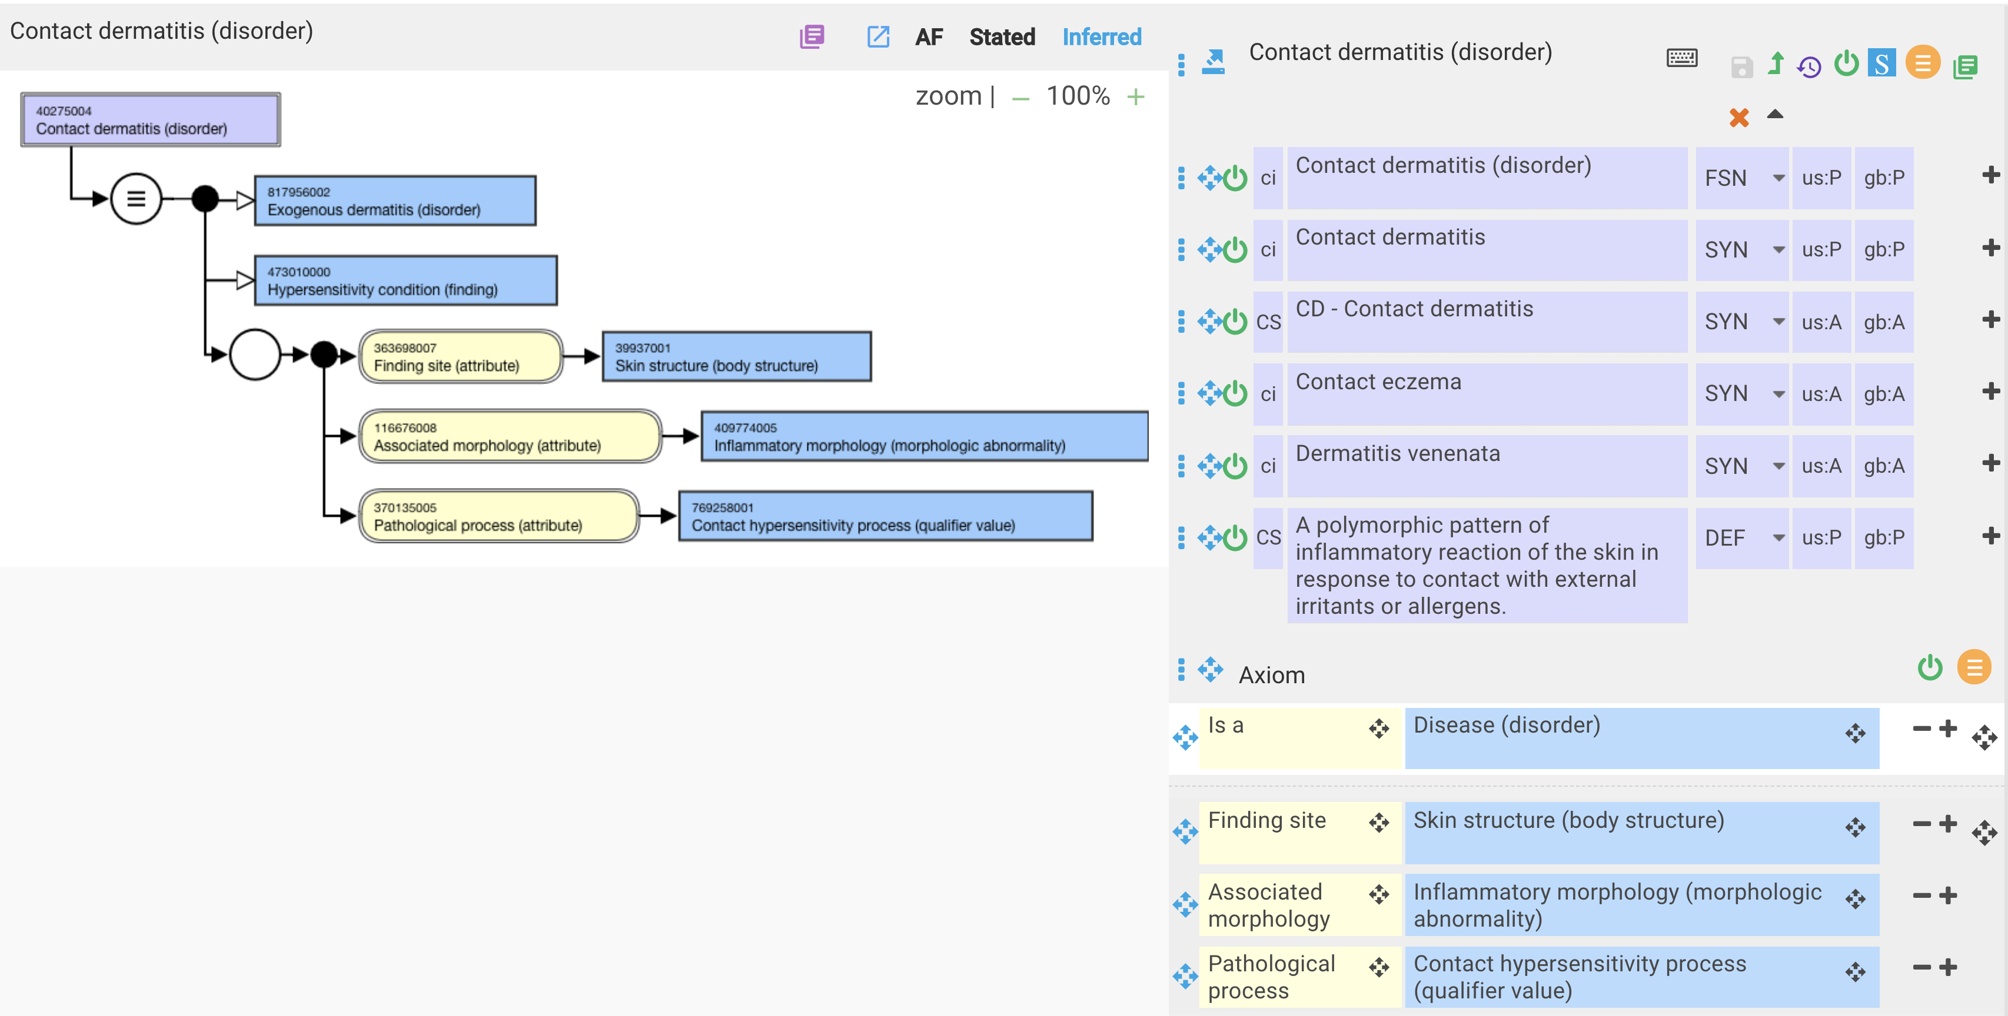
Contact dermatitis – current model

Slide 3
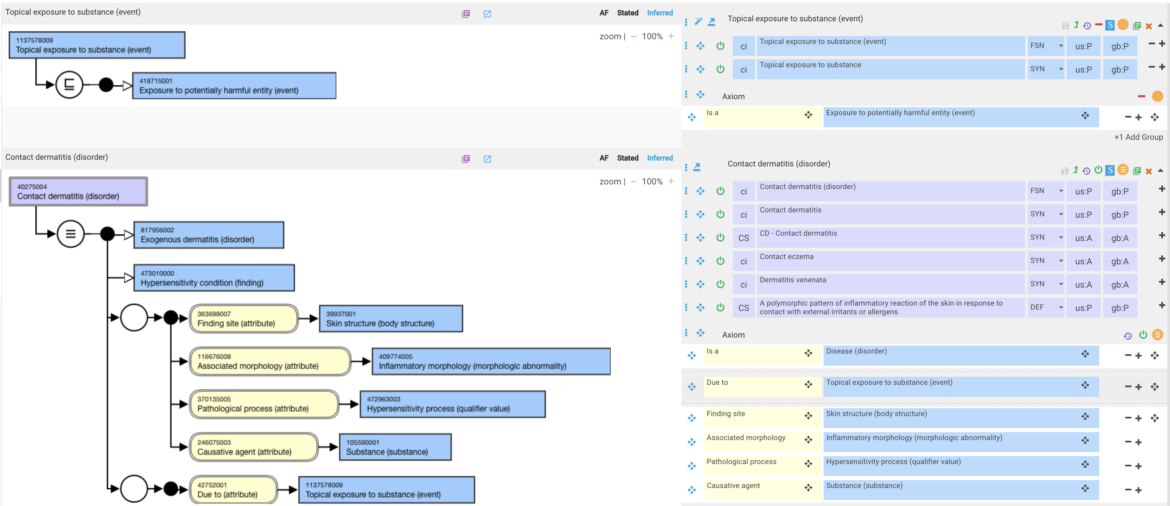
Contact dermatitis – proposed revision

Slide 4
Is contact dermatitis always due to a topical exposure (i.e. contact with skin) to substance?
SYSTEMIC CONTACT DERMATITIS
  Allergic systemic contact dermatitis (SCD) may present as a generalized dermatitis or an exanthema in the intertriginous and flexural areas (Baboon Syndrome).
  Flares can also develop in previous CD or positive patch test sites with systemic exposure to a known contact sensitizer (e.g., ingestion, infusion or transcutaneous exposure).
  The pathophysiology is similar to ACD, with initiation of an inflammatory response upon activation of allergen-specific T lymphocytes.
  The most common causes of SCD include metals (mercury, nickel, gold), medications (aminoglycosides antibacterials, corticosteroids, aminophylline), plants and herbal products (Balsam of Peru, Compositae and Anacardiaceae plant families).

Slide 5
Metal implant dermatitis
Wawrzynski J, Gil JA, Goodman AD, Waryasz GR. Hypersensitivity to Orthopedic Implants: A Review of the Literature. Rheumatol Ther. 2017;4(1):45-56. doi:10.1007/s40744-017-0062-6
  Metal hypersensitivity often manifests as contact dermatitis on the area of skin that was exposed to the metal; however, metallic orthopedic implants are inserted deep within the tissue and away from the skin. Nevertheless, these metals can sensitize the body and provoke an immune reaction.
  The first report of cutaneous hypersensitivity caused by a metallic orthopedic implant was a 1966 case report by Foussereau and Laugier, which described a patient with eczematous dermatitis overlying the site of a metallic plate used for fracture fixation. Since then, many case reports have described similar cutaneous reactions to metallic implants, including cardiovascular, dental, plastic surgical, and orthopedic varieties.

Slide 6
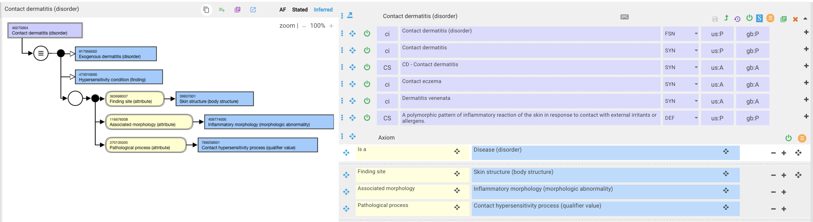
40275004 |Contact dermatitis (disorder)|
Need to retain pathological process of contact hypersensitivity process because without using due to Topical exposure to substance (event) to define contact dermatitis there would be no way to SD contact dermatitis
A contact hypersensitivity process should be interpreted as a pathological process that results in contact dermatitis but does not necessarily imply a topical exposure

Slide 7
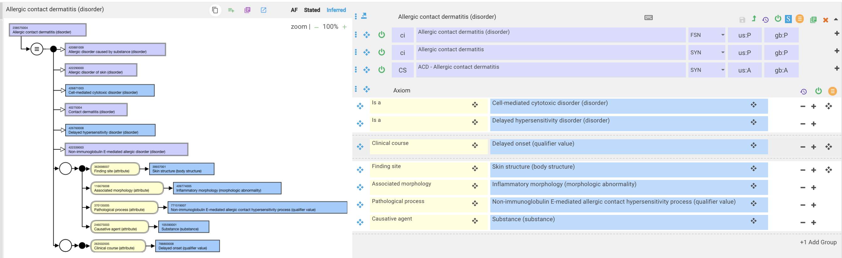
238575004 |Allergic contact dermatitis (disorder)|

Slide 8


410049000 |Contact dermatitis caused by urushiol from Toxicodendron (disorder)|

Slide 9
Allergic contact dermatitis due to exposure to organisms or devices
Without using due to contact with/exposure to organism/device, one can link the organism/device to a substance derived from same.
This approach has been used by the Allergy CRG to develop a model for Allergy to animals
  Allergy to cat Allergy to cat protein

Slide 10
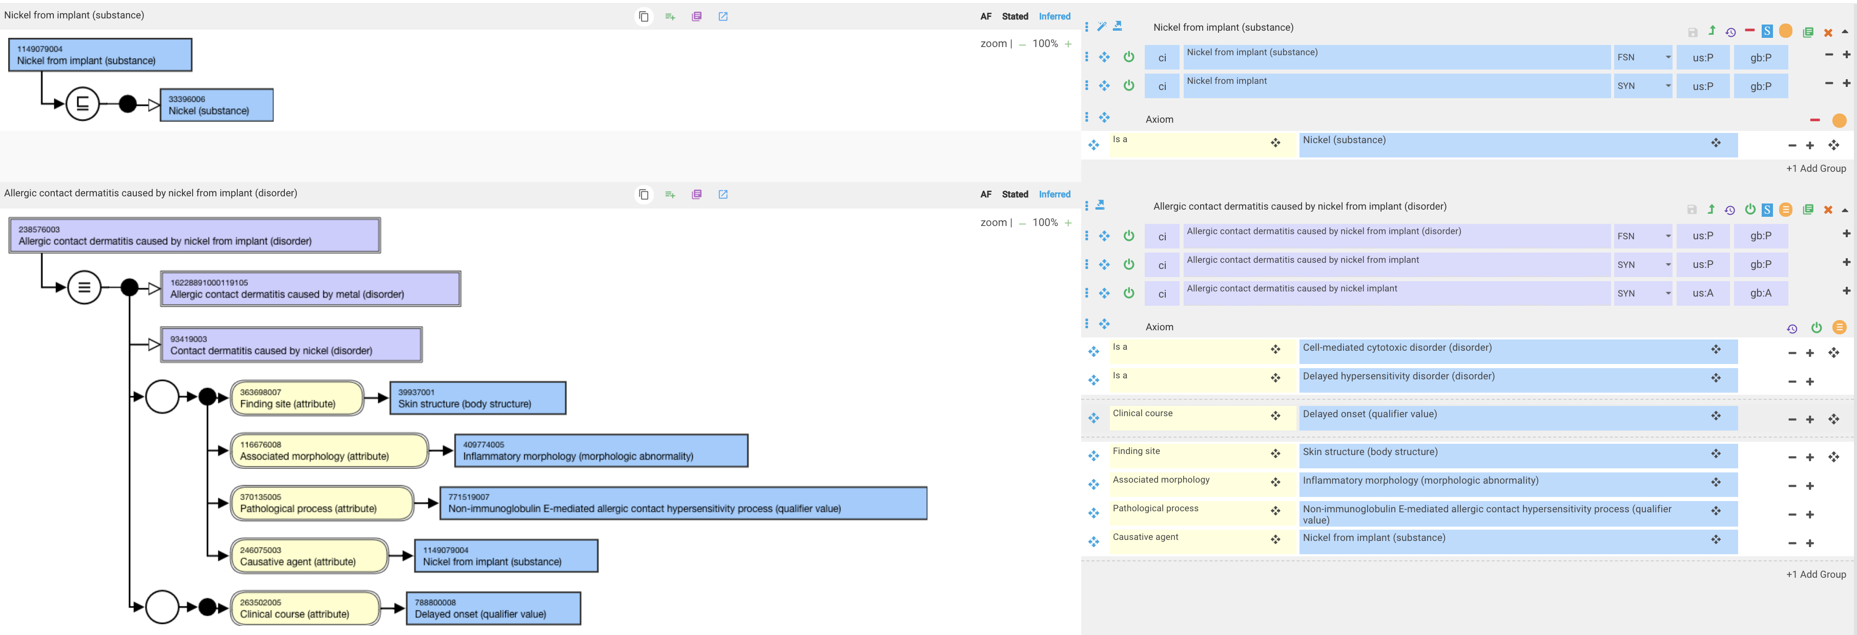
238576003 |Allergic contact dermatitis caused by nickel from implant (disorder)|

