Slide 1

Standardized master catalog of drugs for French hospitals
DEUSG - March 4, 2021 meeting
Olivier Boux, François Macary
Copyright 2021 –PHAST

Slide 2
Content
2 words about PHAST
Usage of SNOMED CT in PHAST’s master drug catalog CIOmed
Identified gaps for the descriptive part of CIOmed
The clinical knowledge part of CIOmed: Computable drug indications
Next steps
Copyright 2021 –PHAST

Slide 3



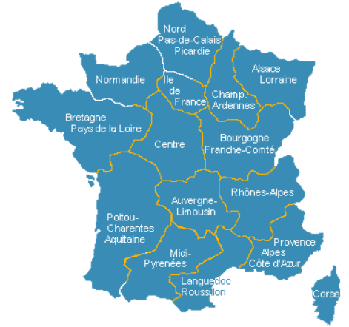


PHAST
Private company based in Paris
25 employees (pharmacists, physicians, software engineers)
> 500 client hospitals
Provides standard-based services:
  HL7 FHIR Terminology services
  HL7 FHIR Catalog services
Distributes master catalogs to support semantic interoperability in hospitals:
  medications workflows
  (prescribe, dispense, administer)
  medical devices
  (order, use)
  laboratory medicine services
  (order, perform, report)
Contributes to SDOs:
  HL7: CTS2, IPS, Catalogs in FHIR
  SNOMED CT: cochair of multi-NRC French translation group
  IHE: Pathology and Laboratory Medicine (PaLM)
Training, consulting and mapping on semantic interoperability:
  FHIR,
  SNOMED CT, LOINC, UCUM
  Mappings to local interface terminologies
Copyright 2021 –PHAST

Slide 4
Master catalog of medications for semantic interoperability
~ 13,500 actual (branded) medications authorized on the French market
National
identifier for
dispense
Clinical
knowledge
Regulatory
economic constraints
Names
Ingredients
Unit
Volume
Kinetics
Form
Route
ATC
Backed by internal dictionary of the catalog
Substances
Units of measure
Dose forms
ATC
Units of
presentation
Kinetics
Therapeutic
indications
Routes of administration
Copyright 2021 –PHAST

Slide 5


Master catalog of medications for semantic interoperability
~ 13,500 actual (branded) medications authorized on the French market
National
identifier for
dispense
Clinical
knowledge
Regulatory
economic constraints
Names
Ingredients
Unit
Volume
Kinetics
Form
Route
ATC
Backed by internal dictionary of the catalog
Substances
Units of measure
Dose forms
ATC
WHO
ATC
Units of
presentation
Kinetics
Standard Terms
indications
Routes of administration
Standard Terms
Backed by international terminologies:
WHO
ATC
Standard Terms
Copyright 2021 –PHAST

Slide 6
Implementation of SNOMED CT by CIOmed is a mapping effort
CIOmed will be distributed through the HL7 FHIR standard for catalogs of healthcare items with codeable data elements of FHIR resources using codings based on the mapped reference terminologies (SNOMED CT, EDQM, national nomenclatures…)
(https://build.fhir.org/ig/HL7/fhir-order-catalog/)
Copyright 2021 –PHAST

Slide 7
Regulatory requirement in France to progressively adopt the abstract representation of drug
Prescribe:
  Medicinal Product Only [+ kinetics], Dosage instruction
  Dosage instruction = {route [+ method], dose and rate, timing}
Dispense:
  Clinical Drug
Copyright 2021 –PHAST

Slide 8

Identifiers for abstract medications in
IDMP
PhPID SUB L1
Paracetamol + Codeine
Medicinal Product Only
+ route
+ strength
+ dose form
Paracetamol + Codeine – oral route
PhPID SUB L2
PhPID SUB L3
Paracetamol + Codeine
500 mg + 30 mg
Paracetamol + Codeine
oral solution
+ dose form
+ strength
+ pharmaceutical dose form
transformation
Clinical Drug
PhPID SUB L4
Paracetamol + Codeine
500 mg + 30 mg
oral solution
Paracetamol + Codeine
500 mg + 30 mg
effervescent tablet
Administrable dose form
Pharmaceutical dose form
Copyright 2021 –PHAST

Slide 9
Semantic alignments with SNOMED CT for the descriptive content
Current count
in CIOmed
Pharmaceutical dose forms 243
Routes of administration 59
Units of presentation 46
Dose form release characteristics 4
Substances 2482
Medicinal products only 1830
Clinical Drugs 5063
average of ~ 2.5 branded drugs per Clinical Drug
Copyright 2021 –PHAST

Slide 10
Mapping issues on dose forms
12 atomic dose forms missing → 37 branded medications concerned
  Example:
  missing: vapor emulsion for inhalation
  available: conventional release vapor solution for inhalation
36 combined dose forms missing → 324 branded medications
  Example:
  missing: powder and solvent for ocular solution
  available: powder for conventional release eye solution
To be decided whether we create those in our extension or not, given that combined dose forms are currently out of scope of international edition.
Copyright 2021 –PHAST

Slide 11
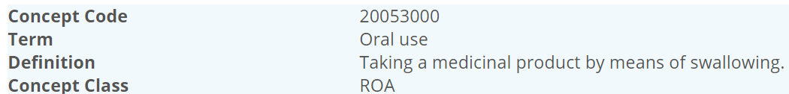
The oral route issue
  Oral route is used by 60% of CIOmed branded medications.
  CIOmed follows the EDQM meaning:
  Distinct from SNOMED CT concept: 26643006 |Oral route (qualifier value)|
    “A digestive tract route that begins in the mouth.”
Standard Terms
Problem with dental route, sublingual route, gingival route… considered to be kinds of oral routes in SNOMED CT, not in CIOmed.
Copyright 2021 –PHAST

Slide 12
Current status of ongoing mapping
Concepts | Total in CIOmed | # mapped to SNOMED CT | %mapped
Substances | 2482 | 2404 | 97%
Medicinal products only | 1830 | 1706 | 93%
Clinical drugs | 5063 | 4011 | 79%
The mapping against the January 2021 edition is not completed yet .
So we do not have the “gaps for sure” yet at this stage.
Copyright 2021 –PHAST

Slide 13
The clinical knowledge part of CIOmed starting with therapeutic indications
Summary of Product Characteristics:
1) Name of the medicinal product
2) Qualitative and quantitative composition
3) Pharmaceutical form
4) Clinical particulars
4.1 Therapeutic indications
Conversion of therapeutic indications from plain text to computable data needs to combine several models, depending on the semantic and logic richness expressed by the text.
4.2 Posology and method of administration
4.3 Contraindications
4.4 Special warnings and precautions for use
4.5 Interactions
4.6 Fertility, pregnancy and lactation
https://www.ema.europa.eu/en/glossary/summary-product-characteristics
https://ec.europa.eu/health//sites/health/files/files/eudralex/vol-2/c/smpc_guideline_rev2_en.pdf
Copyright 2021 –PHAST

Slide 14




Models and underlying standards for representing therapeutic indications
Information model
Uses two FHIR resources
MedicationKnowledge
ClinicalUseIssue
R5
binding
Inference model
Concept model
binding
Copyright 2021 –PHAST

Slide 15
Concept model for therapeutic indications
Treatment intent: curative, preventive, adjunct …
|Has intent (attribute)|
|Recipient category (attribute)|
Patient characteristic: adult, newborn, pregnant …
Range for a measurable patient characteristic
e.g. age, body weight …
Therapeutic Indication
|Route of administration (attribute)|
< |Clinical finding|
<<|Administration of drug or medicament (procedure)|
< |Procedure|
|Has focus (attribute)|
< |Finding with explicit context|
< |Procedure with explicit context|
|Method (attribute)|
Range for a measurable observation
Maximum duration of treatment
< |Pharmaceutical product|
< |Substance|
Related therapy (drug or other product or activity)
< |Procedure|
Copyright 2021 –PHAST

Slide 16
Example of a simple indication (1/2)
“Prevention of recurrence of deep vein thrombosis in adults”
a) Linguistic identification of blocs:
treatment guideline target of treatment
Prevention of recurrence of deep vein thrombosis in adults
b) Semantic normalization:
Prevention 18629005 |Administration of drug or medicament|:
    363703001 |Has intent| = 129428001 |Preventive - procedure intent|,
of 363702006 |Has focus| =
recurrence of deep vein thrombosis 710167004 |Recurrent deep vein thrombosis|,
in adults 370131001 |Recipient category| = 133936004 |Adult |
Copyright 2021 –PHAST

Slide 17
Example of a simple indication (2/2)
Prevention of recurrence of deep vein thrombosis in adults
c) Formalization of the computable indication
MedicationKnowledge
…
indicationGuideline
indication.concept: [
  coding: {system: http://snomed.info/sct, code : 710167004, display : recurrent deep vein thrombosis}
]
dosingGuideline: {
treatmentIntent: [coding: {system: http://snomed.info/sct, code: 129428001, display: preventive intent} ]
patientCharacteristic : {
type: [coding: {system: http://snomed.info/sct, code: 370131001, display: recipient category} ]
valueCodeableConcept: [coding: {system: http://snomed.info/sct, code: 133936004, display: adult} ]
}
  …
Copyright 2021 –PHAST

Slide 18
Next steps for CIOmed
Conclude the gap analysis on the mappings to SNOMED CT → April
Publish beta release of CIOmed as a FHIR catalog of drugs → June
New ballot of HL7 FHIR implementation guide “catalogs” → August
Test API with client applications at FHIR connectathons → September
Copyright 2021 –PHAST

Slide 19

www.phast.fr
Copyright 2021 –PHAST

