Slide 1
Singapore Drug Dictionary
Wong Jing Jing, Singapore
04 February, 2021

Slide 2
Singapore Drug Dictionary & SNOMED CT
A Singapore Extension of SNOMED CT
A national standard to unambiguously identify, code & interpret medicines
  Standardised, consistent descriptions for each drug product
  Facilitates seamless exchange of data
  Meet diverse requirements of different users and cater for new innovative products
It is NOT a drug database, but needs to link to them
Linkage to Decision Support Vendors (e.g. MIMS)
  Drug-drug interaction,
  Drug-health alerts
  Dose checking
  Allergy alerts

Slide 3
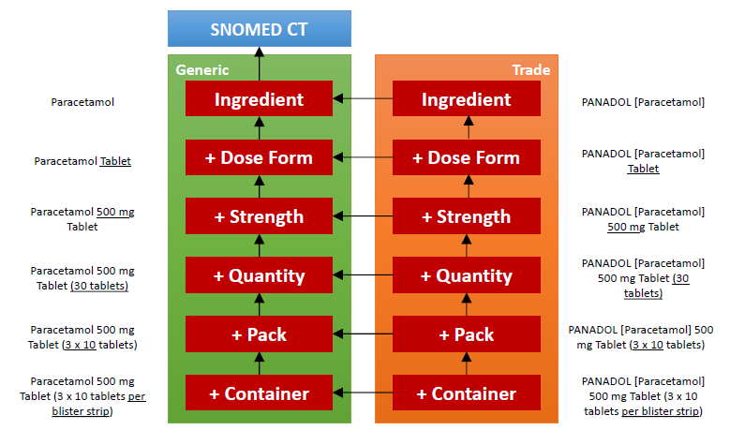
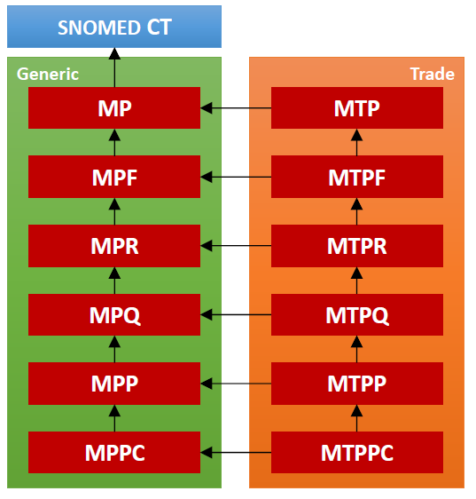
SDD Model

Slide 4
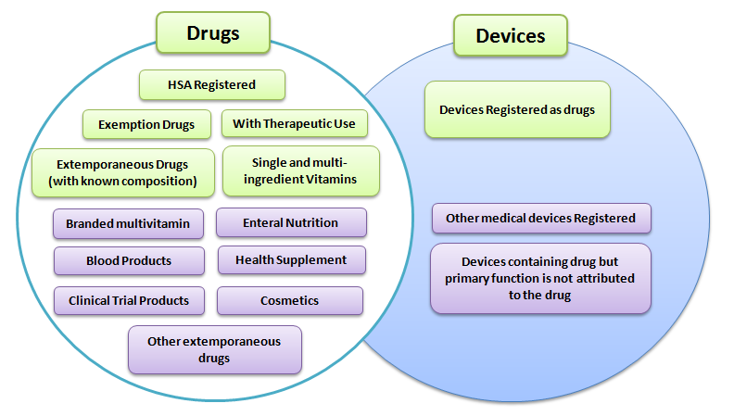
SDD Scope
In scope
Out of Scope

Slide 5
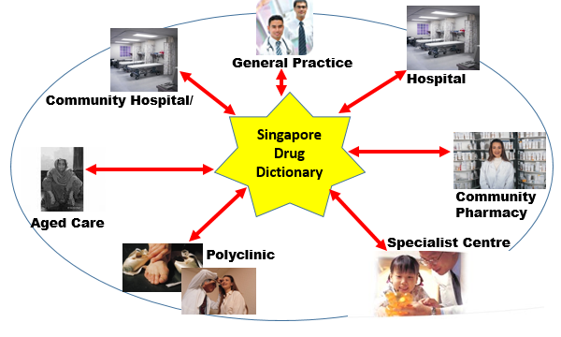
SDD Use Cases
Standard Medication codes for Health Information Exchange
Prescribing, Dispensing, Allergy, Procurement
Standard Supporting Medication Terminology – e.g. frequency, dosage form, route of administration, UOM
Health Care settings

Slide 6
SDD Implementation
Mapping approach
  Preserves integrity of historical transactions and fulfils use of standards at national level
Challenges
  Stakeholders: overcame with strong support from Chief Pharmacist and Chief Medical Informatics Officer
    Large number from various institutions
    Impact on workflow and comfort level with legacy codes
For more information, 2018 SNOMED Expo presentation decks available:
https://drive.google.com/file/d/1IcE760YosXdklGf9W6e2sK3CjHbCs-EF/view

Slide 7
SDD Implementation
Challenges
  Technical: cleared through collaboration and cooperation
    Large number of systems (44), intricate interdependencies between
    Need for consensus on which and how systems should deploy enhancements
  Semantic: resolved through engagement and learning
    Lexical mapping preferred for stakeholders. Difficult due to differences in nomenclature from academic vs operational pov
    Discussed differences and resolved some variances in nomenclature with agreed definitions
    Developed national mapping guide to reduce variability

Slide 8
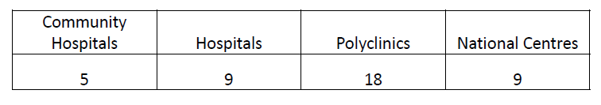
SDD Implementation - outcome
All public healthcare institutions contributing medication data in SDD to national EHR
SDD codes replaces the national group procurement (GPO) codes (legacy codes used by many public healthcare institutions)
SDD Lite web provides interface to SDD codes, with search capability using drug attributes

Slide 9
SDD Authoring process
Semi-automated using internal tooling solution
    Data Entry Interface
    Template of Attribute Fields
    Fields linked to reference sets where applicable
    SDD Concepts constructed based on SDD Data Model
User Guide for using the tool
    Tied back to other SDD Design Principles and Editorial Rules
SDD weekly publication presentation slides, 2019 SNOMED Expo:
https://confluence.ihtsdotools.org/display/FT/201948+Weekly+content+release+of+Singapore+Drug+Dictionary%2C+a+SNOMED+CT+SG+Extension

Slide 10
SDD Authoring process/ governance
Documented guidelines on editorial steps
  Scope of SDD
  Standardize data fields for product types
    Strength representation for parenteral, vs oral liquid
      E.g. total active/ total volume (parenteral); total active/ 5 mL (oral liquid)
    Definition of data fields or attributes:
      Ingredients
      Dose forms
      UOM
      Packaging container/ devices
      Other defining attributes, e.g. nanoparticles, porcine, equine

Slide 11
SDD Authoring process/ governance
Review process for every drug product authored
Standardised use of product information sources/ references
  Product inserts
  Ingredients – Martindale
SDD Workgroup and SDD Editorial group comprised of IT pharmacists representing health clusters in Singapore
  Discussion for SDD implementation
  Discussion for nomenclature and semantic meaning
  Co-authoring of National Drug Mapping guide

Slide 12
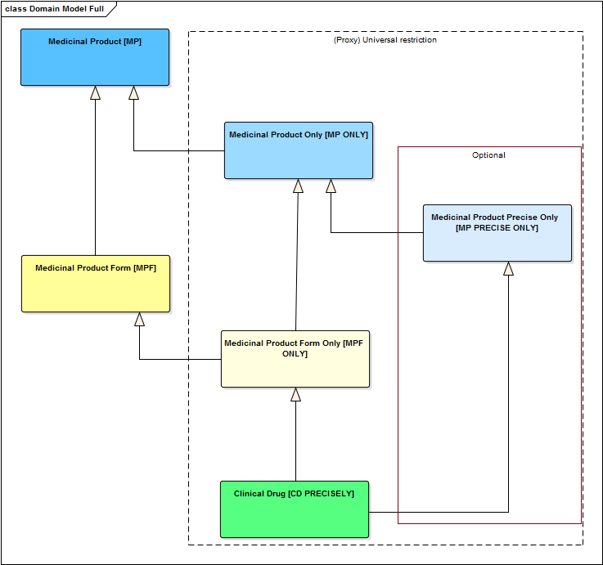
SNOMED International: SNOMED Drug Product Model

Slide 13
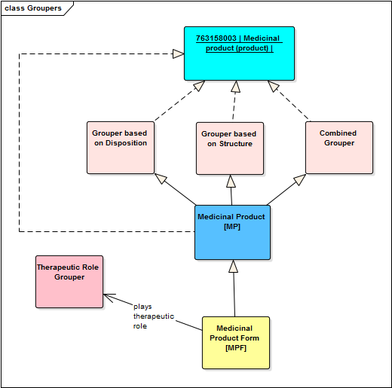
SNOMED Int’l Model – other features
Grouper concepts based on
  disposition (MoA),
  structure,
  combination of structure & disposition, or
  therapeutic role
SDD has very different local use case for grouping concepts
  May consider adopting this feature of SNOMED International grouping

Slide 14
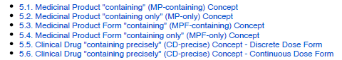
SNOMED Int’l Drug Model: Differences vs SDD
Covers only generic side, equivalences of MP, MPF, MPR (in SDD). SDD has trade concepts modelled.
Has more described concept ‘layer’ to make it compatible with IDMP (closed world view). SDD concepts are designed in closed world view, ie “contain only” and “contain precisely”
MP “containing precisely” concept is recommended as extension and not part of international model. SDD is an extension.
Strength representation using concepts as concrete domain currently not yet supported in International Model. SDD uses concrete domain to represent strength/ number values (similar to AMT)

Slide 15
In Summary
A Drug Extension Model provides
    Flexibility – can be localized
    Extensibility – can be extended for local products
Implementation
    Engagement with stakeholders
    Support from relevant authority
    Collaboration and cooperation

Slide 16
In Summary
Editorial guidelines/ process governance
    Established basic guidelines from drug product knowledge
      Fine-tuned with different products encountered
    Established data and process governance for authoring
    Engaged clinical end-users to resolve variations and differences in nomenclature/ semantics

Slide 17
Next steps
Use of SDD in other national initiatives, tapping on the rich relationships and attributes
  National Drug Formulary
  National Harmonised Integrated Pharmacy Solution (NHIPS)
Remodelling planned
  SDD too complex and too heavy for local clinical use cases
  Obtained better understanding of what clinical users need for EHR standards
  Alignment to international drug model/ international hierarchies will be part of the consideration, with adaptation to local context where needed

