Slide 1
Contact dermatitis
Further considerations

Slide 2
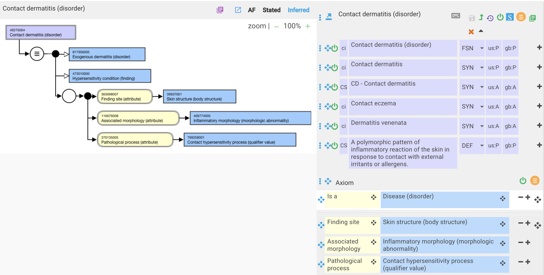
Contact dermatitis – current model

Slide 3
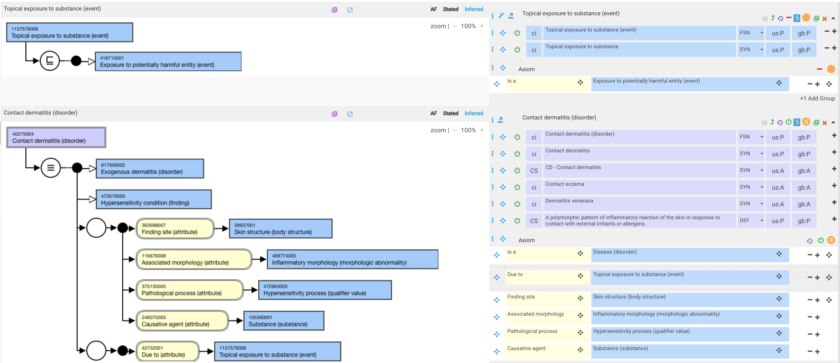
Contact dermatitis – proposed revision

Slide 4
Contact dermatitis due to specific exposures - 1
Contact dermatitis is defined in the previous slide as due to a topical exposure to substance
Contact dermatitis is not necessarily due to a topical exposure
  Wawrzynski J, Gil JA, Goodman AD, Waryasz GR. Hypersensitivity to Orthopedic Implants: A Review of the Literature. Rheumatol Ther. 2017;4(1):45-56. doi:10.1007/s40744-017-0062-6
    Metal hypersensitivity often manifests as contact dermatitis on the area of skin that was exposed to the metal; however, metallic orthopedic implants are inserted deep within the tissue and away from the skin. Nevertheless, these metals can sensitize the body and provoke an immune reaction.
    The first report of cutaneous hypersensitivity caused by a metallic orthopedic implant was a 1966 case report by Foussereau and Laugier, which described a patient with eczematous dermatitis overlying the site of a metallic plate used for fracture fixation. Since then, many case reports have described similar cutaneous reactions to metallic implants, including cardiovascular, dental, plastic surgical, and orthopedic varieties.
Contact dermatitis caused by a substance due to exposure to an organism or physical object will not classify under contact dermatitis unless these exposures are incorrectly considered to be subtypes of Topical exposure to substance (event)

Slide 5

Contact dermatitis due to specific exposures - 2

Slide 6
Contact dermatitis
Revised model

Slide 7
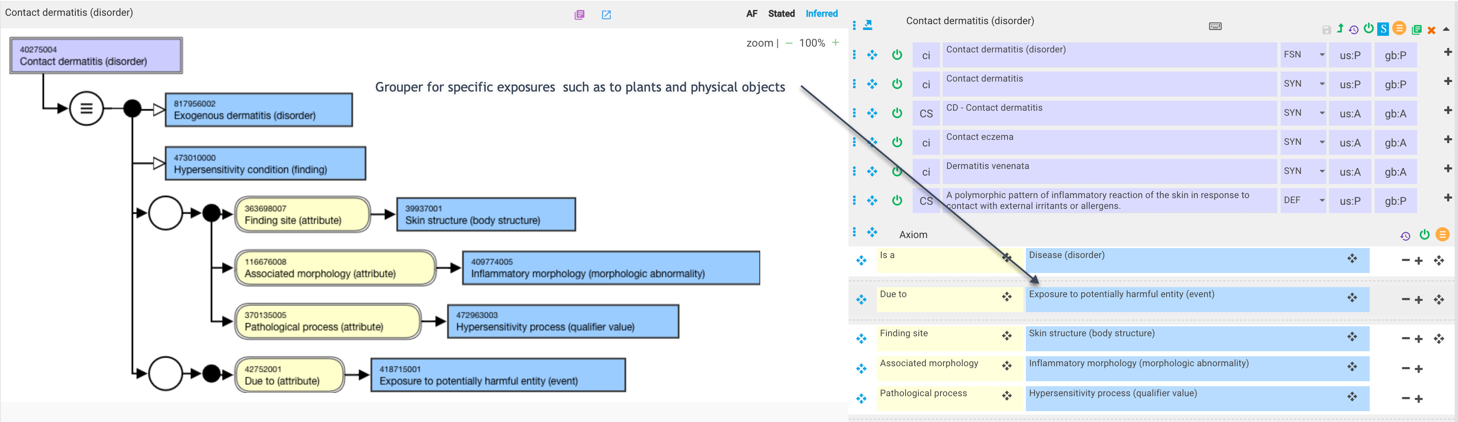
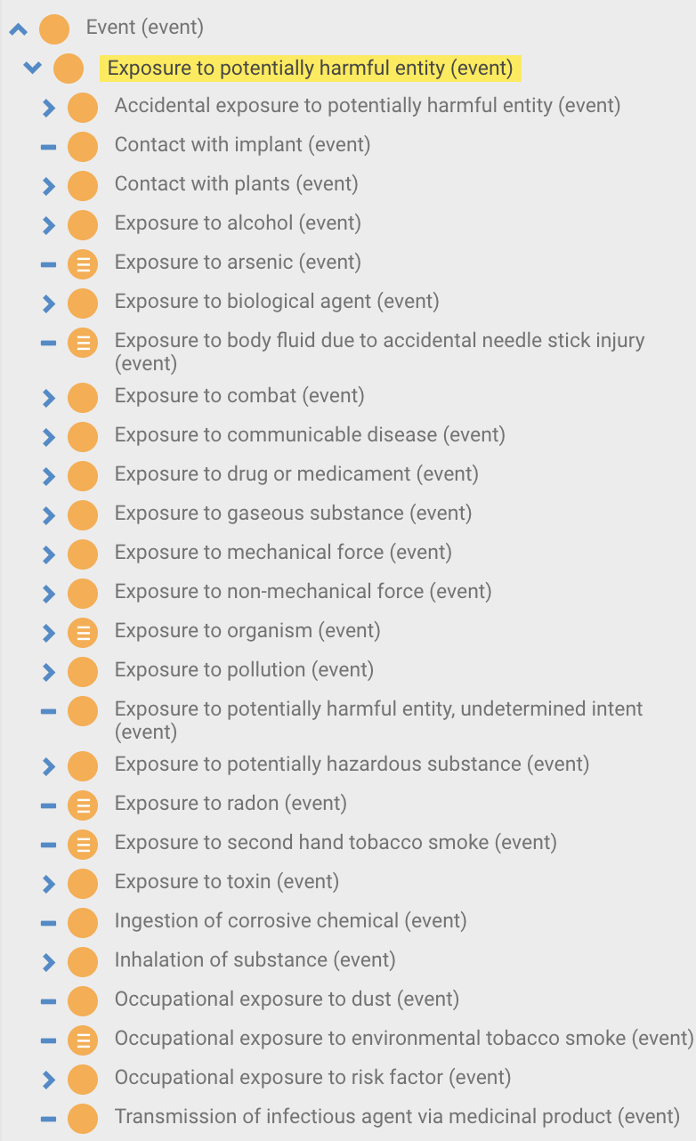
40275004 |Contact dermatitis (disorder)|
No causative agent at this level in order to accommodate products as well as substances as causative agents

Slide 8

238575004 |Allergic contact dermatitis (disorder)|

Slide 9

238576003 |Allergic contact dermatitis caused by nickel from implant (disorder)|

Slide 10
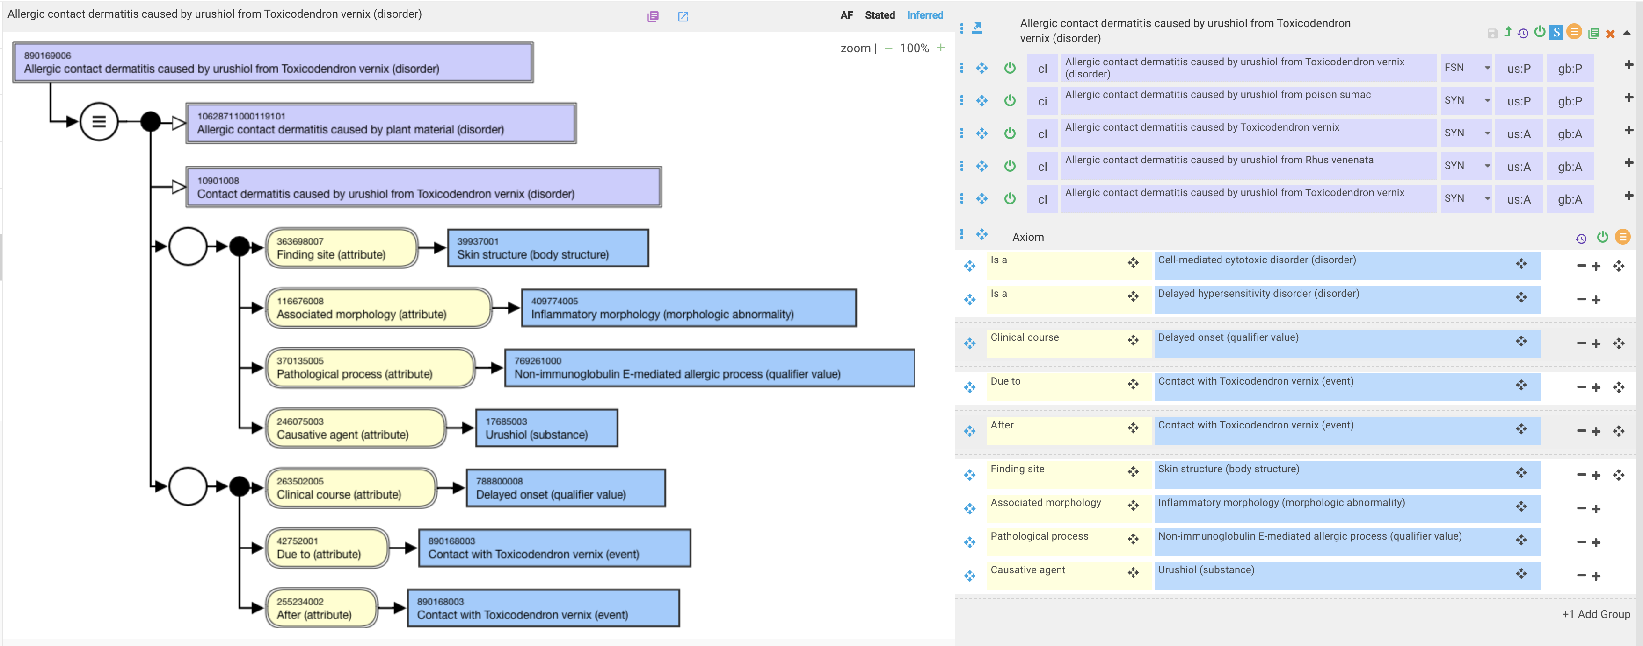
890169006 |Allergic contact dermatitis caused by urushiol from Toxicodendron vernix (disorder)|

Slide 11

Allergic contact dermatitis caused by fragrance (disorder)

