Slide 1

DEUSG – Perspectives from Norway
Online meeting 26th November 2020
Martha Schei Hynne

Slide 2
Topics
The current medicinal product dictionary in Norway
Our project(s)
Our challenges
Notes:
.

Slide 3
Medicinal product dictionary in Norway
FEST
A MPD with authorised product information data from the Norwegian Medicines Agency (NoMA)
Used in e-prescription/e-health systems nationally
Prescribing at package level most common
Generic substitution at pharmacies
Goal: More generic prescribing/dose based prescription instead of using brand name

Slide 4
Our work – Two projects in one
“SAFEST” – Norwegian Medicines Agency (NoMA) and hospitals
  Medicinal product dictionary for hospital needs
  including data for dose based prescription
“Common Language” – The National Release Center
  SNOMED CT as a terminology throughout the health sector
  Several areas, including medication
  EPIC – New EHR-system. Go-Live 2021
Decision:
Let’s use SNOMED CT for dose based prescription ☺
Notes:
Common language: The National release center

Slide 5
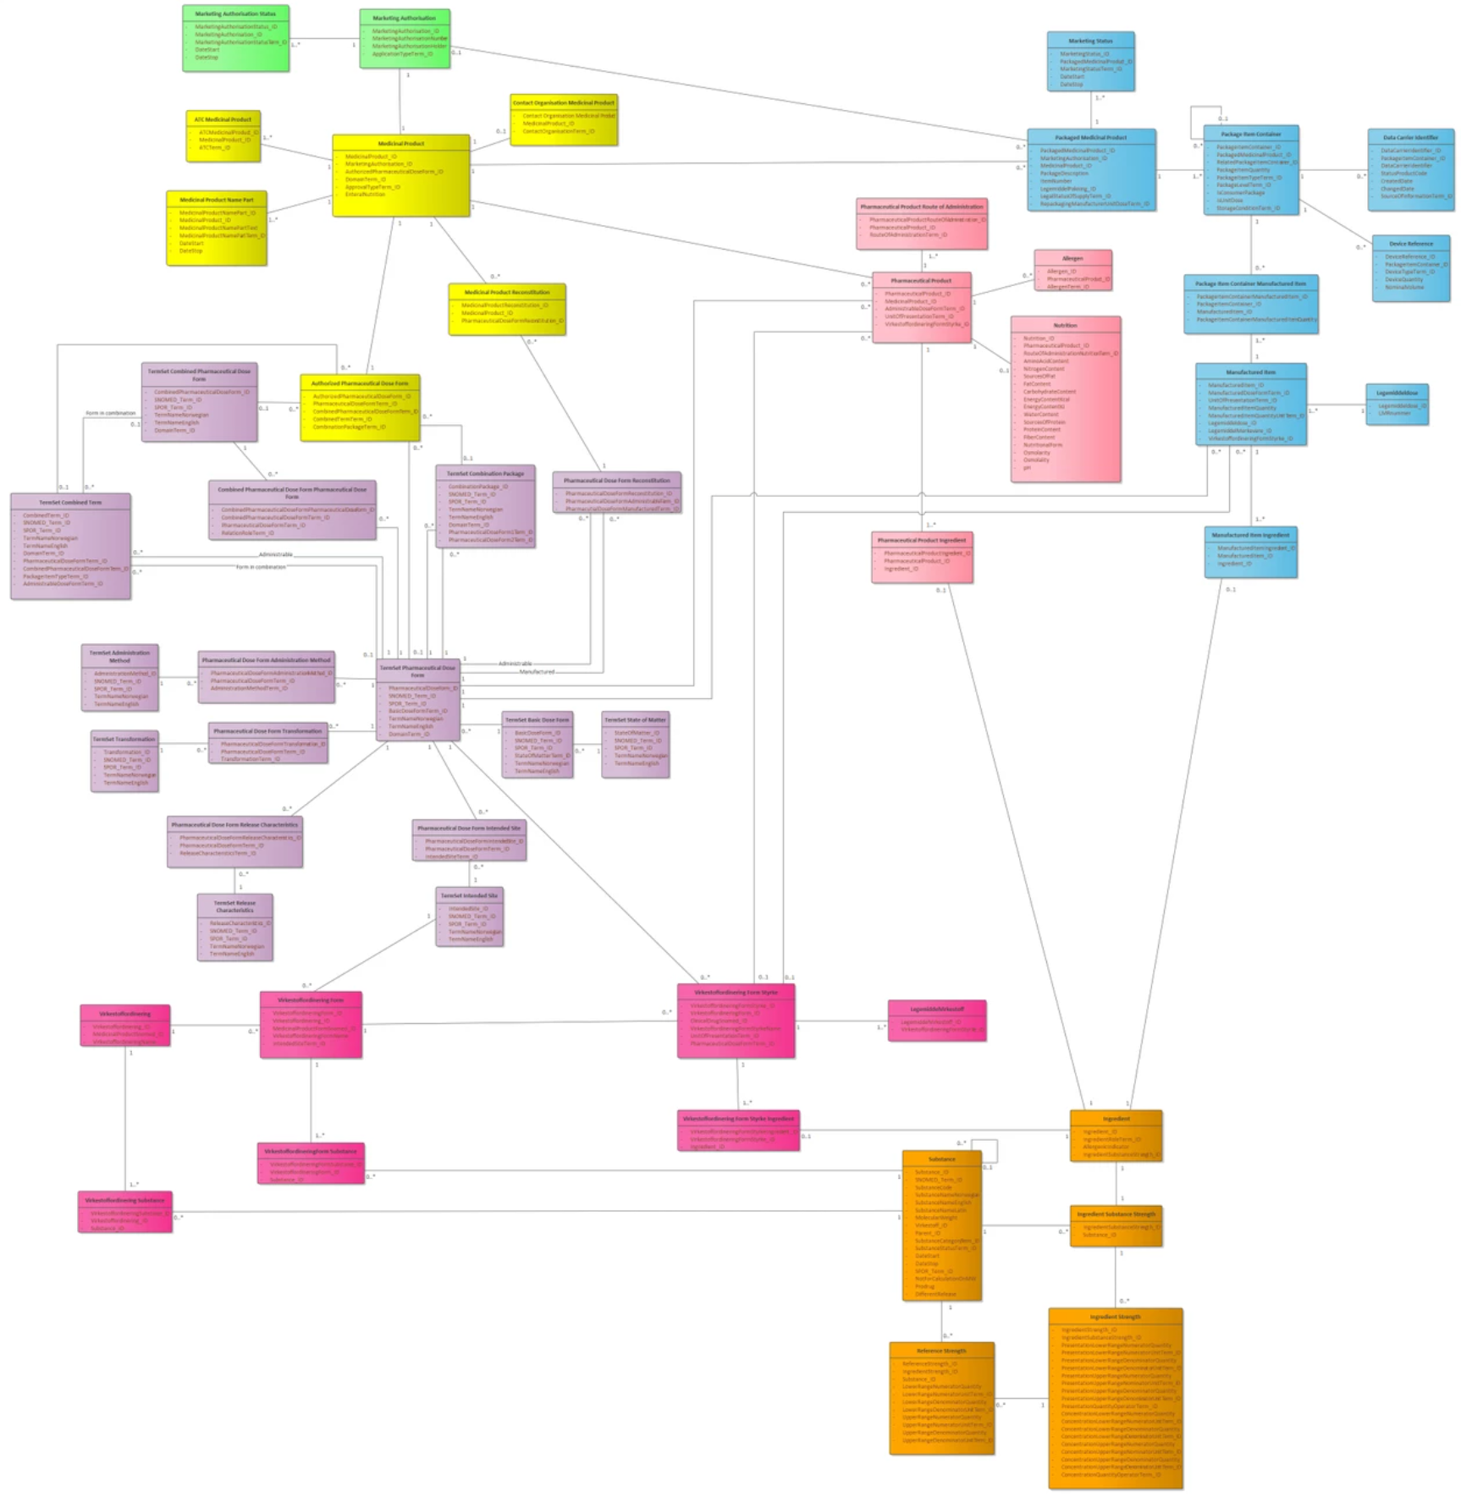
SAFEST
Data to support hospital needs of medicinal information
Use of international standards – where possible
EPIC – the first EHR-system to use the data from our project
What we are doing
IDMP database – for (branded) product information
Mapping to SNOMED CT to support “Dose based prescription”
  Medicinal product
  Medicinal product Form
  Clinical drug

Slide 6
The mapping
Based on authorised product information in FEST (Todays MDP)
Mapping of substances, pharmaceutical dose forms and strengths
Mapping of products
Adaptations
Simplification of pharmaceutical dose form
  E.g. Film-coated tablet → tablet
SNOMED-rules for strength (some exceptions)
Generation of new concepts when needed

Slide 7
Challenges
“Duplicate” clinical drug for generics – less flexibility for health care professionals when selecting product
Strengths in SNOMED CT not according to clinical needs
Drugs not suitable for dose based prescription – Drug with clinical differences mapped to the same clinical drug
Communication with stakeholders/users of the data

Slide 8
“Duplicate” Clinical drugs
Inconsistent pharmaceutical dose form in the authorised product information
Our decision (driven by the need for a single ID for the combination):
Only the combination (infusion or injection) is used in clinical drug
  Products with “injection” or “infusion” is mapped to the combination
  If different UoP (vial; bag) → Additional clinical drug
Product containing precisely ceftazidime (as ceftazidime pentahydrate) 1 gram/1 vial powder for conventional release solution for infusion or injection (clinical drug)
Product containing precisely ceftazidime (as ceftazidime pentahydrate) 1 gram/1 vial powder for conventional release solution for injection (clinical drug)
Notes:
Not a SNOMED issue

Slide 9
“Duplicate” Clinical drugs
Identical BoSS, different precise ingredient
Our decision (driven by the need for a single ID):
Create an additional clinical drug based on the BoSS only
Product containing precisely almotriptan (as almotriptan d,l-hydrogenmalate) 12.5 milligram/1 each conventional release oral tablet (clinical drug)
Product containing precisely almotriptan (as almotriptan malate) 12.5 milligram/1 each conventional release oral tablet (clinical drug)

Slide 10
Strength in SNOMED CT not according to clinical needs
Presentation strength vs concentration strength
E.g Dalteparin sodium
Concentration strength 25 000 IE/mL
Presentation strength 5000 IE/0.2 mL; 7500 IE/0.3 mL etc
Our decision: Use both concentration strength and presentation strength
  5000 IE/syringe
  25 000 IE/mL
Notes:
Dalteparin: Same concentration in many prefilled syringes with different volumes. The prescriber is interested in the total amount in the syringe. Risk of not caclulating the right pack size when selection based on the concentration strength.

Slide 11
Strength in SNOMED CT not according to clinical needs
Strength as percent %
Our decision:
Use concentration strength calculated from the percent strength (w/v; w/w or v/v)
Use % -strength as part of the textual name (synonym) of clinical drug

Slide 12
Strength in SNOMED CT not according to clinical needs
Strength for patches /24h
Our decision:
Use strength/24h in clinical drug
Notes:
Strenght per 1 hour is not relevant.

Slide 13
Different drugs mapped to the same clinical drug
Some products mapped to the same clinical drug is not interchangeable
E.g “Liposomal dose forms”
Product containing precisely doxorubicin hydrochloride 2 milligram/1 milliliter concentrate for conventional release solution for infusion (clinical drug)
  Doxorubicin Accord®
  Caelyx pegylated liposomal®
Identical ingredient, pharmaceutical dose form and strength
NOT identical dosing regime
Notes:
Not a SNOMED issue.
General: the product informations is not detailed enough to capture the differences.

Slide 14
Communication with stakeholders
  Users/EPIC(?) want a “flat list” of drug information
    Difficult to communicate the possibilities with SCT when it comes to finding products with certain attributes
  IDMP vs SNOMED CT
    Difficult to communicate the differences and similarities between the PHPIDs in IDMP and Medicinal product levels in SCT
      Especially since global PHPID does not exist yet

Slide 15
Thank you!
Questions?

