Slide 1
Contact dermatitis
Proposed revisions to model

Slide 2
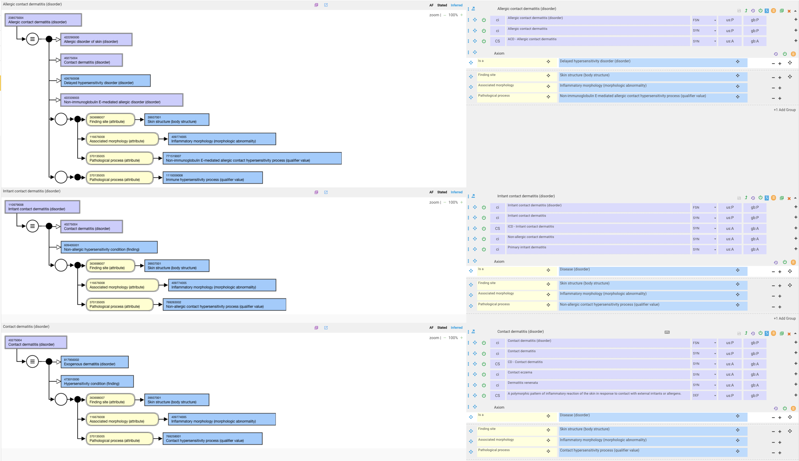
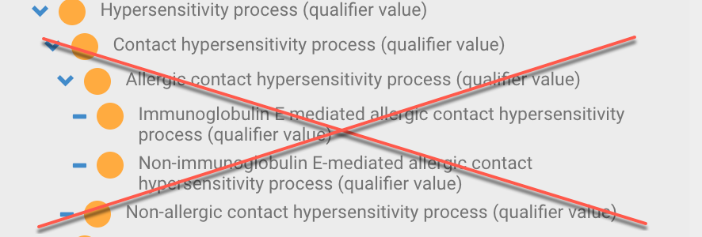
Contact dermatitis – current models

Slide 3
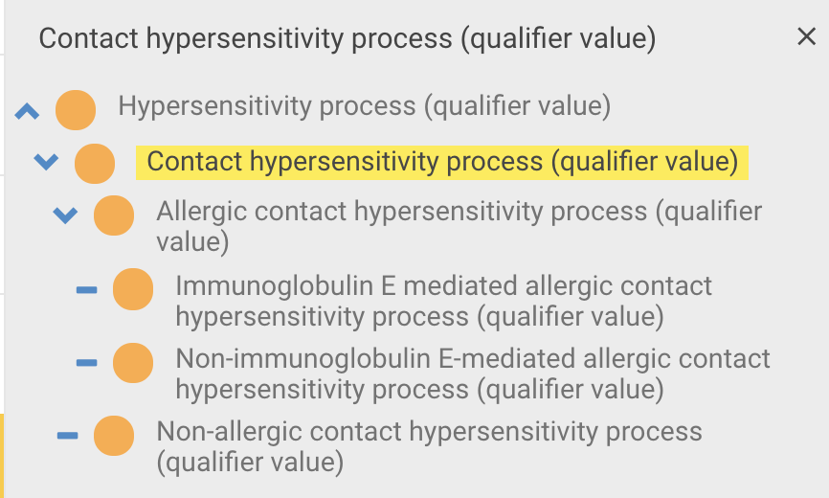
Contact hypersensitivity (qualifier value) hierarchy

Slide 4
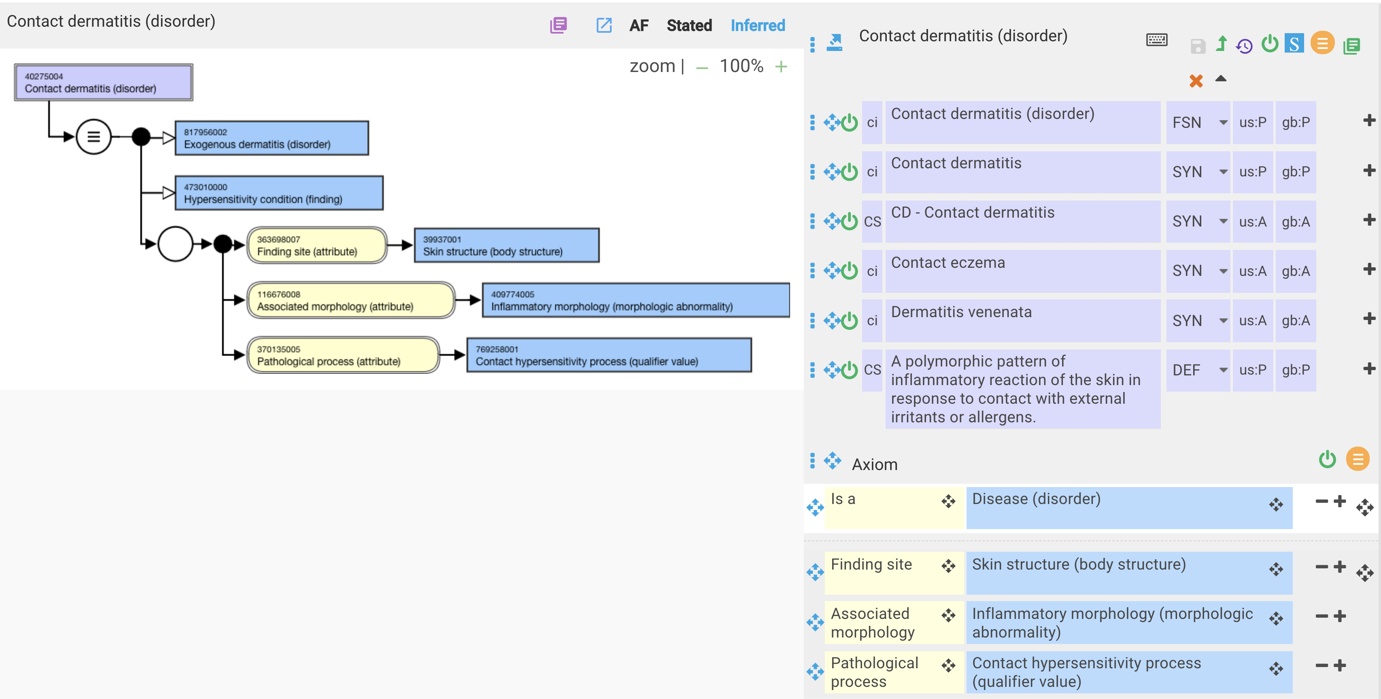
Contact dermatitis – current model

Slide 5
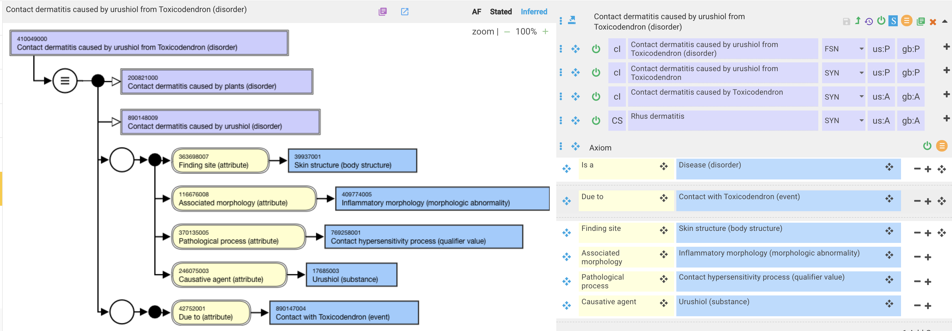
410049000 |Contact dermatitis caused by urushiol from Toxicodendron (disorder)| - current model

Slide 6
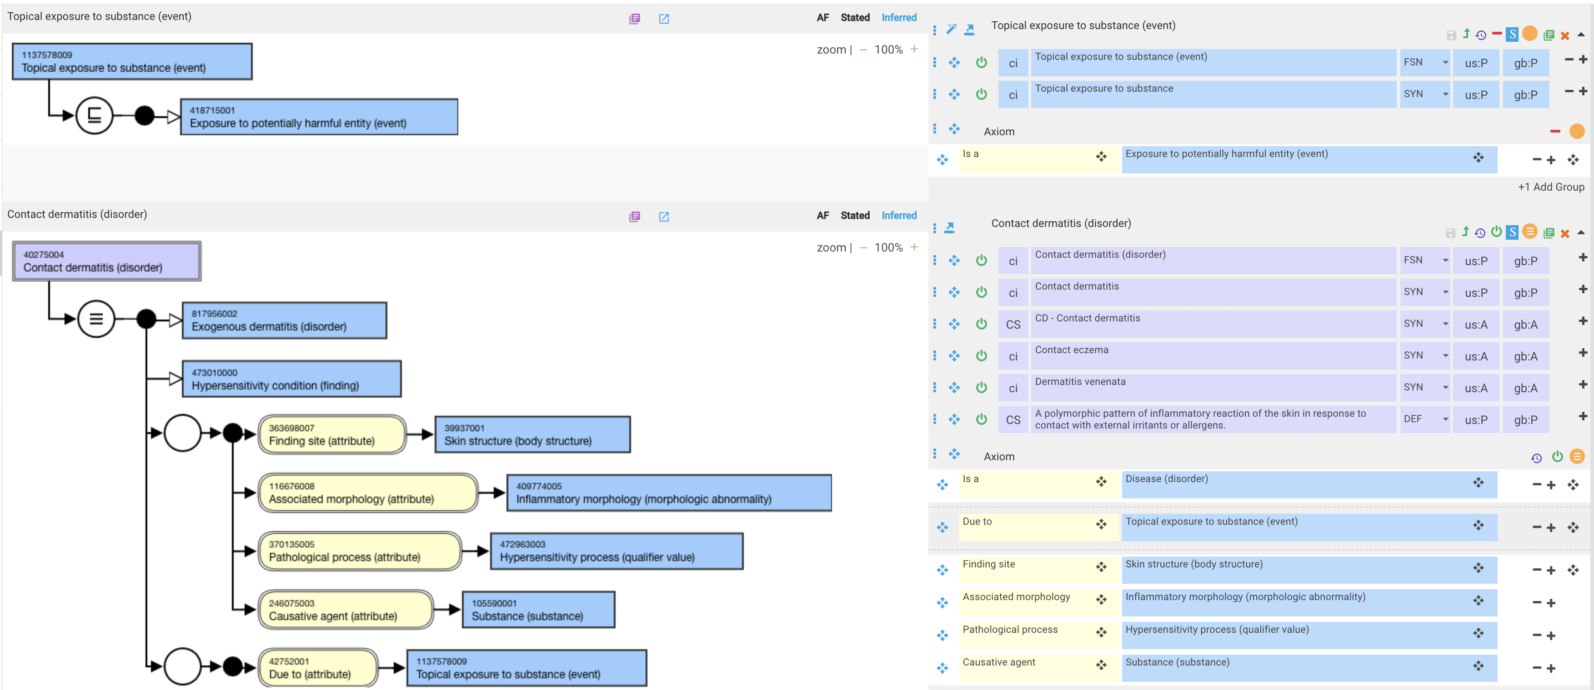
Contact dermatitis – proposed revision

Slide 7
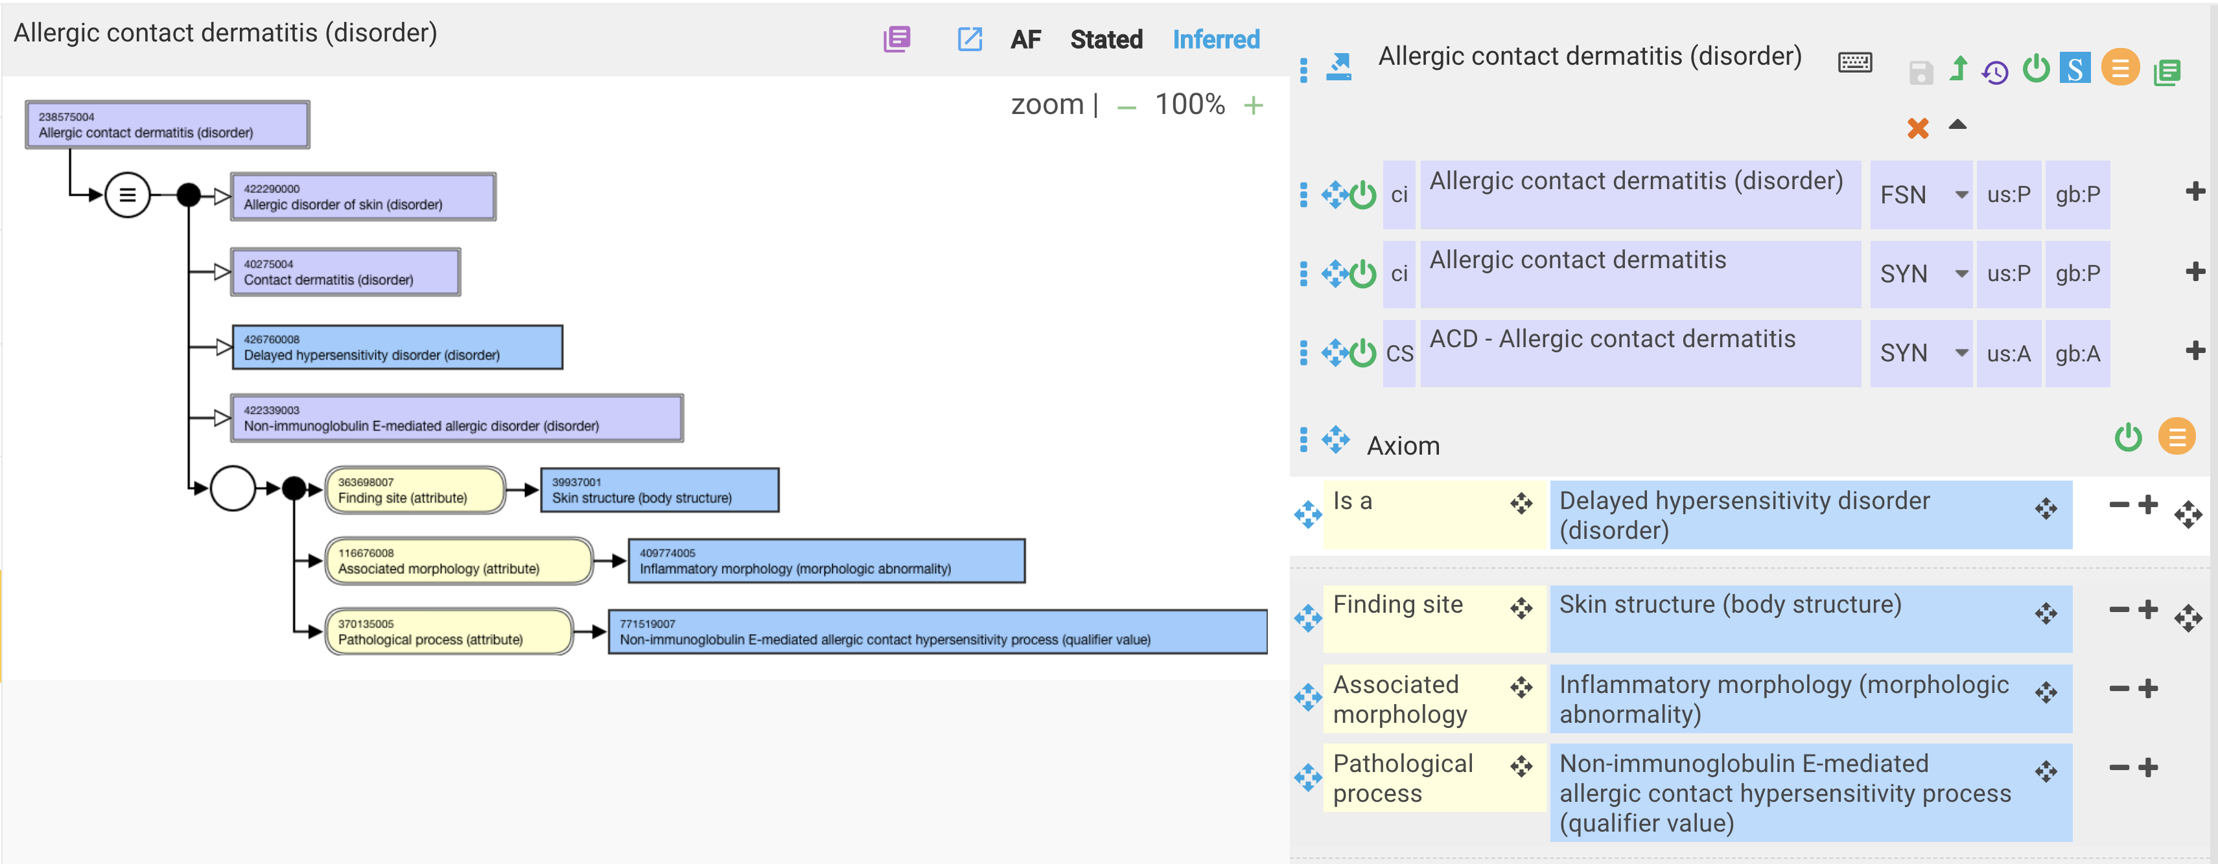
Allergic contact dermatitis – current model

Slide 8
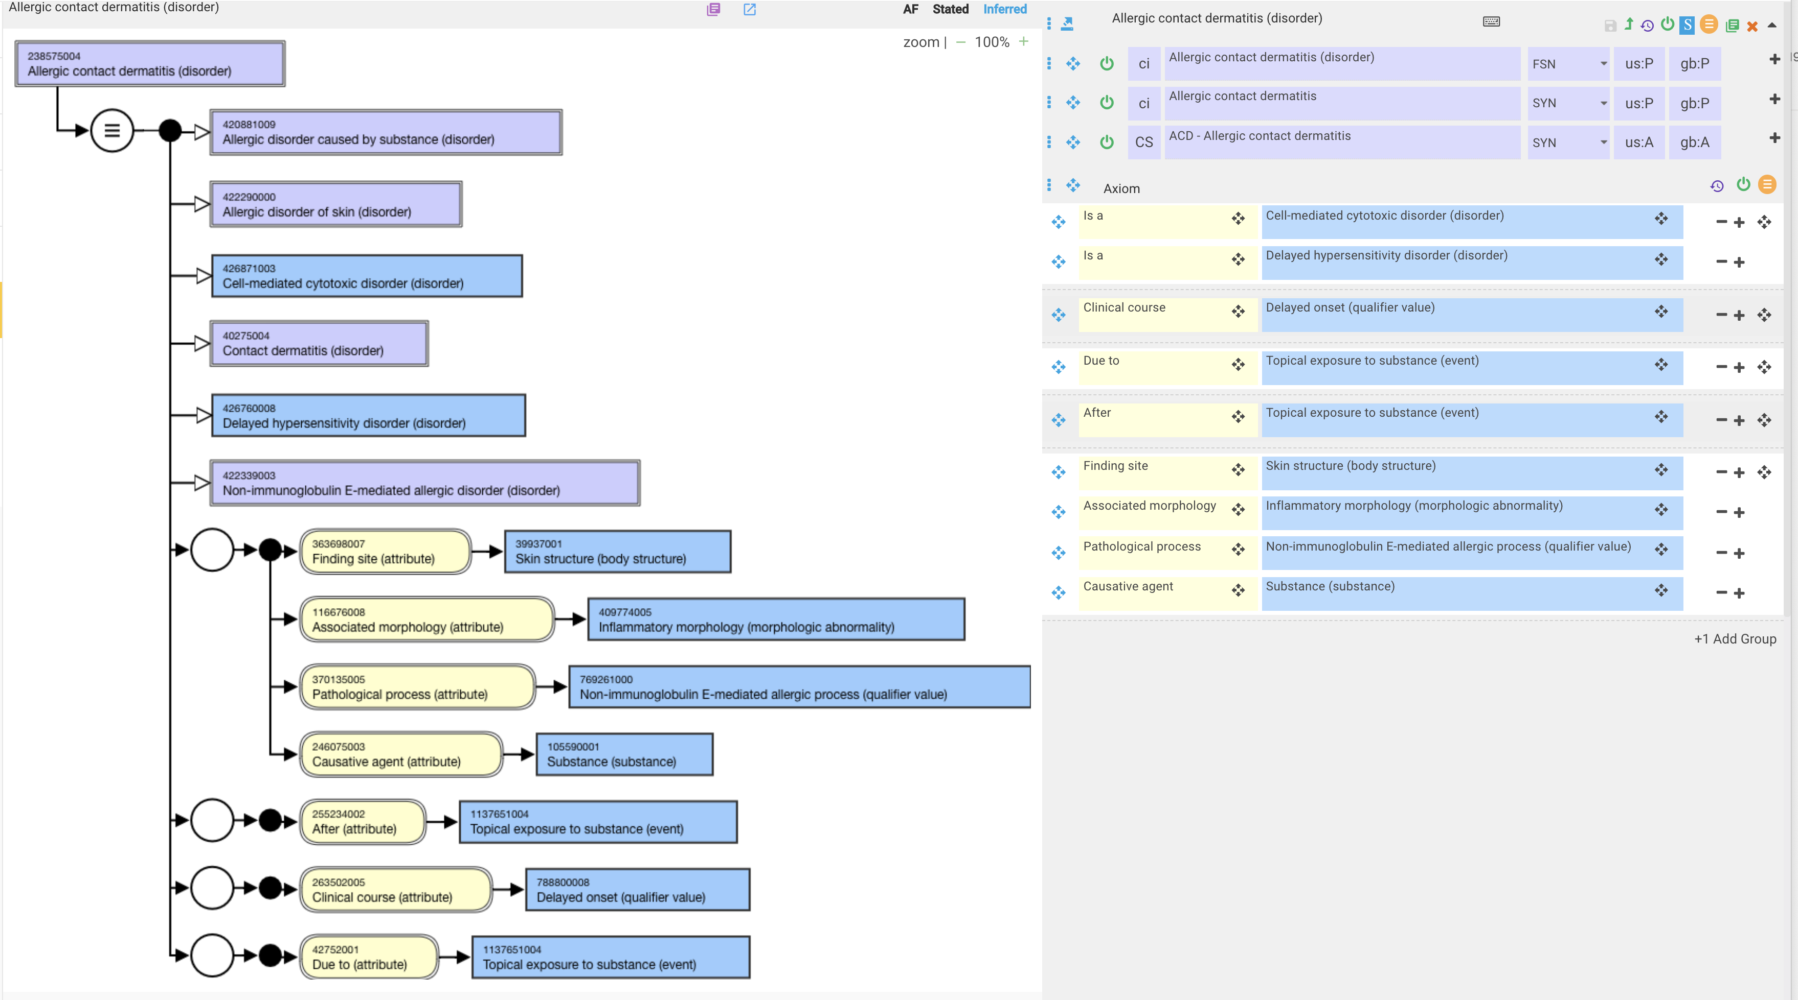
Allergic contact dermatitis – proposed revision

Slide 9
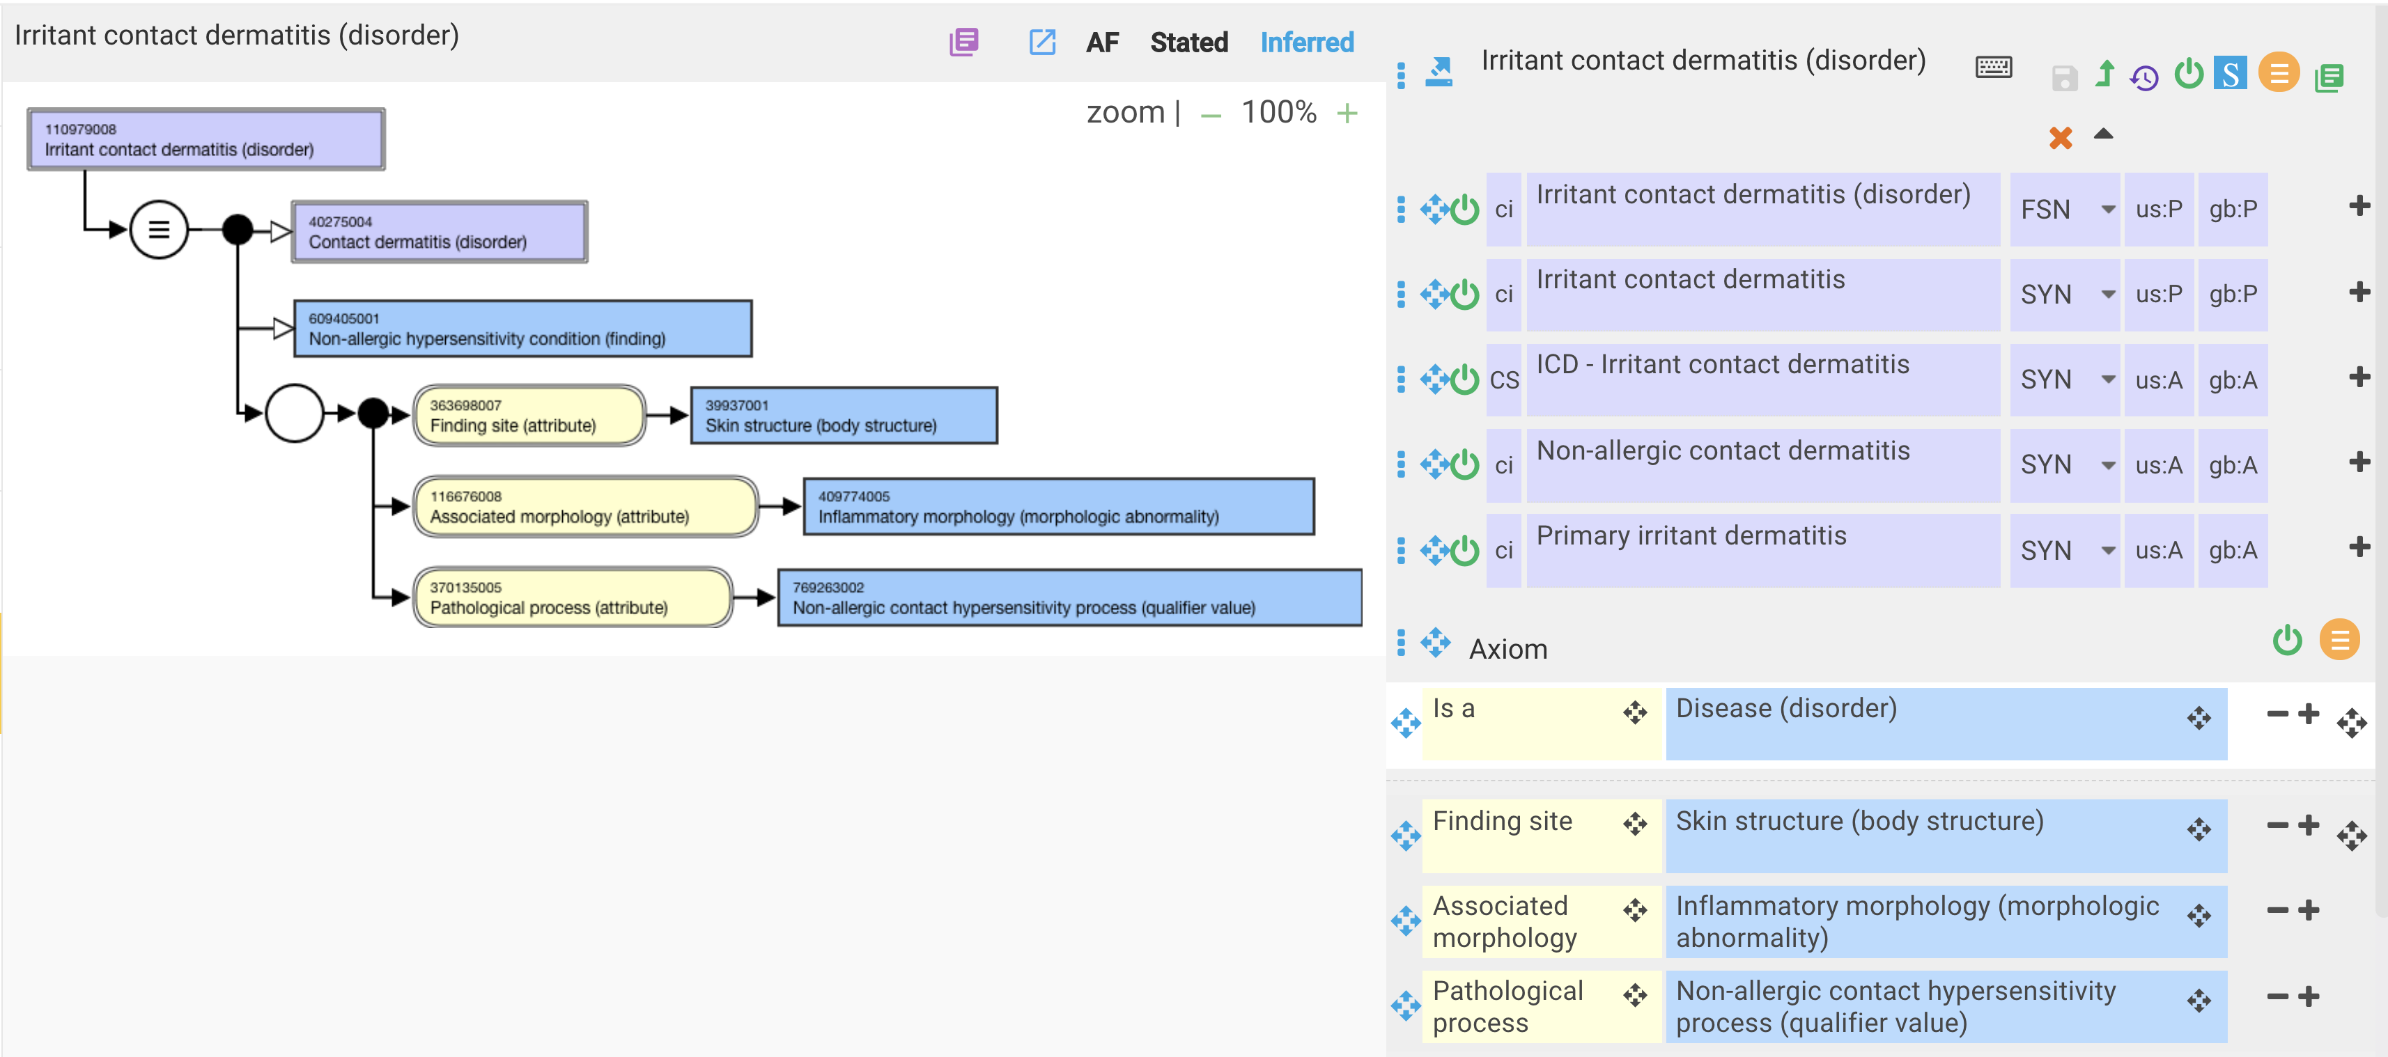
Irritant contact dermatitis – current model

Slide 10
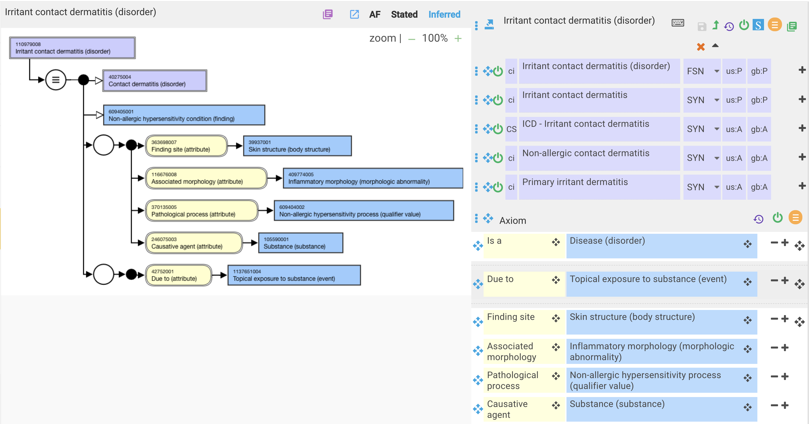
Irritant contact dermatitis – proposed revision

