Slide 1
Additional testing to evaluate the impact of retiring 362977000 |Sequela (disorder)|

Slide 2
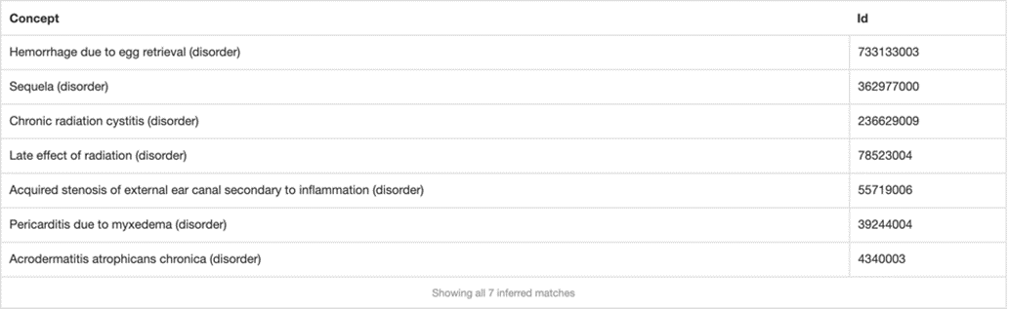
Initial findings
678 descendants of Sequela (disorder)
  6 concepts modeled with a parent of Sequela (disorder) do not have an after relationship
1546 concepts that contain an after relationship to a disorder, procedure or event do not have a parent of Sequela (disorder)
  106 concepts represent traumatic injuries
    (<<64572001 |Disease| minus <<362977000 |Sequela|): 255234002 |After| = (<<773760007 |Traumatic event (event)|)
  611 concepts represent postoperative complications
    (<<64572001 |Disease| minus <<362977000 |Sequela|): 255234002 |After| = (<<387713003 |Surgical procedure (procedure)|)
  836 concepts represent other than above
    (<<64572001 |Disease| minus <<362977000 |Sequela|): 255234002 |After| != (<<387713003 |Surgical procedure (procedure)| OR <<773760007 |Traumatic event (event)|)

Slide 3
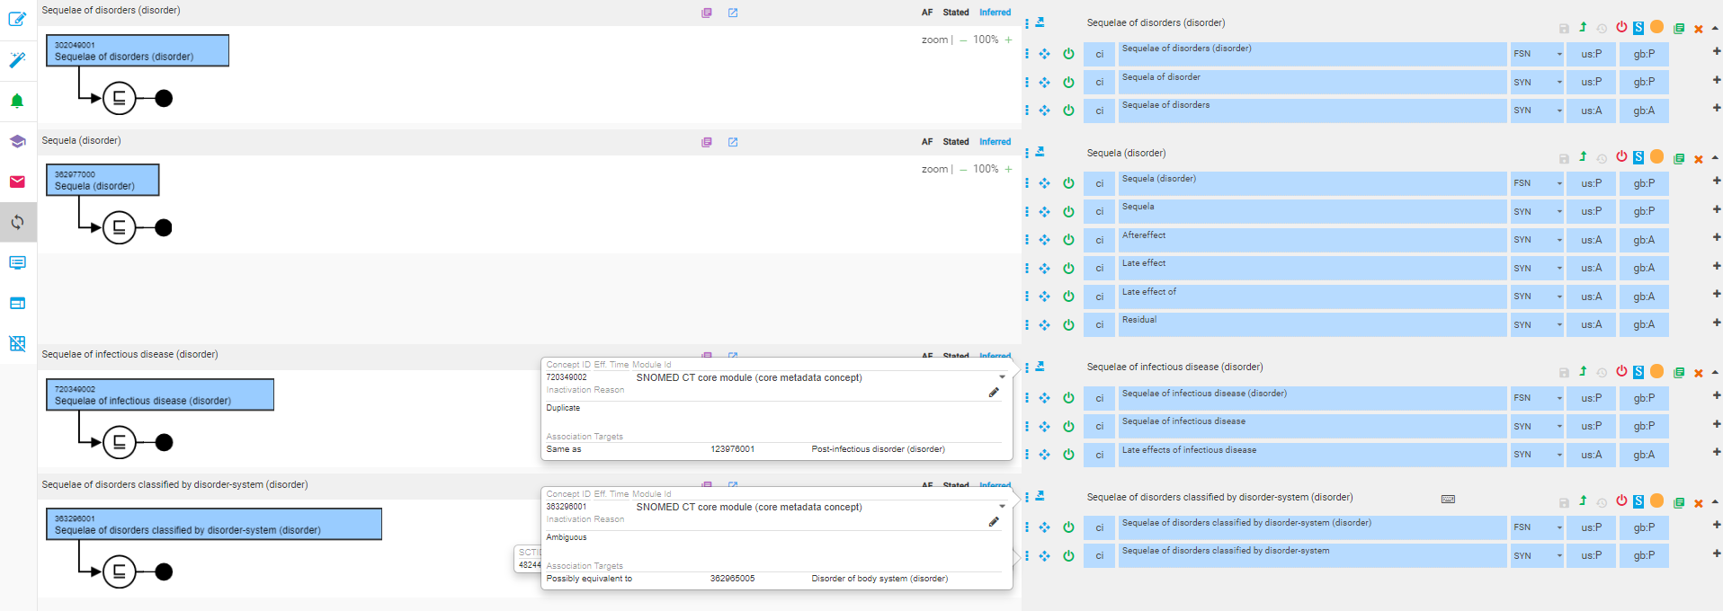
Testing

Slide 4
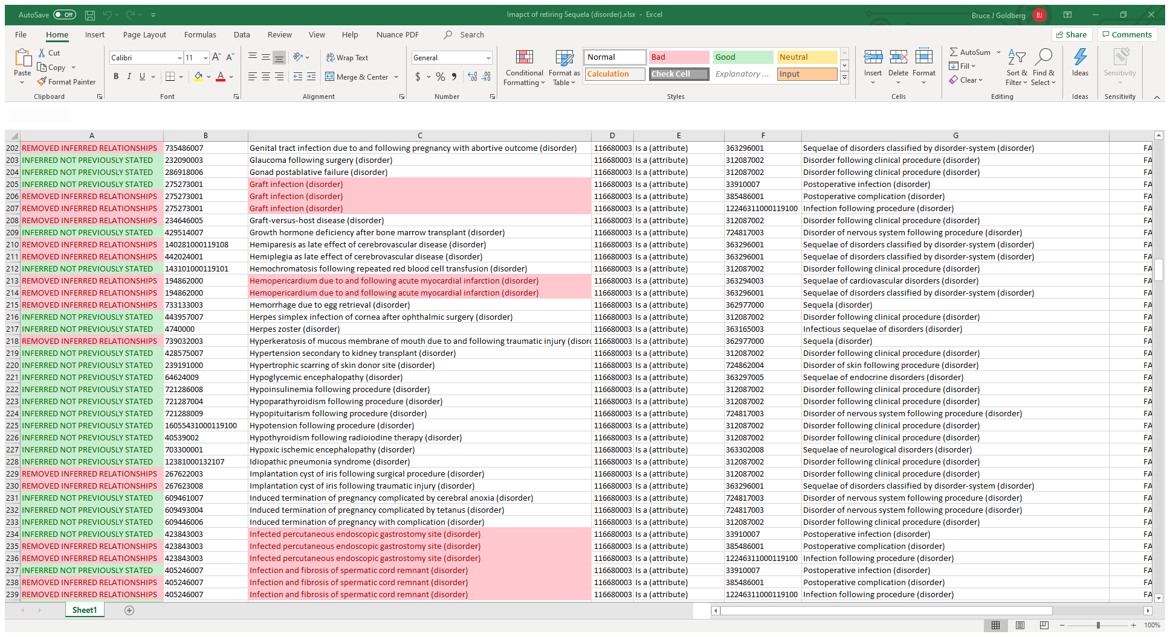
Impact of inactivating Sequela (disorder)
767 classification results

Slide 5
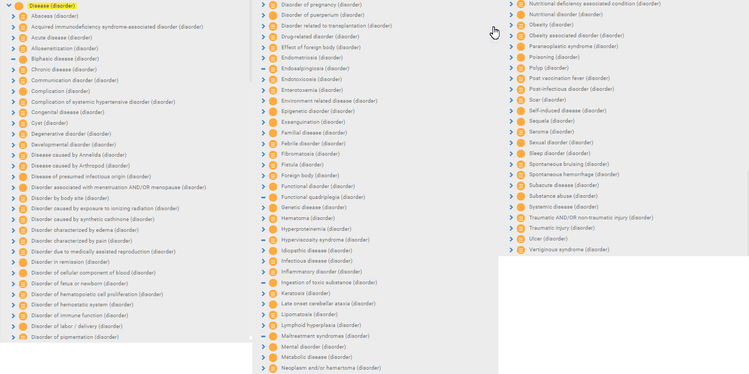
Disease hierarchy before inactivation of Sequela (disorder)

Slide 6
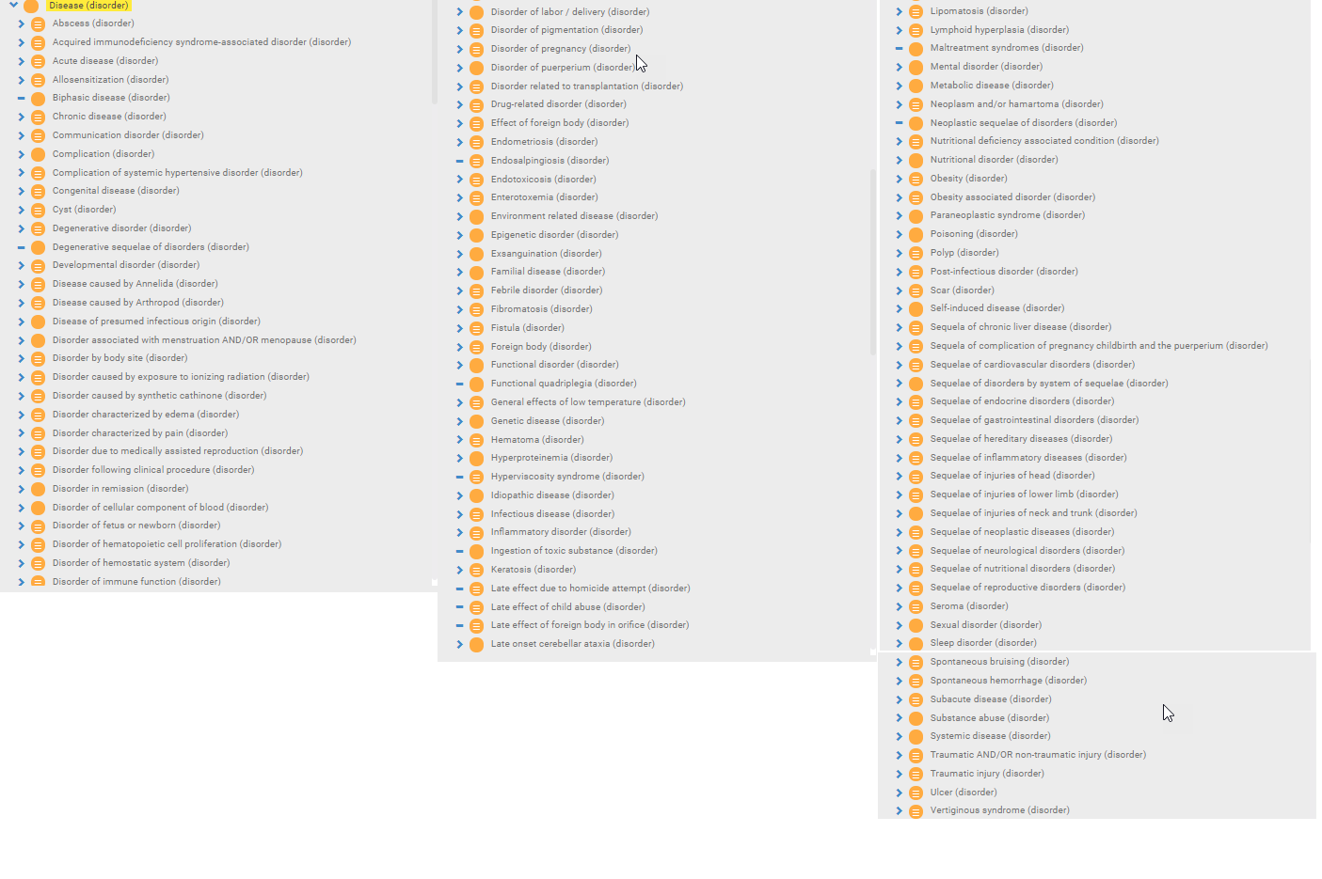
Disease hierarchy after inactivation of Sequela (disorder)

Slide 7
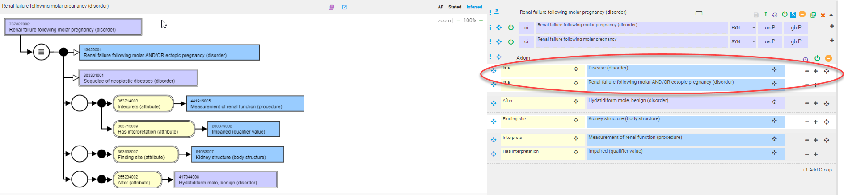
Issue identified
If a concept is modeled with a stated parent of Sequela (disorder) + another stated disorder parent, after inactivation of Sequela (disorder), the concept has parents of Disease (disorder) + the other stated disorder parent

