Slide 1
Exacerbation
Bruce Goldberg MD, PhD
Notes:
I would like to review the model for combined disorders by going over the background principles that lead to the development of this model as well as discuss the individual modeling patterns with the hope of answering some of the questions that have arisen in terms of applying the model

Slide 2
Exacerbation Patterns
Pattern | #
Exacerbation of X Worsening X | 69 3
Aggravated by / X aggravated Y Exacerbated by / X exacerbated Y Worse by | 6 5 1

Slide 3
Exacerbation of X
Exacerbation of eczema (disorder) | Exacerbation of Crohn's disease of small intestine (disorder)
Acute exacerbation of chronic obstructive airways disease (disorder) | Acute exacerbation of moderate persistent asthma (disorder)
Acute exacerbation of asthma (disorder) | Acute exacerbation of chronic asthmatic bronchitis (disorder)
Exacerbation of peptic ulcer (disorder) | Acute exacerbation of chronic latent schizophrenia (disorder)
Exacerbation of osteoarthritis (disorder) | Acute severe exacerbation of mild persistent asthma (disorder)
Exacerbation of allergic asthma (disorder) | Acute exacerbation of idiopathic pulmonary fibrosis (disorder)
Exacerbation of multiple sclerosis (disorder) | Acute exacerbation of chronic paranoid schizophrenia (disorder)
Exacerbation of ulcerative colitis (disorder) | Acute exacerbation of chronic obstructive bronchitis (disorder)
Exacerbation of intermittent asthma (disorder) | Acute exacerbation of subchronic latent schizophrenia (disorder)
Acute severe exacerbation of asthma (disorder) | Acute exacerbation of chronic catatonic schizophrenia (disorder)
Acute exacerbation of bronchiectasis (disorder) | Acute severe exacerbation of severe persistent asthma (disorder)
Exacerbation of non-infective colitis (disorder) | Acute exacerbation of chronic congestive heart failure (disorder)
Acute exacerbation of immunoglobulin E-mediated allergic asthma (disorder) | Acute on chronic right-sided congestive heart failure (disorder)
Moderate acute exacerbation of asthma (disorder) | Acute exacerbation of subchronic paranoid schizophrenia (disorder)
Exacerbation of mild persistent asthma (disorder) | Acute severe exacerbation of moderate persistent asthma (disorder)
Acute exacerbation of intrinsic asthma (disorder) | Acute exacerbation of subchronic catatonic schizophrenia (disorder)
Premenstrual exacerbation of dermatosis (disorder) | Subchronic disorganized schizophrenia with acute exacerbations (disorder)
Acute exacerbation of chronic bronchitis (disorder) | Exacerbation of constitutional dermatitis due to occupation (disorder)
Exacerbation of severe persistent asthma (disorder) | Acute exacerbation of chronic schizoaffective schizophrenia (disorder)
Exacerbation of congestive heart failure (disorder) | Acute severe exacerbation of mild persistent allergic asthma (disorder)
Exacerbation of moderate persistent asthma (disorder) | Acute exacerbation of subchronic schizoaffective schizophrenia (disorder)
Acute exacerbation of chronic schizophrenia (disorder) | Acute severe exacerbation of severe persistent allergic asthma (disorder)
Acute exacerbation of mild persistent asthma (disorder) | Acute exacerbation of asthma co-occurrent with allergic rhinitis (disorder)
Pregnancy-related exacerbation of dermatosis (disorder) | Acute severe exacerbation of moderate persistent allergic asthma (disorder)
Acute severe exacerbation of allergic asthma (disorder) | Acute infective exacerbation of chronic obstructive airways disease (disorder)
Acute severe exacerbation of immunoglobin E-mediated allergic asthma (disorder) | Acute exacerbation of chronic obstructive airways disease with asthma (disorder)
Acute severe exacerbation of intrinsic asthma (disorder) | Acute severe exacerbation of asthma co-occurrent with allergic rhinitis (disorder)
Life threatening acute exacerbation of asthma (disorder) | Chronic obstructive asthma co-occurrent with acute exacerbation of asthma (disorder)
Acute severe refractory exacerbation of asthma (disorder) | Acute severe exacerbation of severe persistent asthma co-occurrent with allergic rhinitis (disorder)
Exacerbation of allergic asthma due to infection (disorder) | Acute severe exacerbation of moderate persistent asthma co-occurrent with allergic rhinitis (disorder)
Exacerbation of Crohn's disease of large intestine (disorder) | Acute severe exacerbation of mild persistent allergic asthma co-occurrent with allergic rhinitis (disorder)

Slide 4

Exacerbation of X
Exacerbation of X clinical finding/disease concepts are subsumed by X clinical finding/disease
Exacerbation of X clinical finding/disease concepts are mostly primitive. Some (particularly asthma) have descendants.
Should Exacerbation of X clinical finding/disease concepts be moved to the event hierarchy?

Slide 5
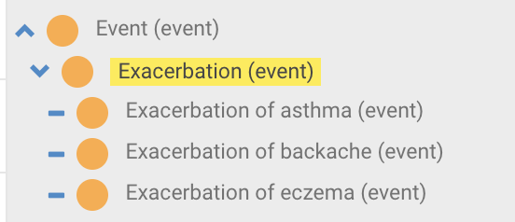
Exacerbation (event)

Slide 6
Exacerbated/aggravated by
Exacerbating factors in SNOMED CT are mostly substances but can also be physical forces (and potentially products, disorders, organisms)
Disorders with “exacerbated by” or ”aggravated by” in the FSN are subsumed by Substance induced disorders
Certain conditions can be caused and/or worsened by certain factors
  Occupational diseases may be caused and/or worsened by workplace exposures

Slide 7
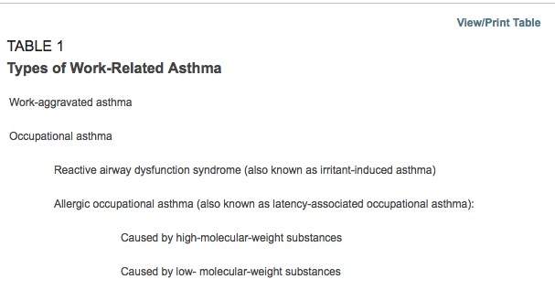
Work-related asthma
Work-related asthma includes work aggravation of preexisting asthma and new-onset asthma induced by occupational exposure (i.e. occupational asthma).
Youakim S. Work-related asthma. Am Fam Physician. 2001 Dec 1;64(11):1839-48.PubMed PMID: 11764862.

Slide 8
Induced by vs. X exacerbated by
Induce
  Effect, cause (to cause the formation of)
Exacerbate
  Aggravate, complicate, worsen
  An induced disorder implies that the disorder does not exist prior to its cause
  An exacerbated disorder implies that the disorder does exist prior to exposure to an aggravating factor
  In SNOMED sometimes induced and exacerbated are used interchangeably

Slide 9
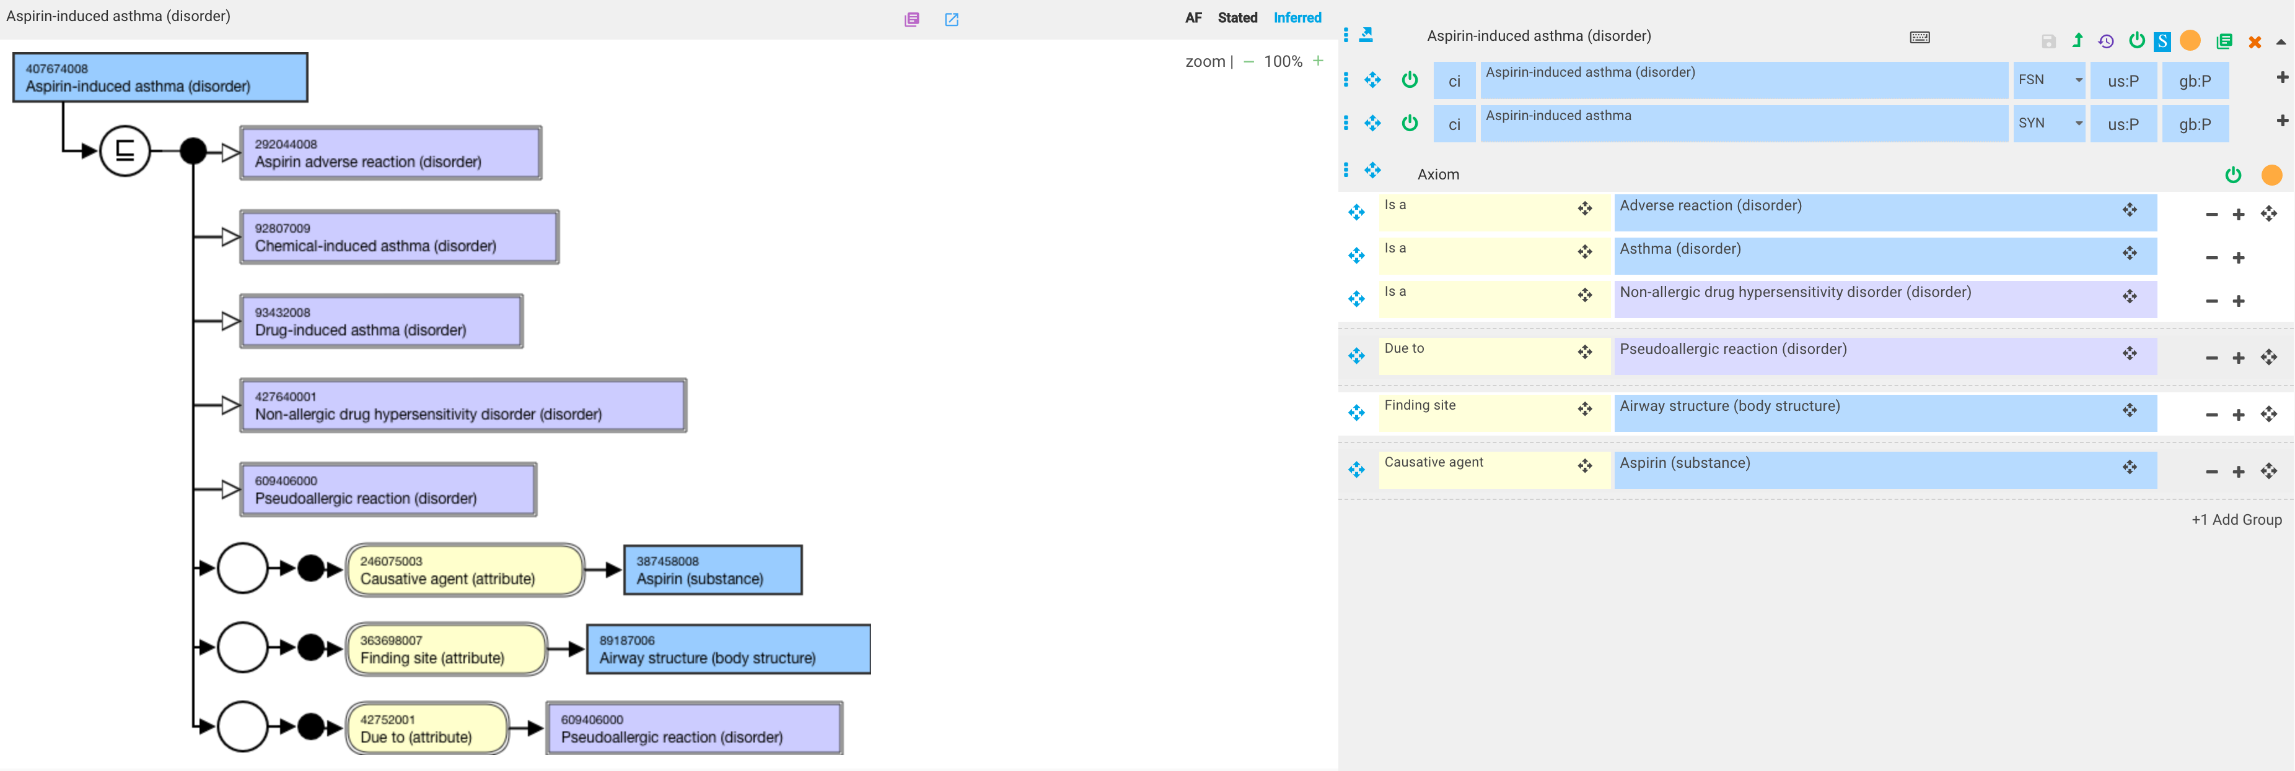
407674008 |Aspirin-induced asthma (disorder)|
Aspirin-induced asthma is erroneous. Aspirin does not cause asthma de novo but rather can worsen pre-existing asthma.
Aspirin-exacerbated asthma. Allergy Asthma Clin Immunol. 2008;4(2):75‐83. doi:10.1186/1710-1492-4-2-75)

Slide 10
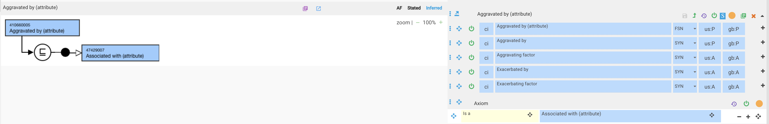
Proposal: Promote unapproved attribute, 410660005 |Aggravated by (attribute)|

Slide 11
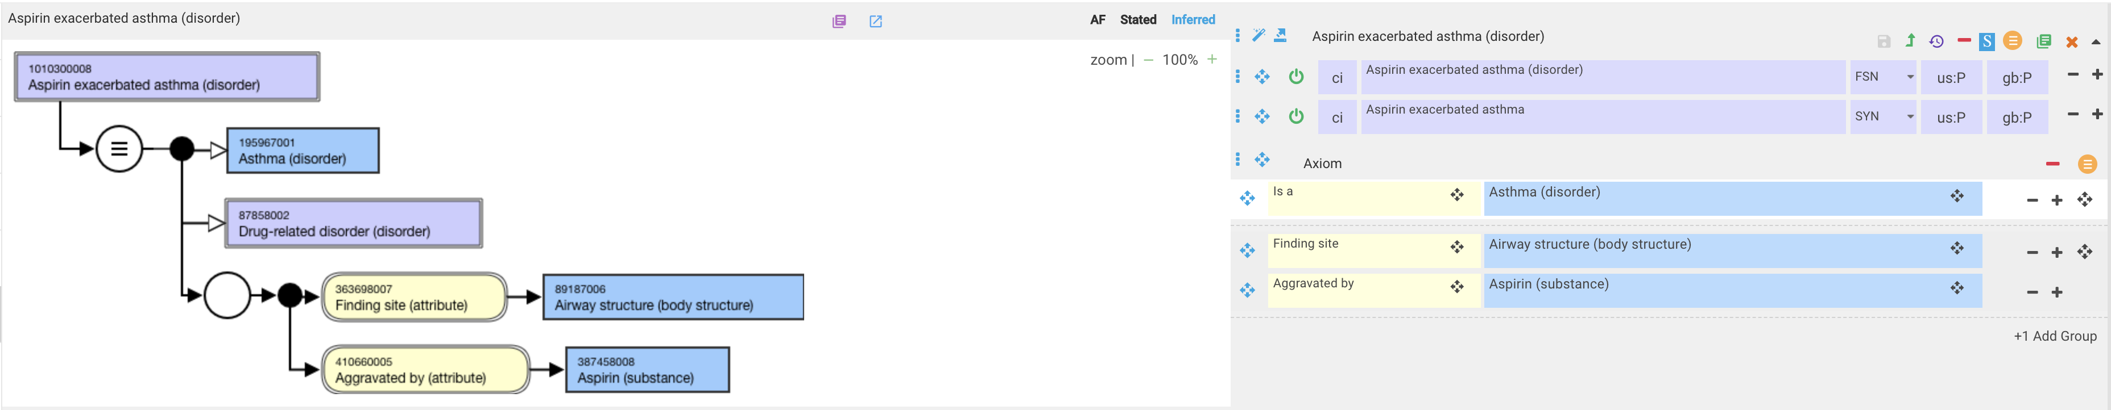
Aspirin exacerbated asthma

Slide 12
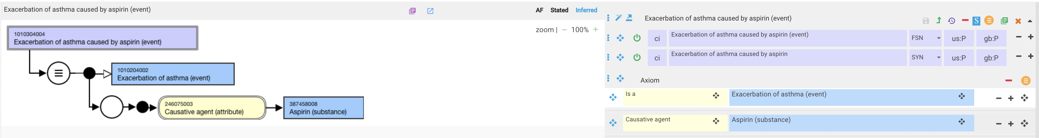
Exacerbation of asthma caused by aspirin

Slide 13
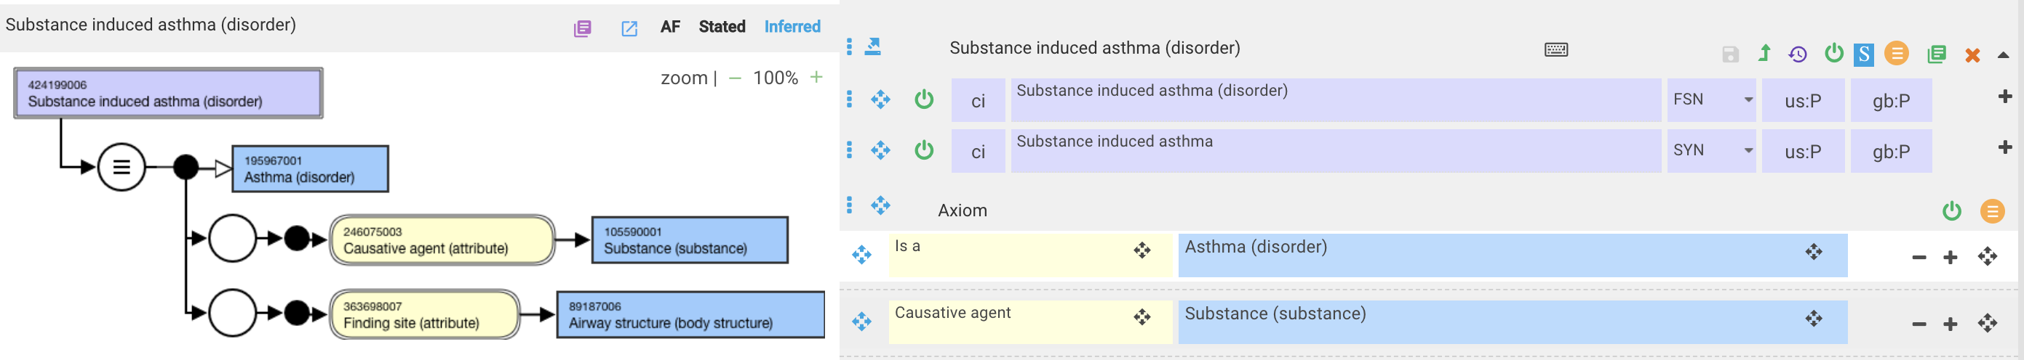
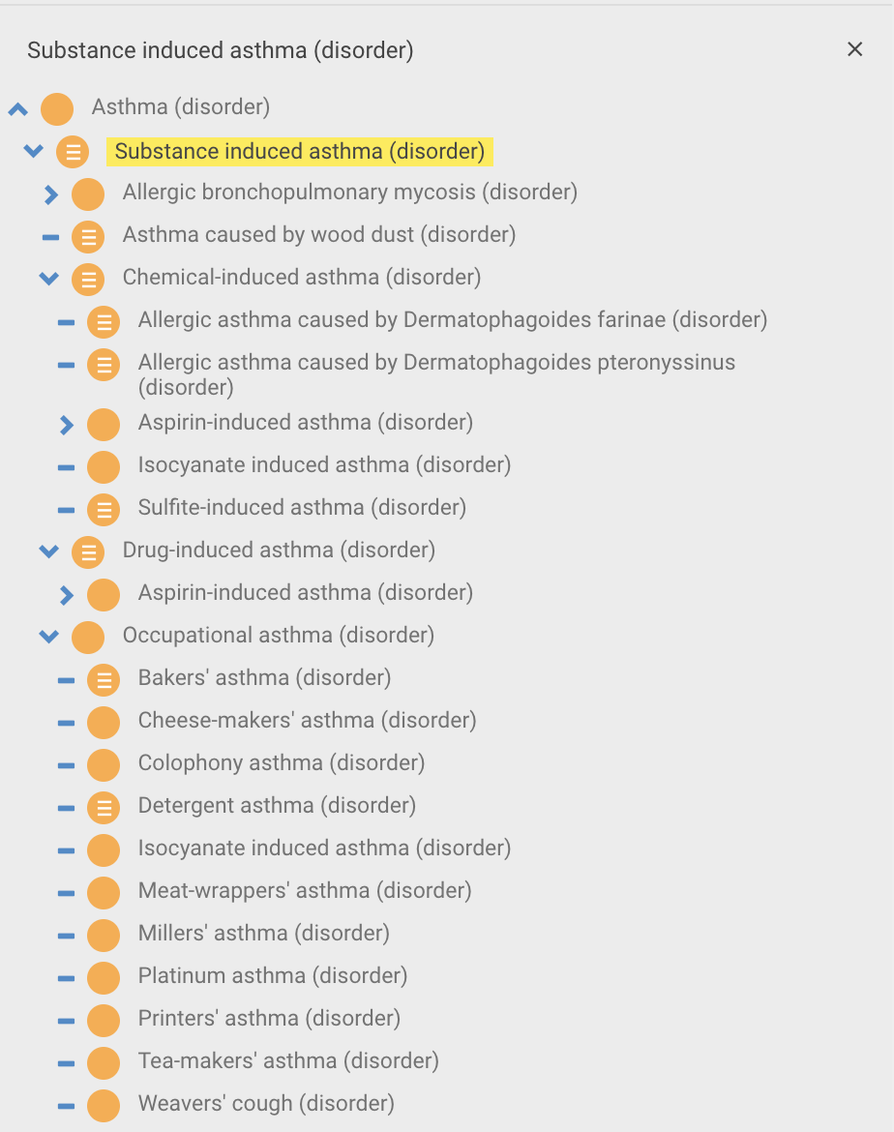
424199006 |Substance induced asthma (disorder)|
Exacerbated by
New onset or exacerbated by
Exacerbated by
Exacerbated by
New onset or exacerbated by
New onset or exacerbated by

Slide 14
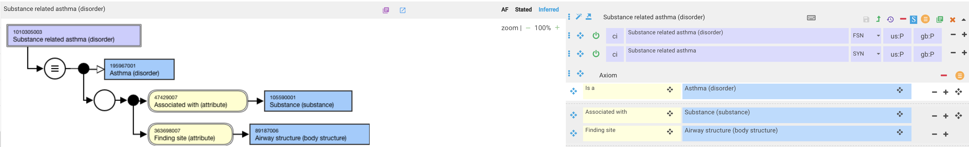
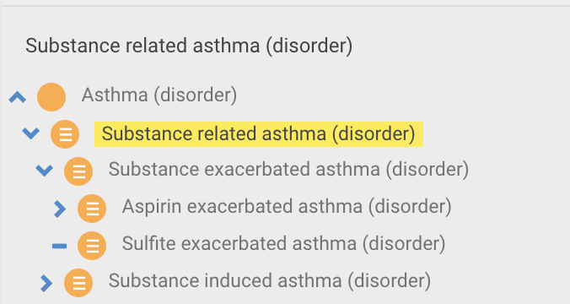
Substance related asthma (disorder) – new concept

Slide 15
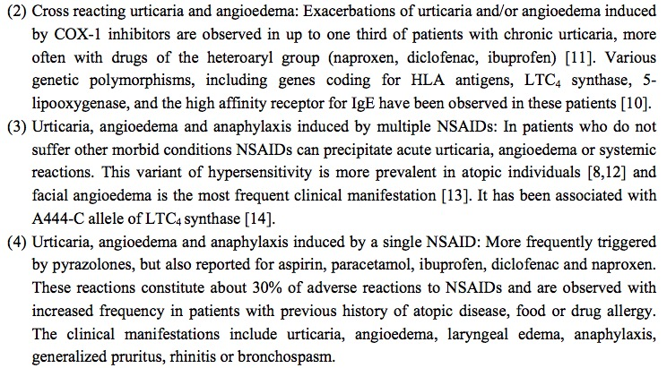
241959003 |Non-steroid anti-inflammatory drug-induced angioedema-urticaria (disorder)|
241959003 |Non-steroid anti-inflammatory drug-induced angioedema-urticaria (disorder)|

Slide 16
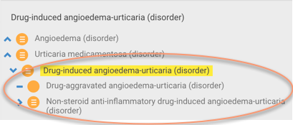
Drug-induced vs. aggravated angioedema-urticaria

Slide 17
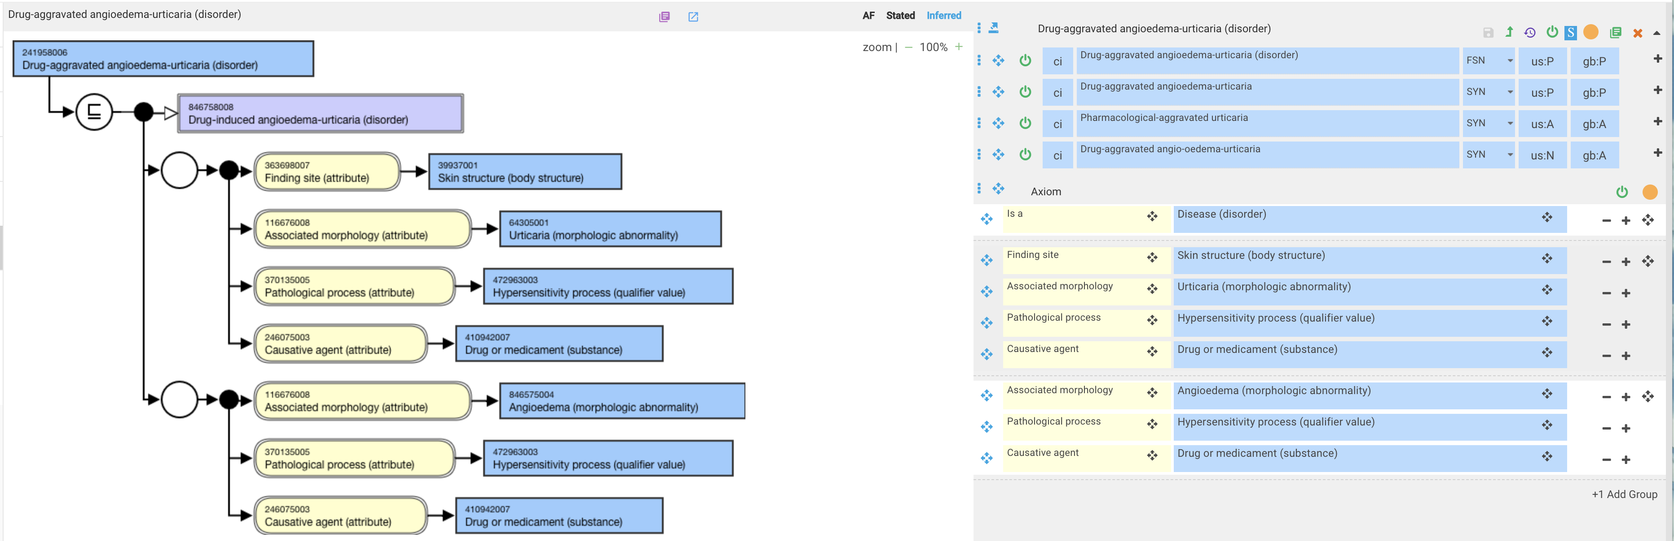
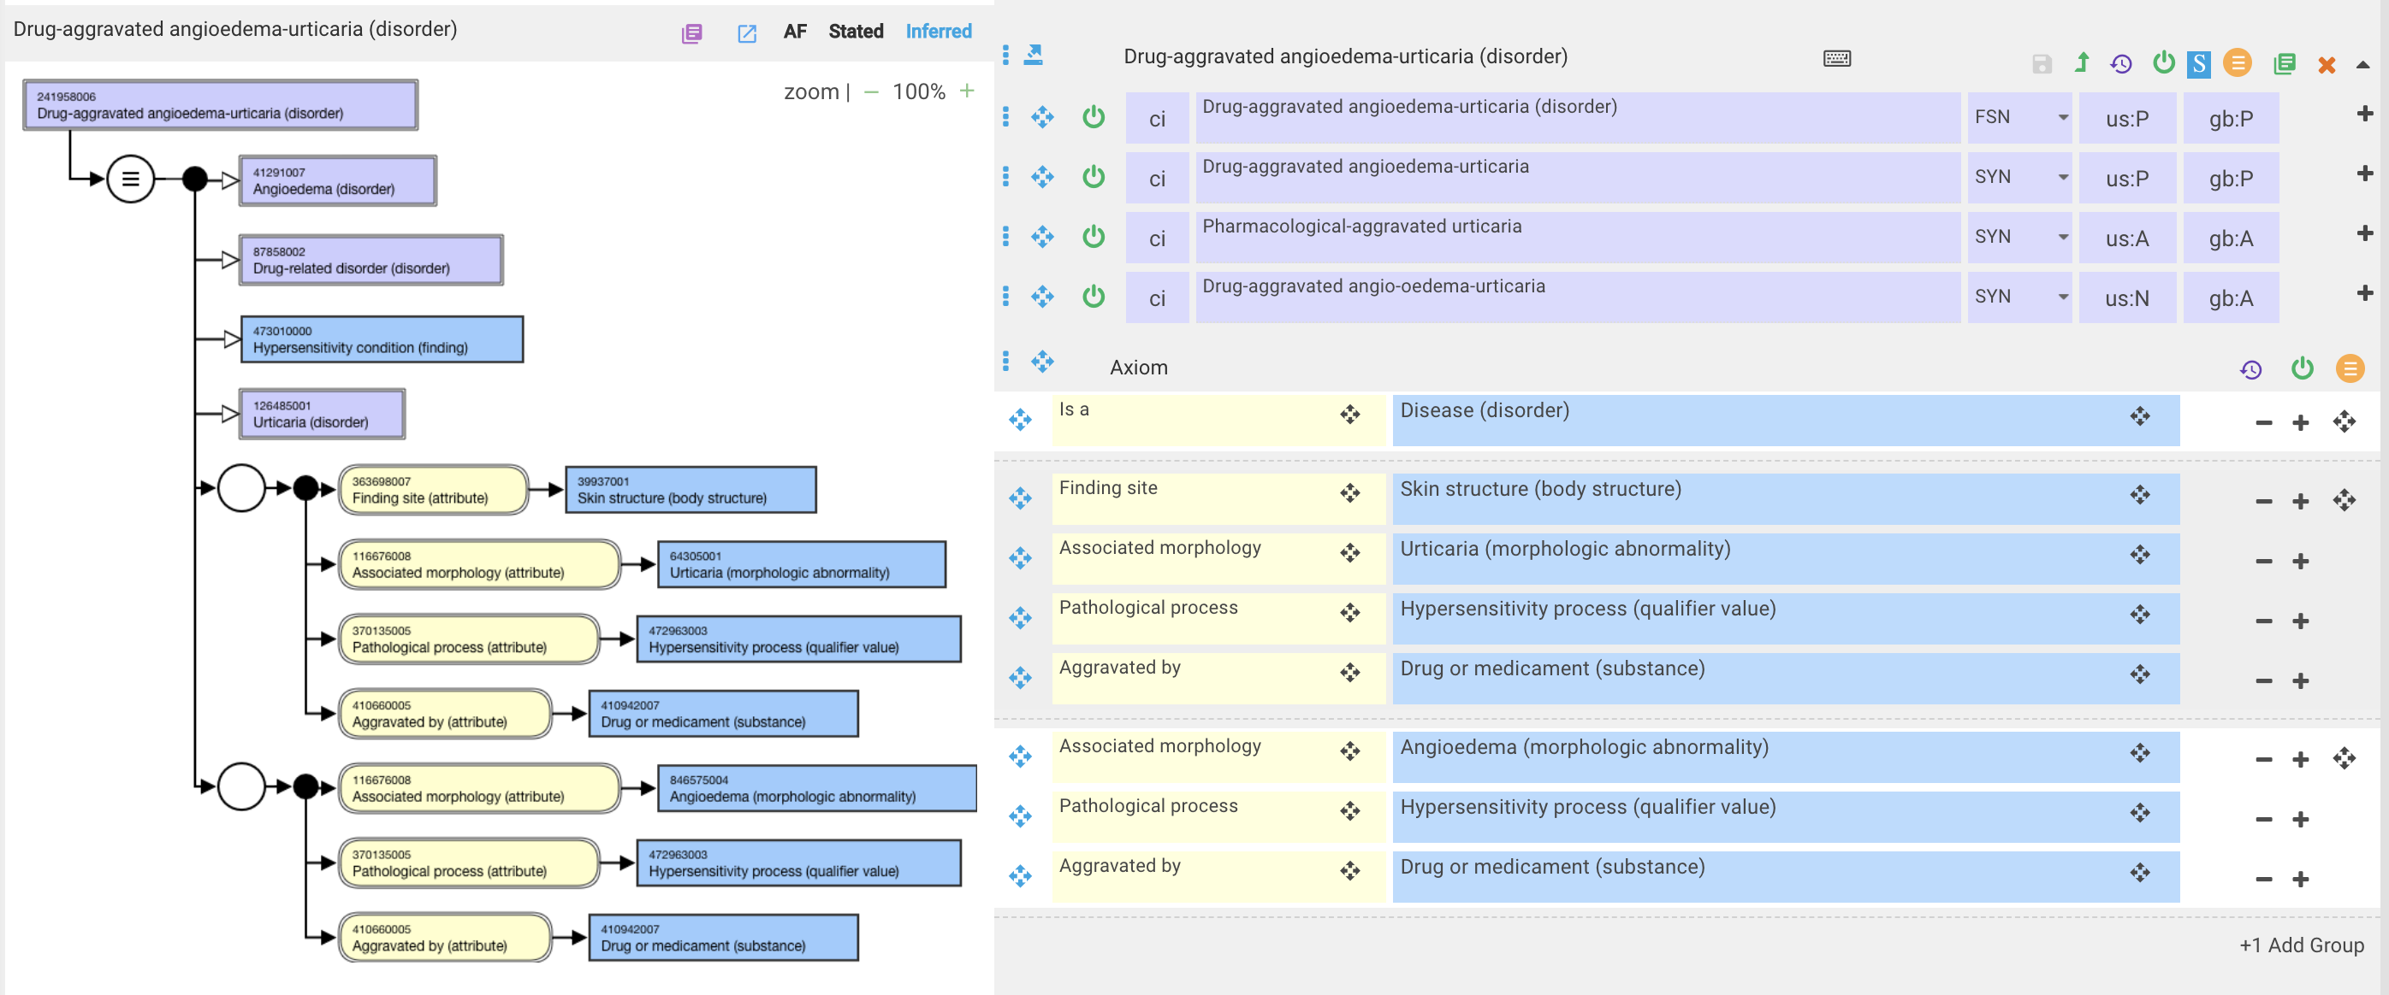
241958006 |Drug-aggravated angioedema-urticaria (disorder)|
Current
Revised

Slide 18
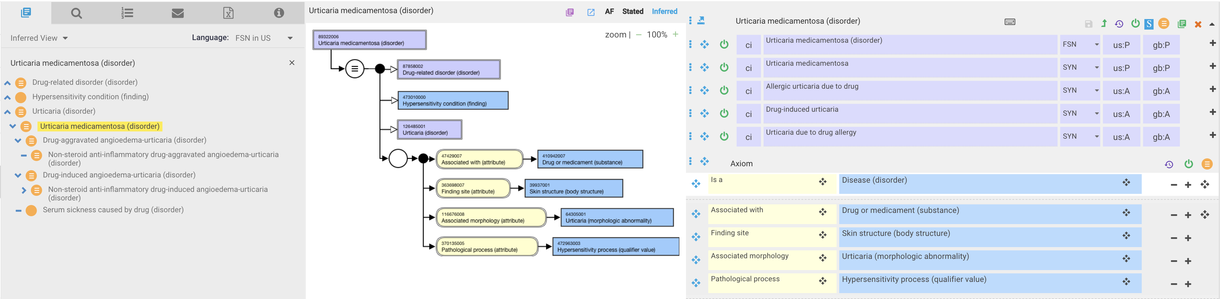
89322006 |Urticaria medicamentosa (disorder)|

Slide 19
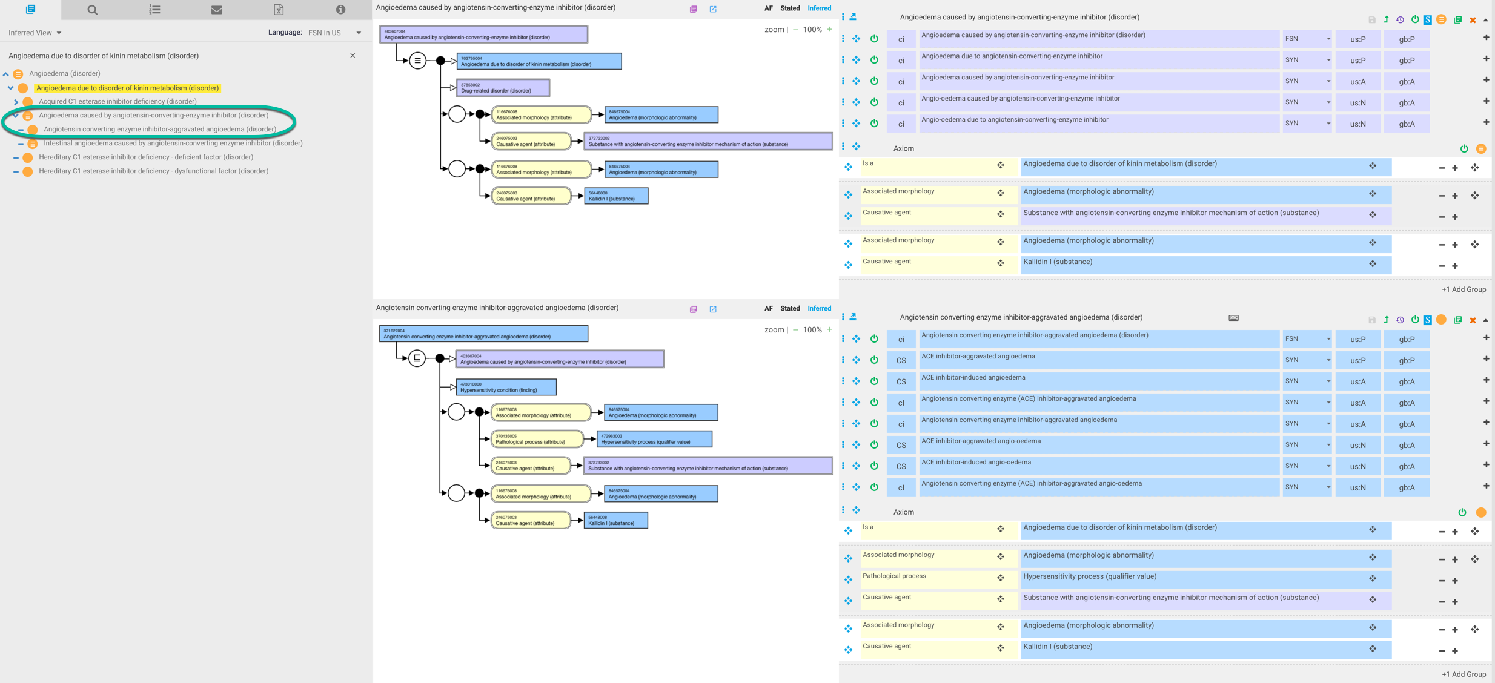
371627004 |Angiotensin converting enzyme inhibitor-aggravated angioedema (disorder)|

Slide 20
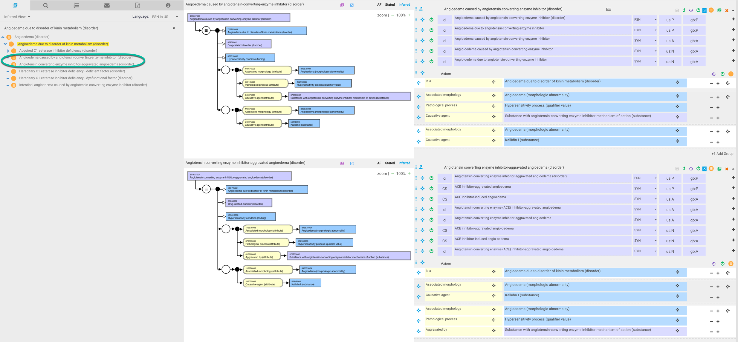
371627004 |Angiotensin converting enzyme inhibitor-aggravated angioedema (disorder)|- revised model

Slide 21
Requested approvals
Move Exacerbation of [clinical finding/disorder] (disorder) concepts from disease hierarchy to event hierarchy (y/n?)
Approve 410660005 |Aggravated by (attribute)|(y/n?)
  Proposed domain: clinical findings and disorders
  Proposed range: substances, products, physical forces, organisms, clinical findings and disorders

