Slide 1
Management of Concept Inactivation WG
✓ Confluence Site
January-September 2020
Paul Amos, Jeremy Rogers, Jeff Pierson,
Brian Carlsen, Anne Randorff Højen

Slide 2
Outline
Recap:
  How have concept inactivation and historical associations been used?
  What problems are caused by incorrect usage?
Working Group Activities
  Diagnosis: How much is wrong?
  Prevention : Sins of the Future
  Rehabilitation : Sins of the Past

Slide 3
Concept Inactivations:
Usage and effects through time

Slide 5
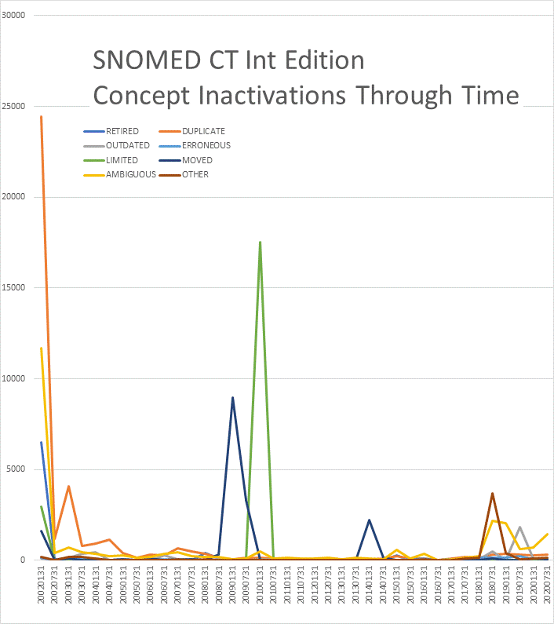
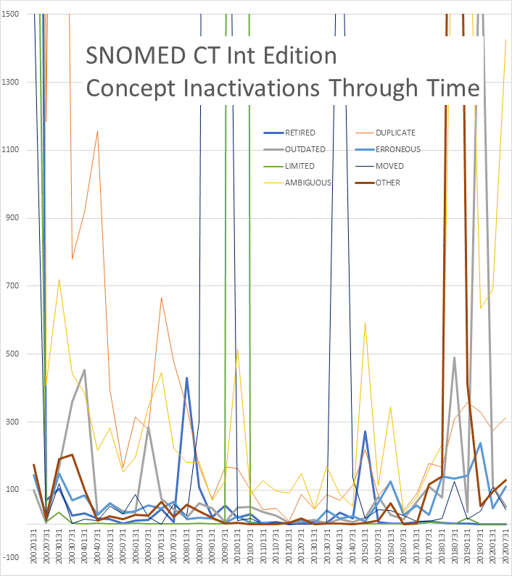
2002 Reconciliation of CTV3-RT duplicates
2010 Mass inactivation of Limited Status
2009 Return of ~10k “square bracket” ICD codes to UK
2018
Dr Case
becomes CTO ;-)
2019 Pharmacy Redesign
2014 US Veterinary Extension

Slide 6
Before October 2011…
…changes happen…
After October 2011…
363660007
Ambiguous concept
363662004
Duplicate concept
404684003
Clinical Finding
275498002
Respiratory Tract Infection
Naïve query for RTI….
Naïve query for RTI….
…never found these.
Naïve query for RTI….
…never found these.
Now it won’t find this either
IF you only consider the IS-A relationships
54150009
Upper respiratory tract infection
50417007
Lower respiratory tract infection
128486005
Upper respiratory
bacterial infection
(inactivated Jul 2002)
312118003
Bacterial upper respiratory infection
[V3 XaDcC]
SAME_AS
195746005
Recurrent
chest infection
[V2 H06z2]
448739000
Recurrent lower
respiratory tract
infection
308130008
Recurrent
chest infection
[V3 XaBM8]
MAY_BE_A
SAME_AS
MAY_BE_A

Slide 7
These we have loved…
Popular IE concepts inactivated July 2020

Slide 8
Effects of inactivation on cumulative EPR
10 billion primary care
EPR entries 2011-2018
2% inactive by 2018
2.5% <<275498002 Respiratory tract infection
  28,977,526 active
  755,753 inactive
0.44% <<363346000 Cancer
6.3% <<74732009 Mental disorder
21% <<609328004 Allergy
6.8% of 888k ED diagnoses 2009-2017

Slide 9
Historical Associations:
Does it matter if they’re wrong?

Slide 10
“Abdominal Presentations”
One ED dept, 7 years, 888k attendances
-- 151 CODES across 47543 EPISODES met the report definition (5.4% of all Episodes)
23078 episodes of 21522001 Abdominal pain (finding) 48.54%
3110 episodes of 7093002 Renal colic (finding) 55.08%
2423 episodes of 249519007 Diarrhea and vomiting (finding) 60.18%
1745 episodes of 62315008 Diarrhea (finding) 63.85%
1689 episodes of 12063002 Rectal hemorrhage (disorder) 67.4%
1532 episodes of 314212008 Abdominal pain - cause unknown (finding) 70.62%
1405 episodes of 85189001 Acute appendicitis (disorder) 73.58%
1177 episodes of 79922009 Epigastric pain (finding) 76.06%
1114 episodes of 409966000 Acute diarrhea (disorder) 78.4%
991 episodes of 18165001 Jaundice (finding) 80.48%
970 episodes of 314041007 Abdominal pain in early pregnancy (finding) 82.52%
943 episodes of 197119006 Acute constipation (disorder) 84.51%
712 episodes of 74400008 Appendicitis (disorder) 86%
693 episodes of 444673007 Hyperemesis (disorder) 87.46%
503 episodes of 37389005 Biliary colic (finding) 88.52%
472 episodes of 102570003 Inguinal pain (finding) 89.51%
386 episodes of 266599000 Dysmenorrhea (disorder) 90.32%
383 episodes of 236069009 Chronic constipation (disorder) 91.13%
379 episodes of 54586004 Lower abdominal pain (finding) 91.93%
364 episodes of 309737007 Abdominal pain in pregnancy (finding) 92.69%
261 episodes of 274279008 Renal pain (finding) 93.24%
260 episodes of 9991008 Abdominal colic (finding) 93.79%
246 episodes of 304542004 Nonspecific abdominal pain (finding) 94.31%
237 episodes of 271857006 Loin pain (finding) 94.8%
178 episodes of 34000006 Crohn's disease (disorder) 95.18%
160 episodes of 17329003 Ureteric colic (finding) 95.52%
150 episodes of 247355005 Flank pain (finding) 95.83%
139 episodes of 111985007 Chronic abdominal pain (finding) 96.12%
133 episodes of 77880009 Rectal pain (finding) 96.4%
108 episodes of 95545007 Hemorrhagic diarrhea (disorder) 96.63%
106 episodes of 21005005 Burning epigastric pain (finding) 96.85%
83 episodes of 162051008 Right iliac fossa pain (finding) 97.03%
80 episodes of 285387005 Left sided abdominal pain (finding) 97.2%
69 episodes of 272047006 Complaining of loin pain (finding) 97.34%
68 episodes of 285388000 Right sided abdominal pain (finding) 97.48%
66 episodes of 116290004 Acute abdominal pain (finding) 97.62%
63 episodes of 236071009 Chronic diarrhea (disorder) 97.76%
61 episodes of 35363006 Infantile colic (finding) 97.88%
53 episodes of 274288004 On examination - epigastric pain (finding) 98%
42 episodes of 43548008 Mittelschmerz (finding) 98.08%
40 episodes of 162049009 Left flank pain (finding) 98.17%
38 episodes of 162052001 Left iliac fossa pain (finding) 98.25%
38 episodes of 162042000 Abdominal wall pain (finding) 98.33%
32 episodes of 301717006 Right upper quadrant pain (finding) 98.4%
31 episodes of 162053006 Suprapubic pain (finding) 98.46%
30 episodes of 162050009 Right flank pain (finding) 98.52%
28 episodes of 271681002 Stomach ache (finding) 98.58%
27 episodes of 235841007 Chronic nonspecific abdominal pain (finding) 98.64%
25 episodes of 74704000 Abdominal pain through to back (finding) 98.69%
24 episodes of 83132003 Upper abdominal pain (finding) 98.74%
23 episodes of 162046002 Central abdominal pain (finding) 98.79%
23 episodes of 426549001 Crohn's disease in remission (disorder) 98.84%
22 episodes of 75879005 Abdominal migraine (disorder) 98.89%
22 episodes of 371102005 Generalized colicky abdominal pain (finding) 98.93%
22 episodes of 45979003 Abdominal wind pain (finding) 98.98%
20 episodes of 301469002 Antibiotic-associated diarrhea (disorder) 99.02%
18 episodes of 272049009 Complaining of renal pain (finding) 99.06%
18 episodes of 414991007 Painful rectal bleeding (finding) 99.1%
18 episodes of 31499008 Chronic constipation with overflow (disorder) 99.13%
17 episodes of 11840006 Traveler's diarrhea (disorder) 99.17%
17 episodes of 267060006 Diarrhea symptom (finding) 99.2%
17 episodes of 274287009 On examination - abdominal pain (finding) 99.24%
16 episodes of 102614006 Generalized abdominal pain (finding) 99.27%
16 episodes of 279028009 Ovarian pain (finding) 99.31%
15 episodes of 272021002 Complaining of ureteric colic (finding) 99.34%
15 episodes of 414153008 Exacerbation of Crohn's disease of large intestine (disorder) 99.37%
13 episodes of 102830001 Renal angle tenderness (finding) 99.4%
13 episodes of 38654001 Recurrent biliary colic (finding) 99.43%
12 episodes of 162740002 On examination - jaundiced color (finding) 99.45%
9 episodes of 102626001 Liver pain (finding) 99.47%
9 episodes of 71850005 Abdominal pain worse on motion (finding) 99.49%
9 episodes of 301715003 Left upper quadrant pain (finding) 99.51%
8 episodes of 274277005 Complaining of right iliac fossa pain (finding) 99.52%
8 episodes of 128333008 Diarrheal disorder (disorder) 99.54%
8 episodes of 274278000 Complaining of left iliac fossa pain (finding) 99.56%
8 episodes of 414154002 Exacerbation of Crohn's disease of small intestine (disorder) 99.58%
8 episodes of 102831002 Renal angle pain (finding) 99.59%
7 episodes of 102613000 Localized abdominal pain (finding) 99.61%
7 episodes of 275297005 Diarrhea and vomiting, symptom (finding) 99.62%
6 episodes of 15803009 Bladder pain (finding) 99.63%
6 episodes of 17551007 Chronic diarrhea of unknown origin (disorder) 99.65%
6 episodes of 25319005 Chronic diarrhea of infants AND/OR young children (disorder) 99.66%
6 episodes of 19213003 Infectious diarrheal disease (disorder) 99.67%
5 episodes of 50440006 Crohn's disease of colon (disorder) 99.68%
5 episodes of 268651002 Psychogenic diarrhea (disorder) 99.69%
5 episodes of 62647006 Painful spasm of anus (disorder) 99.7%
5 episodes of 247354009 Iliac fossa pain (finding) 99.71%
4 episodes of 65754002 Primary dysmenorrhea (disorder) 99.72%
4 episodes of 43240000 Diarrhea of presumed infectious origin (disorder) 99.73%
4 episodes of 428867008 Diarrhea due to drug (disorder) 99.74%
4 episodes of 163222006 On examination - abdominal pain - left iliac (finding) 99.75%
4 episodes of 286967008 Acute perforated appendicitis (disorder) 99.76%
4 episodes of 39963006 Toddler diarrhea (disorder) 99.76%
4 episodes of 301419005 Rebound tenderness of right iliac fossa (finding) 99.77%
4 episodes of 449890002 Functional abdominal pain syndrome (disorder) 99.78%
4 episodes of 439469002 Recurrent abdominal pain (finding) 99.79%
4 episodes of 438506002 Visceral abdominal pain (finding) 99.8%
4 episodes of 49237006 Allergic diarrhea (disorder) 99.81%
3 episodes of 82934008 Chronic idiopathic constipation (disorder) 99.81%
3 episodes of 163220003 On examination - abdominal pain - right iliac (finding) 99.82%
3 episodes of 163215003 On examination - abdominal pain - epigastrium (finding) 99.83%
3 episodes of 235769005 Acute focal appendicitis (disorder) 99.83%
3 episodes of 15770003 Acute cholestatic jaundice syndrome (disorder) 99.84%
3 episodes of 301716002 Left lower quadrant pain (finding) 99.84%
3 episodes of 397172008 Gastrointestinal Crohn's disease (disorder) 99.85%
3 episodes of 266439004 Acute appendicitis with appendix abscess (disorder) 99.86%
3 episodes of 268941000 On examination - abdominal pain on palpation (finding) 99.86%
3 episodes of 43478001 Abdominal tenderness (finding) 99.87%
2 episodes of 35611005 Rebound tenderness (finding) 99.87%
2 episodes of 2919008 Nausea, vomiting and diarrhea (disorder) 99.88%
2 episodes of 88522004 Umbilical pain (finding) 99.88%
2 episodes of 268850004 Neonatal diarrhea (disorder) 99.89%
2 episodes of 247362001 Pain on abdominal wall movement (finding) 99.89%
2 episodes of 163218001 On examination - abdominal pain - umbilical (finding) 99.89%
2 episodes of 276498006 Complaining of ureteric pain (finding) 99.9%
2 episodes of 44018007 Cholestatic jaundice syndrome (disorder) 99.9%
2 episodes of 162040008 Abdominal migraine - symptom (finding) 99.91%
2 episodes of 274280006 Ureteric pain (finding) 99.91%
2 episodes of 38205001 Diarrhea in diabetes (disorder) 99.92%
2 episodes of 36729000 Prostatic pain (finding) 99.92%
2 episodes of 196578009 Orofacial Crohn's disease (disorder) 99.92%
2 episodes of 102631004 Pancreatic pain (finding) 99.93%
2 episodes of 197120000 Chronic constipation without overflow (disorder) 99.93%
2 episodes of 247353003 Site of abdominal pain (finding) 99.94%
2 episodes of 236074001 Diarrhea due to laxative abuse (disorder) 99.94%
2 episodes of 69980003 Non-infective diarrhea (disorder) 99.95%
2 episodes of 11003002 Nervous diarrhea (disorder) 99.95%
2 episodes of 72048003 Acute appendicitis without peritonitis (disorder) 99.95%
1 episode of 301411008 Tenderness of left iliac fossa (finding) 99.96%
1 episode of 308903002 On examination - epigastric pain on palpation (finding) 99.96%
1 episode of 38106008 Crohn's disease of ileum (disorder) 99.96%
1 episode of 56689002 Crohn's disease of small intestine (disorder) 99.96%
1 episode of 443503005 Periumbilical pain (finding) 99.96%
1 episode of 91313006 Appendicitis of a pelvic appendix (disorder) 99.97%
1 episode of 9124008 Subacute appendicitis (disorder) 99.97%
1 episode of 275406005 Appendicular pain (finding) 99.97%
1 episode of 247352008 Subcostal pain (finding) 99.97%
1 episode of 6744007 Painful bladder spasm (finding) 99.97%
1 episode of 197125005 Irritable bowel syndrome with diarrhea (disorder) 99.98%
1 episode of 7620006 Crohn's disease of large bowel (disorder) 99.98%
1 episode of 271858001 Recurrent acute abdominal pain (finding) 99.98%
1 episode of 28845006 Acute appendicitis with generalized peritonitis (disorder) 99.98%
1 episode of 274289007 On examination - iliac pain - abdominal (finding) 99.99%
1 episode of 301405005 Tenderness of left hypochondrium (finding) 99.99%
1 episode of 163221004 On examination - abdominal pain - hypogastrium (finding) 99.99%
1 episode of 163219009 On examination - abdominal pain - left lumbar (finding) 99.99%
1 episode of 286993001 Dysmenorrhea - non-psychogenic (disorder) 99.99%
1 episode of 289817003 Pain of cervix (finding) 100%
1 episode of 2946003 Osmotic diarrhea (disorder) 100%
1 episode of 301367001 Right hypochondrial pain (finding) 100%
1 episode of 58997001 Chronic appendicitis (disorder) 100%
-- 183 CODES across 57672 EPISODES met the report definition (6.5% of all Episodes)
23078 episodes of 21522001 Abdominal pain (finding) 40.02%
7723 episodes of 499111000000101 [D]Abdominal pain (situation) 53.41%**
3110 episodes of 7093002 Renal colic (finding) 58.8%
2423 episodes of 249519007 Diarrhea and vomiting (finding) 63%
1745 episodes of 62315008 Diarrhea (finding) 66.03%
1689 episodes of 12063002 Rectal hemorrhage (disorder) 68.96%
1532 episodes of 314212008 Abdominal pain - cause unknown (finding) 71.61%
1405 episodes of 85189001 Acute appendicitis (disorder) 74.05%
1177 episodes of 79922009 Epigastric pain (finding) 76.09%
1114 episodes of 409966000 Acute diarrhea (disorder) 78.02%
991 episodes of 18165001 Jaundice (finding) 79.74%
970 episodes of 314041007 Abdominal pain in early pregnancy (finding) 81.42%
943 episodes of 197119006 Acute constipation (disorder) 83.06%
712 episodes of 74400008 Appendicitis (disorder) 84.29%
693 episodes of 444673007 Hyperemesis (disorder) 85.49%
656 episodes of 502841000000108 [D]Nonspecific abdominal pain (situation) 86.63%**
574 episodes of 498731000000103 [D]Renal colic (situation) 87.62%**
503 episodes of 37389005 Biliary colic (finding) 88.5%
472 episodes of 102570003 Inguinal pain (finding) 89.32%
386 episodes of 266599000 Dysmenorrhea (disorder) 89.98%
383 episodes of 236069009 Chronic constipation (disorder) 90.65%
379 episodes of 54586004 Lower abdominal pain (finding) 91.31%
364 episodes of 309737007 Abdominal pain in pregnancy (finding) 91.94%
294 episodes of 428811000000108 [D]Icterus NOS (situation) 92.45%**
261 episodes of 274279008 Renal pain (finding) 92.9%
260 episodes of 9991008 Abdominal colic (finding) 93.35%
246 episodes of 304542004 Nonspecific abdominal pain (finding) 93.78%
237 episodes of 271857006 Loin pain (finding) 94.19%
228 episodes of 499161000000104 [D]Epigastric pain (situation) 94.58%**
178 episodes of 34000006 Crohn's disease (disorder) 94.89%
161 episodes of 390251000000109 [D]Abdominal pain NOS (situation) 95.17%**
160 episodes of 17329003 Ureteric colic (finding) 95.45%
150 episodes of 247355005 Flank pain (finding) 95.71%
139 episodes of 111985007 Chronic abdominal pain (finding) 95.95%
138 episodes of 502591000000100 [D]Upper abdominal pain (situation) 96.19%**
133 episodes of 77880009 Rectal pain (finding) 96.42%
114 episodes of 468471000000105 [X]Diarrhea and gastroenteritis of presumed infectious origin (disorder) 96.62%** ?? FALSE +VE ??
108 episodes of 95545007 Hemorrhagic diarrhea (disorder) 96.8%
106 episodes of 21005005 Burning epigastric pain (finding) 96.99%
83 episodes of 162051008 Right iliac fossa pain (finding) 97.13%
80 episodes of 285387005 Left sided abdominal pain (finding) 97.27%
71 episodes of 499221000000103 [D]Groin pain (situation) 97.39%**
69 episodes of 272047006 Complaining of loin pain (finding) 97.51%
68 episodes of 285388000 Right sided abdominal pain (finding) 97.63%
66 episodes of 116290004 Acute abdominal pain (finding) 97.75%
63 episodes of 236071009 Chronic diarrhea (disorder) 97.86%
61 episodes of 35363006 Infantile colic (finding) 97.96%
53 episodes of 274288004 On examination - epigastric pain (finding) 98.05%
42 episodes of 43548008 Mittelschmerz (finding) 98.13%
40 episodes of 162049009 Left flank pain (finding) 98.19%
40 episodes of 499141000000100 [D]Infantile colic (situation) 98.26%**
38 episodes of 162042000 Abdominal wall pain (finding) 98.33%
38 episodes of 162052001 Left iliac fossa pain (finding) 98.4%
35 episodes of 236076004 Infective diarrhea (disorder) 98.46%**
32 episodes of 301717006 Right upper quadrant pain (finding) 98.51%
31 episodes of 162053006 Suprapubic pain (finding) 98.57%
30 episodes of 162050009 Right flank pain (finding) 98.62%
28 episodes of 271681002 Stomach ache (finding) 98.67%
28 episodes of 499131000000109 [D]Abdominal colic (situation) 98.72%**
27 episodes of 498751000000105 [D]Ureteric colic (situation) 98.76%**
27 episodes of 235841007 Chronic nonspecific abdominal pain (finding) 98.81%
25 episodes of 74704000 Abdominal pain through to back (finding) 98.85%
24 episodes of 83132003 Upper abdominal pain (finding) 98.89%
23 episodes of 162046002 Central abdominal pain (finding) 98.93%
23 episodes of 426549001 Crohn's disease in remission (disorder) 98.97%
22 episodes of 75879005 Abdominal migraine (disorder) 99.01%
22 episodes of 371102005 Generalized colicky abdominal pain (finding) 99.05%
22 episodes of 45979003 Abdominal wind pain (finding) 99.09%
21 episodes of 499251000000108 [D]Recurrent acute abdominal pain (situation) 99.12%**
20 episodes of 301469002 Antibiotic-associated diarrhea (disorder) 99.16%
18 episodes of 272049009 Complaining of renal pain (finding) 99.19%
18 episodes of 31499008 Chronic constipation with overflow (disorder) 99.22%
18 episodes of 502571000000104 [D]Right upper quadrant pain (situation) 99.25%**
18 episodes of 414991007 Painful rectal bleeding (finding) 99.28%
17 episodes of 274287009 On examination - abdominal pain (finding) 99.31%
17 episodes of 267060006 Diarrhea symptom (finding) 99.34%
17 episodes of 11840006 Traveler's diarrhea (disorder) 99.37%
16 episodes of 279028009 Ovarian pain (finding) 99.4%
16 episodes of 102614006 Generalized abdominal pain (finding) 99.43%
16 episodes of 462851000000101 [X]Pain localised to other parts of lower abdomen (finding) 99.46%**
15 episodes of 272021002 Complaining of ureteric colic (finding) 99.48%
15 episodes of 414153008 Exacerbation of Crohn's disease of large intestine (disorder) 99.51%
13 episodes of 38654001 Recurrent biliary colic (finding) 99.53%
13 episodes of 102830001 Renal angle tenderness (finding) 99.55%
12 episodes of 162740002 On examination - jaundiced color (finding) 99.57%
9 episodes of 301715003 Left upper quadrant pain (finding) 99.59%
9 episodes of 102626001 Liver pain (finding) 99.6%
9 episodes of 71850005 Abdominal pain worse on motion (finding) 99.62%
8 episodes of 274278000 Complaining of left iliac fossa pain (finding) 99.63%
8 episodes of 128333008 Diarrheal disorder (disorder) 99.65%
8 episodes of 414154002 Exacerbation of Crohn's disease of small intestine (disorder) 99.66%
8 episodes of 102831002 Renal angle pain (finding) 99.68%
8 episodes of 274277005 Complaining of right iliac fossa pain (finding) 99.69%
7 episodes of 499281000000102 [D]Other specified abdominal pain (situation) 99.7%**
7 episodes of 498741000000107 [D]Renal colic, unspecified (situation) 99.71%**
7 episodes of 102613000 Localized abdominal pain (finding) 99.73%
7 episodes of 275297005 Diarrhea and vomiting, symptom (finding) 99.74%
6 episodes of 25319005 Chronic diarrhea of infants AND/OR young children (disorder) 99.75%
6 episodes of 499201000000107 [D]Pain in right iliac fossa (situation) 99.76%**
6 episodes of 19213003 Infectious diarrheal disease (disorder) 99.77%
6 episodes of 17551007 Chronic diarrhea of unknown origin (disorder) 99.78%
6 episodes of 15803009 Bladder pain (finding) 99.79%
5 episodes of 50440006 Crohn's disease of colon (disorder) 99.8%
5 episodes of 268651002 Psychogenic diarrhea (disorder) 99.81%
5 episodes of 247354009 Iliac fossa pain (finding) 99.82%
5 episodes of 62647006 Painful spasm of anus (disorder) 99.82%
4 episodes of 502581000000102 [D]Left upper quadrant pain (situation) 99.83%**
4 episodes of 499191000000105 [D]Suprapubic pain (situation) 99.84%**
4 episodes of 439469002 Recurrent abdominal pain (finding) 99.85%
4 episodes of 499241000000105 [D]Abdominal migraine (situation) 99.85%**
4 episodes of 301419005 Rebound tenderness of right iliac fossa (finding) 99.86%
4 episodes of 39963006 Toddler diarrhea (disorder) 99.87%
4 episodes of 65754002 Primary dysmenorrhea (disorder) 99.87%
4 episodes of 43240000 Diarrhea of presumed infectious origin (disorder) 99.88%
4 episodes of 428867008 Diarrhea due to drug (disorder) 99.89%
4 episodes of 449890002 Functional abdominal pain syndrome (disorder) 99.89%
4 episodes of 286967008 Acute perforated appendicitis (disorder) 99.9%
4 episodes of 438506002 Visceral abdominal pain (finding) 99.91%
4 episodes of 163222006 On examination - abdominal pain - left iliac (finding) 99.92%
4 episodes of 498521000000105 [D]Gas pain (abdominal) (situation) 99.92%**
4 episodes of 49237006 Allergic diarrhea (disorder) 99.93%
3 episodes of 440501000000108 [D]Renal colic NOS (situation) 99.93%**
3 episodes of 43478001 Abdominal tenderness (finding) 99.94%
3 episodes of 235769005 Acute focal appendicitis (disorder) 99.94%
3 episodes of 266439004 Acute appendicitis with appendix abscess (disorder) 99.95%
3 episodes of 163215003 On examination - abdominal pain - epigastrium (finding) 99.95%
3 episodes of 397172008 Gastrointestinal Crohn's disease (disorder) 99.96%
3 episodes of 268941000 On examination - abdominal pain on palpation (finding) 99.97%
3 episodes of 163220003 On examination - abdominal pain - right iliac (finding) 99.97%
3 episodes of 15770003 Acute cholestatic jaundice syndrome (disorder) 99.98%
3 episodes of 301716002 Left lower quadrant pain (finding) 99.98%
3 episodes of 82934008 Chronic idiopathic constipation (disorder) 99.99%
2 episodes of 196578009 Orofacial Crohn's disease (disorder) 99.99%
2 episodes of 499171000000106 [D]Umbilical pain (situation) 99.99%**
2 episodes of 197120000 Chronic constipation without overflow (disorder) 100%
2 episodes of 44018007 Cholestatic jaundice syndrome (disorder) 100%
2 episodes of 162040008 Abdominal migraine - symptom (finding) 100%
2 episodes of 72048003 Acute appendicitis without peritonitis (disorder) 100.01%
2 episodes of 163218001 On examination - abdominal pain - umbilical (finding) 100.01%
2 episodes of 11003002 Nervous diarrhea (disorder) 100.01%
2 episodes of 276498006 Complaining of ureteric pain (finding) 100.02%
2 episodes of 496751000000106 [D]Jaundice (not of newborn) (situation) 100.02%**
2 episodes of 38205001 Diarrhea in diabetes (disorder) 100.02%
2 episodes of 102631004 Pancreatic pain (finding) 100.03%
2 episodes of 274280006 Ureteric pain (finding) 100.03%
2 episodes of 247353003 Site of abdominal pain (finding) 100.03%
2 episodes of 2919008 Nausea, vomiting and diarrhea (disorder) 100.04%
2 episodes of 236074001 Diarrhea due to laxative abuse (disorder) 100.04%
2 episodes of 268850004 Neonatal diarrhea (disorder) 100.05%
2 episodes of 88522004 Umbilical pain (finding) 100.05%
2 episodes of 36729000 Prostatic pain (finding) 100.05%
2 episodes of 247362001 Pain on abdominal wall movement (finding) 100.06%
2 episodes of 69980003 Non-infective diarrhea (disorder) 100.06%
2 episodes of 499211000000109 [D]Pain in left iliac fossa (situation) 100.06%**
2 episodes of 35611005 Rebound tenderness (finding) 100.07%
1 episode of 9124008 Subacute appendicitis (disorder) 100.07%
1 episode of 498491000000107 [D]Flatulence, eructation and gas pain (situation) 100.07%**
1 episode of 443503005 Periumbilical pain (finding) 100.07%
1 episode of 38106008 Crohn's disease of ileum (disorder) 100.07%
1 episode of 7620006 Crohn's disease of large bowel (disorder) 100.07%
1 episode of 391071000000104 [D]Jaundice (not of newborn) NOS (situation) 100.08%**
1 episode of 91313006 Appendicitis of a pelvic appendix (disorder) 100.08%
1 episode of 301411008 Tenderness of left iliac fossa (finding) 100.08%
1 episode of 275406005 Appendicular pain (finding) 100.08%
1 episode of 286993001 Dysmenorrhea - non-psychogenic (disorder) 100.08%
1 episode of 274289007 On examination - iliac pain - abdominal (finding) 100.08%
1 episode of 28845006 Acute appendicitis with generalized peritonitis (disorder) 100.09%
1 episode of 289817003 Pain of cervix (finding) 100.09%
1 episode of 502291000000102 [D]Icterus (situation) 100.09%**
1 episode of 2946003 Osmotic diarrhea (disorder) 100.09%
1 episode of 271858001 Recurrent acute abdominal pain (finding) 100.09%
1 episode of 197125005 Irritable bowel syndrome with diarrhea (disorder) 100.1%
1 episode of 301405005 Tenderness of left hypochondrium (finding) 100.1%
1 episode of 163219009 On examination - abdominal pain - left lumbar (finding) 100.1%
1 episode of 56689002 Crohn's disease of small intestine (disorder) 100.1%
1 episode of 58997001 Chronic appendicitis (disorder) 100.1%
1 episode of 247352008 Subcostal pain (finding) 100.1%
1 episode of 6744007 Painful bladder spasm (finding) 100.11%
1 episode of 685501000000109 Diarrhea symptom NOS (finding) 100.11%**
1 episode of 308903002 On examination - epigastric pain on palpation (finding) 100.11%
1 episode of 462691000000108 [D]Flatulence, eructation and gas pain NOS (situation) 100.11%**
1 episode of 163221004 On examination - abdominal pain - hypogastrium (finding) 100.11%
1 episode of 301367001 Right hypochondrial pain (finding) 100.11%
INCLUDE:
<< 74400008 Appendicitis (code and all its descendants)
<< 197119006 Acute constipation (code and all its descendants)
<< 236069009 Chronic constipation (code and all its descendants)
<< 62315008 Diarrhoea (code and all its descendants)
= 444673007 Hyperemesis (code only and NOT also its descendants)
<< 34000006 Crohn's disease (code and all its descendants)
<< 21522001 Abdominal pain (code and all its descendants)
<< 12063002 Rectal haemorrhage (code and all its descendants)
<< 18165001 Jaundice (code and all its descendants)

Slide 11
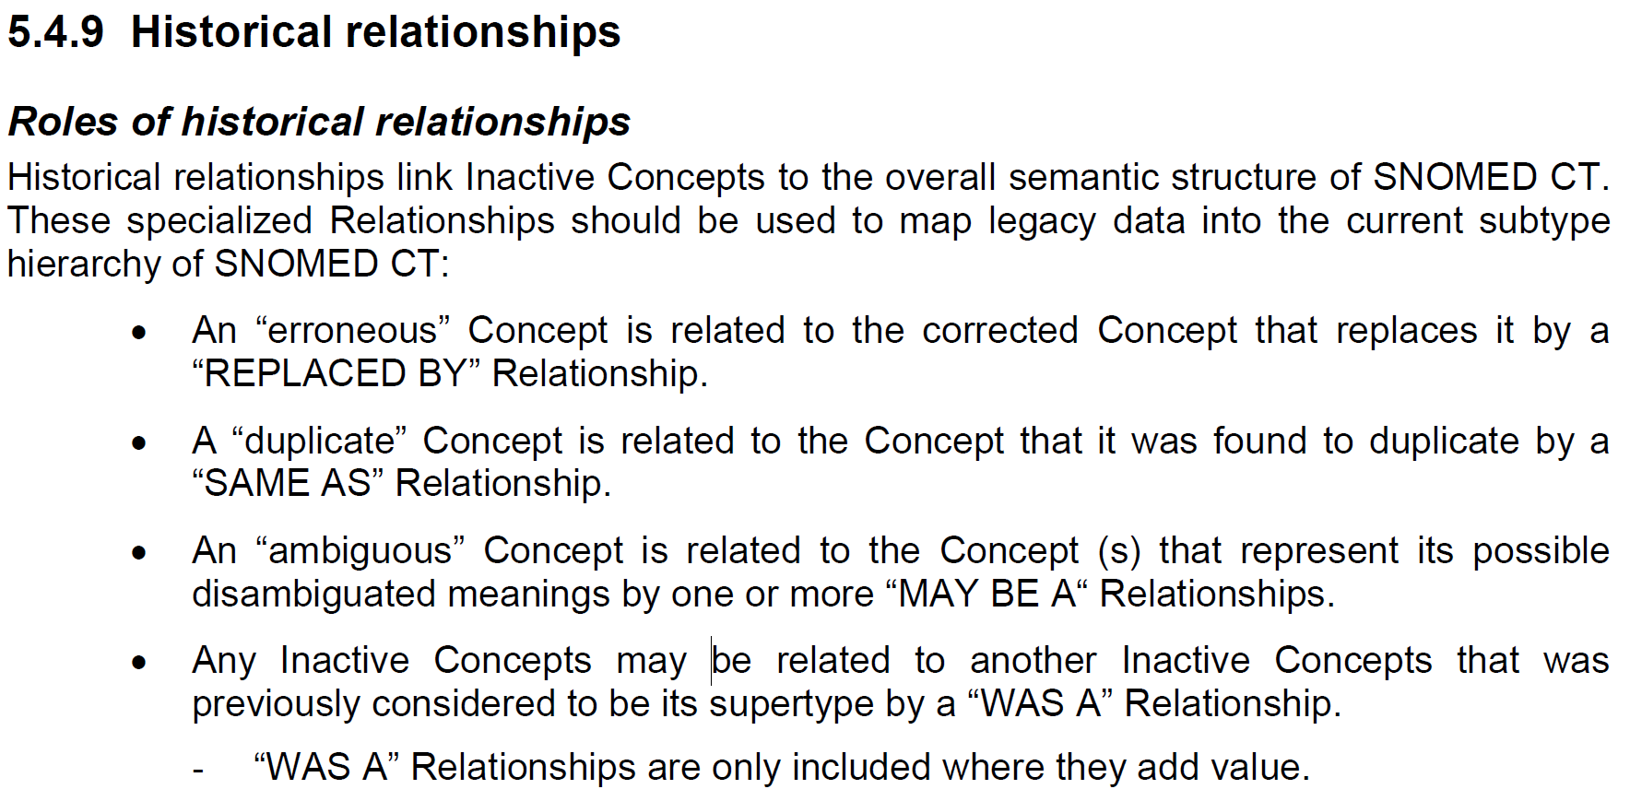
Historical Associations:
Intended role in Data Repair
Technical Implementation Guide July 2009

Slide 12
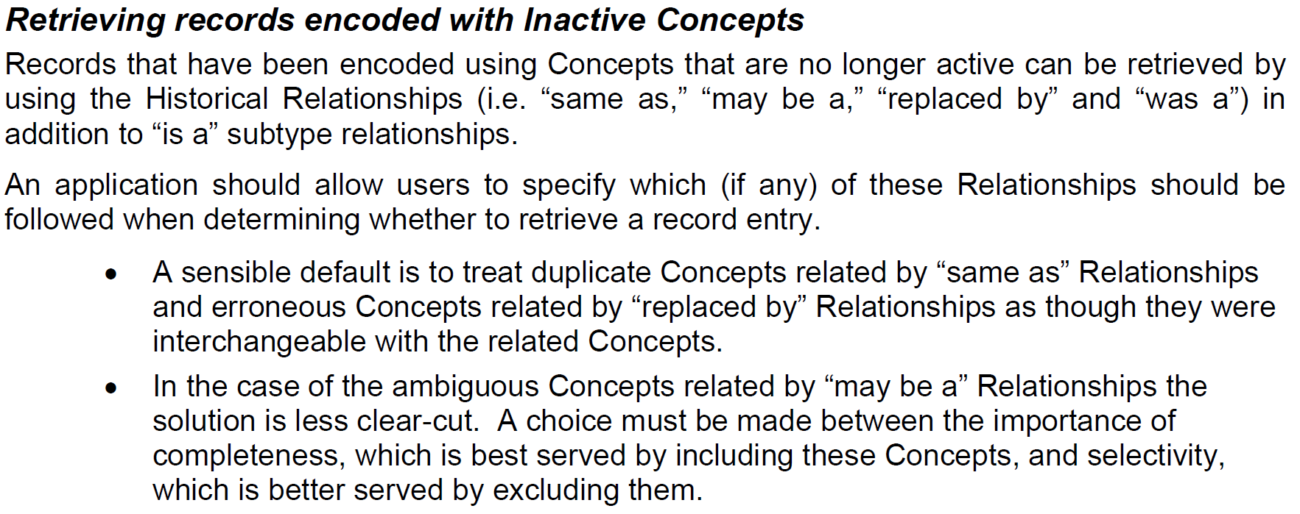
Historical Associations:
Intended role in Data Repair
Technical Implementation Guide July 2009

Slide 13
Historical Associations:
How many are wrong?

Slide 14
Quality Review of Historical Associations:
Methodology
Substrate: SNOMED Int Ed July 2018 + UK Clinical and Drug
For all 91,756 inactive concepts, identify:
  Date on which inactivated
  Reason for inactivation
  All already explicit or complex inferable historical associations
  Lexical similarity of original and target FSNs
Partition resulting 302,981 rows between 26 subcategories
Randomly select (up to) 100 from each category for review
Dual independent review all items selected, marking each as either Yes, No or OK

Slide 15
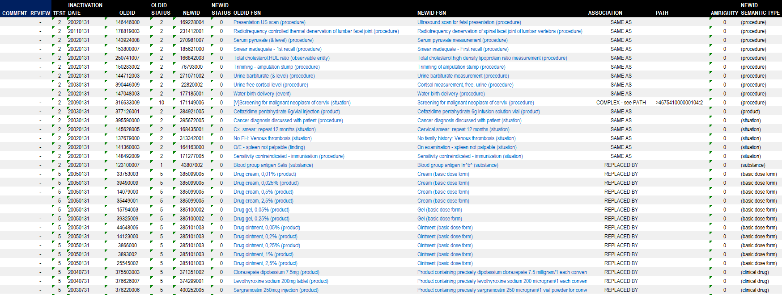
Quality Review of Historical Associations:
Sample of review data

Slide 16
Quality Review of Historical Associations:
Outcome and headline results
1926 inactive concepts with at least one historical association
  400 0 reviews
  431 1 review
  994 2 reviews
  101 3 reviews
High reviewer disagreement 44% (4-92%)
About 30-40% of all historical associations are wrong

Slide 17
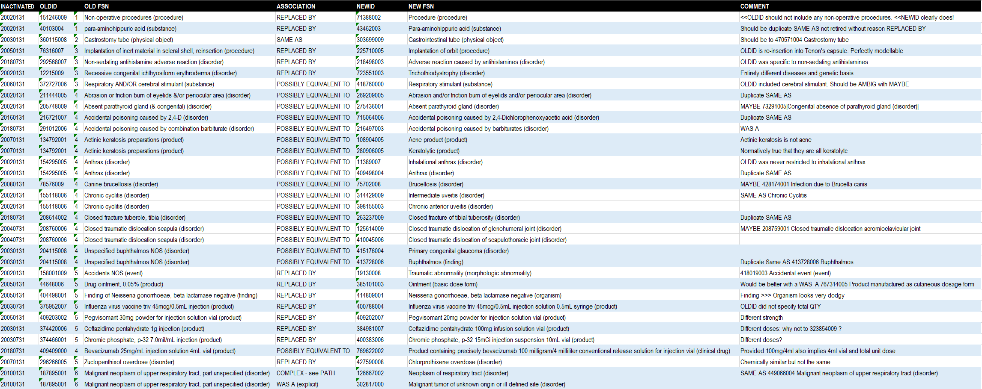
Quality Review of Historical Associations:
Examples of errors

Slide 18
Quality Review of Historical Associations:
Results
Duplicate, erroneous, outdated, moved, limited status, non-conformant
12% incorrect
Ambiguous
54% incorrect

Slide 19
Next Steps:
Prevention and Rehab

Slide 20
Next Steps
Prevention: How do we reduce errors going forward?
  Improve the guidance – extensive ongoing work on Confluence
  Enforce the guidance – changes to authoring tooling?
  Eat dogfood: more operational systems attempting data repair using the associations
Rehab: How much of the historical data do we need to repair?
  All of it, or just some? Which bit first?
  Targetting options
    inactivation reason
    flavour of association
    pre-inactivation semantic type
    usage of inactivated concept or its designated substitute(s)
    can we automate any repairs?
  Algorithms with high precision but poor recall could still exempt much of the “good” historical data from needing review

