Slide 1
Disorder due to disorder - due to vs explict statements in an axiom (aka due to vs. co-occurrent)

Slide 2
Modeling patterns for combined disorders
Pattern | Model | Used for | Comment
Simple co-occurence | isA X+isA Y | Multi component syndromes Manifestations of multisystem diseases
Due to | isA X due to Y | A causal relationship between 2 disorders Causality is interpreted as any point on a causal chain | May be combined with a temporal relationship when specified
Co-occurrent and due to | isA X+isA Y due to Y | A causal relationship between 2 disorders in which both disorders are necessarily present at the same time | Recommended to retire due to difficulty applying consistently
Temporal relationships | X temporally related to Y X before Y X during Y X after Y | When used by itself, a temporal relationship between 2 disorders that are not causally related | Can be combined with due to if both a causal and temporal relationship are specified

Slide 3
Issue as stated (by JCA)
“As you are probably aware, I have an aversion to disorder DUE TO disorder concepts”
“One of the reasons I don't like using disorder in the DUE TO relationship is because it often hides many relevant relationships from the classifier that would be better explicitly stated in an axiom”.
  This has the effect of creating co-occurrence between 2 disorders - BG
It is my impression that we are not trying to represent the natural history of a condition in our concepts.
The focus should be the presentation of the clinical condition at the time the assessment is made and a statement related to that instance of the condition.
In that sense, we need to identify the actionable focal meaning of the concept.
In the case of simple co-occurrence, there are two (or more) focal meanings, which hopefully have the same actionable resolution of the disposition

Slide 4
Concerns voiced by BGO
If the idea to model many/most of the combined disorders with a causal relationship as co-occurrent but with some exceptions, I think we are going back to square one which is why we decided to not use co-occurrent and due to, i.e. it places the decision when to use the exception on the author which will invariably lead to inconsistency.
I have had difficulty trying to decide exactly what the exceptions are that would require due to rather than co-occurrence.
Possible solutions all directed at maintaining a consistent approach to authoring.
  Model all combined disorders with a causal relationship as co-occurrent with the implied meaning that co-occurrence signifies a causal relationship. This has several drawbacks.
    It does not mesh with the WHO view of causality
      2,252 ICD-10 terms contain “due to”
    It will impact how we model syndromes and manifestations of systemic disorders
    How would we name these?
  Model all combined disorders with a causal relationship as co-occurrent and due to.
  Model all combined disorders with a causal relationship as due to. The causal condition can be retrieved using ECL queries.

Slide 5
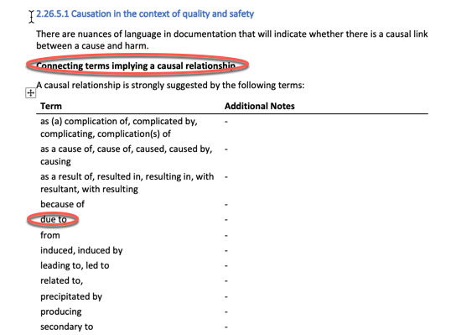
WHO - causality

Slide 6
Modeling examples

Slide 7
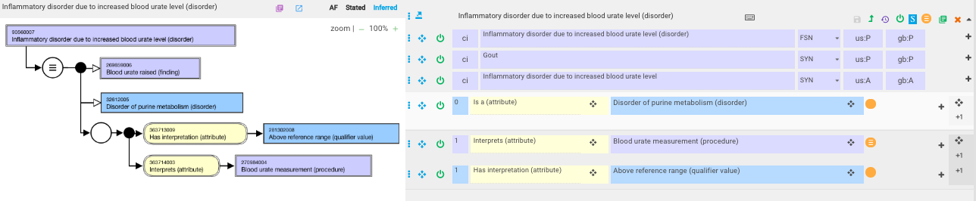
Gout – current model
The FSN states this is an inflammatory disorder but there is no mention of inflammation in the model

Slide 8
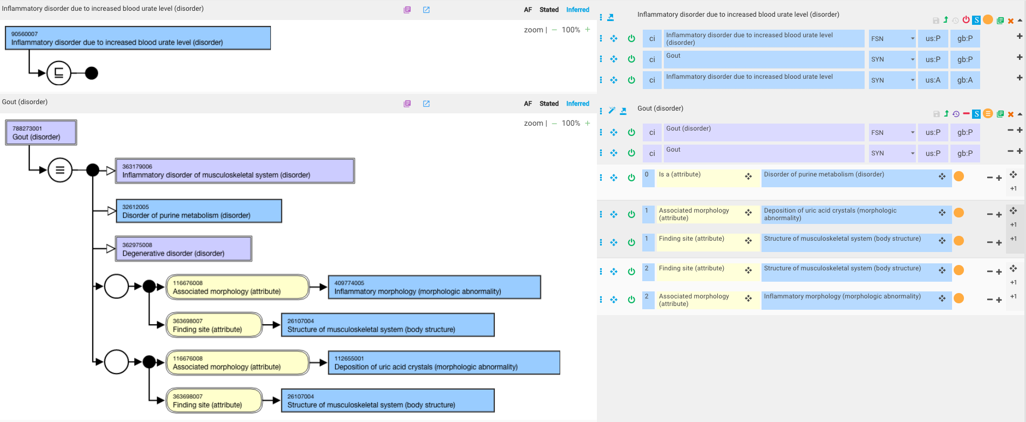
Gout – proposed revision to model
Or 112654002 |Deposition of sodium urate crystals (morphologic abnormality)|?

Slide 9
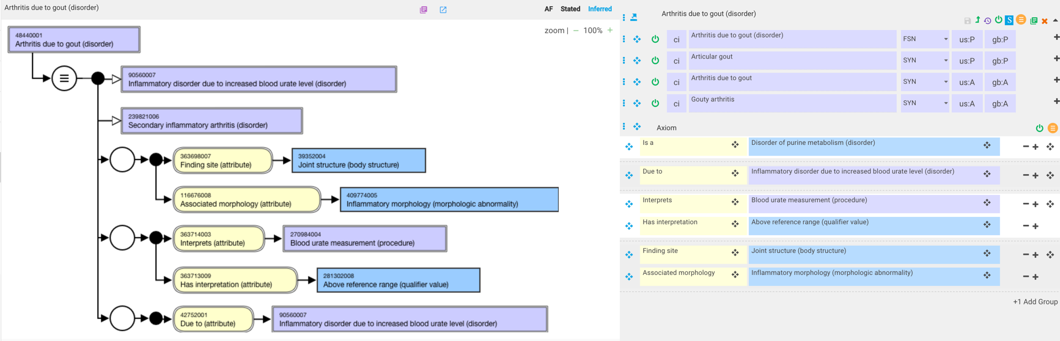

Arthritis due to gout (disorder)
Gout is a common form of inflammatory arthritis…

Slide 10
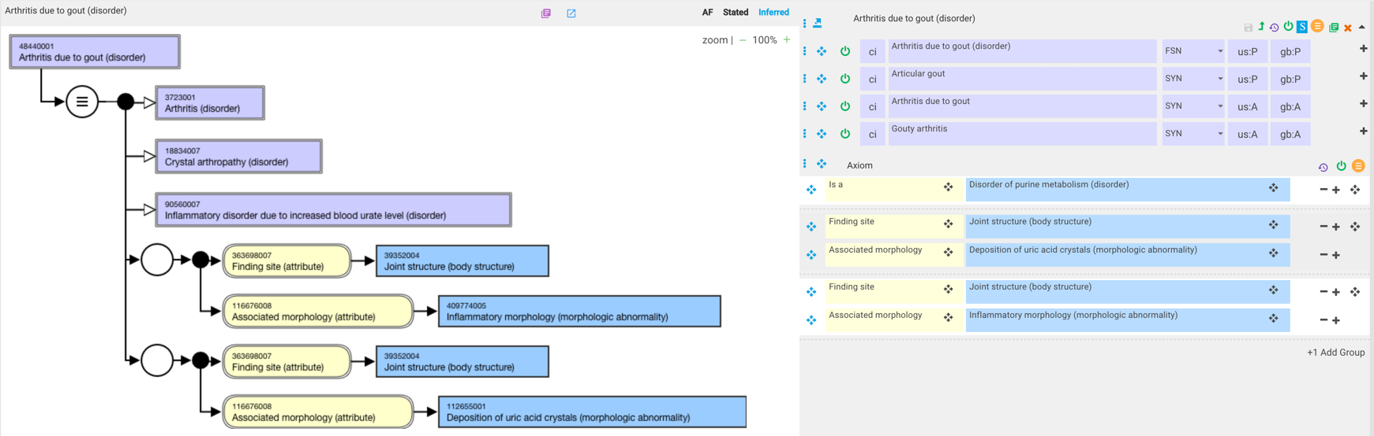
Arthritis due to gout (disorder) – revised model

Slide 11
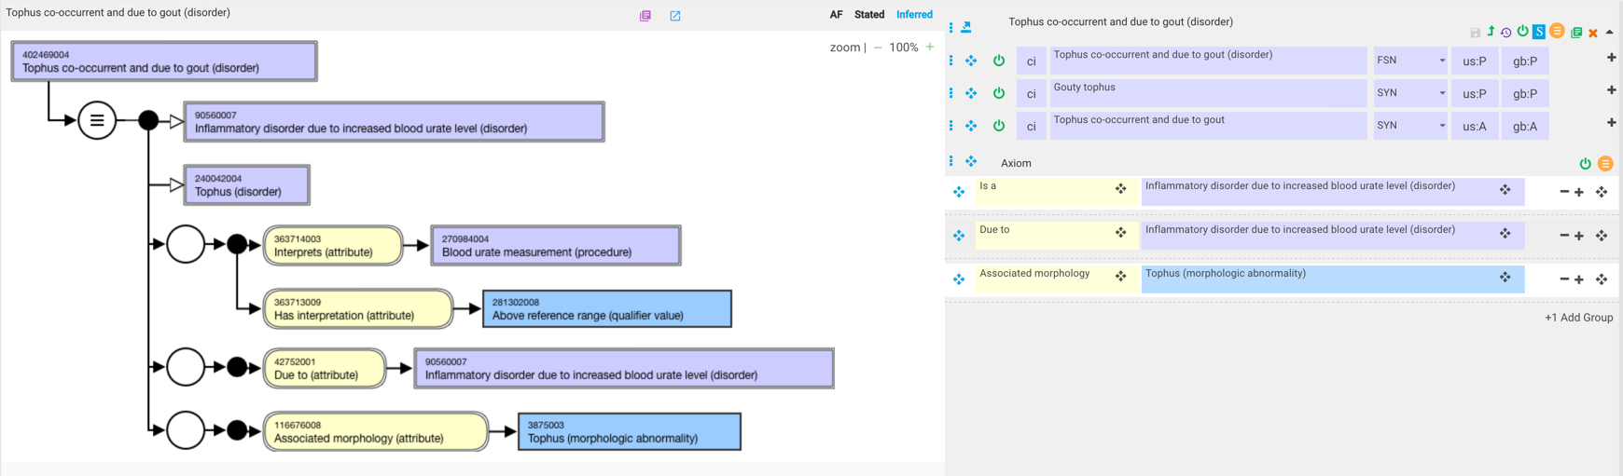
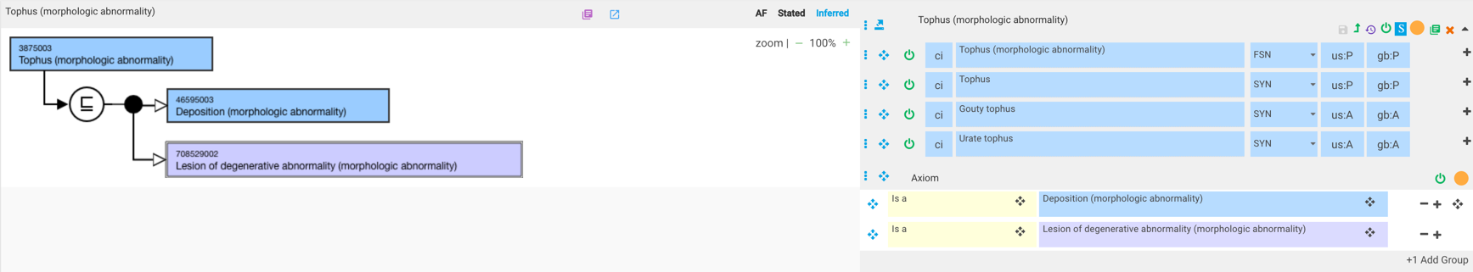
Tophus co-occurrent and due to gout (disorder) –current model

Slide 12
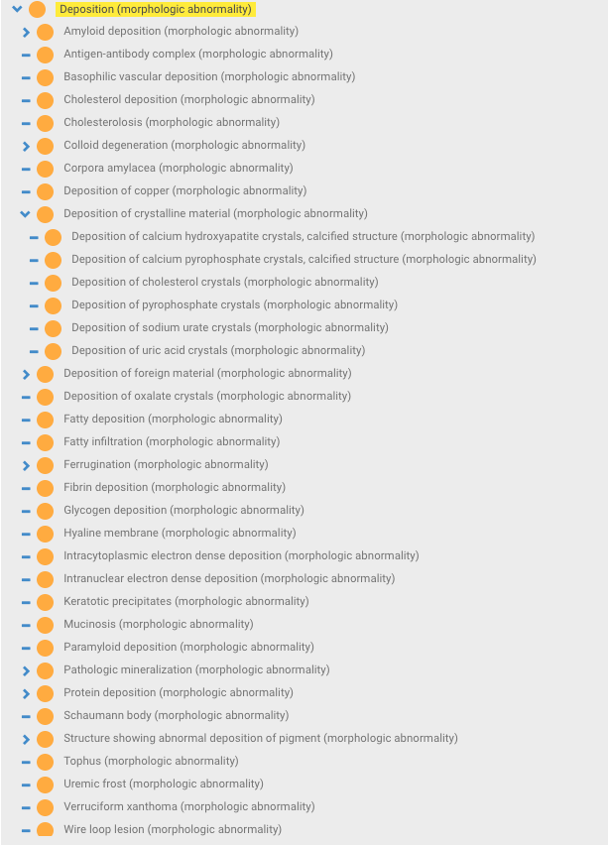
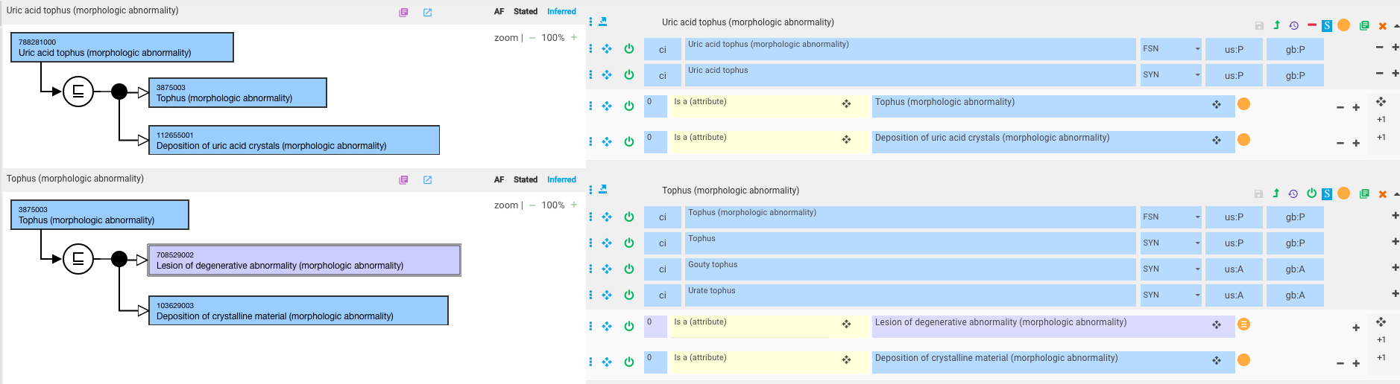
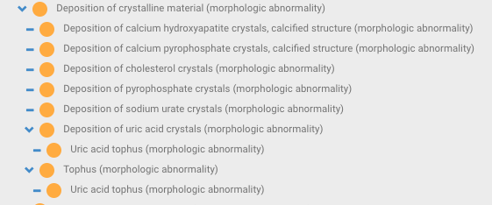
Deposition (morphologic abnormality) hierarchy
Current Deposition morphology hierarchy
New concept: Uric acid tophus (morphologic abnormality)

Slide 13
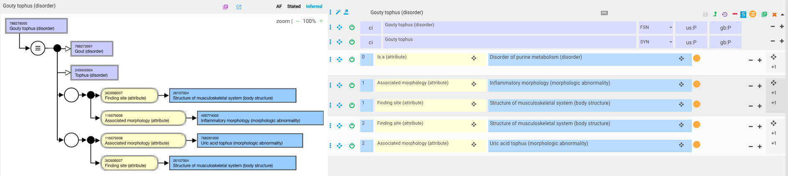
Gouty tophus

Slide 14
Injuries – co-occurrent vs. 2 due tos
We are modeling traumatic injuries using due to traumatic event and nontraumatic injuries using due to spontaneous event
When a specific cause of an injury is indicated, possible models include:
  2 due tos (traumatic event/spontaneous event)+other causative disorder
  1 due to (traumatic event/spontaneous event)+additional role group representing causative disorder

Slide 15
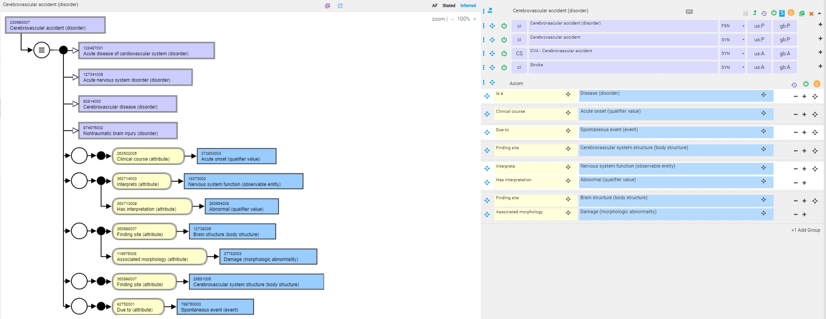
Definition of cerebrovascular accident*
(Acute non-traumatic brain injury with resulting neurological dysfunction due to cerebrovascular disease)
*An Updated Definition of Stroke for the 21st Century A Statement for Healthcare Professionals From the American Heart Association/American Stroke Association

Slide 16
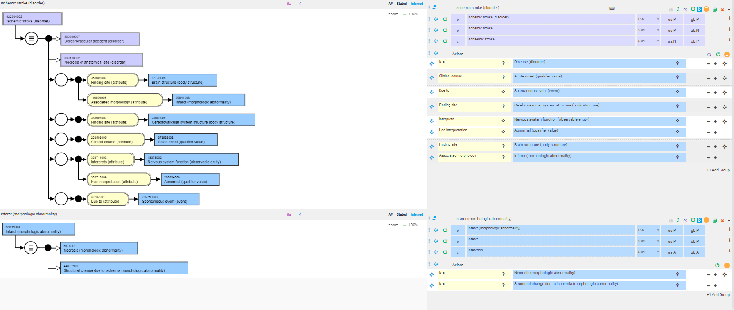
422504002 |Ischemic stroke (disorder)|
Ischemic strokes are brain infarcts

Slide 17
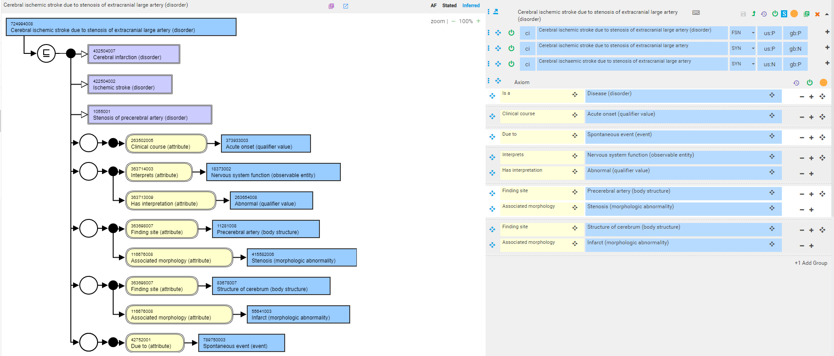
724994008 |Cerebral ischemic stroke due to stenosis of extracranial large artery (disorder)|
How to name this without using “due to” in the FSN?

Slide 18
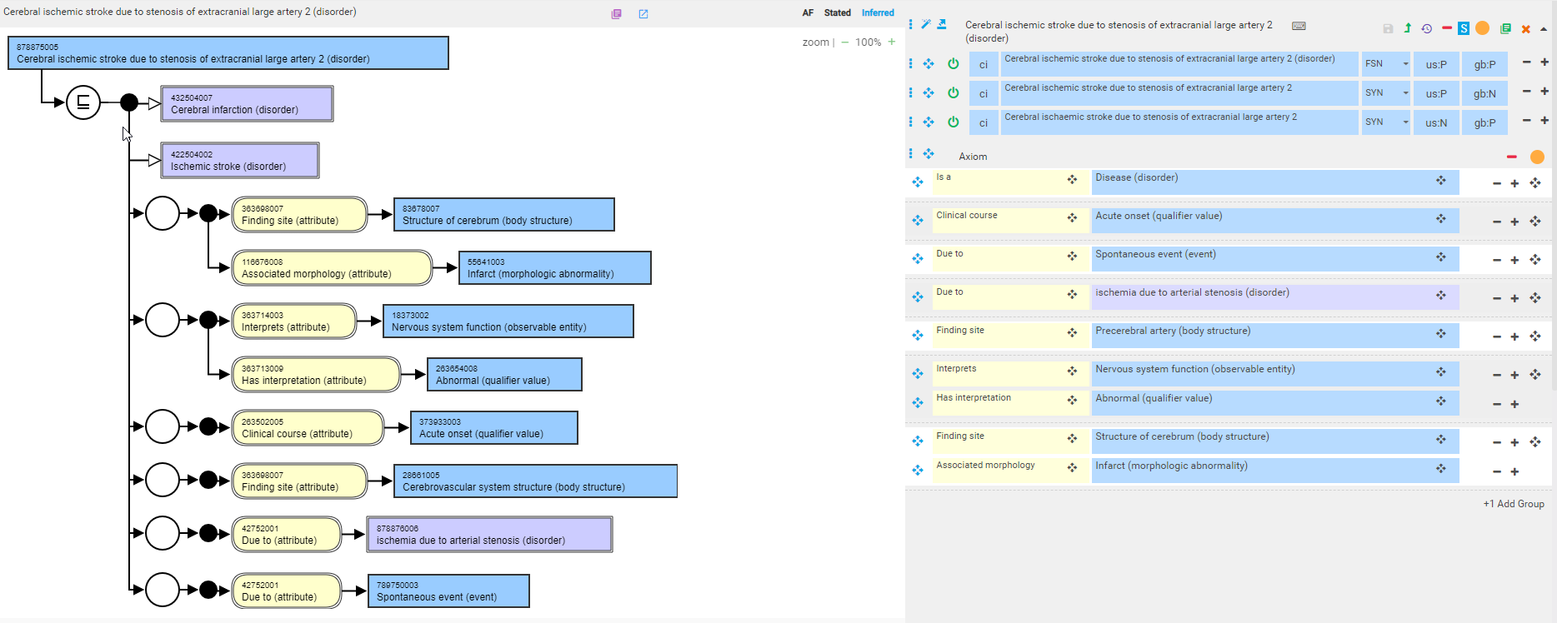
724994008 |Cerebral ischemic stroke due to stenosis of extracranial large artery (disorder)|- alternate model

Slide 19
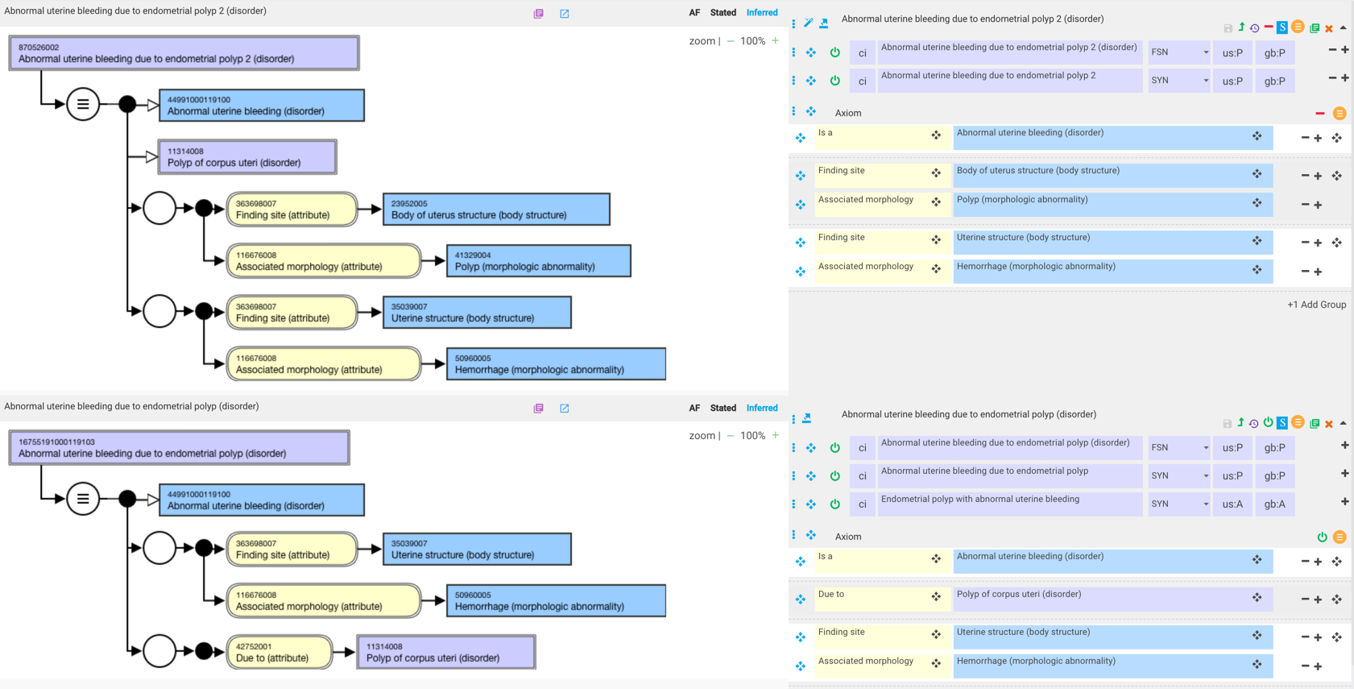
870526002 |Abnormal uterine bleeding due to endometrial polyp (disorder)|
Since most polyps are small, they probably do not often cause symptoms. However, when symptoms do occur, they usually include excessive bleeding during a menstrual period, or bleeding in between periods, or even spotting after intercourse. Some women report a few days of brown blood after a normal menstrual period. Polyps cause these symptoms because they dangle from their stalks and irritate the surrounding tissue, which causes the tissue to rub off, exposing tiny blood vessels.

Slide 20
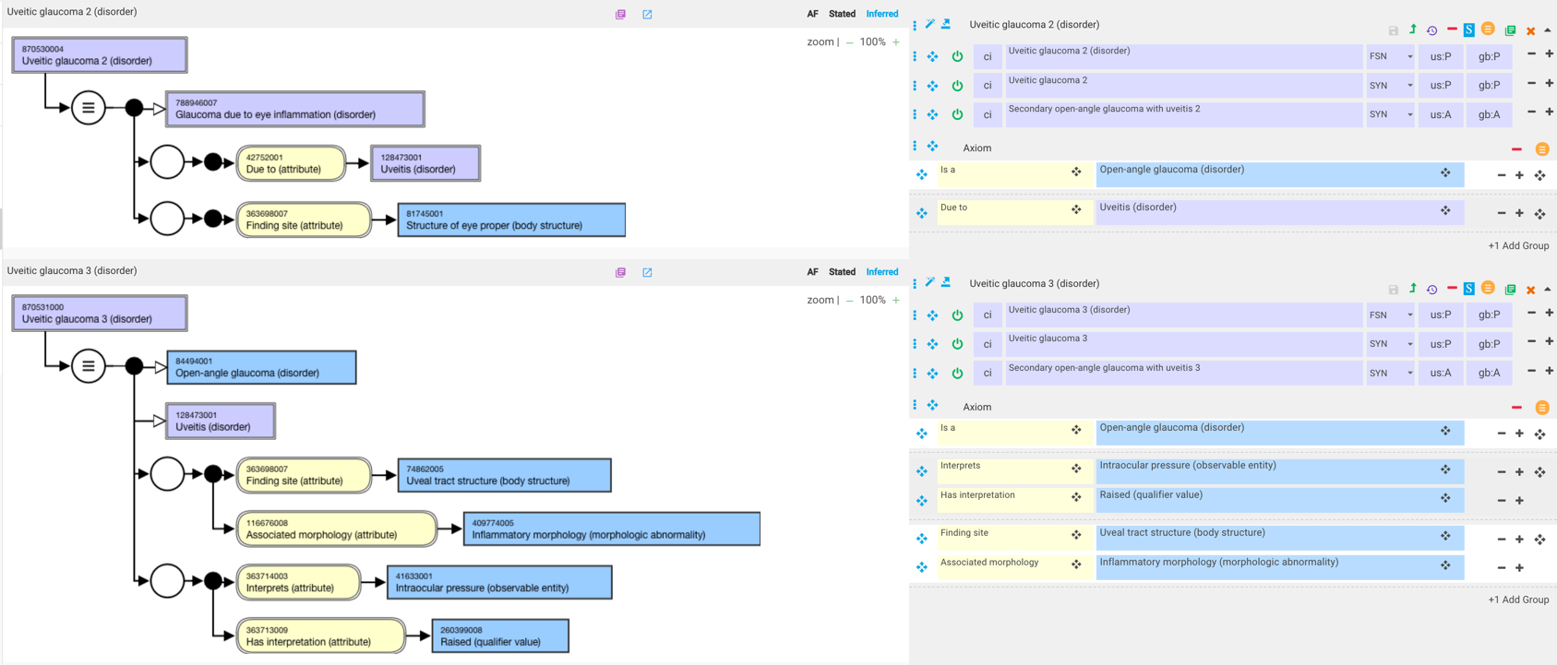
314033007 |Uveitic glaucoma (disorder)|- alternate models

Slide 21
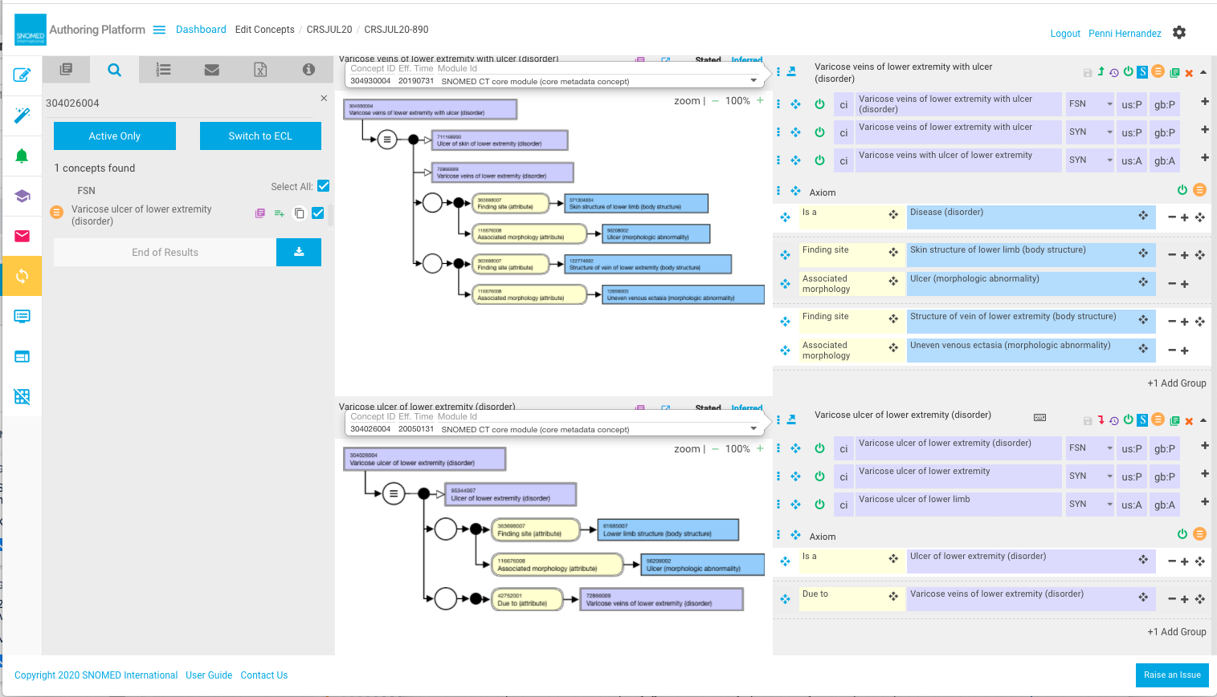
304026004 |Varicose ulcer of lower extremity (disorder)|

Slide 22
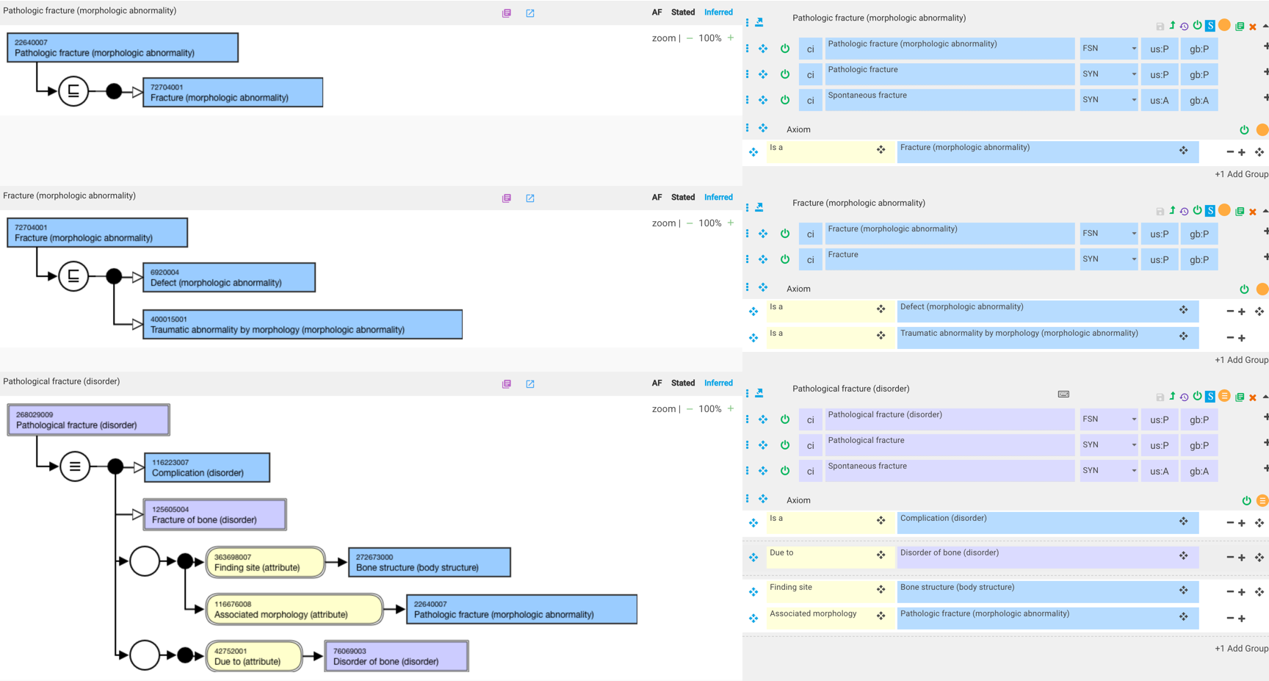
268029009 |Pathological fracture (disorder)|

Slide 23
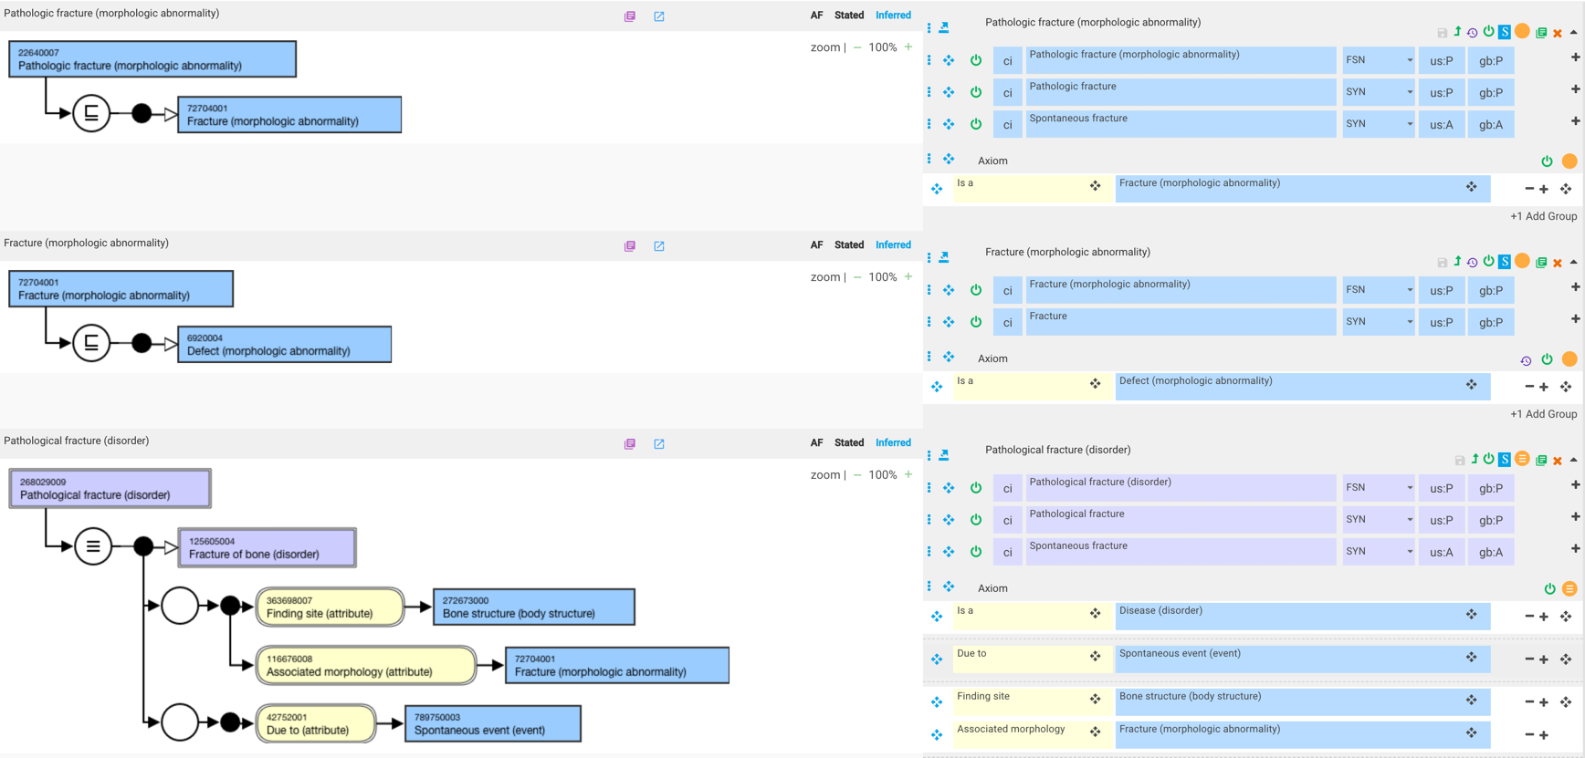
268029009 |Pathological fracture (disorder)|-2

Slide 24
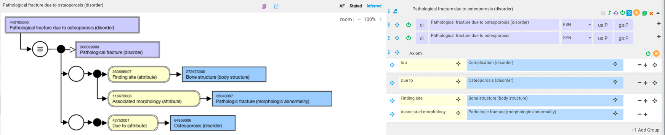
443165006 |Pathological fracture due to osteoporosis (disorder)|- current model

Slide 25
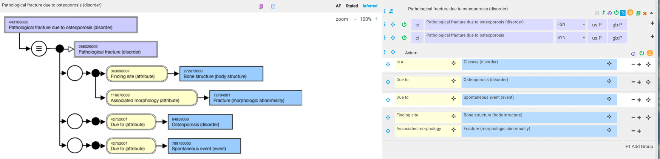
443165006 |Pathological fracture due to osteoporosis (disorder)|- alternate model with 2 due to relationships

Slide 26
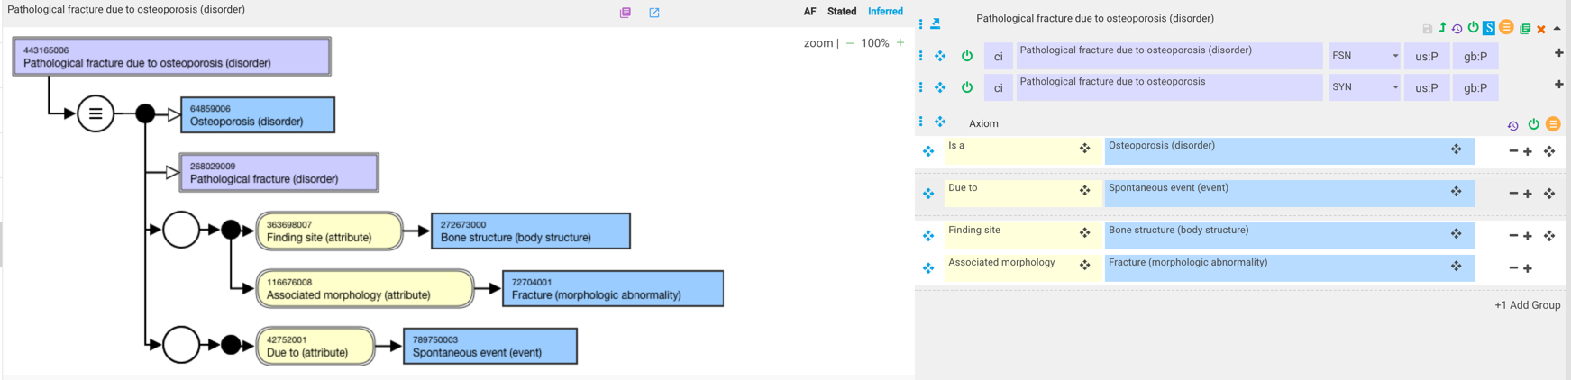
443165006 |Pathological fracture due to osteoporosis (disorder)|- alternate model 1

Slide 27
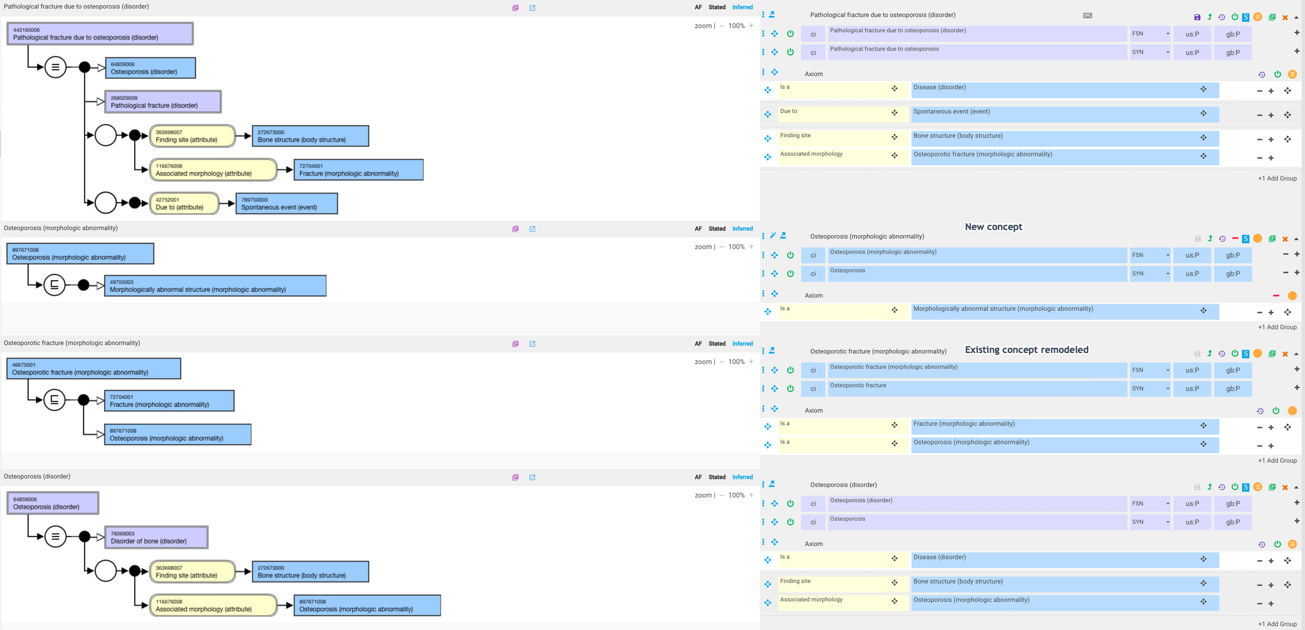
443165006 |Pathological fracture due to osteoporosis (disorder)|- alternate model 2

Slide 28
Is osteoporosis a valid morphology?
Fracture is a morphology in SNOMED
Osteoporosis is not a morphology in SNOMED

Slide 29

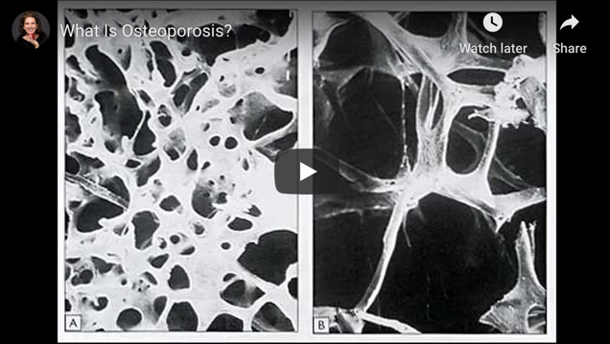
What is Osteoporosis and What Causes It?
Osteoporosis means “porous bone.” Viewed under a microscope, healthy bone looks like a honeycomb. When osteoporosis occurs, the holes and spaces in the honeycomb are much larger than in healthy bone. Osteoporotic bones have lost density or mass and contain abnormal tissue structure.
Osteoporosis appears to be a morphologically abnormal structure

Slide 30
Modeling consistency for due to vs. co-occurrent
id | fsn | JTC - DUE TO/CO-OCCURRENT | BGO - DUE TO/CO-OCCURRENT | Monica
402469004 | Tophus co-occurrent and due to gout (disorder) | DUE TO | CO-OCCURENT. | CO-OCCURRENT
83850008 | Acidosis co-occurrent and due to uremia (disorder) | DUE TO | DUE TO | DUE TO
735173007 | Shock co-occurrent and due to anaphylaxis (disorder) | BGO: No cause and effect? | CO-OCCURENT | DUE TO
724992007 | Epilepsy co-occurrent and due to dementia (disorder) | Pending review by Epilepsy CRG | DUE TO. Needed for directionality as dementia may result in epilepsy and vice versa. See Cognition and dementia in older patients with epilepsy
195900001 | Pneumonia co-occurrent and due to measles (disorder) | CAUSED BY Organism | CAUSED BY | Agree
19431000 | Arthritis co-occurrent and due to rubella (disorder) | CAUSED BY Organism | CAUSED BY | Agree
367171000119100 | Hematuria co-occurrent and due to cystitis (disorder) | DUE TO | DUE TO | DUE TO
719680009 | Tophus of toe co-occurrent and due to gout (disorder) | DUE TO BGO: Why co-occurrent?) | CO-OCCURENT | CO-OCCURENT
14763005 | Tophus of ear co-occurrent and due to gout (disorder) | DUE TO BGO: Why co-occurrent?) | CO-OCCURENT | CO-OCCURENT
80119007 | Pericarditis co-occurrent and due to uremia (disorder) | DUE TO | DUE TO | DUE TO
190842000 | Tophus of hand co-occurrent and due to gout (disorder) | DUE TO BGO: Why co-occurrent?) | CO-OCCURENT | CO-OCCURENT
368371000119102 | Hematuria co-occurrent and due to trigonitis (disorder) | DUE TO | DUE TO | CO-OCCURENT
281362006 | Tophus of bursa co-occurrent and due to gout (disorder) | DUE TO BGO: Why co-occurrent?) | CO-OCCURENT | CO-OCCURENT
402470003 | Tophus of digit co-occurrent and due to gout (disorder) | DUE TO BGO: Why co-occurrent?) | CO-OCCURENT | CO-OCCURENT
27277001 | Tophus of heart co-occurrent and due to gout (disorder) | DUE TO BGO: Why co-occurrent?) | CO-OCCURENT | CO-OCCURENT
281363001 | Tophus of tendon co-occurrent and due to gout (disorder) | DUE TO BGO: Why co-occurrent?) | CO-OCCURENT | CO-OCCURENT
724766009 | Chorea co-occurrent and due to Wilson disease (disorder) | DUE TO BGO: Why co-occurrent?) | CO-OCCURENT | CO-OCCURENT

Slide 31
Questions
Main result of adding additional relationships to an axiom instead of using a due to relationship appears to be to assert co-occurrence with the causative disorder
Would adding additional relationships to an axiom replace all due to disorder relationships or some?
  If some, this resurfaces the issue we had with the co-occurrent and due to pattern in terms of maintaining modeling consistency and was the main reason we retired this modeling pattern

