Slide 1
Substance related disease exacerbations
Bruce Goldberg MD, PhD
Notes:
I would like to review the model for combined disorders by going over the background principles that lead to the development of this model as well as discuss the individual modeling patterns with the hope of answering some of the questions that have arisen in terms of applying the model

Slide 2
X-induced vs. X exacerbated/aggravated by
Induce
  Effect, cause (to cause the formation of)
Exacerbate
  Aggravate,complicate, worsen
  An induced disorder implies that the disorder does not exist prior to its cause
  An exacerbated disorder implies that the disorder does exist prior to exposure to an aggravating factor

Slide 3
Issues in SNOMED regarding Substance induced disease and disease exacerbation
Concepts with “exacerbated” or ”aggravated” in the FSN are subsumed by Substance induced diseases
This is a particular concern for the area of occupational asthma in which substances can worsen pre-existing asthma and/or cause new onset asthma

Slide 4
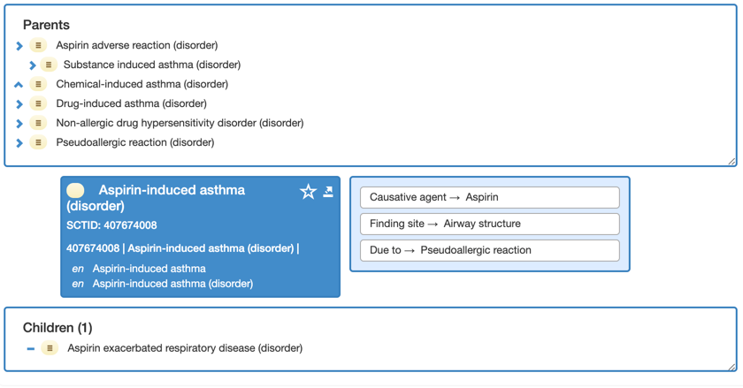
407674008 |Aspirin-induced asthma (disorder)|
Aspirin-induced asthma is erroneous. Aspirin does not cause asthma de novo but rather can worsen pre-existing asthma.
Aspirin-exacerbated asthma. Allergy Asthma Clin Immunol. 2008;4(2):75‐83. doi:10.1186/1710-1492-4-2-75)

Slide 5
Alternate models

Slide 6
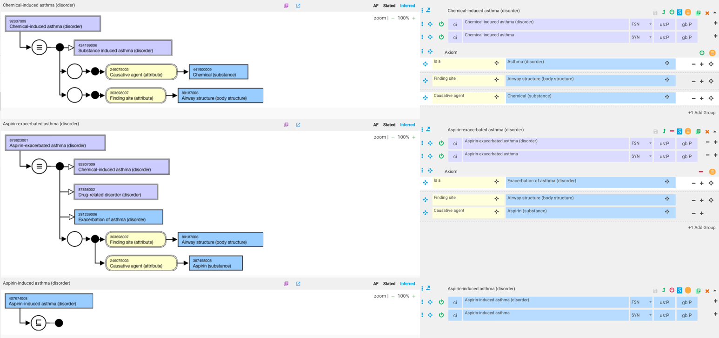
Aspirin exacerbated asthma
As Exacerbation of asthma (disorder) is a subtype of asthma (is this correct?), Aspirin exacerbated asthma (disorder) inherits a parent of Chemical-induced asthma (disorder) implying that the asthma is caused by aspirin

Slide 7
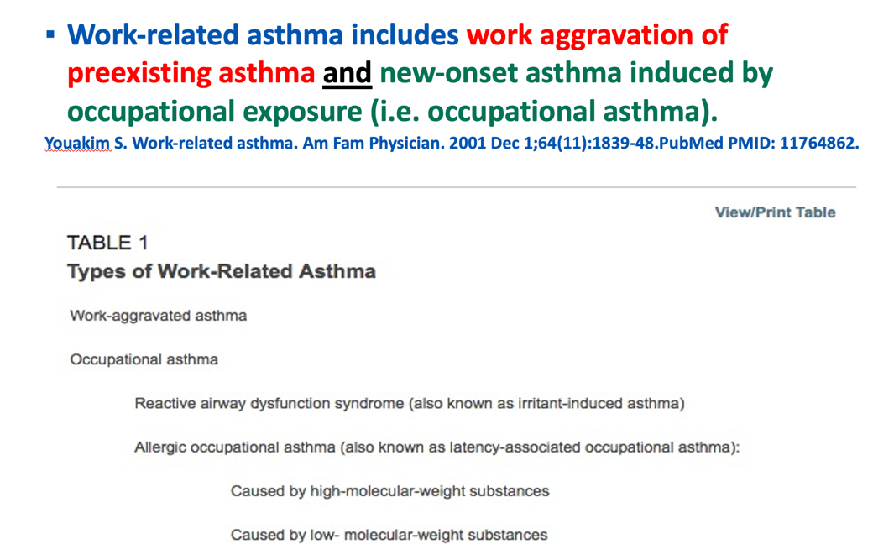
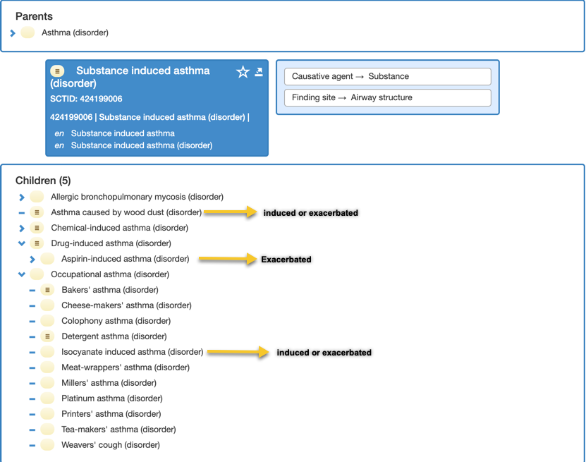
Option 2
Convert 424199006 |Substance induced asthma (disorder)|and 92807009 |Chemical-induced asthma (disorder)|into Substance exacerbated asthma (disorder) and Chemical-exacerbated asthma (disorder) ?

Slide 8
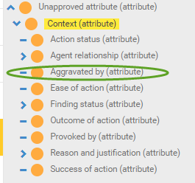
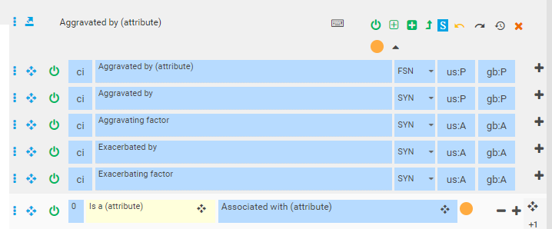
410660005 |Aggravated by (attribute)|
Current location
Proposed location
Proposed domain: clinical findings and disorders
Proposed range: clinical findings and disorders, substances, physical forces, physical objects

Slide 9
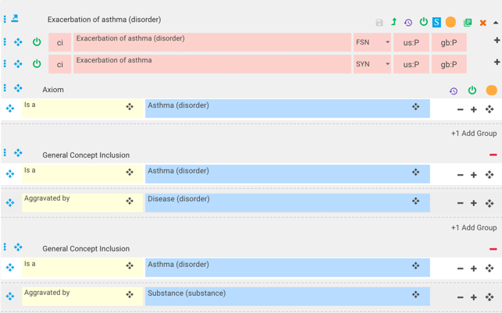
281239006 |Exacerbation of asthma (disorder)|- remodel using GCIs

Slide 10
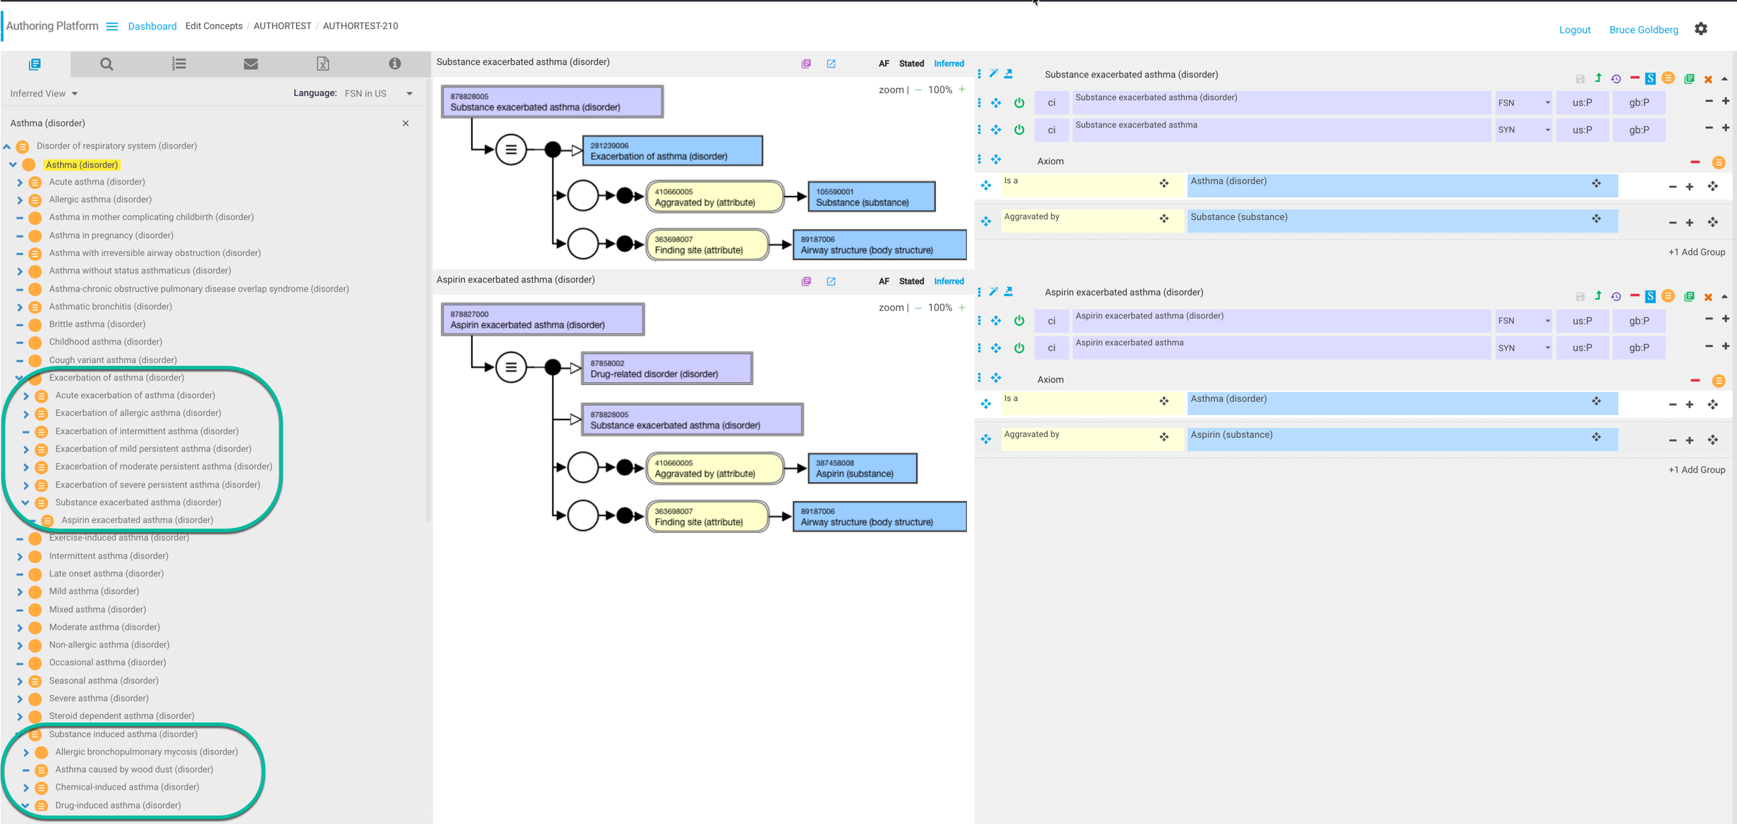
Substance and Aspirin exacerbated asthma

Slide 11
Other use cases

Slide 12
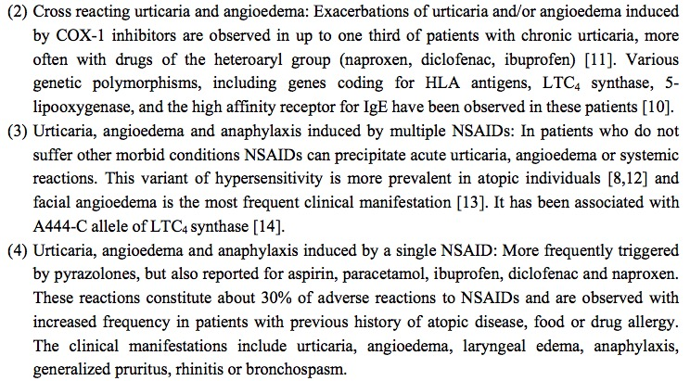
Issues identified - 2
241959003 |Non-steroid anti-inflammatory drug-induced angioedema-urticaria (disorder)|

Slide 13
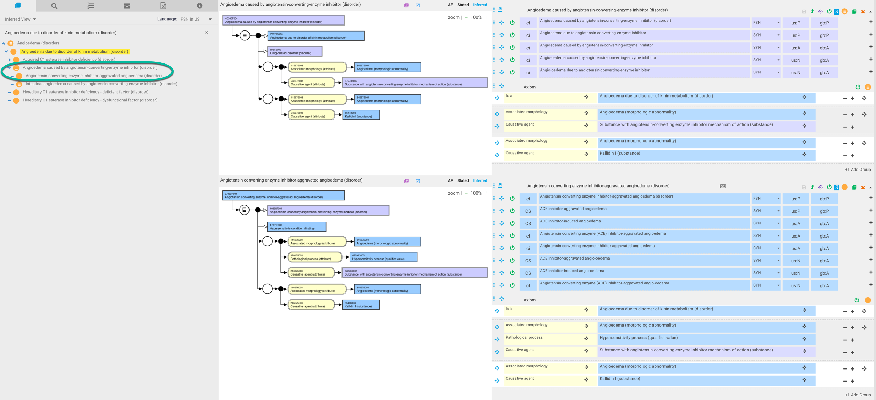
371627004 |Angiotensin converting enzyme inhibitor-aggravated angioedema (disorder)|

Slide 14
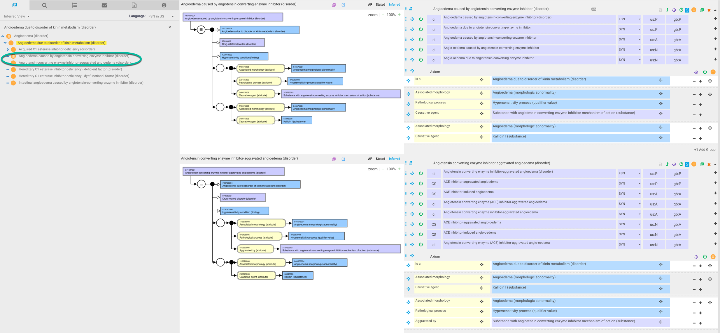
371627004 |Angiotensin converting enzyme inhibitor-aggravated angioedema (disorder)|- revised model

Slide 15
Patterns
Pattern | #
Exacerbation of | 69
Aggravated by / X aggravated Y | 6
Worsening X | 3
Exacerbated by / X exacerbated Y | 5
Worse by | 1

Slide 16
Exacerbation of X
Exacerbation of eczema (disorder) | Exacerbation of Crohn's disease of small intestine (disorder)
Acute exacerbation of chronic obstructive airways disease (disorder) | Acute exacerbation of moderate persistent asthma (disorder)
Acute exacerbation of asthma (disorder) | Acute exacerbation of chronic asthmatic bronchitis (disorder)
Exacerbation of peptic ulcer (disorder) | Acute exacerbation of chronic latent schizophrenia (disorder)
Exacerbation of osteoarthritis (disorder) | Acute severe exacerbation of mild persistent asthma (disorder)
Exacerbation of allergic asthma (disorder) | Acute exacerbation of idiopathic pulmonary fibrosis (disorder)
Exacerbation of multiple sclerosis (disorder) | Acute exacerbation of chronic paranoid schizophrenia (disorder)
Exacerbation of ulcerative colitis (disorder) | Acute exacerbation of chronic obstructive bronchitis (disorder)
Exacerbation of intermittent asthma (disorder) | Acute exacerbation of subchronic latent schizophrenia (disorder)
Acute severe exacerbation of asthma (disorder) | Acute exacerbation of chronic catatonic schizophrenia (disorder)
Acute exacerbation of bronchiectasis (disorder) | Acute severe exacerbation of severe persistent asthma (disorder)
Exacerbation of non-infective colitis (disorder) | Acute exacerbation of chronic congestive heart failure (disorder)
Acute exacerbation of immunoglobulin E-mediated allergic asthma (disorder) | Acute on chronic right-sided congestive heart failure (disorder)
Moderate acute exacerbation of asthma (disorder) | Acute exacerbation of subchronic paranoid schizophrenia (disorder)
Exacerbation of mild persistent asthma (disorder) | Acute severe exacerbation of moderate persistent asthma (disorder)
Acute exacerbation of intrinsic asthma (disorder) | Acute exacerbation of subchronic catatonic schizophrenia (disorder)
Premenstrual exacerbation of dermatosis (disorder) | Subchronic disorganized schizophrenia with acute exacerbations (disorder)
Acute exacerbation of chronic bronchitis (disorder) | Exacerbation of constitutional dermatitis due to occupation (disorder)
Exacerbation of severe persistent asthma (disorder) | Acute exacerbation of chronic schizoaffective schizophrenia (disorder)
Exacerbation of congestive heart failure (disorder) | Acute severe exacerbation of mild persistent allergic asthma (disorder)
Exacerbation of moderate persistent asthma (disorder) | Acute exacerbation of subchronic schizoaffective schizophrenia (disorder)
Acute exacerbation of chronic schizophrenia (disorder) | Acute severe exacerbation of severe persistent allergic asthma (disorder)
Acute exacerbation of mild persistent asthma (disorder) | Acute exacerbation of asthma co-occurrent with allergic rhinitis (disorder)
Pregnancy-related exacerbation of dermatosis (disorder) | Acute severe exacerbation of moderate persistent allergic asthma (disorder)
Acute severe exacerbation of allergic asthma (disorder) | Acute infective exacerbation of chronic obstructive airways disease (disorder)
Acute severe exacerbation of immunoglobin E-mediated allergic asthma (disorder) | Acute exacerbation of chronic obstructive airways disease with asthma (disorder)
Acute severe exacerbation of intrinsic asthma (disorder) | Acute severe exacerbation of asthma co-occurrent with allergic rhinitis (disorder)
Life threatening acute exacerbation of asthma (disorder) | Chronic obstructive asthma co-occurrent with acute exacerbation of asthma (disorder)
Acute severe refractory exacerbation of asthma (disorder) | Acute severe exacerbation of severe persistent asthma co-occurrent with allergic rhinitis (disorder)
Exacerbation of allergic asthma due to infection (disorder) | Acute severe exacerbation of moderate persistent asthma co-occurrent with allergic rhinitis (disorder)
Exacerbation of Crohn's disease of large intestine (disorder) | Acute severe exacerbation of mild persistent allergic asthma co-occurrent with allergic rhinitis (disorder)

