Slide 1
Additional testing to evaluate the impact of retiring 362977000 |Sequela (disorder)|

Slide 2
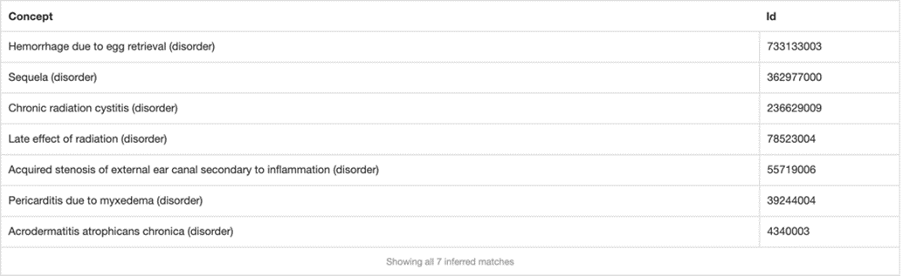
Initial findings
678 descendants of Sequela (disorder)
  6 concepts modeled with a parent of Sequela (disorder) do not have an after relationship
1546 concepts that contain an after relationship to a disorder, procedure or event do not have a parent of Sequela (disorder)
  106 concepts represent traumatic injuries
    (<<64572001 |Disease| minus <<362977000 |Sequela|): 255234002 |After| = (<<773760007 |Traumatic event (event)|)
  611 concepts represent postoperative complications
    (<<64572001 |Disease| minus <<362977000 |Sequela|): 255234002 |After| = (<<387713003 |Surgical procedure (procedure)|)
  836 concepts represent other than above
    (<<64572001 |Disease| minus <<362977000 |Sequela|): 255234002 |After| != (<<387713003 |Surgical procedure (procedure)| OR <<773760007 |Traumatic event (event)|)

Slide 3
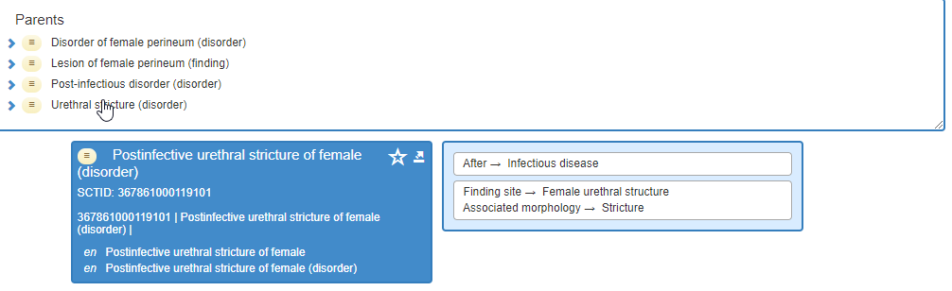
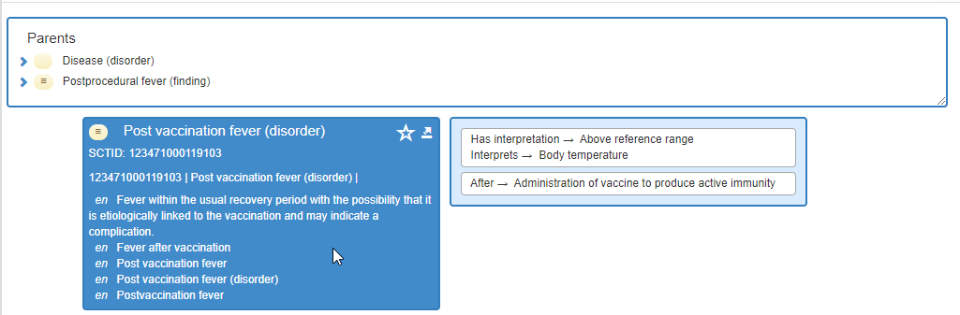
Examples of other disorders modeled with AFTER relationships that did not include a parent of sequela (disorder) -1

Slide 4
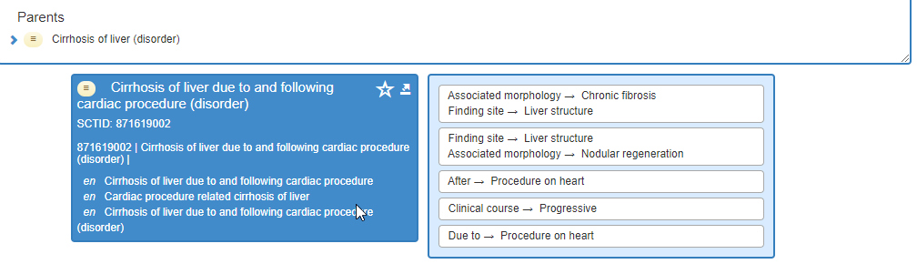
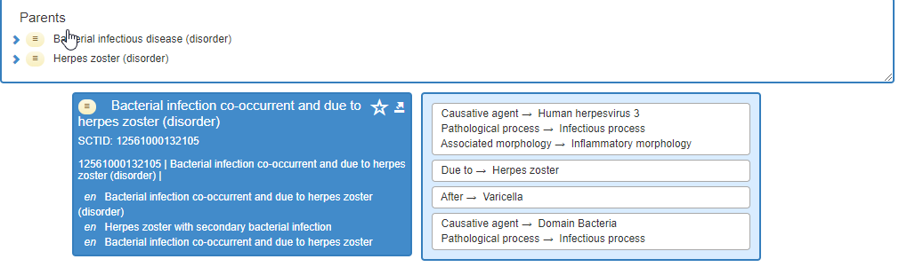
Examples of other disorders modeled with AFTER relationships that did not include a parent of sequela (disorder) -2

Slide 5
Testing
Retired 362977000 |Sequela (disorder)|maybeA 64572001 |Disease (disorder)|
Retired 720349002 |Sequelae of infectious disease (disorder)|as a duplicate of 123976001 |Post-infectious disorder (disorder)| (results in equivalency error after Sequela (disorder) replaced by Disease (disorder)

Slide 6
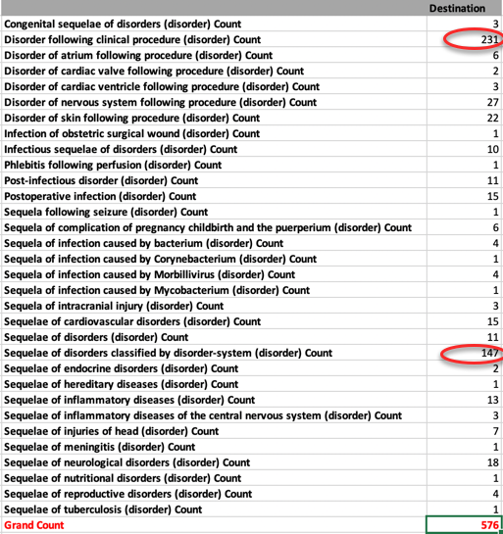
Inferred not previously stated

Slide 7
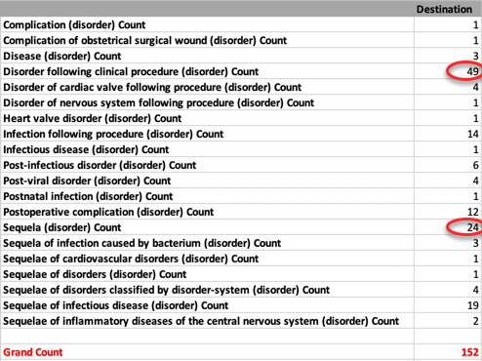
Removed inferred relationships

Slide 8
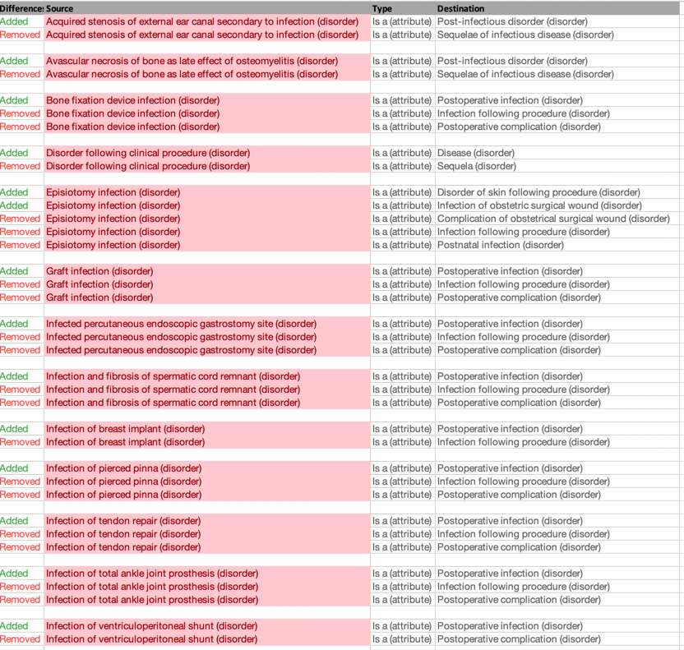
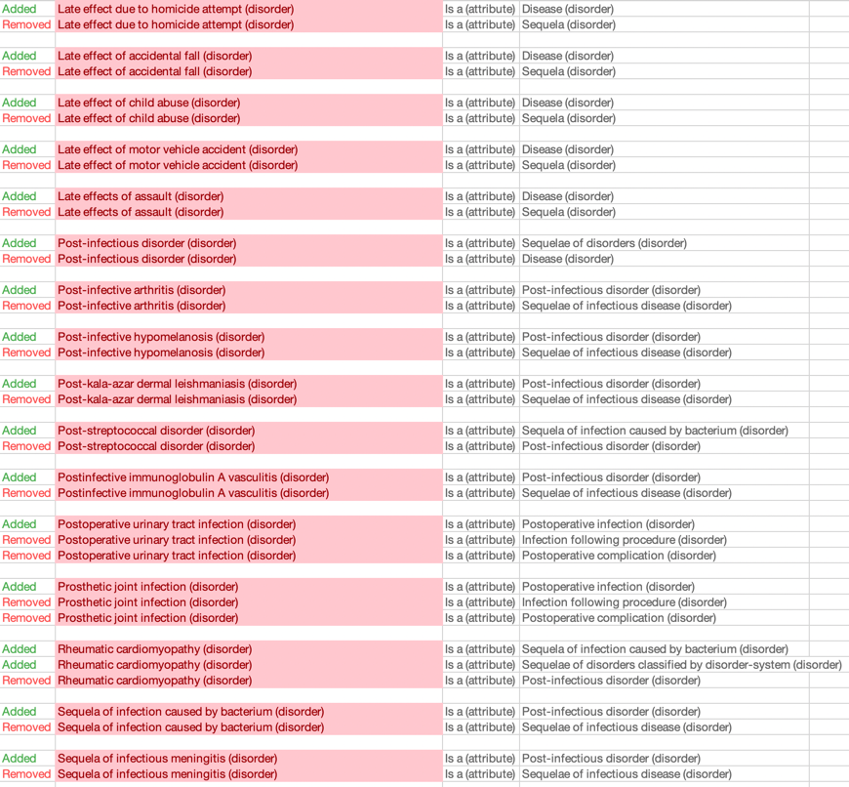
Concepts with both added and removed inferences

Slide 9
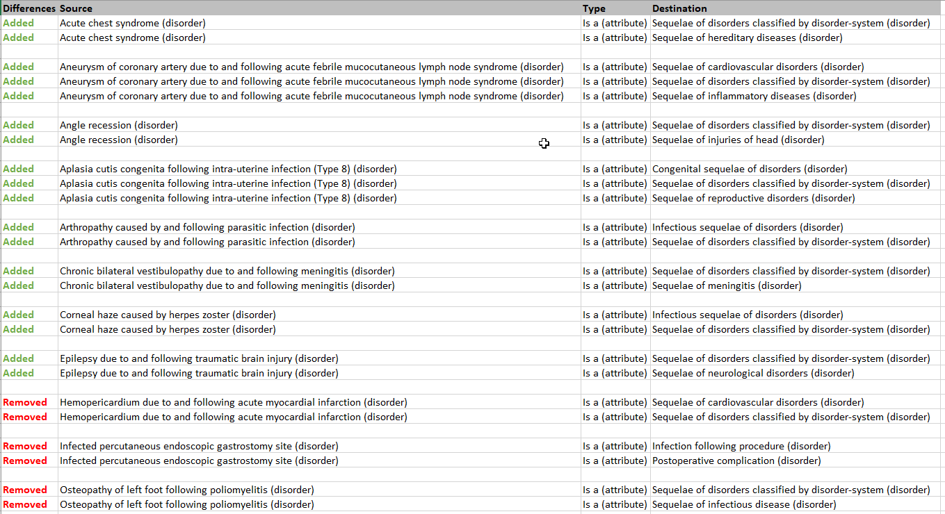
Concepts with either added or removed inferences

Slide 10
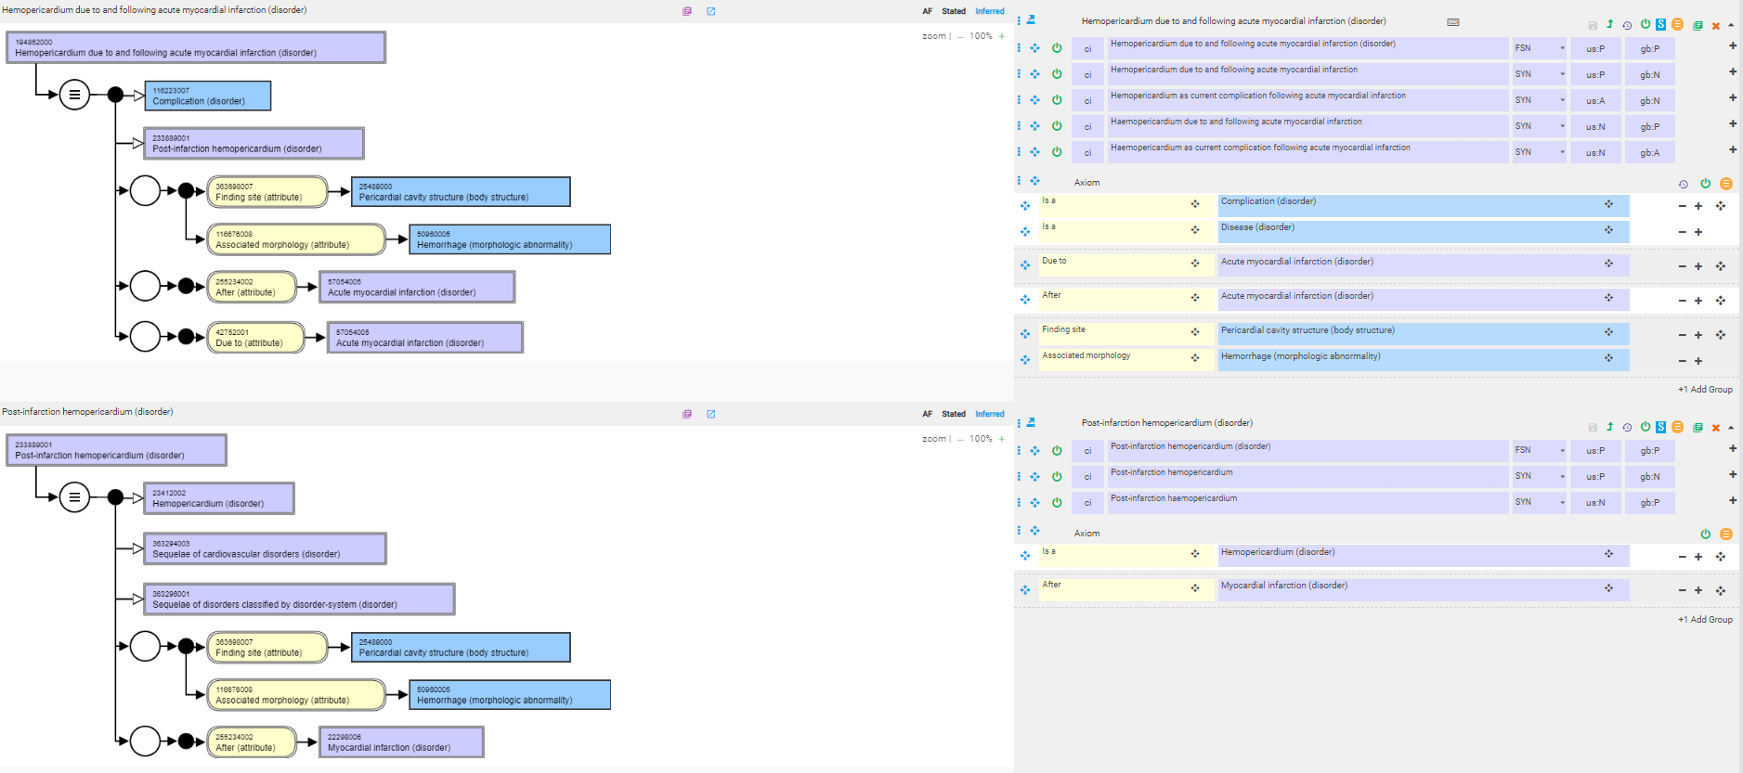
Examples of concepts with only removed inferences - 1

Slide 11
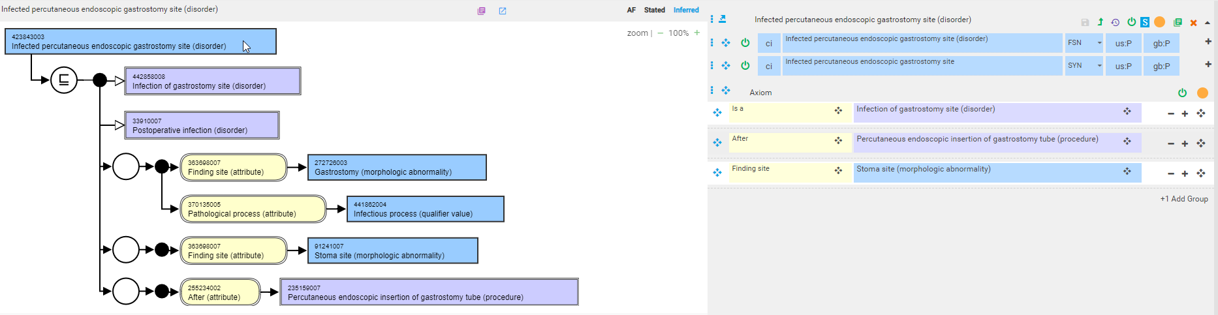
Examples of concepts with only removed inferences - 2

Slide 12
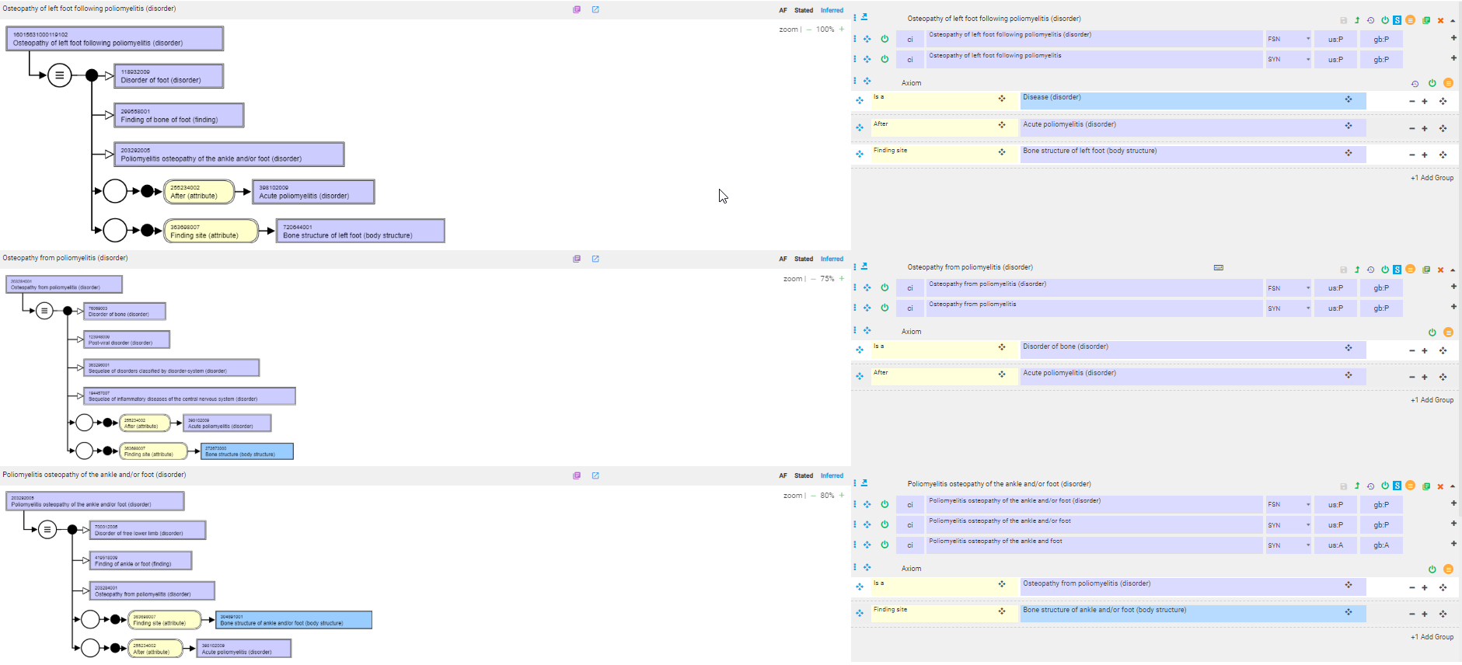
Examples of concepts with only removed inferences - 3

Slide 13
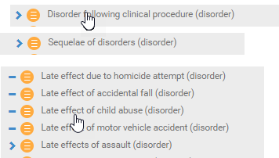
Concepts that had 362977000 |Sequela (disorder)|as the only parent
These are moved directly under 64572001 |Disease (disorder)|

Slide 14
Conclusions
Little impact from inactivating sequela as most most descendants have one or more other parents and removing sequelae often results in the inheritance of more specific parents
Question:
  Would it be useful to organize all disorders following disorders, procedures or events under a single hierarchy using GCIs?

