Slide 1
Procedure complications

Slide 2
Decisions regarding procedure complications from ECE meeting in KL
All disorders temporally related to procedures (except surgical procedures) would be considered to have a causal relationship to that procedure and thus be considered to be complications
For surgical procedures, an unanticipated outcome temporally related to the surgery would have a parent of 116223007 |Complication (disorder)|but no due to relationship to <<387713003 |Surgical procedure (procedure)|(e.g. postoperative or intraoperative complications) unless specifically stated or implied by the FSN as being due to the surgery.
  735923005 |Cataract lens fragments in vitreous of eye due to and following cataract surgery (disorder)|
  724867005 |Complication due to and following cosmetic surgery (disorder)|
For surgical procedures with an anticipated outcome following surgery, use 362977000 |Sequela (disorder)|as a parent.

Slide 3
Issues
Expected outcomes of non surgical procedures (Disorders that universally occur or occur at a very high frequency following a nonsurgical procedure)
  767658000 |Neutropenia due to and following chemotherapy (disorder)|
  109257007 |Mucositis following radiation therapy (disorder)|
Outcomes that may or may not be due a procedure
  139851000119105 |Anaphylaxis due to allergen immunotherapy (disorder)|.
    The disorder can be due to the procedure e.g., the nurse administers a wrong dose or related to allergen exposure prior to the procedure such as exposed to a cat before receiving the treatment.
  << 269295009 |Transplanted organ failure (disorder)|
    The failure may have nothing to do with the transplantation procedure but rather to the transplanted organ or the host response
  Device complications
    << 473023007 |Complication associated with device (disorder)|
      Many of these are not due to the procedure to place the device but rather to intrinsic problems with the device itself

Slide 4
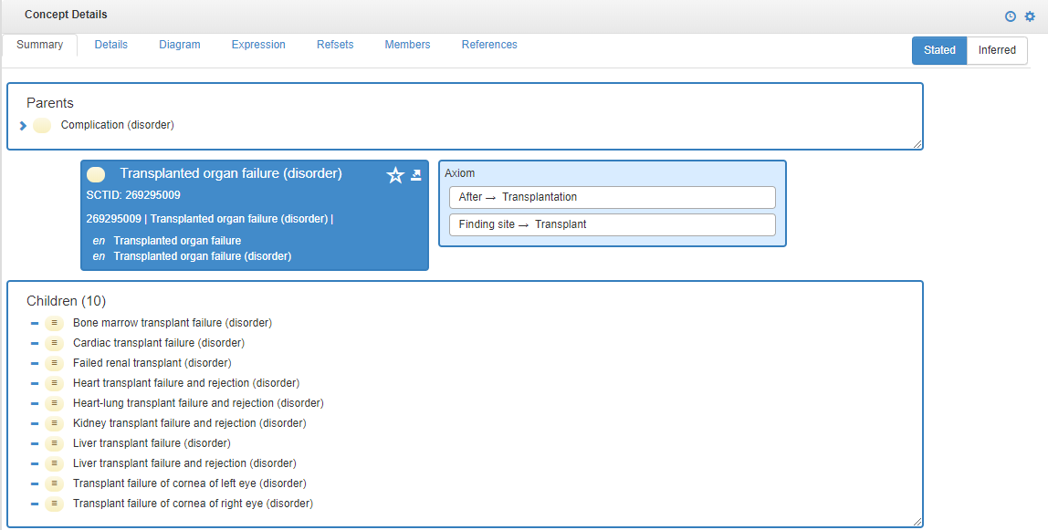
<< 269295009 |Transplanted organ failure (disorder)|
Modeled like a postoperative complication without a due to relationship to 77465005 |Transplantation (procedure)| and 77465005 |Transplantation (procedure)| is not a subtype of 387713003 |Surgical procedure (procedure

Slide 5
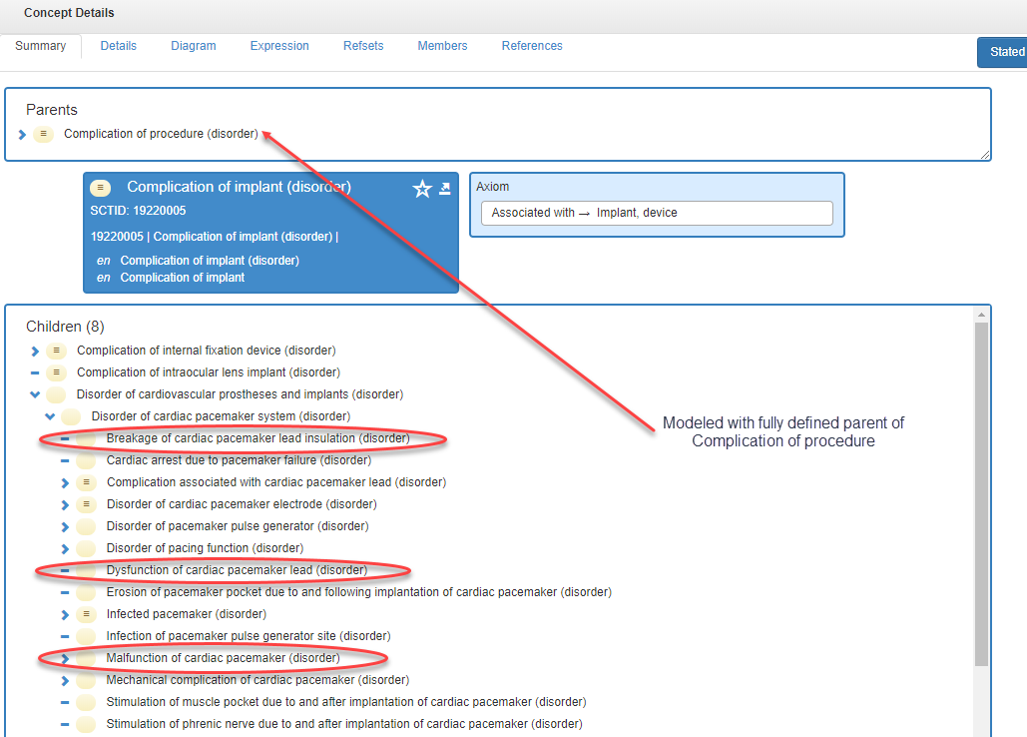
19220005 |Complication of implant (disorder)|

Slide 6
Proposal 1
The following represent agreements reached at the April 2017 London meeting
  Eliminate the use of complication and sequela in FSNs and model all content using causal and or temporal relationships with FSNs reflecting the ECE naming conventions for combined disorders and disorders with procedures. Complication and sequela can be used as synonyms or perhaps as preferred terms as required.
    Guillermo had some reservations about using complication and sequela as synonyms for due to especially for non-English speaking countries.
  Model all complications and sequela using the existing editorial guidelines for combined disorders/procedures
  116223007 |Complication (disorder)| and 362977000 |Sequela (disorder)| will not be retired due to common usage
Above favored by BGO and JCA

Slide 7
Proposal 2
Eliminate the use of complication and sequela in FSNs and model all content using causal and or temporal relationships with FSNs reflecting the ECE naming conventions for combined disorders and disorders with procedures.
Retain current heuristics for Perioperative complications and surgical sequelae due to common usage
  Surgical complication(s) - About 1,510,000 results on Google
  Surgical sequelae - About 11,200 results on Google
  Perioperative complication(s) – About 599,000 results on Google
  Postoperative complication(s) - About 3,270,000 results on Google
  Intraoperative complication(s) - About 471,000 results on Google
  Preoperative complication - About 27,300 results on Google

Slide 8
What about Disorders for which a causal relationship to surgery is explicitly stated in the FSN ?
Should these be allowed?
  213306005 |Air embolism due to surgery (disorder)|
  724867005 |Complication due to and following cosmetic surgery (disorder)|
  735924004 |Cataract lens fragments in anterior chamber of eye due to and following cataract surgery (finding)|
  My inclination is not to give these a parent of 116223007 |Complication (disorder)|

Slide 9
Parent grid for disorders related to procedures
 | 116223007 |Complication (disorder)| | 362977000 |Sequela (disorder)| | Comments
X finding/disorder due to Y nonsurgical procedure | no | no
X finding/disorder due to and following Y nonsurgical procedure | no | no
Unexpected/undesired X finding/disorder temporally related to/during/following Y surgical procedure | yes | no | Perioperative/intraoperative/postoperative complications. Causal relationship may not be to surgical procedure
Expected X following surgical procedure | no | yes

