Slide 1
Injuries
continued

Slide 2
Model for injuries
64572001 |Disease (disorder)| :
{ 116676008 |Associated morphology (attribute)| = 37782003 |Damage (morphologic abnormality)| }
Although damage may be difficult to precisely define, maintenance of the 37782003 |Damage (morphologic abnormality)|hierarchy will enable the modelers to correctly assign certain disorders as injuries
As suggested by Langley J, Brenner R. What is an injury?. Inj Prev. 2004;10(2):69–71. doi:10.1136/ip.2003.003715 an approach that has been widely used is to consider an injury as those disorders included under the Injury and poisoning chapter of ICD
Add additional morphologies under 37782003 |Damage (morphologic abnormality)|derived from disorders under ICD-11 chapter 22 Injury, poisoning or certain other consequences of external causes

Slide 3
Proposed injury models
Model for Traumatic injuries
  Due to 773760007 |Traumatic event (event)|
  Retire traumatic morphologies (<<19130008 |Traumatic abnormality (morphologic abnormality)|)and replace with unspecified morphologies
    Ie. 415747007 |Traumatic rupture (morphologic abnormality)| 125671007 |Rupture (morphologic abnormality)|
Model for Nontraumatic injuries
  Due to 789750003 |Spontaneous event (event)|
  Replace nontraumatic and spontaneous morphologies with unspecified morphologies and move under 37782003 |Damage (morphologic abnormality)|if not already a subtype

Slide 4
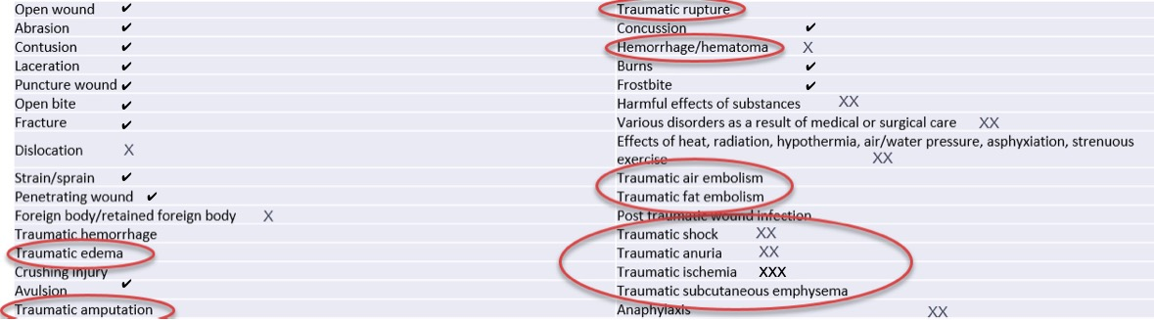
Injuries in ICD-11
X = morphology not a descendant of 37782003 |Damage (morphologic abnormality)|
XX = do not have morpholgies
XXX = 449735000 |Structural change due to ischemia (morphologic abnormality)|
These have morphologies that are descendants of 37782003 |Damage (morphologic abnormality)|
✓

Slide 5
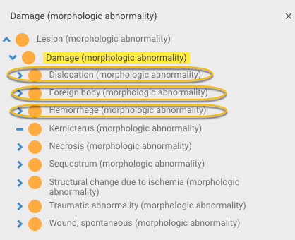
Revised 37782003 |Damage (morphologic abnormality)|hierarchy

Slide 6
ICD-11 traumatic disorders
Traumatic edema
Traumatic amputation
Traumatic rupture
Traumatic air embolism
Traumatic fat embolism
Post traumatic wound infection
Traumatic shock
Traumatic anuria
Traumatic ischemia
Traumatic subcutaneous emphysema
Traumatic in the FSN implies an injury
If traumatic morphologies are inactivated and replaced by unspecified morphologies, the unspecified morphologies may not be regarded as kinds of damage
  e.g. edema, fat embolus, air embolus
Some ICD-11 injury disorders do not have morphologies
  e.g. shock, anuria

Slide 7
Proposal
For traumatic injuries for which the morphology without containing the word “traumatic” would not be considered a kind of damage, use 2 role groups, one containing that morphology and the other containing 37782003 |Damage (morphologic abnormality)|
Can apply similar approaches to nontraumatic injuries

Slide 8
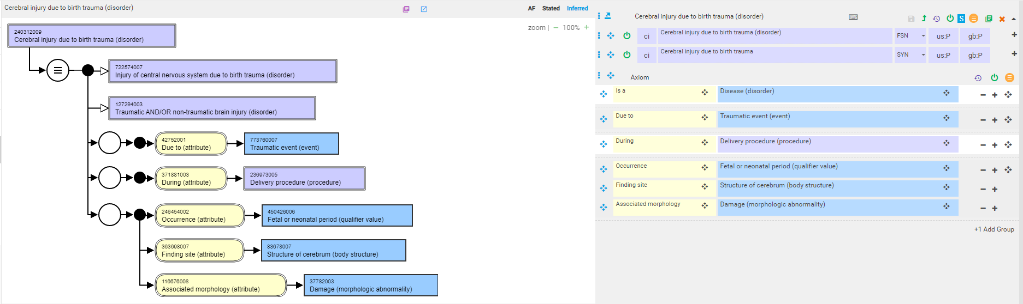
240312009 |Cerebral injury due to birth trauma (disorder)|

Slide 9
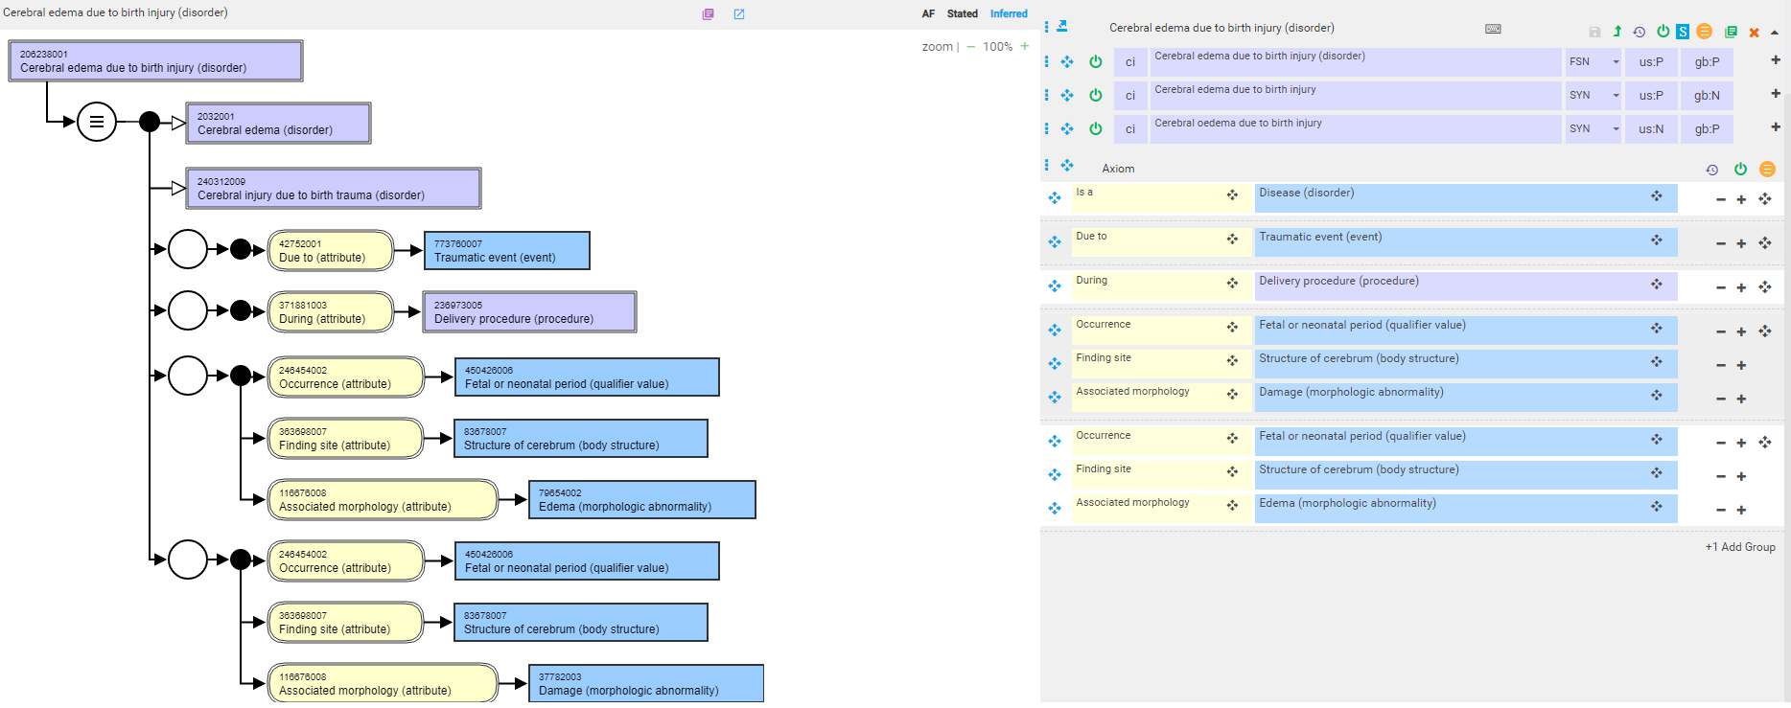
206238001 |Cerebral edema due to birth injury (disorder)| - proposed model using 2 role groups

Slide 10
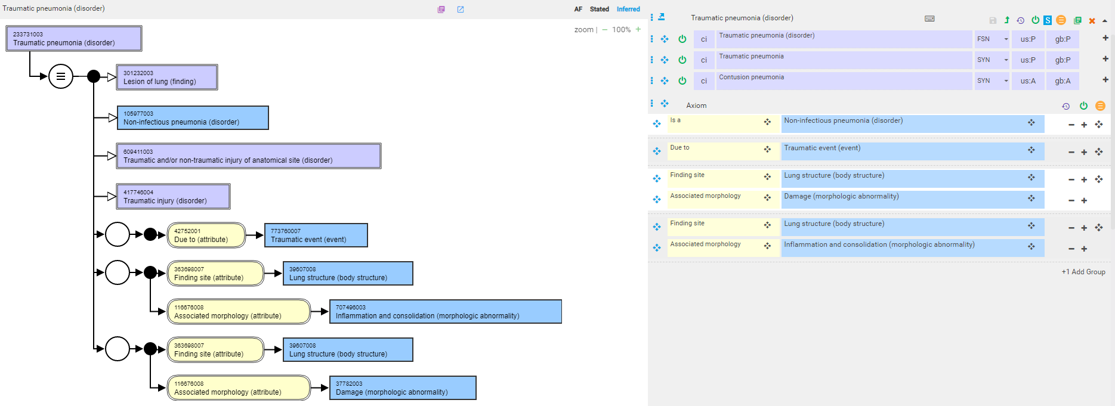
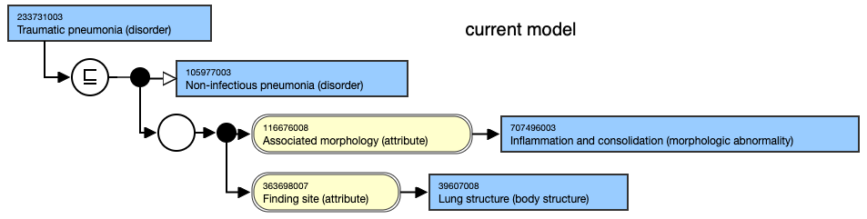
233731003 |Traumatic pneumonia (disorder)|- proposed model

Slide 11
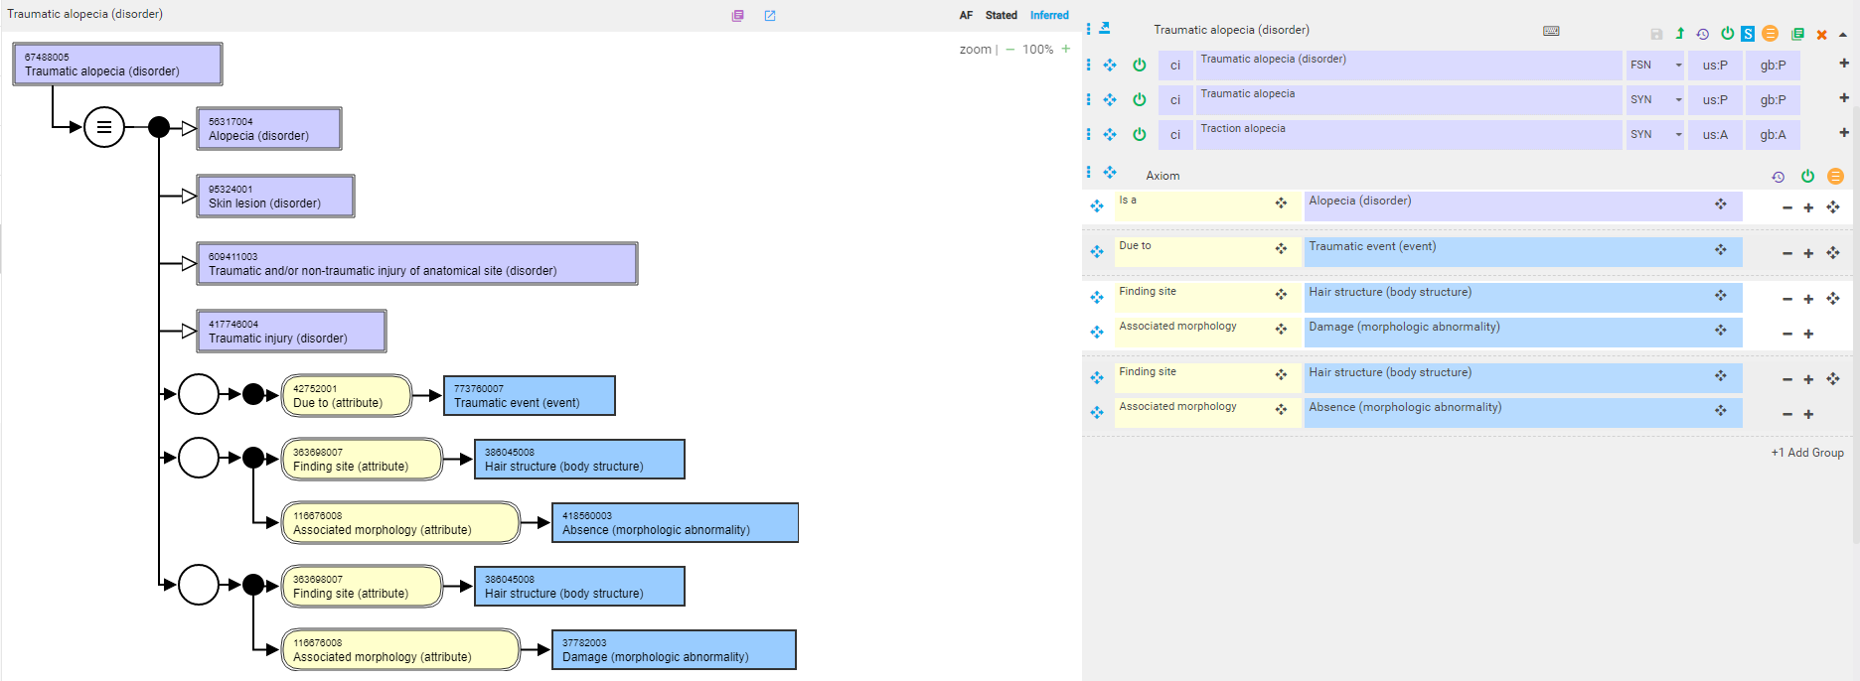
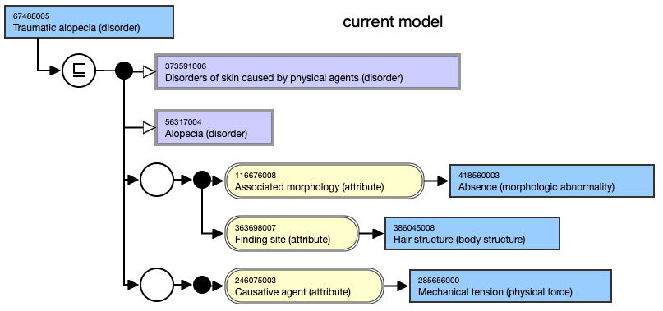
67488005 |Traumatic alopecia (disorder)|- proposed model

